Slide 1
Linux and Shell Scripting

Slide 2
Learning Outcomes
understand the basic things about shell.

Slide 3
Introduction
The Bourne Again Shell and TC Shell are command interpreters and high-level programming languages.
As command interpreters, they process commands you enter on the command line in response to a prompt.
When you use the shell as a programming language, it processes commands stored in files called shell scripts.

Slide 4
Which shell you are using currently?
Give the command echo “$SHELL”
Under most Linux distributions, bash is the default shell.
You can run any shell you like once you are logged in.

Slide 5
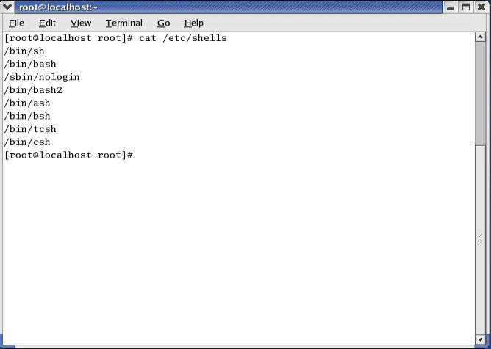
Check available shells

Slide 6
Change your login shell
Enter the name of the shell you want to use (bash, tcsh, or another shell) and press RETURN; the next prompt will be that of the new shell.
Give an exit command to return to the previous shell.

Slide 7
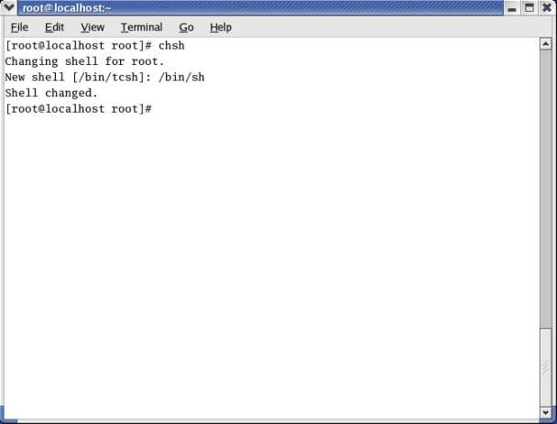
Change your login shell

Slide 8
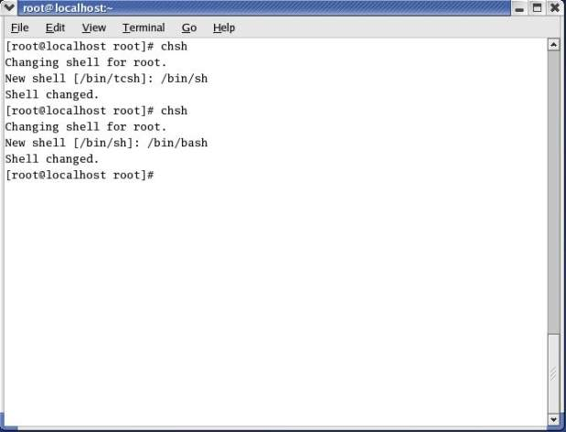
Change your login shell

Slide 9
Startup Files
When a shell starts, it runs startup files to initialize itself.
Which files the shell runs depends on whether it is a login shell, an interactive shell that is not a login shell, or a noninteractive shell.
You must have read access to a startup file to execute the commands in it.

Slide 10
Login Shells
The shells that you start with the bash ––login option.
Login shells are, by their nature, interactive.

Slide 11
Login Shells
1) /etc/profile: The shell first executes the commands in /etc/profile. A user working with root privileges can set up this file to establish system-wide default characteristics for users running bash.

Slide 12
Login Shells
2) .bash_profile, .bash_login, .profile: Next the shell looks for ~/.bash_profile, ~/.bash_login, and ~/.profile (~/ is shorthand for your home directory), in that order, executing the commands in the first of these files it finds. You can put commands in one of these files to override the defaults set in /etc/profile.

Slide 13
Login Shells
3) .bash_logout: When you log out, bash executes commands in the ~/.bash_logout file. This file often holds commands that clean up after a session, such as those that remove temporary files.

Slide 14
Interactive Nonlogin Shells
The commands in these startup files are not executed by interactive, nonlogin shells. However, these shells inherit values from the login shell variables that are set by these startup files.

Slide 15
Interactive Nonlogin Shells
1) /etc/bashrc: Although not called by bash directly, many ~/.bashrc files call /etc/bashrc.
This setup allows a user working with root privileges to establish systemwide default characteristics for nonlogin bash shells.

Slide 16
Interactive Nonlogin Shells
2) .bashrc: An interactive nonlogin shell executes commands in the ~/.bashrc file.
Typically a startup file for a login shell, such as .bash_profile, runs this file, so both login and nonlogin shells run the commands in .bashrc.

Slide 17
Noninteractive Shells
However, the noninteractive shells inherit login shell variables that are set by these startup files.
BASH_ENV: Noninteractive shells look for the environment variable BASH_ENV (or ENV if the shell is called as sh) and execute commands in the file named by this variable.

Slide 18
Commands That Are Symbols
The Bourne Again Shell uses the symbols
Symbol | Command
() | Subshell
$( ) | Command Substitution
(( )) | Arithmetic evaluation
$(( )) | Arithmetic expression
[ ] | The test command
[[ ]] | Conditional expression; similar to [ ] but adds string comparisons

Slide 19
Redirecting Standard Error
A command can send error messages to standard error to keep them from getting mixed up with the information it sends to standard output.

Slide 20
Redirecting Standard Error
File Descriptors
A file descriptor is the place a program sends its output to and gets its input from. When you execute a program, Linux opens three file descriptors for the program:
0 (standard input), (0<)
1 (standard output), (1>)
and 2 (standard error), (2>)

Slide 21
Redirecting Standard Error
Opening a File Descriptor
The Bourne Again Shell opens files using the exec builtin as follows:
exec n> outfile
exec m< infile
The first line opens outfile for output and holds it open, associating it with file descriptor n.
The second line opens infile for input and holds it open, associating it with file descriptor m.

Slide 22
Redirecting Standard Error
Duplicating a file descriptor
The <& token duplicates an input file descriptor; >& duplicates an output file descriptor.

Slide 23
Redirection Operators
Operator | Meaning
< filename | Redirects standard input from filename
filename | Redirects standard output to filename unless filename exists and noclobber is set. If noclobber is not set, this redirection creates filename if it does not exist and overwrites it if it does exist.
>| filename | Redirects standard output to filename, even if the file exists and noclobber is set.
>> filename | Redirects and appends standard output to filename unless filename exists andnoclobber is set. If noclobber is not set, this redirection creates filename if it does not exist.
&> filename | Redirects standard output and standard error to filename.
<&m | Duplicates standard input from file descriptor m
[n] > &m | Duplicates standard output or file descriptor n if specified from file descriptor m
[n] < &- | Closes standard input or file descriptor n if specified
[n] > &- | Closes standard output or file descriptor n if specified.

Slide 24
Writing a Simple Shell Script
A shell script is a file that holds commands that the shell can execute. The commands in a shell script can be any commands you can enter in response to a shell prompt.
For example, a command in a shell script might run a Linux utility, a compiled program, or another shell script.

Slide 25
Writing a Simple Shell Script
Like the commands you give on the command line, a command in a shell script can use ambiguous file references and can have its input or output redirected from or to a file or sent through a pipe.
You can also use pipes and redirection with the input and output of the script itself.

Slide 26
chmod: Makes a File Executable
To execute a shell script by giving its name as a command, you must have permission to read and execute the file that contains the script.
Read permission enables you to read the file that holds the script.
Execute permission tells the shell and the system that the owner, group, and/or public has permission to execute the file; it implies that the content of the file is executable.

Slide 27
chmod: Makes a File Executable
When you create a shell script using an editor, the file does not typically have its execute permission set.
The following example shows a file named whoson that contains a shell script:
$ cat whoson
date
echo "Users Currently Logged In"
who
$ ./whoson
bash: ./whoson: Permission denied

Slide 28
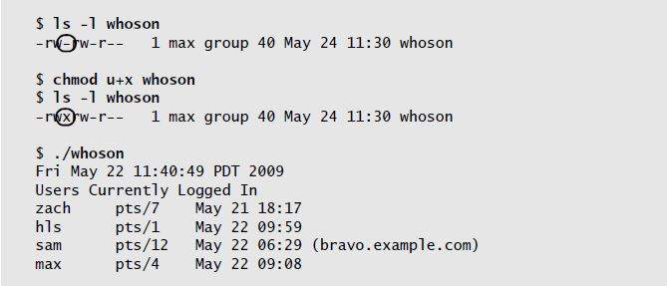
chmod: Makes a File Executable

Slide 29
#! Specifies a Shell
You can put a special sequence of characters on the first line of a shell script to tell the operating system which shell (or other program) should execute the file.
Because the operating system checks the initial characters of a program before attempting to execute it using exec, these characters save the system from making an unsuccessful attempt.

Slide 30
# Begins a Comment
Comments make shell scripts and all code easier to read and maintain by you and others. The comment syntax is common to both the Bourne Again and the TC Shells.

Slide 31
Executing a Shell Script
A command on the command line causes the shell to fork a new process, creating a duplicate of the shell process (a subshell).
The new process attempts to exec (execute) the command. Like fork, the exec routine is executed by the operating system (a system call).

Slide 32
Separating and Grouping Commands
Whether you give the shell commands interactively or write a shell script, you must separate commands from one another.

Slide 33
Job Control
Job: A job is a command pipeline.
Example 1: You run a simple job whenever you give the shell a command. For example, if you type date on the command line and press RETURN, you have run a job.

Slide 34
Job Control
Example 2: You can also create several jobs with multiple commands on a single command line:
$ find . -print | sort | lpr & grep -l max /tmp/* > maxfiles &
[1] 18839
[2] 18876

Slide 35
Job Control
jobs: Lists Jobs
The jobs builtin lists all background jobs.
Following, the sleep command runs in the background and creates a background job that jobs reports on:
$ sleep 60 &
[1] 7809
$ jobs
[1] + Running sleep 60 &

Slide 36
Job Control
fg: Brings a Job to the Foreground
The shell assigns a job number to each command you run in the background.
For each job run in the background, the shell lists the job number and PID number immediately, just before it issues a prompt:

Slide 37
Job Control
$ xclock &
[1] 1246
$ date &
[2] 1247
$ Tue Dec 2 11:44:40 PST 2008
[2]+ Done date
$ find /usr -name ace -print > findout &
[2] 1269
$ jobs
[1]- Running xclock &
[2]+ Running find /usr -name ace -print > findout &

Slide 38
Job Control
To move a background job to the foreground, use the fg builtin followed by the job number. Alternatively, you can give a percent sign (%) followed by the job number as a command.
Either of the following commands moves job 2 to the foreground.
When you move a job to the foreground, the shell displays the command it is now executing in the foreground.

Slide 39
Job Control
$ fg 2
find /usr -name ace -print > findout
or
$ %2
find /usr -name ace -print > findout

Slide 40
Job Control
Suspending a Job
Pressing the suspend key (usually CONTROL-Z) immediately suspends (temporarily stops) the job in the foreground and displays a message that includes the word Stopped.
CONTROL-Z
[2]+ Stopped find /usr -name ace -print > findout

Slide 41
Job Control
bg: Sends a Job to the Background
To move the foreground job to the background, you must first suspend the job using CONTROL-Z.
You can then use the bg builtin to resume execution of the job in the background.
$ bg
[2]+ find /usr -name ace -print > findout &

Slide 42
Manipulating the Directory Stack
The Bourne Again Shell allows you to store a list of directories you are working with, enabling you to move easily among them.
This list is referred to as a stack.
Implements LIFO rule.

Slide 43
dirs: Displays the Stack
The dirs builtin displays the contents of the directory stack. If you call dirs when the directory stack is empty, it displays the name of the working directory:
$ dirs
~/literature
The dirs builtin uses a tilde (~) to represent the name of the home directory.

Slide 44

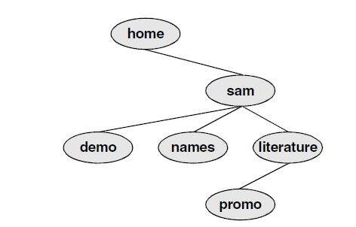
Example

Slide 45
pushd: Pushes a Directory on the Stack
When you supply the pushd (push directory) builtin with one argument, it pushes the directory specified by the argument on the stack, changes directories to the specified directory, and displays the stack.

Slide 46
pushd: Pushes a Directory on the Stack
$ pushd ../demo
~/demo ~/literature
$ pwd
/home/sam/demo
$ pushd ../names
~/names ~/demo ~/literature
$ pwd
/home/sam/names

Slide 47
pushd: Pushes a Directory on the Stack
names
2
pushd
demo
1
pushd
literature

Slide 48
pushd: Pushes a Directory on the Stack
When you use pushd without an argument, it swaps the top two directories on the stack, makes the new top directory (which was the second directory) the new working directory, and displays the stack

Slide 49
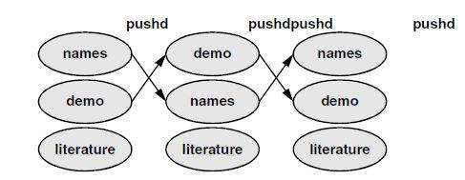
pushd: Pushes a Directory on the Stack

Slide 50
pushd: Pushes a Directory on the Stack
Using pushd in this way, you can easily move back and forth between two directories.
You can also use cd – to change to the previous directory, whether or not you have explicitly created a directory stack.
To access another directory in the stack, call pushd with a numeric argument preceded by a plus sign. The directories in the stack are numbered starting with the top directory, which is number 0.

Slide 51
popd: Pops a Directory Off the Stack
To remove a directory from the stack, use the popd (pop directory) builtin.

Slide 52
popd: Pops a Directory Off the Stack
$ dirs
~/literature ~/demo ~/names
$ popd
~/demo ~/names
$ pwd
/home/sam/demo

Slide 53
popd: Pops a Directory Off the Stack
literature
popd
demo
names

Slide 54
popd: Pops a Directory Off the Stack
To remove a directory other than the top one from the stack, use popd with a numeric argument preceded by a plus sign.
$ dirs
~/literature ~/demo ~/names
$ popd +1
~/literature ~/names

