Slide 1
Linux and Shell Scripting

Slide 2
Learning Outcomes
Understand the Control Structures

Slide 3
Control Structures
The control flow commands alter the order of execution of commands within a shell script.

Slide 4
Control structures
if...then,
for...in,
while,
until,
break,
Continue
case statements,

Slide 5
if...then
The if...then control structure has the following syntax:
if test-command
then
commands
fi
The bold words in the syntax description are the items you supply to cause the structure to have the desired effect. The nonbold words are the keywords the shell uses to identify the control structure.

Slide 6
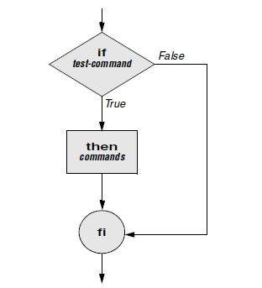
if...then

Slide 7
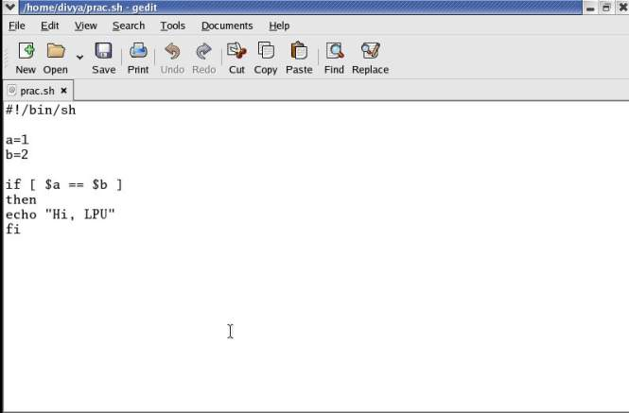
if...then

Slide 8
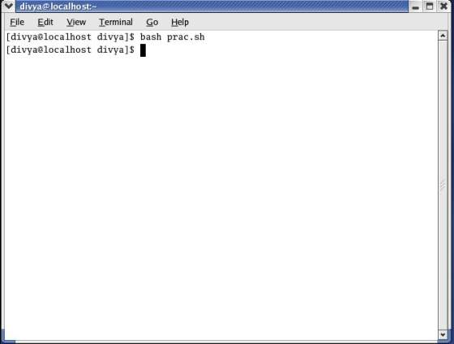
if...then

Slide 9
if...then...else
The if...then...else control structure has the following syntax:
if test-command
then
commands
else
commands
fi

Slide 10
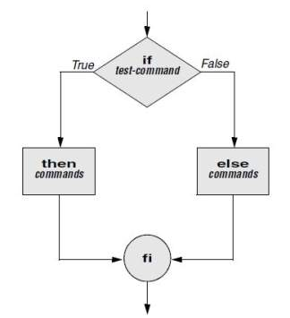
if...then...else

Slide 11
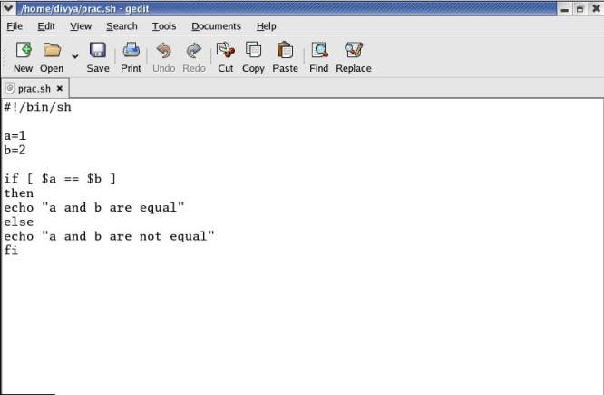
if...then...else

Slide 12
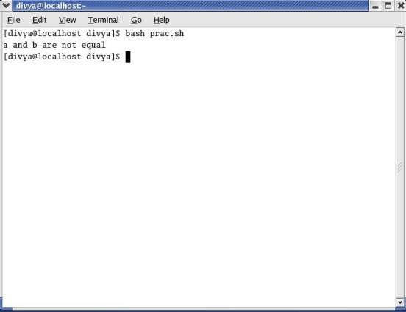
if...then...else

Slide 13
if...then...elif
The if...then...elif control structure has the following syntax:
if test-command
then
commands
elif test-command
then
commands
. . .
else
commands
fi

Slide 14
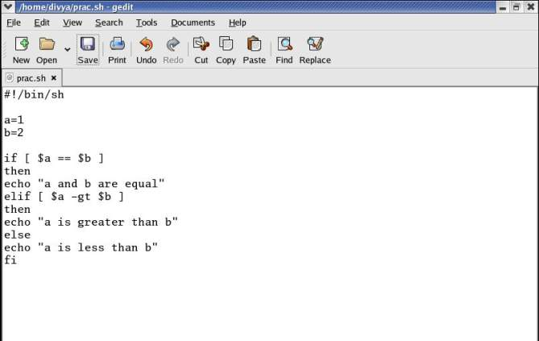
if...then...elif

Slide 15
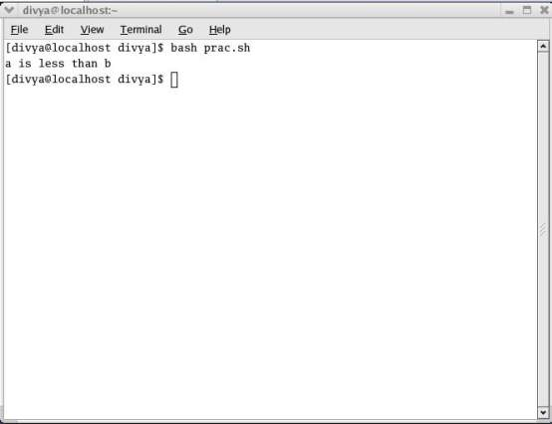
if...then...elif

Slide 16
for...in
The for...in control structure has the following syntax:
for loop-index in argument-list
do
commands
done

Slide 17
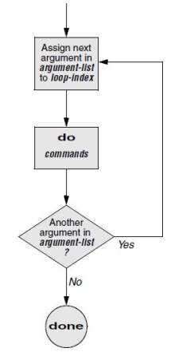
for...in

Slide 18
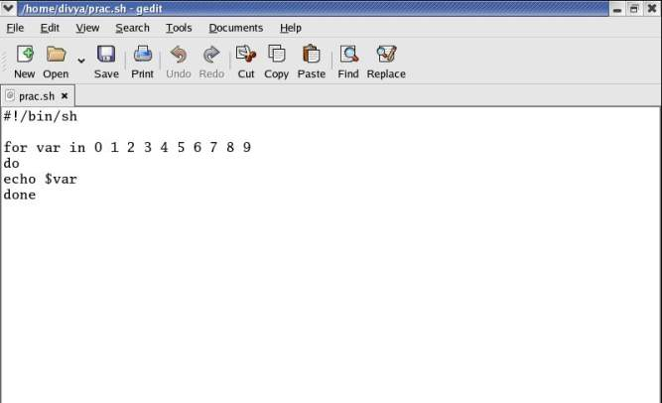
for...in

Slide 19
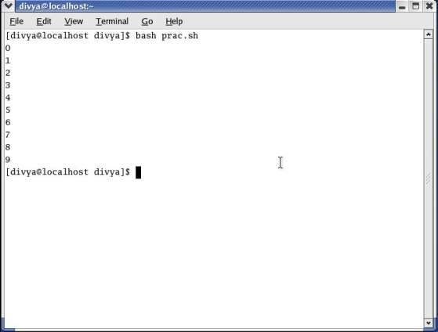
for...in

Slide 20
while
The while control structure (not available in tcsh) has the following syntax:
while test-command
do
commands
done

Slide 21
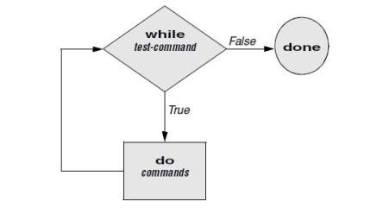
while

Slide 22
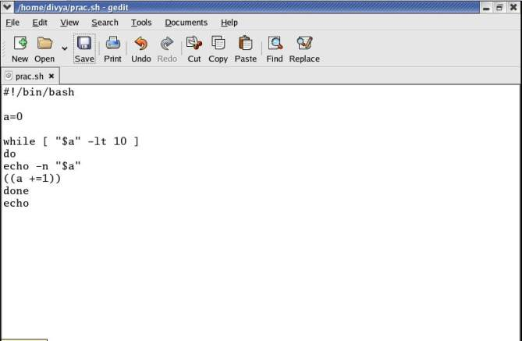
while

Slide 23
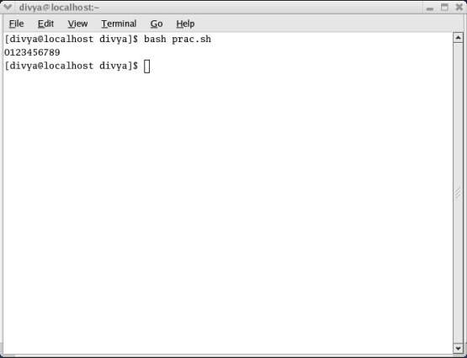
while

Slide 24
until
The while loop is perfect for a situation where you need to execute a set of commands while some condition is true. Sometimes you need to execute a set of commands until a condition is true.
until command
do
Statement(s) to be executed until command is true
done

Slide 25
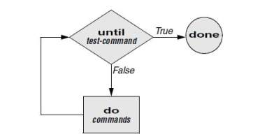
until

Slide 26
break and continue
You can interrupt a for, while, or until loop by using a break or continue statement.
The break statement transfers control to the statement after the done statement, thereby terminating execution of the loop.
The continue command transfers control to the done statement, continuing execution of the loop.

Slide 27
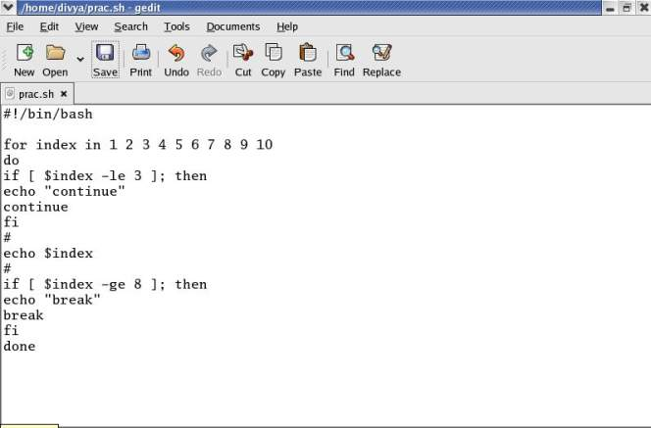
break and continue

Slide 28
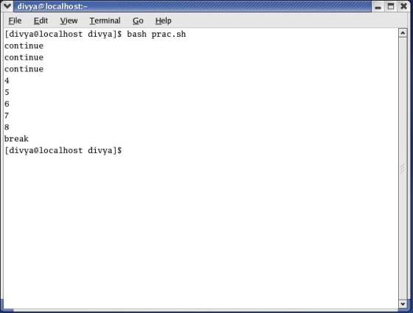
break and continue

Slide 29
case
You can use multiple if...elif statements to perform a multiway branch. However, this is not always the best solution, especially when all of the branches depend on the value of a single variable.
It supports case...esac statement which handles exactly this situation, and it does so more efficiently than repeated if...elif statements.

Slide 30
case
The case structure is a multiple-branch decision mechanism.
The path taken through the structure depends on a match or lack of a match between the test-string and one of the patterns.

Slide 31
case
case test-string in
pattern-1)
commands-1
;;
pattern-2)
commands-2
;;
pattern-3)
commands-3
;;
. . .
esac

Slide 32
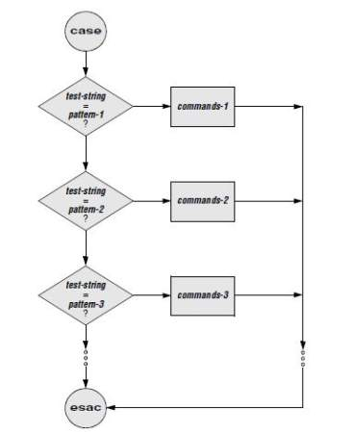
case

Slide 33
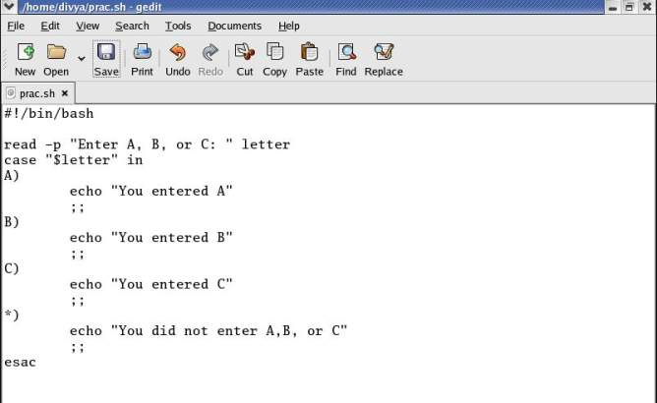
case

Slide 34
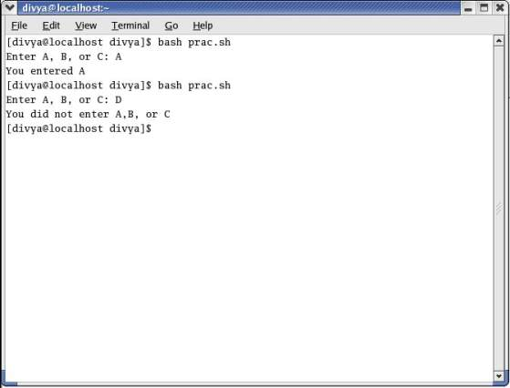
case

Slide 35
select
The select control structure is based on the one found in the Korn Shell. It displays a menu, assigns a value to a variable based on the user’s choice of items, and executes a series of commands.
The select control structure has the following syntax:
select varname [in arg . . . ]
do
commands
done

Slide 36
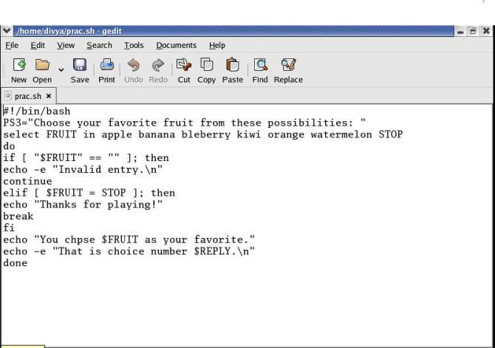
select

Slide 37
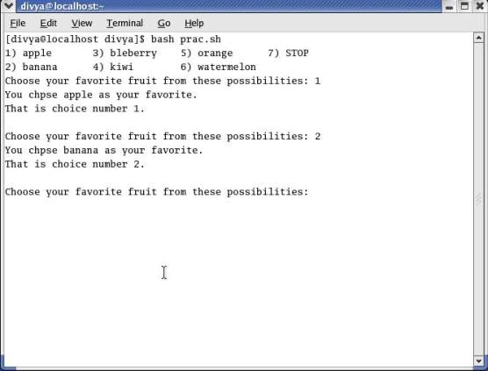
select

