Slide 1
Linux and Shell Scripting

Slide 2
Learning Outcomes
know how to back up files,
schedule tasks,
understand how to configure user and group accounts, system reports and parted.

Slide 3
Configuring User and Group Accounts
More than a username is required for a user to be able to log in and use a system.
At a minimum a user must have an entry in the /etc/passwd and /etc/shadow files and a home directory.

Slide 4
system-config-users: Manages User Accounts
The system-config-users utility displays the User Manager window and enables you to add, delete, and modify system users and groups.
To display the User Manager window, enter system-config-users on a command line or select Main menu: System􀁄Administration􀁄Users and Groups.

Slide 5
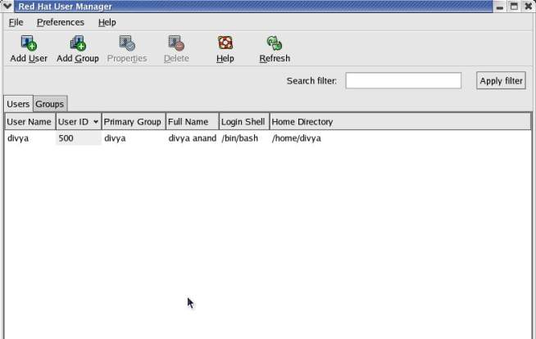
system-config-users: Manages User Accounts

Slide 6
system-config-users: Manages User Accounts
This window has two tabs: Users and Groups, where each tab displays information appropriate to its name.

Slide 7
system-config-users: Manages User Accounts
Search filter:
The Search filter, located just below the toolbar, selects users or groups whose names match the string, which can include wildcards, that you enter in the Search filter text box.
The string matches the beginning of a name. For example, *nob matches nobody and nfsnobody, whereas nob matches only nobody.

Slide 8
system-config-users: Manages User Accounts
Adding a user:
To create a new user, click the Add User button on the toolbar. The User Manager displays the Create New User window.
Enter the information for the new user and click OK.

Slide 9
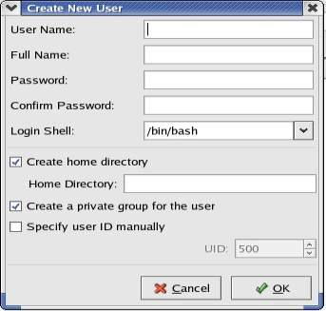
system-config-users: Manages User Accounts

Slide 10
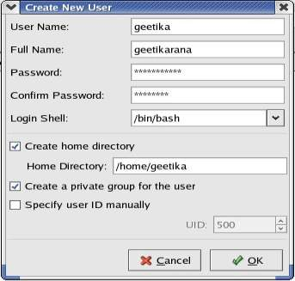
system-config-users: Manages User Accounts

Slide 11
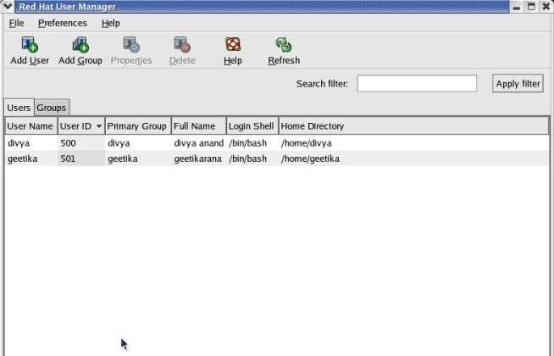
system-config-users: Manages User Accounts

Slide 12
system-config-users: Manages User Accounts
Modifying a user
Once you create a user, you can modify the user to add/change/remove information.
To modify a user, highlight the user in the User Manager window and click Properties on the toolbar; the utility displays the User Properties window.

Slide 13
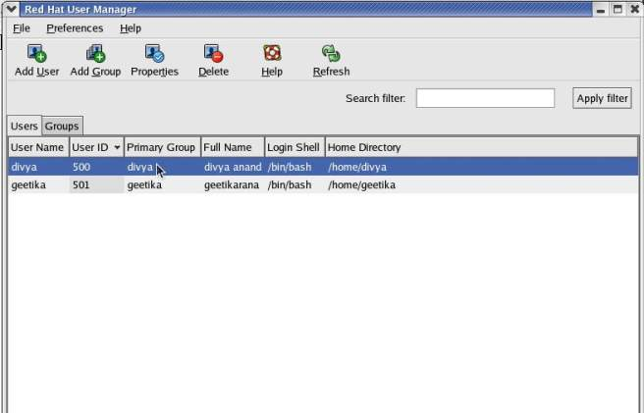
system-config-users: Manages User Accounts

Slide 14
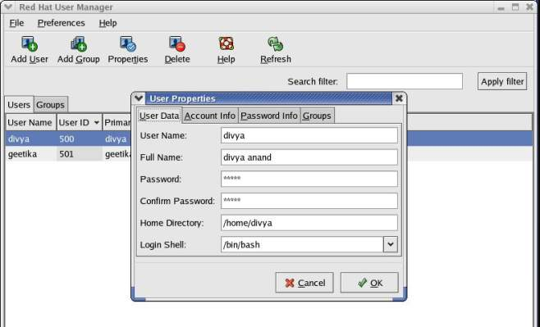
system-config-users: Manages User Accounts

Slide 15
system-config-users: Manages User Accounts
The User Properties window has four tabs: User Data, Account Info, Password Info, and Groups.
User Data tab: It holds basic user information such as name and password.
Account Info tab: It allows you to specify an expiration date for the account and to lock the account so the user cannot log in.

Slide 16
system-config-users: Manages User Accounts
Password Info tab: It allows you to turn on password expiration and specify various related parameters.
Groups tab: You can specify the groups that the user is a member of.

Slide 17
system-config-users: Manages User Accounts
Working with groups
Click the Groups tab in the User Manager window to work with groups.

Slide 18
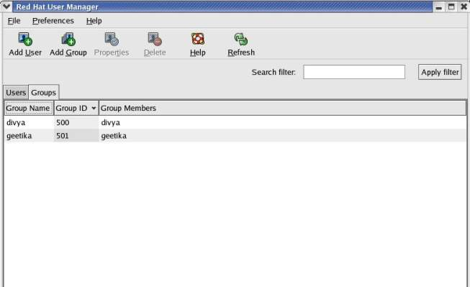
system-config-users: Manages User Accounts

Slide 19
system-config-users: Manages User Accounts
To create a group, click Add Group on the toolbar and specify the name of the group.

Slide 20
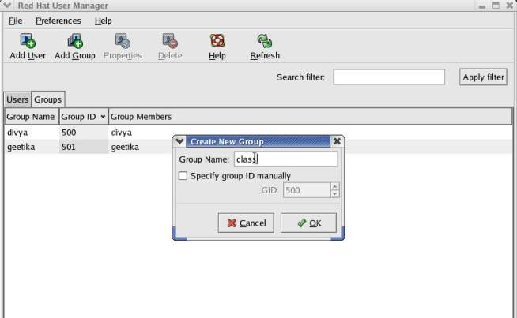
system-config-users: Manages User Accounts

Slide 21
system-config-users: Manages User Accounts
To change the name of a group or to add or remove users from a group, highlight the group and click Properties on the toolbar.

Slide 22
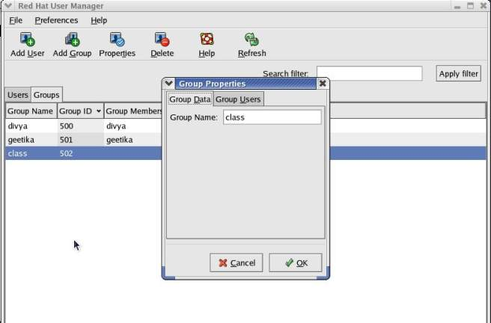
system-config-users: Manages User Accounts

Slide 23
system-config-users: Manages User Accounts
Help:
The User Manager provides extensive help. To access it, click Help on the toolbar.
When you are done working with users and groups, close the window.

Slide 24
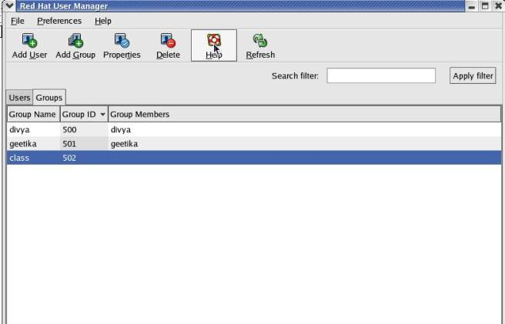
system-config-users: Manages User Accounts

Slide 25
useradd: Adds a User Account
The useradd utility adds a new user account to the system.
By default, useradd assigns the next highest unused user ID to a new account and specifies bash as the user’s login shell.

Slide 26
useradd: Adds a User Account
This command creates the user’s home directory (in /home), specifies the user’s group ID, and puts the user’s full name in the comment field:
# useradd -g 500 -c "Alex Watson" alex

Slide 27
userdel: Removes a User Account
The userdel utility deletes user accounts.
This command removes alex’s account and his home directory hierarchy:
# userdel -r alex

Slide 28
userdel: Removes a User Account
To turn off a user’s account temporarily, you can use usermod to change the expiration date for the account.
Because it specifies that his account expired in the past (December 31, 2009), the following command line prevents alex from logging in:
# usermod -e "12/31/09" alex

Slide 29
groupadd: Adds a Group
Just as useradd adds a new user to the system, groupadd adds a new group by adding an entry for it in /etc/group.
creates a new group named rtfm: # groupadd -g 1024 rtfm

Slide 30
groupadd: Adds a Group
Unless you use the –g option to assign a group ID, the system picks the next available sequential number greater than 500.
The –o option allows the group ID to be nonunique if you want to have multiple names for the same group ID.

Slide 31
Backing Up Files
The backup copies are vital in three instances:
When the system malfunctions and files are lost,
When a catastrophic disaster (fire, earthquake, and so on) occurs,
When a user or the system administrator deletes or corrupts a file by accident.

Slide 32
Backing Up Files
Even when you set up RAID, you still need to back up files.
Although RAID provides fault tolerance (helpful in the event of disk failure), it does not help when a catastrophic disaster occurs or when a file is corrupted or accidentally removed.

Slide 33
Backing Up Files
You must back up filesystems on a regular basis. Backup files are usually kept on magnetic tape or some other removable media.
A full backup makes copies of all files, regardless of when they were created or accessed.
An incremental backup makes copies of those files that have been created or modified since the last (usually full) backup.

Slide 34
Backing Up Files
The more people using the system, the more often you should back up the filesystems.
One popular schedule is to perform an incremental backup one or two times a day and a full backup one or two times a week.

Slide 35
Choosing a Backup Medium
If the local system is connected to a network, you can write your backups to a tape drive on another system.
This technique is often used with networked computers to avoid the cost of having a tape drive on each computer in the network and to simplify management of backing up many computers in a network.

Slide 36
Choosing a Backup Medium
Most likely you want to use a tape system for backups.
Other options for holding backups are writable CDs, DVDs, and removable hard disks.
These devices, although not as cost-effective or able to store as much information as tape systems, offer convenience and improved performance over using tapes.

Slide 37
Backup Utilities
A number of utilities help you back up the system, and most work with any media.
Most Linux backup utilities are based on one of the archive programs—tar or cpio— and augment these basic programs with bookkeeping support for managing backups conveniently.

Slide 38
Backup Utilities
You can use any of the tar, cpio, or dump/restore utilities to construct full or partial backups of the system.
Each utility constructs a large file that contains, or archives, other files.
In addition to file contents, an archive includes header information for each file it holds.

Slide 39
Backup Utilities
The amanda utility (Advanced Maryland Automatic Network Disk Archiver), one of the more popular backup systems, uses dump or tar and takes advantage of Samba to back up Windows systems.
The amanda utility backs up a LAN of heterogeneous hosts to a single tape drive. You can use yum to install amanda.

Slide 40
tar: Archives Files
The tar (tape archive) utility stores and retrieves files from an archive and can compress the archive to conserve space.
If you do not specify an archive device, tar uses standard output and standard input.
For displaying the options: # tar ––help | less

Slide 41
tar: Archives Files
It combines single-letter options into a single command-line argument: # tar –ztvf /dev/st0
This command uses descriptive words for the same options: # tar ––gzip ––list ––verbose ––file /dev/st0
Both commands tell tar to generate a (v, verbose) table of contents (t, list) from the tape on /dev/st0 (f, file), using gzip (z, gzip) to decompress the files.

Slide 42
The tar utility
Option | Effect
––append (–r) | Appends files to an archive
––catenate (–A) | Adds one or more archives to the end of an existing archive
––create (–c) | Creates a new archive
––delete | Deletes files in an archive (not on tapes)
––diff (–d) | Compares files in an archive with disk files ––extract

Slide 43
The tar utility
Option | Effect
––extract (–x) | Extracts files from an archive
––help | Displays a help list of tar options
––list (–t) | Lists the files in an archive
––update (–u) | Like the –r option, but the file is not appended if a newer version is already in the archive

Slide 44
cpio: Archives Files
The cpio (copy in/out) program is similar to tar but can use archive files in a variety of formats, including the one used by tar.
Normally cpio reads the names of the files to insert into the archive from standard input and produces the archive file as standard output.
When extracting files from an archive, cpio reads the archive as standard input.

Slide 45
Performing a Simple Backup
When you prepare to make a major change to a system, such as replacing a disk drive or updating the Linux kernel, it is a good idea to archive some or all of the files so you can restore any that become damaged if something goes wrong.
For this type of backup, tar or cpio works well.

Slide 46
Performing a Simple Backup
For example, if you have a SCSI tape drive as device /dev/st0 that is capable of holding all the files on a single tape, you can use the following commands to construct a backup tape of the entire system:
# cd /
# tar –cf /dev/st0 .

Slide 47
Performing a Simple Backup
The tar command then creates an archive (c) on the device /dev/st0 (f). # tar –cjf /dev/st0 .
You can back up the system with a combination of find and cpio.
These commands create an output file and set the I/O block size to 5120 bytes (the default is 512 bytes):
# cd /
# find . –depth | cpio –oB > /dev/st0

Slide 48
Performing a Simple Backup
This command restores the files in the /home directory from the preceding backup. The options extract files from an archive (–i) in verbose mode, keeping the modification times and creating directories as needed.
# cd /
# cpio –ivmd /home/\* < /dev/st0

Slide 49
dump, restore: Back Up and Restore Filesystems
The dump utility, which first appeared in UNIX version 6, backs up either an entire filesystem or only those files that have changed since the last dump.
The restore utility restores an entire filesystem, an individual file, or a directory hierarchy.

Slide 50
dump, restore: Back Up and Restore Filesystems
This command backs up all files (including directories and special files) on the root (/) partition to SCSI tape 0. Frequently there is a link to the active tape drive, named /dev/tape, which you can use in place of the actual entry in the /dev directory.
# dump -0uf /dev/st0 /

Slide 51
dump, restore: Back Up and Restore Filesystems
The option specifies that the entire filesystem is to be backed up (a full backup).
There are ten dump levels: 0–9. Zero is the highest (most complete) level and always backs up the entire filesystem.

Slide 52
dump, restore: Back Up and Restore Filesystems
Each additional level is incremental with respect to the level above it.
For example, 1 is incremental to 0 and backs up only files that have changed since the last level 0 dump; 2 is incremental to 1 and backs up only files that have changed since the last level 1 dump; and so on.

Slide 53
dump, restore: Back Up and Restore Filesystems
The u option updates the /etc/dumpdates file with filesystem, date, and dump level information for use by the next incremental dump.
The f option and its argument write the backup to the device named /dev/st0.

Slide 54
dump, restore: Back Up and Restore Filesystems
This command makes a partial backup containing all files that have changed since the last level 0 dump. The first argument is a 1, specifying a level 1 dump:
# dump -1uf /dev/st0 /

Slide 55
dump, restore: Back Up and Restore Filesystems
To restore an entire filesystem from a tape, first restore the most recent complete (level 0) backup.
Perform this operation carefully because restore can overwrite the existing filesystem.

Slide 56
dump, restore: Back Up and Restore Filesystems
When you are logged in as Superuser, cd to the directory the filesystem is mounted on and give this command: # restore -if /dev/st0
i: Interactive mode
f: specifies the name of the device that the backup medium is mounted on.

Slide 57
Scheduling Tasks
It is a good practice to schedule certain routine tasks to run automatically.
For example, you may want to remove old core files once a week, summarize accounting data daily, and rotate system log files monthly.

Slide 58
crond and crontab: Schedule Routine Tasks
Using crontab, you can submit a list of commands in a format that can be read and executed by crond.
Working as Superuser, you can put commands in one of the /etc/cron.* directories to be run at intervals specified by the directory name, such as cron.daily.

Slide 59
at: Runs Occasional Tasks
Like the cron utility, at allows you to run a job sometime in the future. Unlike cron, at runs a job only once.

Slide 60
System Reports
Many utilities report on one thing or another.
The who, finger, ls, ps, and other utilities generate simple end-user reports.
In some cases, these reports can help with system administration.

Slide 61
vmstat: Reports Virtual Memory Statistics
The vmstat utility (procps package) generates virtual memory information along with (limited) disk and CPU activity data.

Slide 62

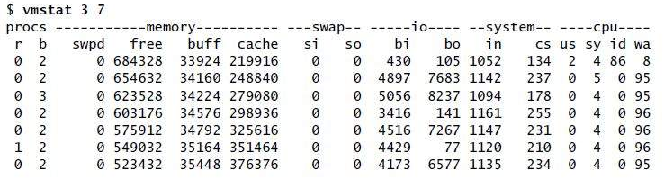
vmstat: Reports Virtual Memory Statistics

Slide 63
vmstat column heads
This shows virtual memory statistics in 3-second intervals for seven iterations.
The first line covers the time since the system was last booted; the rest of the lines cover the period since the previous line.

Slide 64
vmstat column heads
procs | Process information r Number of waiting, runnable processes b Number of blocked processes (in uninterruptable sleep)
Memory | Memory Information in Kilobytes swpd Used virtual memory free Idle memory buff Memory used as buffers cache Memory used as cache

Slide 65
vmstat column heads
swap | System paging activity in kilobytes per second si Memory swapped in from disk so Memory swapped out to disk
io | System I/O activity in blocks per second bi Blocks received from a block device bo Blocks sent to a block device

Slide 66
vmstat column heads
system | Values are per second in Interrupts (including the clock) cs Context switches
cpu | Percentage of total CPU time spent in each of these states us User (nonkernel) sy System (kernel) id Idle wa Waiting for I/O

Slide 67
top: Lists Processes Using the Most Resources
The top utility is a useful supplement to ps.
At its simplest, top displays system information at the top and the most CPU-intensive processes below the system information.
The top utility updates itself periodically; type q to quit.

Slide 68
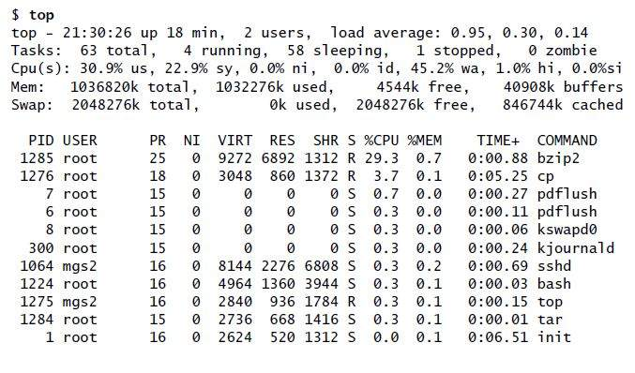
top: Lists Processes Using the Most Resources

Slide 69
top: interactive commands
Command | Function
F | Specify a sort field.
h or ? | Displays a Help screen.
k | Prompts for a PID number and type of signal and sends the process that signal. Defaults to signal 15 (SIGTERM); specify 9 (SIGKILL) only when 15 does not work.
M | Sorts processes by memory usage.
O | Specify a sort field.
P | Sorts processes by CPU usage (default).
q | Quits.

Slide 70
top: interactive commands
Command | Function
S | Prompts for time between updates in seconds. Use 0 for continuous updates.
SPACE | Updates the display immediately.
T | Sorts tasks by time.
W | Writes a startup file named ~/.toprc so that next time you start top, it uses the same parameters it is currently using.

Slide 71
parted: Reports on and Partitions a Hard Disk
The parted (partition editor) utility reports on and manipulates hard disk partitions.

Slide 72
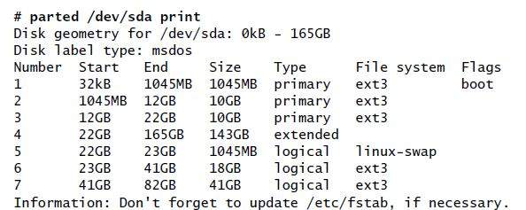
parted: Reports on and Partitions a Hard Disk
The following example shows how to use parted from
the command line

Slide 73
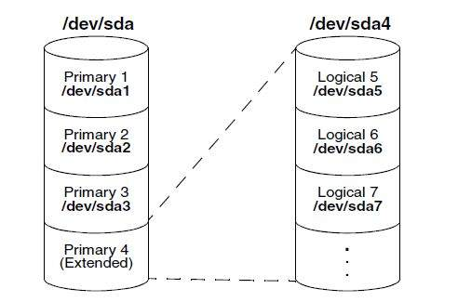
Partitions

Slide 74
parted: Reports on and Partitions a Hard Disk
The print command displays the following columns:
Number—The minor device number of the device holding the partition. This number is the same as the last number in the device name. In the example, 5 corresponds to /dev/sda5.

Slide 75
parted: Reports on and Partitions a Hard Disk
Start—The location on the disk where the partition starts. The parted utility specifies a location on the disk as the distance (in bytes) from the beginning of the disk. Thus partition 3 starts 12 gigabytes from the beginning of the disk.

Slide 76
parted: Reports on and Partitions a Hard Disk
End—The location on the disk where the partition stops. Although partition 2 ends 12 gigabytes from the beginning of the disk and partition 3 starts at the same location, parted takes care that the partitions do not overlap at this single byte.

Slide 77
parted: Reports on and Partitions a Hard Disk
Size—The size of the partition in kilobytes (kB), megabytes (MB), or gigabytes (GB).
Type—The partition type: primary, extended, or logical.

Slide 78
parted: Reports on and Partitions a Hard Disk
File system—The filesystem type: ext2, ext3, fat32, linux-swap, and so on.
Flags—The flags that are turned on for the partition, including boot, raid, and lvm. In the example, partition 1 is bootable.

