Slide 1
Linux and Shell Scripting

Slide 2
Learning Outcomes
understand how to set up a web server

Slide 3
Setting up a web server
When we want to publish web pages on the Internet or on an intranet, we use a web server.
In essence, a web server is an application that does two things:
It listens for page requests.
When it receives a page request, it examines the request and responds with the page that was requested.

Slide 4
Setting up a web server
Of course, there are many different web browsers in existence (including Mozilla, Opera, Internet Explorer, and others), and there are also a great many types of web server software.

Slide 5
Setting up a web server
To enable a browser to request pages from a web server, they communicate using Hypertext Transfer Protocol (HTTP) − this is the standard protocol for the Internet.
The request and response messages are composed using HTTP, and this is what allows any browser to request web pages from any type of web server.

Slide 6
Setting up a web server
By default, all web servers listen for HTTP requests on port 80. Web servers also use port 443 to listen for requests made through secure HTTP connections, over SSL (secure sockets layer), through a protocol called HTTPS.
So, if you want to publish your own web site, you'll need a machine with some web server software.

Slide 7
Why to install a web server on Red Hat Linux Machine
Well, here are two scenarios:
First, if you're building a web site, then you'll need a web server so that you can test your site as you're developing it·
Second, although you might not host an Internet site from your own machine, you might host an intranet site − a private web site available only to other machines inside your private network.

Slide 8
Commercial and open source web servers
Commercial
Netscape
Iplanet
SunONE
Microsoft
Zeus
Open Source
Apache
Thttpd
Redhat TUX

Slide 9
Why Apache
At the time of writing, 66% of all web sites are hosted on Apache web servers, the vast majority of them running on Linux or Unix operating systems.

Slide 10
The Apache Web Server
Apache's popularity is due not only of its open source pedigree, but also to its highly competitive levels of performance, functionality, stability, flexibility, and security.

Slide 11
The Apache Web Server-Flexibility
Apache's flexibility comes from the fact that it is a modular web server. That means that you can meet your requirements by plugging any number of external modules into the core httpd daemon.
Of course, being open source software, you also have access to Apache's source code, which you can customize to fit your needs.

Slide 12
The Apache Web Server-Scalable & Portable
Apache is also very scalable.
You can run Apache on high−end hardware, and it's possible to increase the capacity of Apache web servers by sharing the load across any number of servers.
It's also very portable, being available for a number of operating systems.

Slide 13
The Apache Web Server-Security
Apache's security is very good in comparison to other web servers.
Moreover, the Apache Foundation is extremely active in the continued defense of Apache from security problems − particularly in the form of announcements and patches.

Slide 14
The Apache Web Server-Functionality
Apache performs very well − it boasts a highly optimized daemon for serving static content which dramatically outperforms its nearest rivals. Moreover, it rarely crashes and achieves extremely long up−times.

Slide 15
The Apache Web Server-Documentation
Apache comes with detailed documentation, which helps to make the setup and configuration easy.

Slide 16
The Apache Web Server-Support
There's a wide network of support for Apache, in the form of mailing lists, newsgroups, and commercial vendors like Red Hat.

Slide 17
The Apache Web Server-Stability
Apache development is active.
The Apache Foundation is actively involved in development of new modules; new versions of Apache to make it reliable stable and secure.

Slide 18
Installing Apache
Start RPM’s graphical interface:
Main Menu | System Settings | Add/Remove Applications
$ redhat-config-packages

Slide 19
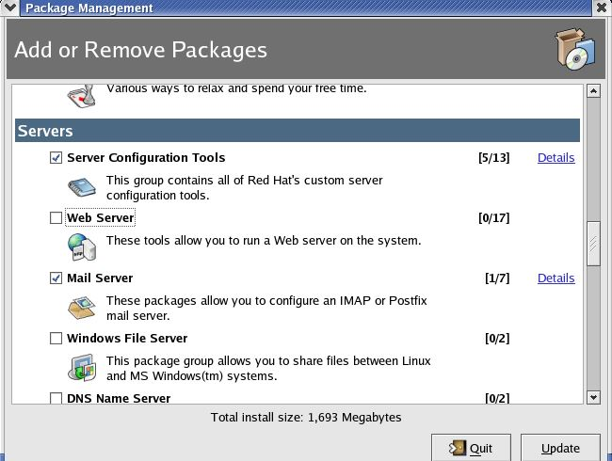
Add or remove packages

Slide 20
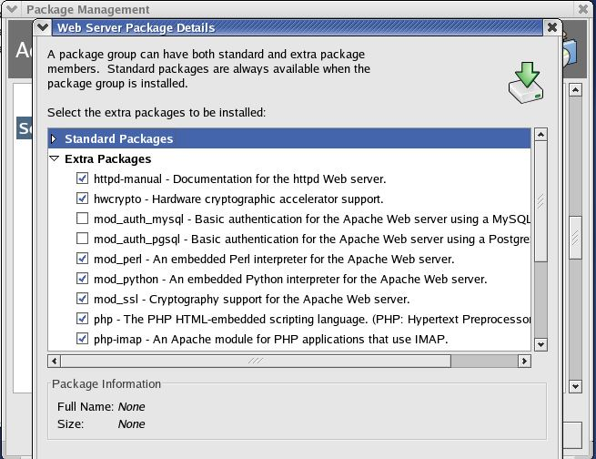
Web server package

Slide 21
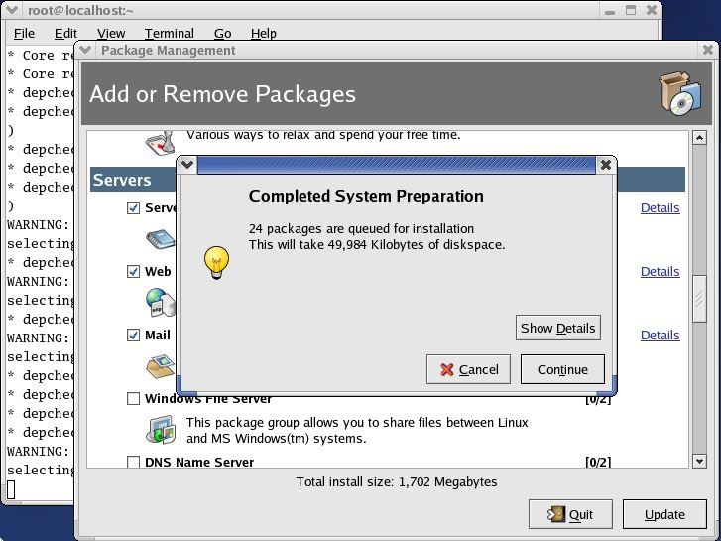
Web server package

Slide 22
Important packages
Package | Description
httpd−manual | Contains the documentation for the Apache web server. After installation, you can access this documentation from the command line by typing man httpd
hwcrypto | Provides support for hardware SSL acceleration cards. This package should be installed if you have hardware SSL acceleration cards like Ncipher Nforce on your server
mod_ssl | Provides an SSL interface to the HTTPS web server, and hence enables the Apache web server to support SSL. This package should be installed if you want to provide secure connections to your clients
php | Provides the PHP module for Apache, which enables the web server to serve PHP web pages. This package is required if you if you want to host web sites which contain pages written with the PHP scripting language
webalizer | Provides programs for web server log file analysis. This package enables you to generate HTML usage reports for your website

Slide 23
Apache Configuration Files
The /etc/httpd/httpd.conf file is Apache's main configuration file.
The /etc/httpd/conf.d directory contains configuration files for any installed modules (such as PHP, SSL, and so on).
The /etc/httpd/logs directory is a symbolic link to /var/log/httpd directory, which contains all the Apache log files.

Slide 24
Apache Configuration Files
The /etc/httpd/modules directory is a symbolic link to /usr/lib/httpd/modules directory, which contains all the Apache modules configured as dynamic shared objects. Dynamic shared objects (or DSOs) are modules that are compiled separately from the Apache httpd binary. They are so−called because they can be loaded on demand.

Slide 25
Apache Configuration Files
The /etc/httpd/run directory is a symbolic link to /var/run, which contains the process ID file (httpd.pid) of the httpd process.
· /etc/rc.d/init.d/httpd is a shell script, used for starting and stopping the Apache web server.

Slide 26
Starting Apache for the First Time
Start Apache
Main Menu | System Settings | Server Settings |Services
$ redhat−config−services

Slide 27
Starting Apache for the First Time
It will ask for root password if you started as a normal user.

Slide 28
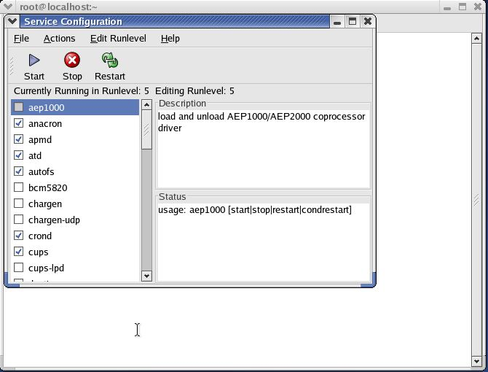
Service Configuration Dialog

Slide 29
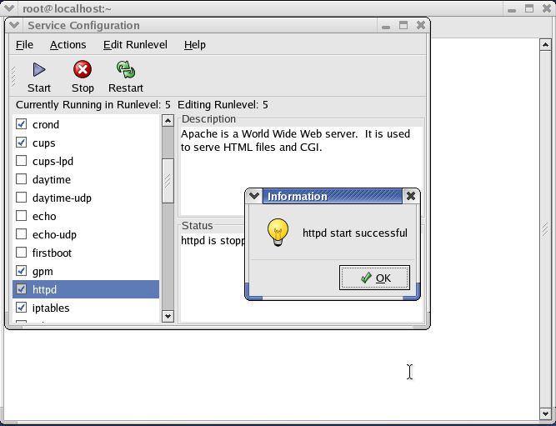
Service Configuration Dialog

Slide 30
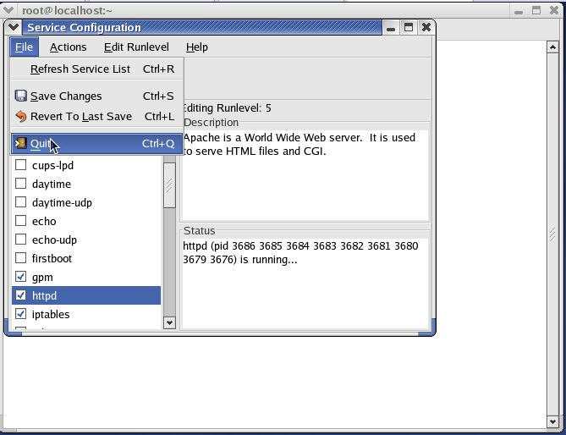
Service Configuration Dialog

Slide 31
Testing the Apache Web Server
Once you've started the Apache web server, you should test it to see if it's working properly.
To do that, we'll use a web browser to request a web page from our server!
There's a page provided by default for this purpose, and you can request it via the URL http://localhost. So, launch a web browser (Main Menu | Internet | Mozilla Web Browser), and type this URL into the address box:

Slide 32
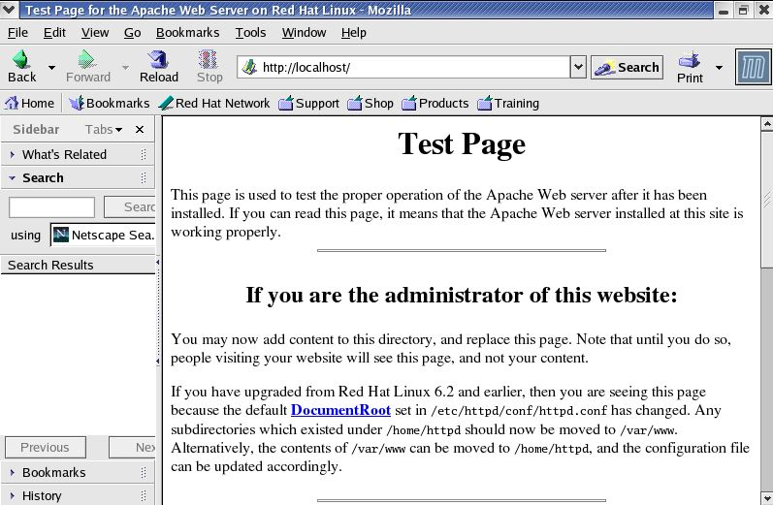
Testing the Apache Web Server

Slide 33
Configuring your Web Server
Launch the gedit text editor (by selecting Main Menu | Accessories | Text Editor).
Use it to open the file /etc/httpd/conf/httpd.conf.
Select Search | Find and use the resulting dialog to find the word ServerAdmin in the file. The first occurrence should be the ServerAdmin directive

Slide 34
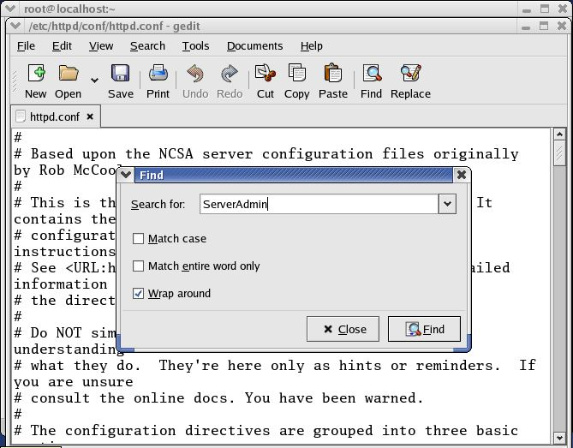
Configuring your Web Server

Slide 35
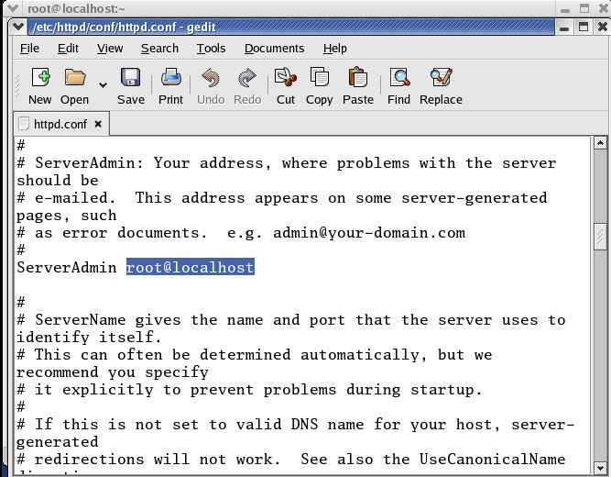
Configuring your Web Server

Slide 36
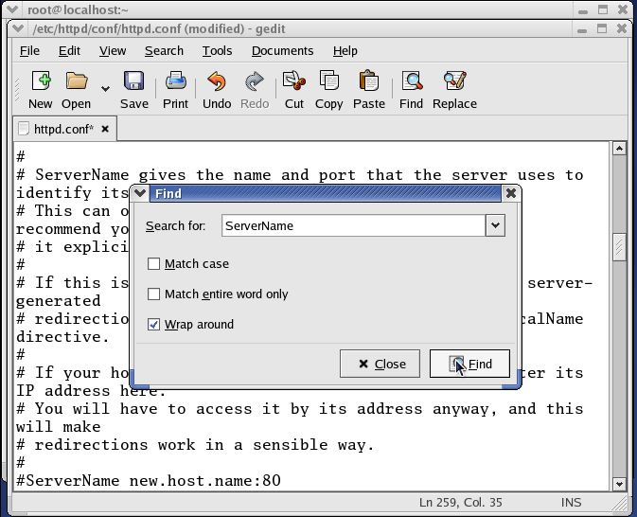
Configuring your Web Server

Slide 37
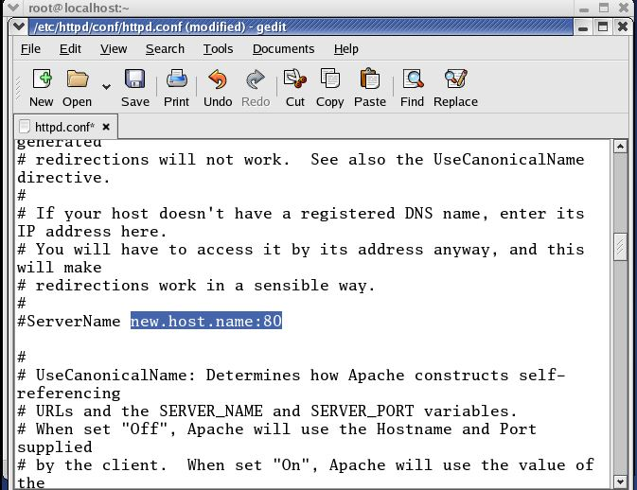
Configuring your Web Server

Slide 38
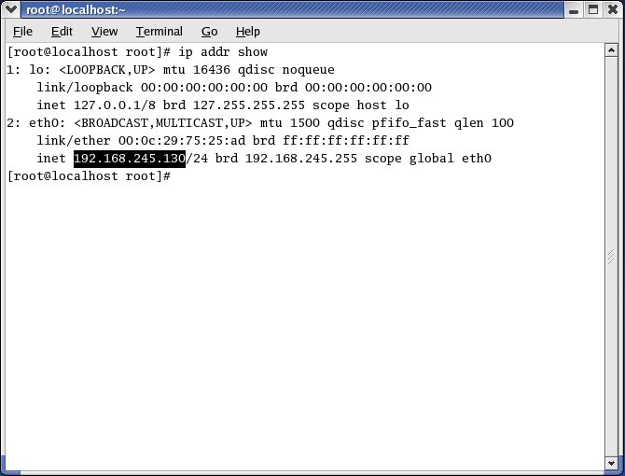
Checking IP Address

Slide 39
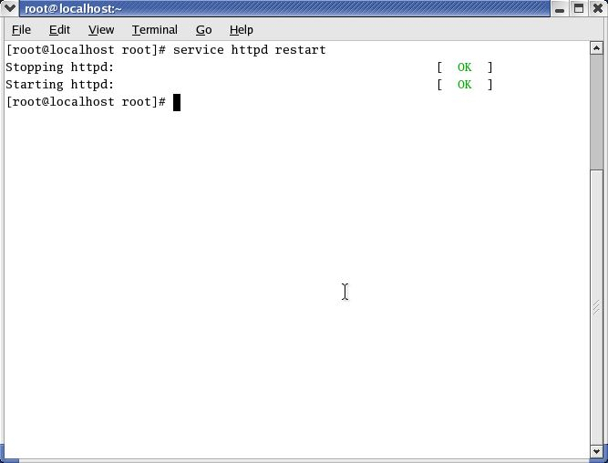
Configuring your Web Server

Slide 40
Configuring your Web Server
Again open httpd://localhost

Slide 41
Setting up Your First Web Page
This involves creating a simple HTML web page, and saving it to a location on the hard disk that is used by the web server to store published web pages.
Then, when a user requests the page, the web server will be able to respond by retrieving it from this location and sending it to the requestor.

Slide 42
Setting up Your First Web Page
Launch an editor (gedit).

Slide 43
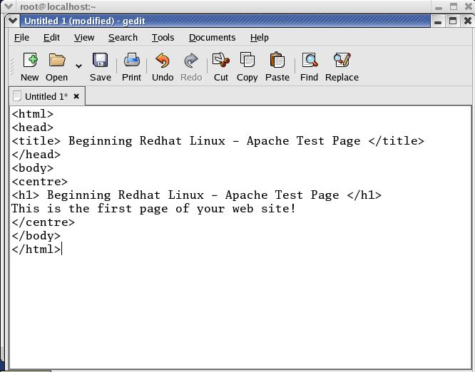
Setting up Your First Web Page

Slide 44
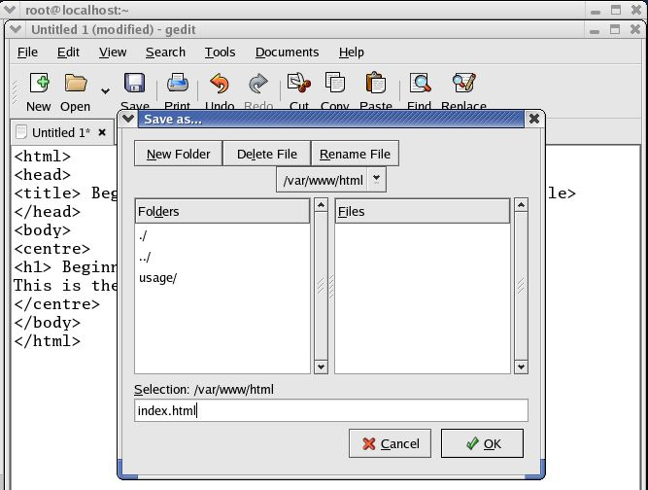
Setting up Your First Web Page

Slide 45
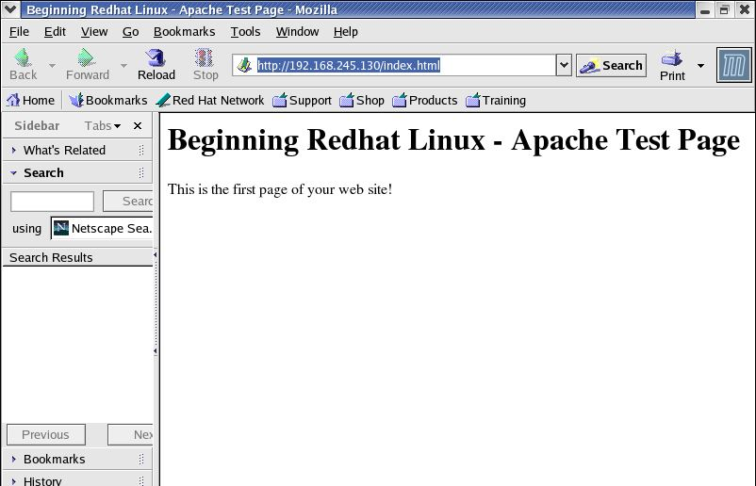
Setting up Your First Web Page

