Slide 1
Linux and Shell Scripting

Slide 2
Learning Outcomes
understand the FTP protocol
how to start and use FTP server
how to use FTP client to test anonymous read access
how to test FTP server

Slide 3
FTP Server
If you want to enable other users to download files from a location on your server's hard disk, and/or to upload files to that location, then one solution is to install an FTP server.
You can think of an FTP server essentially as an area of disk space that is used for storing files, plus the software and configuration required to allow other users to upload and download files.

Slide 4
FTP Client
When users want to upload or download from your FTP server, they use a program called an FTP client.

Slide 5
FTP
These communications between FTP server and FTP client take place using the File Transfer Protocol (FTP).
FTP is a TCP protocol that is designed specifically for the transfer of files over a network, and it's one of the oldest Internet protocols still in widespread use.

Slide 6
Relevance of FTP
The availability of so many different FTP client programs, and the fact that many operating systems come with FTP software pre−installed, are indications of how relevant FTP still is today.

Slide 7
Security of FTP
FTP is not considered a secure protocol, because communication between the FTP client and server are unencrypted.
Consequently, Secure FTP (SFTP) is also becoming popular (and, indeed, is part of the openssh package that comes with Red Hat Linux 9).

Slide 8
Security of FTP
It's also possible to configure your FTP server in other ways, for example by forcing users to log in, or by using access control lists (ACLs) to allow different rights to different groups of users.

Slide 9
Anonymous FTP Access
In fact, many FTP servers still allow anonymous FTP access, which means that the FTP server allows any user to access its disk space and download its files.
Anonymous FTP access is used mostly to enable users to access freely available documents and files via the Internet without access control.

Slide 10
Still FTP is preferred
In spite of the security issues, FTP remains popular − it's fast and easy to use, and it is the Internet standard protocol for file transfer.

Slide 11
FTP Servers in the Red Hat Linux Distribution
FTP Server | Explanation
vsftpd | It is a simplified FTP server implementation. It is designed to be a very secure FTP server, and can also be configured to allow anonymous access.
TUX | is a kernel−based, threaded, extremely high performance HTTP server, which also has FTP capabilities. TUX is perhaps the best in terms of performance, but offers less functionality than other FTP server software. TUX is installed by default with Red Hat Linux 9.
wu-ftpd | is a highly configurable and full−featured FTP daemon, which was popular in earlier versions of Red Hat Linux but has since given way to the more security−conscious vsftpd.
gssftpd | It is a kerberized FTP daemon, which means that it is suitable for use with the Kerberos authentication system.

Slide 12
Installing the vsftpd FTP Server
The easiest way to install the vsftpd FTP Server package is via the RPM GUI tool.
Main Menu | System Settings | Add/Remove Applications
$ redhat-config-packages

Slide 13
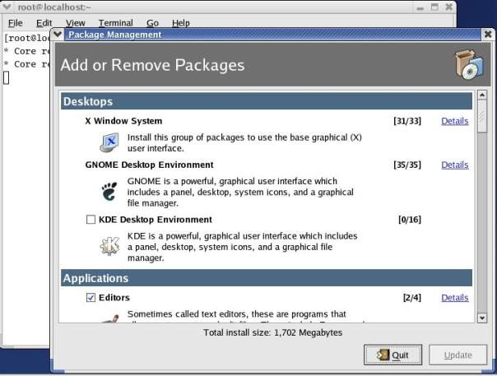
Add or remove packages

Slide 14
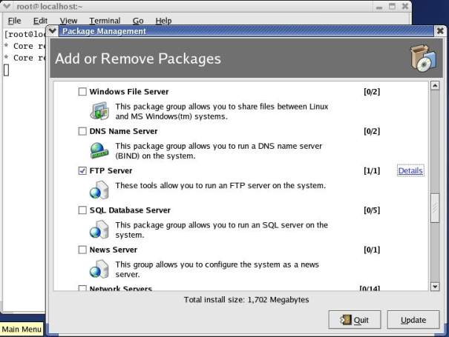
Installing the vsftpd FTP Server

Slide 15
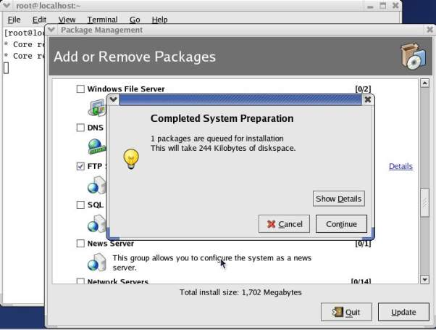
Installing the vsftpd FTP Server

Slide 16
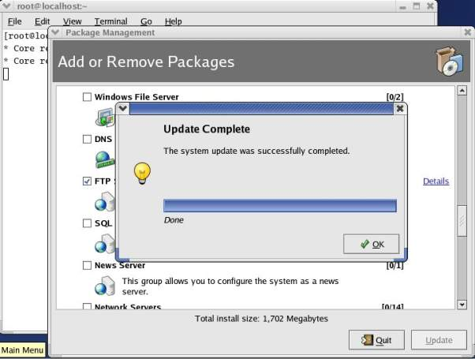
Installing the vsftpd FTP Server

Slide 17
Starting your FTP Server
Start the FTP Service, we can use the Service Configuration tool.
Main Menu | System Settings | Server Settings | Services
$ redhat−config−services

Slide 18
root password
Again, you'll be prompted for the root password, unless you're already logged on as root.

Slide 19
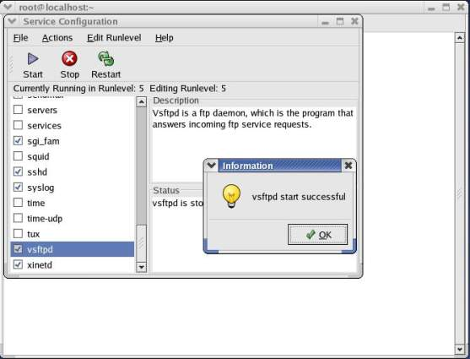
Service Configuration Dialog

Slide 20
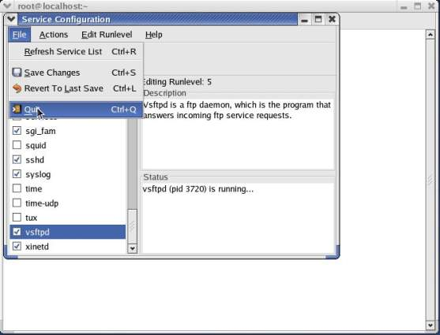
Service Configuration Dialog

Slide 21
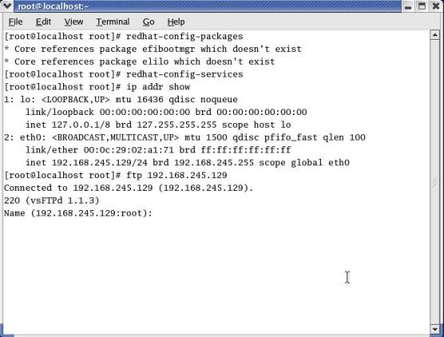
Testing Your FTP Server

Slide 22
Testing Your FTP Server
You should get a Name login prompt like the one shown above − this is enough to confirm to us that the vsftpd server is running.
Press Ctrl−C to terminate this FTP session and return to the command line.

Slide 23
Configuring an Anonymous FTP Server for File Download
Anonymous users cannot read from just any directory on your Linux server.
By default, the vsftpd package creates a directory tree starting at /var/ftp, and enables 'anonymous read access' to this directory and the directory structure beneath it.

Slide 24
Setting up the FTP Server
All we need to do here is place some test content somewhere under the /var/ftp directory, so that other users can access it.
The owner of the /var/ftp is the root account, and by default is the only one with permission to write to the directory

Slide 25
Enter as a root user
So to start, use a command line to switch to the root user:
$ su −
Password:

Slide 26
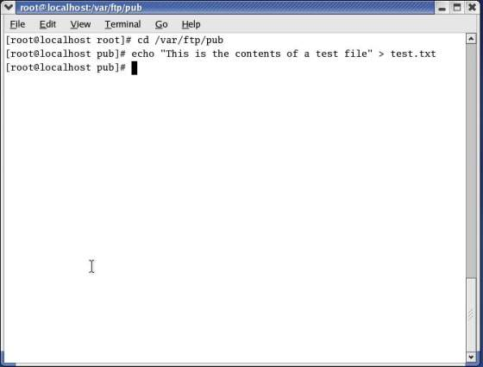
Place content in /pub subdirectory

Slide 27
Using an FTP Client to Test Anonymous Read Access
Now you can test for anonymous read access, by using an FTP client to try to grab a copy of this test file via an FTP connection.
You can use any FTP client, and you can test from a Windows or Linux machine −provided the client machine can see the FTP server across a network.

Slide 28
Using an FTP Client to Test Anonymous Read Access
You can even use your Linux server as a client, if you have only one machine.
For example, in both Windows and Linux you can use the ftp program at the command line.

Slide 29
Using an FTP Client to Test Anonymous Read Access
In the following, we'll use the ftp program as FTP client to connect to the FTP server, examine the contents of the FTP site, and then download the file test.txt:

Slide 30
Using an FTP Client to Test Anonymous Read Access
Start by connecting to the FTP server. When you're prompted for a username, specify anonymous (as shown below) or ftp to indicate that you want anonymous access:

Slide 31
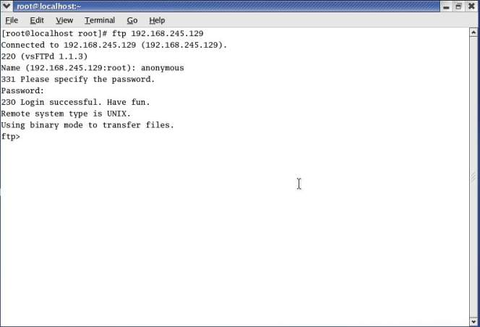
Using an FTP Client to Test Anonymous Read Access

Slide 32
Using an FTP Client to Test Anonymous Read Access
Now, we can start to examine the contents of the FTP site that are available to users with anonymous access.
For example, here we'll use the ls command to examine the contents of the FTP root directory which happens to be the directory /var/ftp on the server:

Slide 33
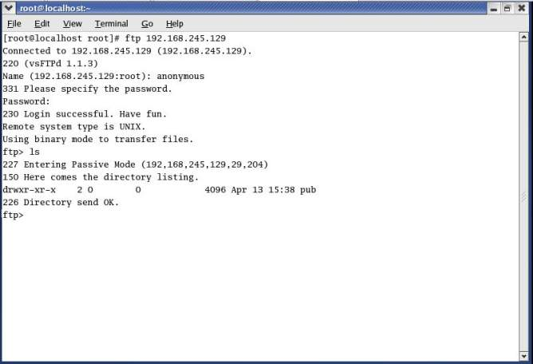
Using an FTP Client to Test Anonymous Read Access

Slide 34
Using an FTP Client to Test Anonymous Read Access
This shows that the root directory contains just one subdirectory, called pub. Now we'll use cd to change to this directory, and we'll list its contents:

Slide 35
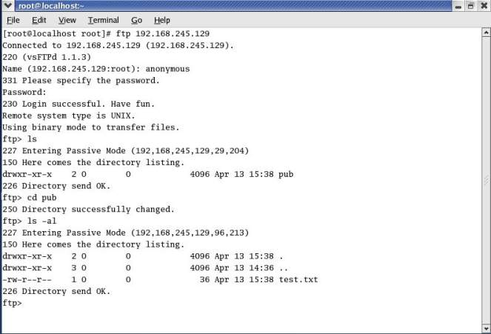
Using an FTP Client to Test Anonymous Read Access

Slide 36
Using an FTP Client to Test Anonymous Read Access
Now, we'll attempt to download the test.txt file we've just located. To do this, we'll use the get command:

Slide 37
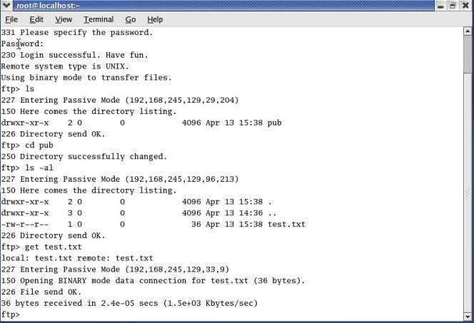
Using an FTP Client to Test Anonymous Read Access

Slide 38
Using an FTP Client to Test Anonymous Read Access
Finally, we'll end the session:

Slide 39
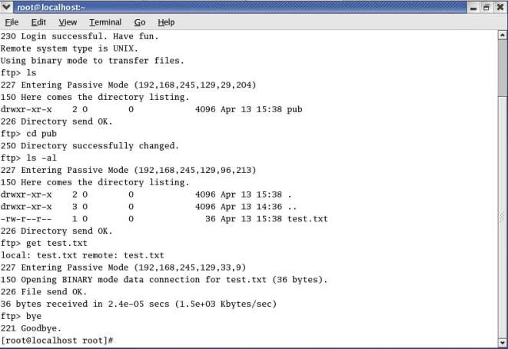
Using an FTP Client to Test Anonymous Read Access

