Slide 2
After this lecture, you will be able to
understand the basics of network.
learn characteristics of effective communication.
analyse the components required for communication.
identify the different ways of representing the information.

Slide 3
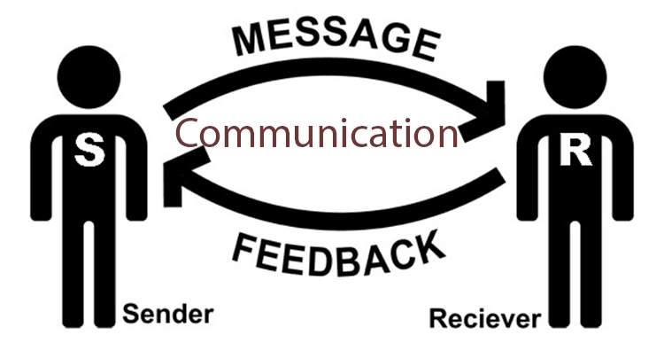
What is Communication?

Slide 4
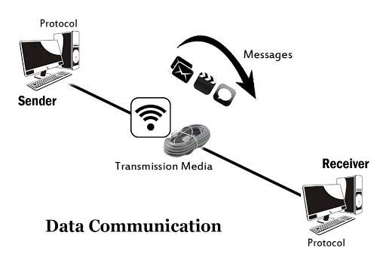
What is Data communication?

Slide 5
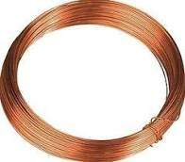
What is Data communication?

Slide 6
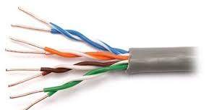
What is Data communication?

Slide 7
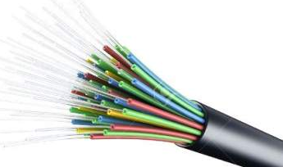
What is Data communication?

Slide 8
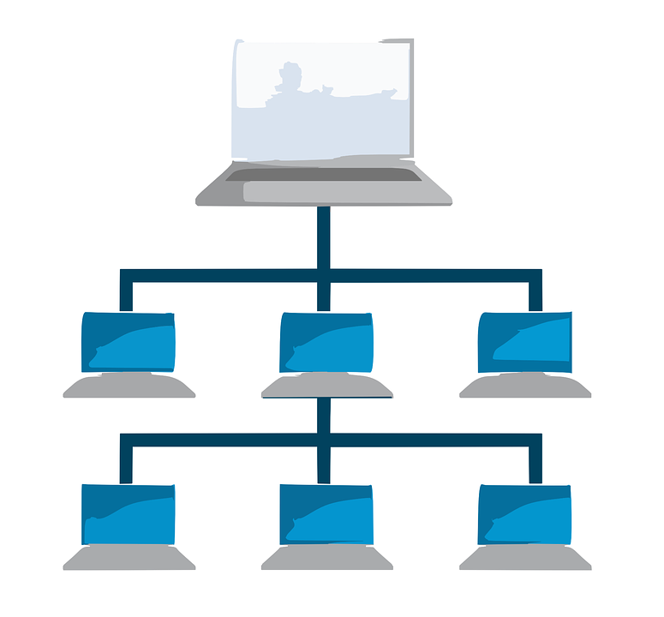
What is a Network?

Slide 9
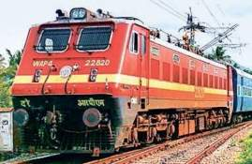
Examples

Slide 10
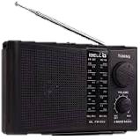
Examples

Slide 11
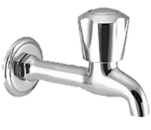
Examples

Slide 12

Examples

Slide 13
Definition
A network is a group of inter-connected computers to share resources, exchange files or allow communication.

Slide 14

Definition
Interconnected Computers

Slide 15
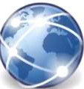
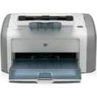
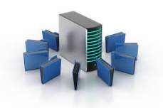
Definition
Interconnected Computers
Resources

Slide 16
What type of shared resources?
Can be in the form of hardware and software
Shared Resources
Hardware
Software
Disks
Scanners
Printers
Files
Applications
Softwares

Slide 17
Benefits of Computer Network
File Sharing
Hardware Sharing
Application sharing
User Communication
Network Gaming

Slide 18
Benefits of Computer Network
File Sharing
Hardware Sharing
Application sharing
User Communication
Network Gaming

Slide 19
Benefits of Computer Network
File Sharing
Hardware Sharing
Application sharing
User Communication
Network Gaming

Slide 20
Benefits of Computer Network
File Sharing
Hardware Sharing
Application sharing
User Communication
Network Gaming

Slide 21
Benefits of Computer Network
File Sharing
Hardware Sharing
Application sharing
User Communication
Network Gaming

Slide 22
Introduction
Data Communication and Networking
Changing the way, we do business and the way we live.
Business decision have to made more quickly.
Decision makers require immediate access to accurate information.

Slide 23
Introduction
Data Communication and Networking
Changing the way, we do business and the way we live.
Business decision have to made more quickly.
Decision makers require immediate access to accurate information.

Slide 24
Introduction
Data Communication and Networking
Changing the way, we do business and the way we live.
Business decision have to made more quickly.
Decision makers require immediate access to accurate information.

Slide 25
Introduction
Data Communication and Networking
Changing the way, we do business and the way we live.
Business decision have to made more quickly.
Decision makers require immediate access to accurate information.

Slide 26
Introduction
Example
Why wait a week for that report from Germany to arrive by mail when it could appear instantaneously through computer networks.
Business today rely on computer networks and internetworks.

Slide 27
Introduction
Before we get hooked up, we need to know:-
How network operate?
What type of technologies are available?
Which design best fills which set of needs?

Slide 28
Introduction
Before we get hooked up, we need to know:-
How network operate?
What type of technologies are available?
Which design best fills which set of needs?

Slide 29
Introduction
Before we get hooked up, we need to know:-
How network operate?
What type of technologies are available?
Which design best fills which set of needs?

Slide 30
Introduction
Before we get hooked up, we need to know:-
How network operate?
What type of technologies are available?
Which design best fills which set of needs?

Slide 31
Introduction
Development of personal computer brought tremendous changes for
Business
Industry
Science
Education

Slide 32
Introduction
Similar revolution is occurring in data communication and networking.
Technology advances are making it possible for communications links to carry more and faster signals.
Services are evolving to allow the use of this expanded capacity.

Slide 33
Introduction
Similar revolution is occurring in data communication and networking.
Technology advances are making it possible for communications links to carry more and faster signals.
Services are evolving to allow the use of this expanded capacity.

Slide 34
Introduction
Similar revolution is occurring in data communication and networking.
Technology advances are making it possible for communications links to carry more and faster signals.
Services are evolving to allow the use of this expanded capacity.

Slide 35
Introduction
Example
Telephone services extended to have:
Conference calling
Call waiting
Voice mail and
Caller ID

Slide 36
Introduction
Research in data communications and networking has resulted in new technologies.
One goal is to be able to exchange data such as
text, audio, and video from all points in the world.

Slide 37
Introduction
Research in data communications and networking has resulted in new technologies.
One goal is to be able to exchange data such as
text, audio, and video from all points in the world.

Slide 38
Introduction
Why we want to access Internet?

Slide 39
Introduction
Why we want to access Internet?
We want to access the Internet to download and upload information quickly and accurately and at any time.

Slide 40
Data Communication
What is Communication?

Slide 41
Data Communication
What is Communication?
When we communicate, we are sharing information.

Slide 42
Data Communication
What is Communication?
When we communicate, we are sharing information.
This sharing can be local or remote.

Slide 43
Data Communication
Local sharing

Slide 44

Data Communication
Local sharing

Slide 45
Data Communication
Remote sharing

Slide 46

Data Communication
Remote sharing

Slide 47
Data Communication
Telecommunication
Telephony, telegraphy, and television, means communication at a distance
Tele is Greek for "far"

Slide 48
Data Communication
Data refers to information
presented in whatever form
is agreed upon by the parties creating and using the data.
Data communications are the exchange of data between two devices via some form of transmission medium such as a wire cable.

Slide 49
Data Communication
Data refers to information
presented in whatever form
is agreed upon by the parties creating and using the data.
Data communications are the exchange of data between two devices via some form of transmission medium such as a wire cable.

Slide 50
Data Communication
Data refers to information
presented in whatever form
is agreed upon by the parties creating and using the data.
Data communications are the exchange of data between two devices via some form of transmission medium such as a wire cable.

Slide 51
Data Communication
Data refers to information
presented in whatever form
is agreed upon by the parties creating and using the data.
Data communications are the exchange of data between two devices via some form of transmission medium such as a wire cable.

Slide 52
Data Communication
For data communications to occur the communicating devices must be part of a communication system made up of a combination of hardware (physical equipment) and software (programs).

Slide 53
Data Communication
Four fundamental characteristics governing the effectiveness of Data Communication: -
Delivery
Accuracy
Timeliness
Jitter

Slide 54
Data Communication
Four fundamental characteristics governing the effectiveness of Data Communication: -
Delivery
Accuracy
Timeliness
Jitter

Slide 55
Data Communication
Four fundamental characteristics governing the effectiveness of Data Communication: -
Delivery
Accuracy
Timeliness
Jitter

Slide 56
Data Communication
Four fundamental characteristics governing the effectiveness of Data Communication: -
Delivery
Accuracy
Timeliness
Jitter

Slide 57
Data Communication
Four fundamental characteristics governing the effectiveness of Data Communication: -
Delivery
Accuracy
Timeliness
Jitter

Slide 58
Data Communication
Delivery
The system must deliver data to the correct destination. Data must be received by the intended device or user and only by that device or user

Slide 59
Data Communication
Accuracy
The system must deliver the data accurately. Data that have been altered in transmission and left uncorrected are unusable.

Slide 60
Data Communication
Timeliness
The system must deliver data in a timely manner.
Data delivered late are useless. In the case of video and audio, timely delivery means delivering data as they are produced, in the same order that they are produced, and without significant delay. This kind of delivery is called real-time transmission.

Slide 61
Data Communication
Jitter
Jitter refers to the variation in the packet arrival time. It is the uneven delay in the delivery of audio or video packets.

Slide 62
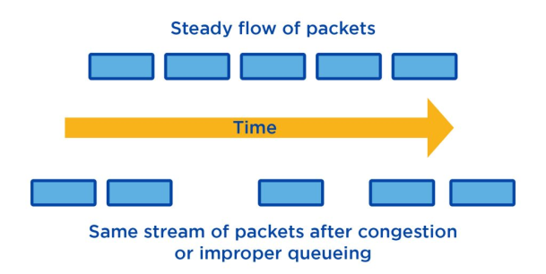
Data Communication
Jitter
Jitter refers to the variation in the packet arrival time. It is the uneven delay in the delivery of audio or video packets.

Slide 63
Components of Data Communication
A data communications system has five components
Message
Sender
Receiver
Transmission medium
Protocol

Slide 64
Components of Data Communication
A data communications system has five components
Message
Sender
Receiver
Transmission medium
Protocol

Slide 65
Components of Data Communication
A data communications system has five components
Message
Sender
Receiver
Transmission medium
Protocol

Slide 66
Components of Data Communication
A data communications system has five components
Message
Sender
Receiver
Transmission medium
Protocol

Slide 67
Components of Data Communication
A data communications system has five components
Message
Sender
Receiver
Transmission medium
Protocol

Slide 68
Components of Data Communication
A data communications system has five components
Message
Sender
Receiver
Transmission medium
Protocol

Slide 69
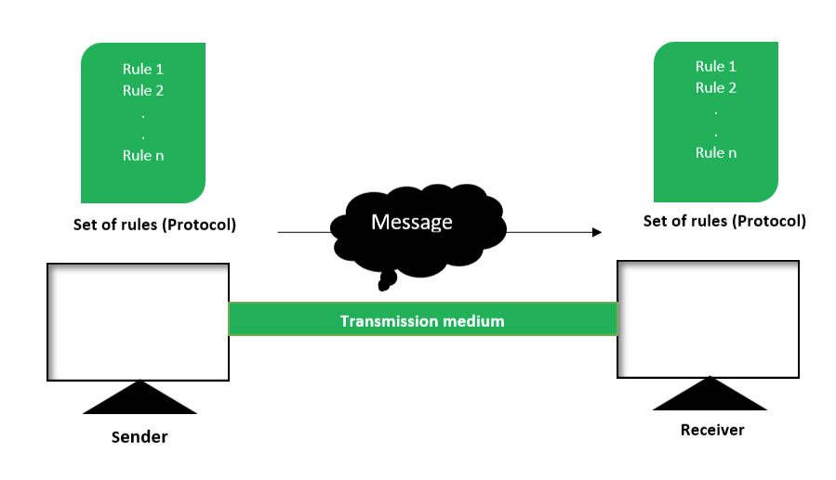
Components of Data Communication

Slide 70
Data Representation
Text
Images
Numbers
Audios
Videos

Slide 71
Data Representation
Text
Images
Numbers
Audios
Videos

Slide 72
Data Representation
Text
Images
Numbers
Audios
Videos

Slide 73
Data Representation
Text
Images
Numbers
Audios
Videos

Slide 74
Data Representation
Text
Images
Numbers
Audios
Videos

