Slide 2
After this lecture, you will be able to
describe the main uses of computer networks

Slide 3
Applications of computer networks
Business Applications
Home Applications
Mobile Users
Social Issues

Slide 4
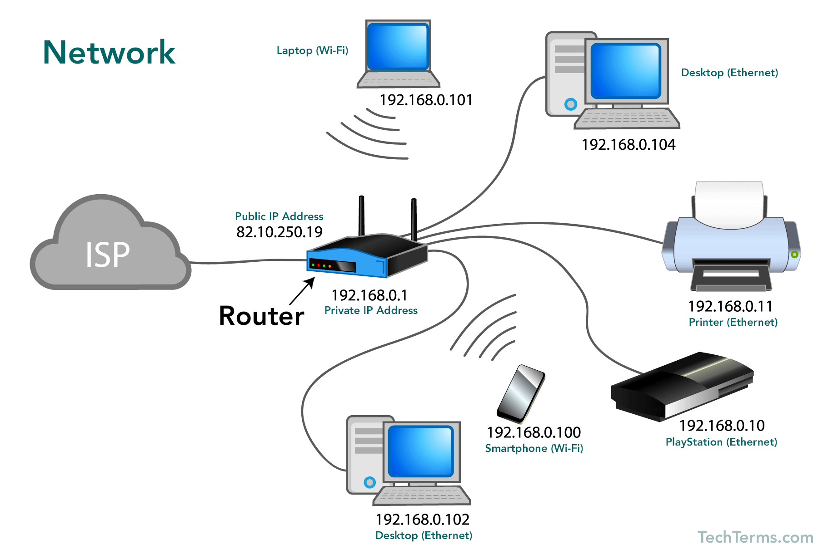
Business Applications
Resource Sharing

Slide 5
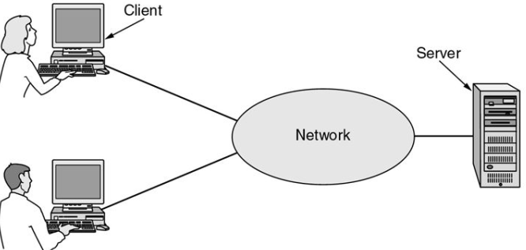
Business Applications
Server Client Model

Slide 6
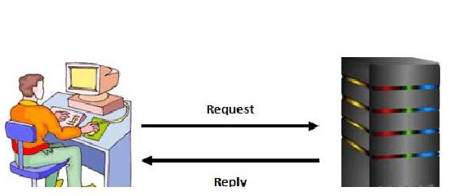
Business Application
Client-Server Model includes request and replies

Slide 7

Business Application
Communication medium

Slide 8



Business Application
E-Commerce
Airlines
Bookstore
Music Vendor

Slide 9
Business Application
E-Commerce
The most popular forms are listed
B2C (Business to Consumer) | When consumer order shoes online
B2B (Business to Business) | Truck manufacturer oredering tires from suppliers
C2C (Consumer to Consumer) | An online auction site(ebay)
G2C (government to Citizen) | reduce the average time for fulfilling citizen’s requests for various government services.
P2P (Peer to Peer) | Buyer and seller transact directly

Slide 10
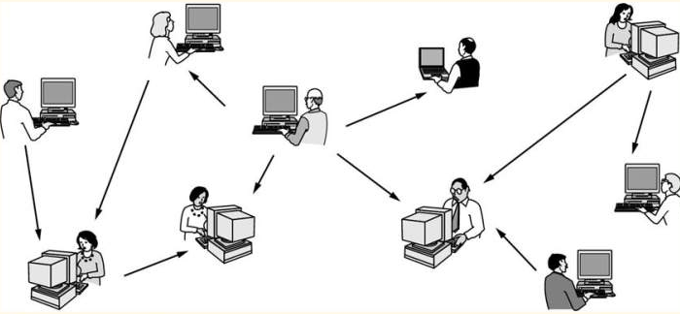
Business Application
Peer to Peer Communication
“No fixed clients or consumers”

Slide 11

Home Applications
Access to remote information

Slide 12

Home Applications
Person to Person communication

Slide 13

Home Applications
Interactive Entertainment

Slide 14

Home Applications
Electronic commerce

Slide 15
Mobile Users
One of the fastest-growing segment of the entire computer industry.
Since having a wired connection is impossible in cars, boats, airplanes, there is lot of interest in wireless networks.

Slide 16
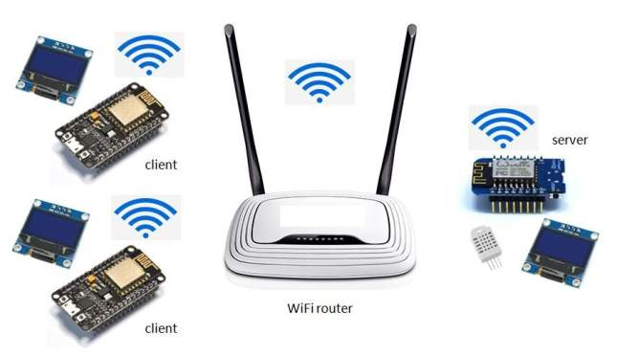
Mobile Users
Wireless hotspots are another kind of wireless network for mobile computers.

Slide 17

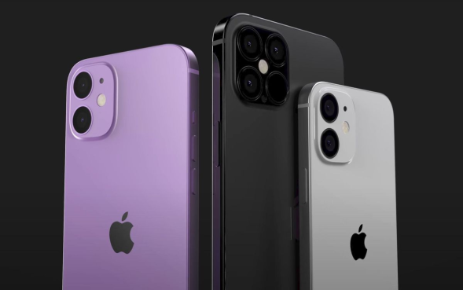
Mobile Users
Smart phones such as popular iPhone, combine aspects of mobile phones and mobile computers.

Slide 18
Mobile Users
Wireless | Mobile | Applications
No | No | Desktop computer in offices
No | Yes | A notebook computer used in a hotel room
Yes | No | Networks in older, unwired buildings
Yes | Yes | Portable office; PDA for store inventory

Slide 19
Social issues
Communication Breakdown
Unauthorized Access
Authentication
Ethical use of Networks
Identity Theft
Cyber Bullying
Gaming Addiction
Health & Fitness

Slide 20
Social issues
Communication Breakdown
Unauthorized Access
Authentication
Ethical use of Networks
Identity Theft
Cyber Bullying
Gaming Addiction
Health & Fitness

Slide 21
Social issues
Communication Breakdown
Unauthorized Access
Authentication
Ethical use of Networks
Identity Theft
Cyber Bullying
Gaming Addiction
Health & Fitness

Slide 22
Social issues
Communication Breakdown
Unauthorized Access
Authentication
Ethical use of Networks
Identity Theft
Cyber Bullying
Gaming Addiction
Health & Fitness

Slide 23
Social issues
Communication Breakdown
Unauthorized Access
Authentication
Ethical use of Networks
Identity Theft
Cyber Bullying
Gaming Addiction
Health & Fitness

Slide 24
Social issues
Communication Breakdown
Unauthorized Access
Authentication
Ethical use of Networks
Identity Theft
Cyber Bullying
Gaming Addiction
Health & Fitness

Slide 25
Social issues
Communication Breakdown
Unauthorized Access
Authentication
Ethical use of Networks
Identity Theft
Cyber Bullying
Gaming Addiction
Health & Fitness

Slide 26
Social issues
Communication Breakdown
Unauthorized Access
Authentication
Ethical use of Networks
Identity Theft
Cyber Bullying
Gaming Addiction
Health & Fitness

Slide 27
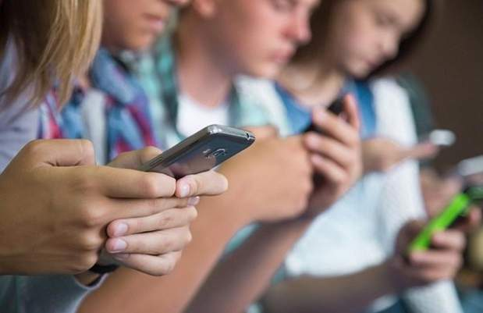
Communication Breakdown

Slide 28

Unauthorised Access

Slide 29
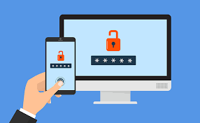
Authentication

Slide 30

Ethical Use of network

Slide 31
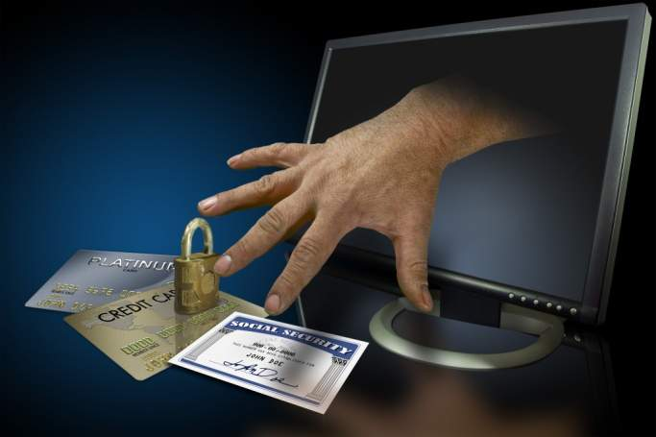
Identity Theft

Slide 32
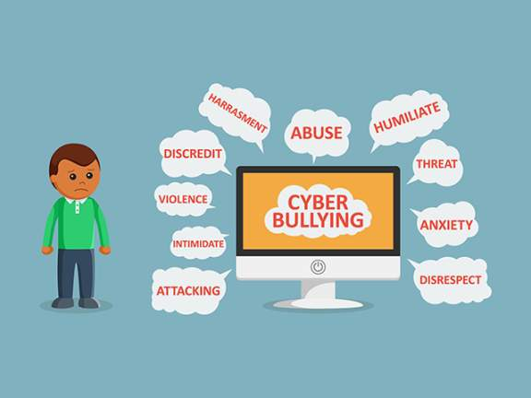
Cyber Bullying

Slide 33

Gaming Addiction

Slide 34

Health & Fitness

