Slide 2
After this lecture, you will be able to
learn different types of network.
identify how one network differ from another network.

Slide 3
Types Of Network
Personal Area Network (PAN)
Local Area Network (LAN)
Wide Area Network (WAN)
Metropolitan Area Network (MAN)

Slide 4
Types Of Network
Personal Area Network (PAN)
Local Area Network (LAN)
Wide Area Network (WAN)
Metropolitan Area Network (MAN)

Slide 5
Types Of Network
Personal Area Network (PAN)
Local Area Network (LAN)
Wide Area Network (WAN)
Metropolitan Area Network (MAN)

Slide 6
Types Of Network
Personal Area Network (PAN)
Local Area Network (LAN)
Wide Area Network (WAN)
Metropolitan Area Network (MAN)

Slide 7
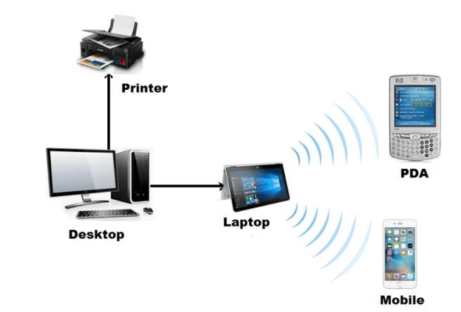
PAN (Personal Area Network)

Slide 8
PAN (Personal Area Network)
Interconnection of information technology devices within the range of an individual person.
Typically, within 10 meters.

Slide 9
PAN (Personal Area Network)
Example,
a person traveling with a laptop, a personal digital assistant (PDA), and a portable printer could interconnect them without having to plug anything in, using some form of wireless technology.

Slide 10
PAN (Personal Area Network)
Organized around an individual person within a single building.
Could be inside a small office or residence.
Would include one or more computers, telephones, peripheral devices or other personal entertainment devices.
Two or more devices that are located on your person and normally connect to one another via bluetooth.

Slide 11
PAN (Personal Area Network)
Organized around an individual person within a single building.
Could be inside a small office or residence.
Would include one or more computers, telephones, peripheral devices or other personal entertainment devices.
Two or more devices that are located on your person and normally connect to one another via bluetooth.

Slide 12
PAN(Personal Area Network)
Organized around an individual person within a single building.
Could be inside a small office or residence.
Would include one or more computers, telephones, peripheral devices or other personal entertainment devices.
Two or more devices that are located on your person and normally connect to one another via bluetooth.

Slide 13
PAN (Personal Area Network)
Organized around an individual person within a single building.
Could be inside a small office or residence.
Would include one or more computers, telephones, peripheral devices or other personal entertainment devices.
Two or more devices that are located on your person and normally connect to one another via bluetooth.

Slide 14
PAN (Personal Area Network)- Types
PAN
Wired Pan
Wireless Pan
Infrared Data Association
Bluetooth

Slide 15
PAN (Personal Area Network)- Types
Wired Pan
The data cable is an example of the above PAN.
This is also a Personal Area Network because that connection is for the user's personal use.
PAN is used for personal use only.

Slide 16
PAN (Personal Area Network)- Types
Wired Pan
The data cable is an example of the above PAN.
This is also a Personal Area Network because that connection is for the user's personal use.
PAN is used for personal use only.

Slide 17
PAN (Personal Area Network)- Types
Wired Pan
The data cable is an example of the above PAN.
This is also a Personal Area Network because that connection is for the user's personal use.
PAN is used for personal use only.

Slide 18
PAN(Personal Area Network)- Types
Wired Pan
The data cable is an example of the above PAN.
This is also a Personal Area Network because that connection is for the user's personal use.
PAN is used for personal use only.

Slide 19
PAN (Personal Area Network)- Types
Wireless PAN
The two kinds of wireless technologies used for WPAN are
Bluetooth
Infrared Data Association

Slide 20
PAN (Personal Area Network)- Types
Wireless PAN
The two kinds of wireless technologies used for WPAN are
Bluetooth
Infrared Data Association

Slide 21
PAN (Personal Area Network)- Types
Bluetooth
Bluetooth uses short-range radio waves over distances up to approximately 10 meters.

Slide 22




PAN (Personal Area Network)- Types
Bluetooth
Bluetooth uses short-range radio waves over distances up to approximately 10 meters.

Slide 23
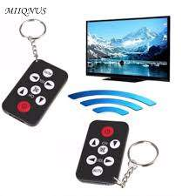
PAN (Personal Area Network)- Types
Infrared Data Association
Infrared Data Association (IrDA) uses infrared light, which has a frequency below the human eye's sensitivity.

Slide 24
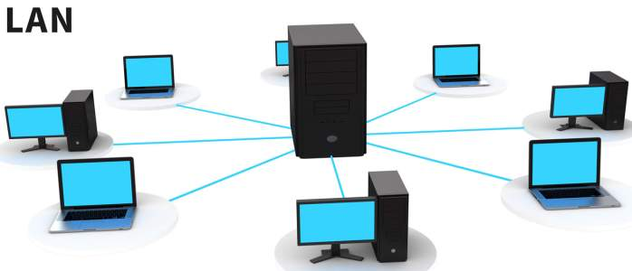
LAN (Local Area Network)

Slide 25
LAN (Local Area Network)
Connects the devices which are Normally located inside the same building.
Usually privately owned networks.
Typically used for single sites where people need to share resources among themselves but not with the outside world.

Slide 26
LAN (Local Area Network)
Connects the devices which are Normally located inside the same building.
Usually privately owned networks.
Typically used for single sites where people need to share resources among themselves but not with the outside world.

Slide 27
LAN (Local Area Network)
Connects the devices which are Normally located inside the same building.
Usually privately owned networks.
Typically used for single sites where people need to share resources among themselves but not with the outside world.

Slide 28
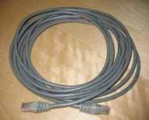

LAN (Local Area Network)- Examples
Two most common transmission technologies in use for local area networks.
Ethernet over twisted pair cabling
Wi-Fi(Wireless Fidelity)

Slide 29
LAN (Local Area Network)- Examples
Historical technologies of LAN include

Slide 30
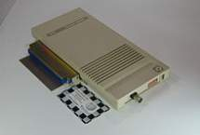
LAN (Local Area Network)- Examples
Historical technologies of LAN include
ARCNET

Slide 31
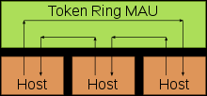
LAN (Local Area Network)- Examples
Historical technologies of LAN include
ARCNET
Token Ring

Slide 32

LAN (Local Area Network)- Examples
Historical technologies of LAN include
ARCNET
Token Ring
Apple Talk

Slide 33
LAN (Local Area Network)- Types
LAN
PEER TO PEER NETWORK
CLIENT SERVER NETWORK

Slide 34
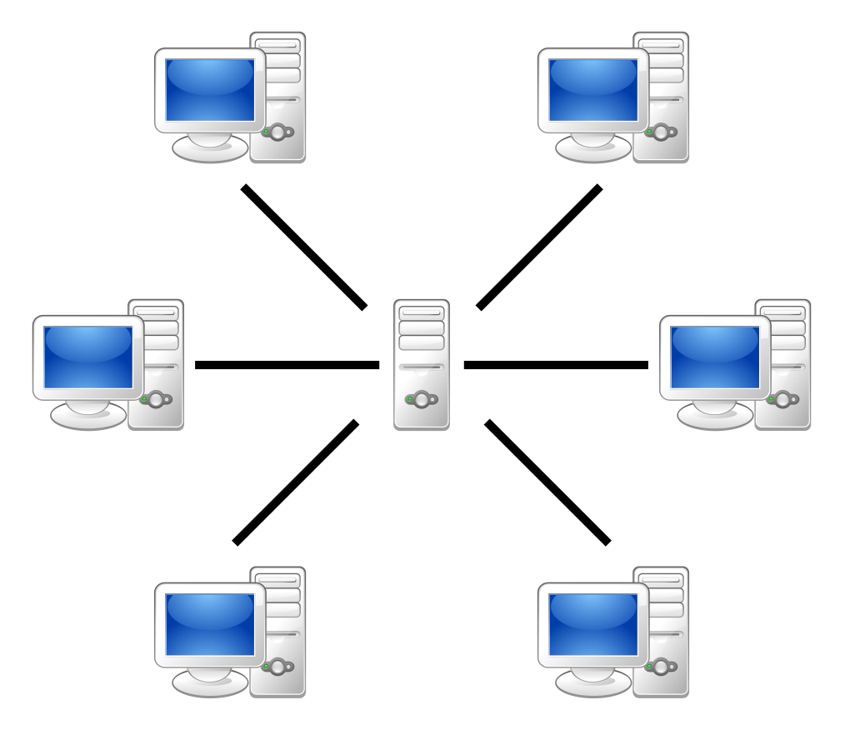
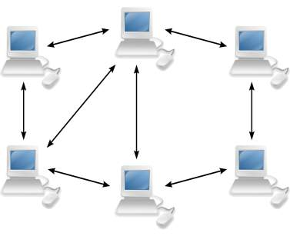
LAN (Local Area Network)- Types
Client Server Model
Peer to peer Model

Slide 35
LAN & WLAN– How are they related?
LAN | WLAN
Local Area Network | Wireless Local area network
Includes wired as well as wireless connection | Completely wireless technology based
Less Expensive | More expensive
More secure than wireless connections | Less secure than wired connections.

Slide 36
LAN & WLAN– How are they related?
LAN | WLAN
Local Area Network | Wireless Local area network
Includes wired as well as wireless connection | Completely wireless technology based
Less Expensive | More expensive
More secure than wireless connections | Less secure than wired connections.

Slide 37
LAN & WLAN– How are they related?
LAN | WLAN
Local Area Network | Wireless Local area network
Includes wired as well as wireless connection | Completely wireless technology based
Less Expensive | More expensive
More secure than wireless connections | Less secure than wired connections.

Slide 38
LAN & WLAN– How are they related?
LAN | WLAN
Local Area Network | Wireless Local area network
Includes wired as well as wireless connection | Completely wireless technology based
Less Expensive | More expensive
More secure than wireless connections | Less secure than wired connections.

Slide 39
LAN & WLAN– How are they related?
LAN | WLAN
Installation is cheaper but complex | Installation is costly but simple.
Provides good performance and impact of weather is limited. | Provides high performance but may get impacted in bad weather.
Connections can not be interrupted easily. | Connections can be interrupted easily.

Slide 40
LAN & WLAN– How are they related?
LAN | WLAN
Installation is cheaper but complex | Installation is costly but simple.
Provides good performance and impact of weather is limited. | Provides high performance but may get impacted in bad weather.
Connections can not be interrupted easily. | Connections can be interrupted easily.

Slide 41
LAN & WLAN– How are they related?
LAN | WLAN
Installation is cheaper but complex | Installation is costly but simple.
Provides good performance and impact of weather is limited. | Provides high performance but may get impacted in bad weather.
Connections can not be interrupted easily. | Connections can be interrupted easily.

Slide 42
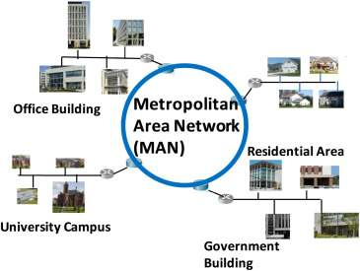
MAN (Metropolitan Area Network)

Slide 43
MAN (Metropolitan Area Network)
A computer network larger than a local area network.
Also known as Municipal Area Network.

Slide 44
MAN (Metropolitan Area Network)
A computer network larger than a local area network.
Also known as Municipal Area Network.

Slide 45
MAN (Metropolitan Area Network)
Consists of a computer network across an entire city, college campus or small region.
Often used to connect several LANs together to form a bigger network.
Larger than a LAN, which is typically limited to a single building or site.

Slide 46
MAN (Metropolitan Area Network)
Consists of a computer network across an entire city, college campus or small region.
Often used to connect several LANs together to form a bigger network.
Larger than a LAN, which is typically limited to a single building or site.

Slide 47
MAN (Metropolitan Area Network)
Consists of a computer network across an entire city, college campus or small region.
Often used to connect several LANs together to form a bigger network.
Larger than a LAN, which is typically limited to a single building or site.

Slide 48
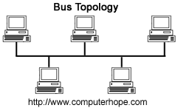
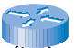
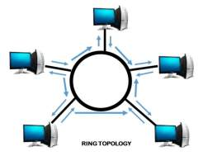
MAN (Metropolitan Area Network)
Local telephone exchange

Slide 49
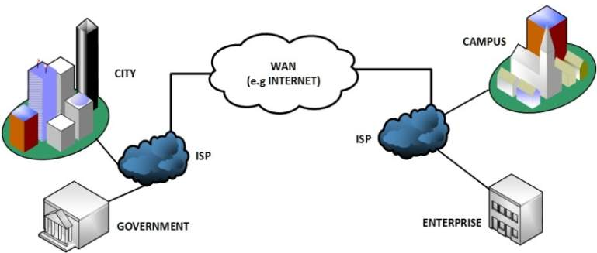
WAN (Wide Area Networking)

Slide 50
WAN (Wide Area Networking)
Generally, any network whose communication link cross metropolitan, regional or national boundaries.
Occupies a very large area, such as an entire country or the entire world

Slide 51
WAN (Wide Area Networking)
Generally, any network whose communication link cross metropolitan, regional or national boundaries.
Occupies a very large area, such as an entire country or the entire world

Slide 52
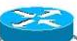
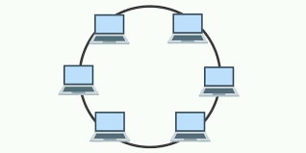
WAN (Wide Area Networking)
DELHI
Over the internet
MUMBAI

Slide 53
WAN (Wide Area Networking)
A WAN can contain multiple smaller networks, such as LANs or MANs.
The Internet is the best-known example of a public WAN.

Slide 54
WAN (Wide Area Networking)
A WAN can contain multiple smaller networks, such as LANs or MANs.
The Internet is the best-known example of a public WAN.

Slide 55
How WAN networks are established?
Computers connected to a wide-area network are often connected through public networks, such as the telephone system.
They can also be connected through leased lines or satellites.
The largest WAN in existence is the Internet.

Slide 56
How WAN networks are established?
Computers connected to a wide-area network are often connected through public networks, such as the telephone system.
They can also be connected through leased lines or satellites.
The largest WAN in existence is the Internet.

Slide 57
Difference between LAN MAN and WAN
LAN | MAN | WAN
LAN’s ownership is private. | MAN’s ownership can be private or public. | While WAN also might not be owned by one organization.
The transmission speed of a LAN is high. | While the transmission speed of a MAN is average. | Whereas the transmission speed of a WAN is low.
The propagation delay is short in a LAN. | There is a moderate propagation delay in a MAN. | Whereas, there is a long propagation delay in a WAN.

Slide 58
Difference between LAN MAN and WAN
LAN | MAN | WAN
LAN’s ownership is private. | MAN’s ownership can be private or public. | While WAN also might not be owned by one organization.
The transmission speed of a LAN is high. | While the transmission speed of a MAN is average. | Whereas the transmission speed of a WAN is low.
The propagation delay is short in a LAN. | There is a moderate propagation delay in a MAN. | Whereas, there is a long propagation delay in a WAN.

Slide 59
Difference between LAN MAN and WAN
LAN | MAN | WAN
LAN’s ownership is private. | MAN’s ownership can be private or public. | While WAN also might not be owned by one organization.
The transmission speed of a LAN is high. | While the transmission speed of a MAN is average. | Whereas the transmission speed of a WAN is low.
The propagation delay is short in a LAN. | There is a moderate propagation delay in a MAN. | Whereas, there is a long propagation delay in a WAN.

Slide 60
Difference between LAN MAN and WAN
LAN | MAN | WAN
Less congestion in LAN | More congestion in MAN. | Even more congestion than MAN in WAN.
LAN’s design and maintenance is easy. | While MAN’s design and maintenance is difficult than LAN. | Whereas WAN’s design and maintenance is also difficult than LAN as well MAN.
There is more fault tolerance in LAN. | While there is less fault tolerance | In WAN, there is also less fault tolerance.

Slide 61
Difference between LAN MAN and WAN
LAN | MAN | WAN
Less congestion in LAN | More congestion in MAN. | Even more congestion than MAN in WAN.
LAN’s design and maintenance is easy. | While MAN’s design and maintenance is difficult than LAN. | Whereas WAN’s design and maintenance is also difficult than LAN as well MAN.
There is more fault tolerance in LAN. | While there is less fault tolerance | In WAN, there is also less fault tolerance.

Slide 62
Difference between LAN MAN and WAN
LAN | MAN | WAN
Less congestion in LAN | More congestion in MAN. | Even more congestion than MAN in WAN.
LAN’s design and maintenance is easy. | While MAN’s design and maintenance is difficult than LAN. | Whereas WAN’s design and maintenance is also difficult than LAN as well MAN.
There is more fault tolerance in LAN. | While there is less fault tolerance | In WAN, there is also less fault tolerance.

