Slide 2
After this lecture, you will be able to
understand analog and digital signals
differentiate between analog and digital signals

Slide 3
Major Function of the Physical Layer
Move data in the form of electromagnetic signals
For example, a photograph must first be changed to a form that transmission media can accept.

Slide 4
Analog and Digital Data
Both data and the signals that represent them can be either analog or digital in form.
Analog Data | Digital Data
The term analog data refers to information that is continuous. | Digital data take on discrete values.

Slide 5


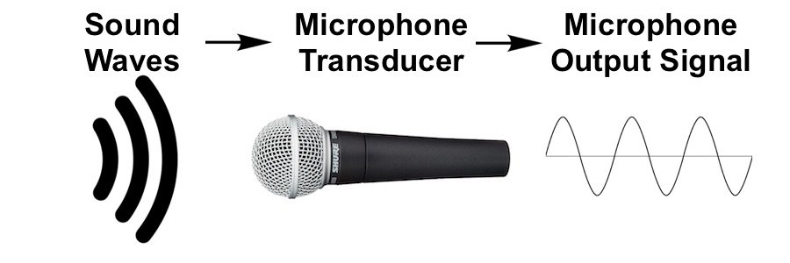
Examples of Analog Data
Sounds made by a human voice take on continuous values.
An analog clock that has hour, minute, and second hands gives information in a continuous form.

Slide 6
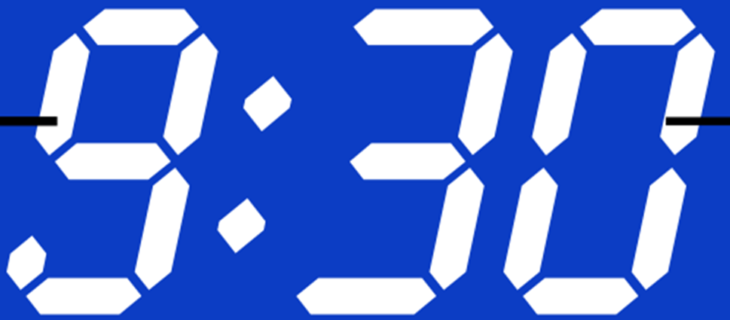
Example of Digital Data
Digital clock that reports the hours and the minutes will change suddenly from 8:05 to 8:06.

Slide 7
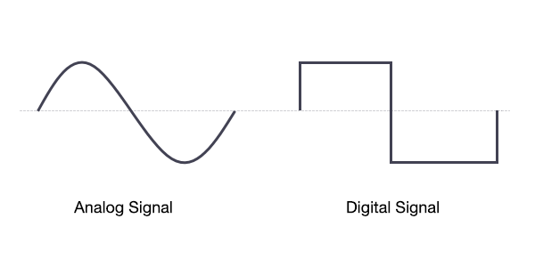
Analog and Digital Signal

Slide 8
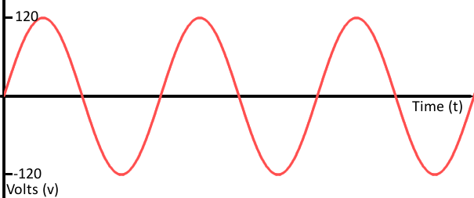
Analog Signal
Many levels of intensity
An infinite number of values.
Vertical axis represent value
Horizontal axis represent time.

Slide 9
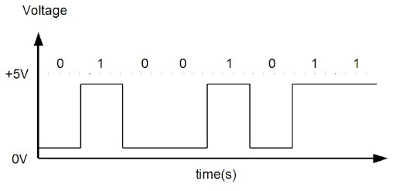
Digital Signal
Limited number of defined values.
Although each value can be any number, it is often as simple as 1 and 0.
Vertical axis represent value
Horizontal axis represent time.

Slide 10
Periodic and Non-Periodic Signals
Both analog and digital signals can take one of two forms: periodic or non-periodic.

Slide 11
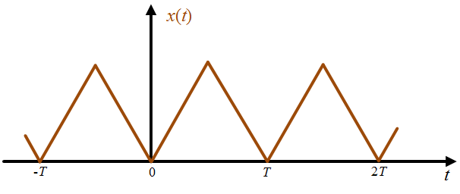
Periodic Signal
Completes a pattern
Repeats that pattern over subsequent identical periods.
The completion of one full pattern is called a cycle.

Slide 12
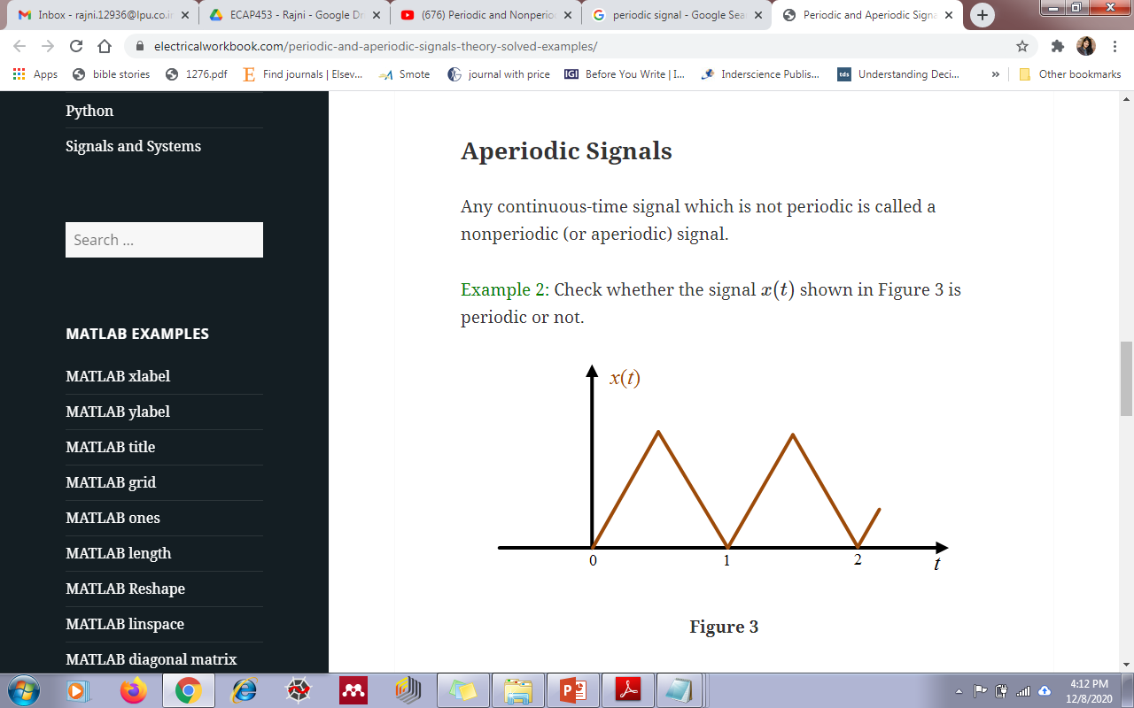
Non-Periodic (Aperiodic) Signal
Changes without exhibiting a pattern
Any continuous-time signal which is not periodic is called a non-periodic.

Slide 13
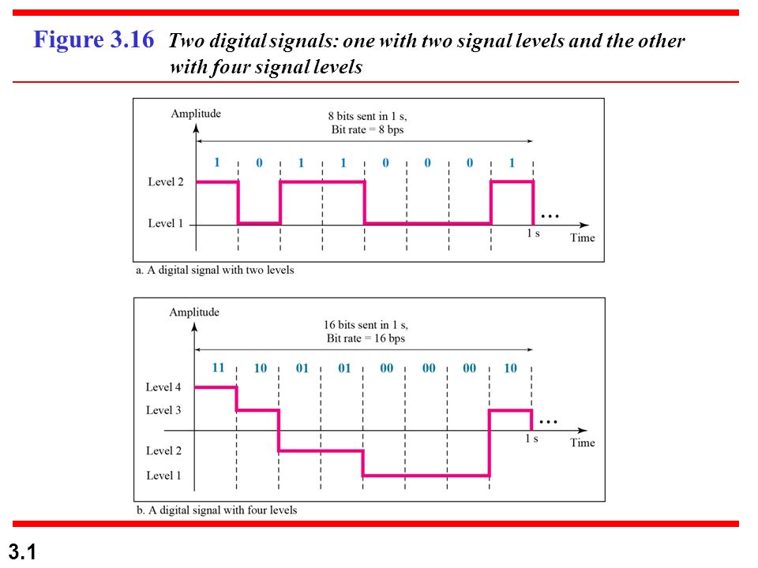
Digital Signals
Information can also be represented by a digital signal. 1 can be encoded as a positive voltage and a 0 as zero voltage.
We send 1 bit per level
A digital signal with two levels

Slide 14
A Digital Signal With Four Levels
A digital signal can have more than two levels. In this case, we can send more than 1 bit for each level.
We send 2 BIT PER LEVEL.

Slide 15
Formula to Calculate Bits Per Level
In general, if a signal has L levels, each level needs log2L bits

Slide 16
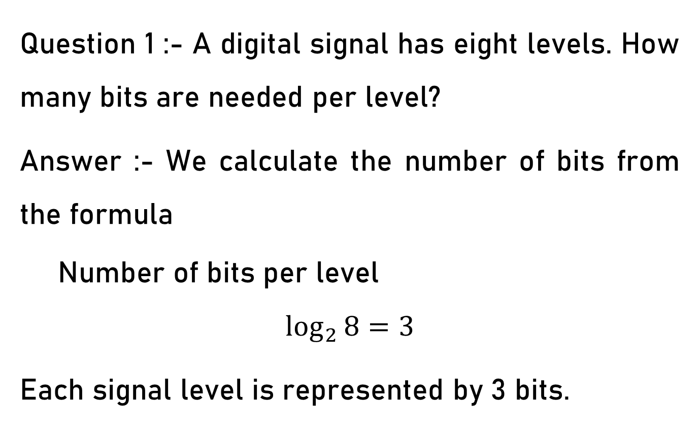
Example

Slide 17
Important Terms
Bit Rate
Baud rate
Bit Length
Bit Interval

Slide 18
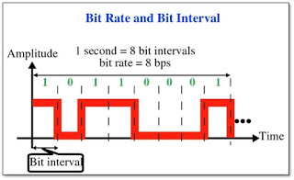
Bit Rate
Bit rate is used to describe digital signals.
The bit rate is the number of bits sent in 1s, expressed in bits per second (bps).

Slide 19
Baud Rate
Baud Rate is the number of signal unit transmitted per second.
Thus Baud Rate is always less than or equal to bit rate. Baud rate is number of symbols per second.

Slide 20
Difference between Bit Rate and Baud Rate
Bit Rate | Baud Rate
Bit rate is also defined as per second travel number of bits . | Baud rate is also defined as per second number of changes in signal.
Bit rate emphasized on computer efficiency. | While baud rate emphasized on data transmission.
Bit rate is not used to decide the requirement of bandwidth for transmission of signal. | While baud rate is used to decide the requirement of bandwidth for transmission of signal.

Slide 21
Bit Length
The bit length is the distance one bit occupies on the transmission medium.
Bit length =propagation speed x bit duration

Slide 22
Bit Interval
Data can be represent by a digital signal.
For Example a 1 can be encoded as a positive voltage and a 0 can be encoded as a zero voltage.

Slide 23
Bit Interval

