Slide 2
After this lecture you will be able to
learn what are transmission impairments
what are the possible causes
how to overcome the same

Slide 3
Transmission Impairment
Signals travel through transmission media, which are not perfect. The imperfection causes signal impairment. This means that the signal at the beginning of the medium is not the same as the signal at the end of the medium. What is sent is not what is received.

Slide 4
Causes of Impairment
The most significant impairment includes:-
Impairment Causes
Attenuation
Distortion
Noise

Slide 5
Attenuation
Means loss of energy -> weaker signal
When a signal travels through a medium it loses energy overcoming the resistance of the medium
Amplifiers are used to compensate for this loss of energy by amplifying the signal.

Slide 6

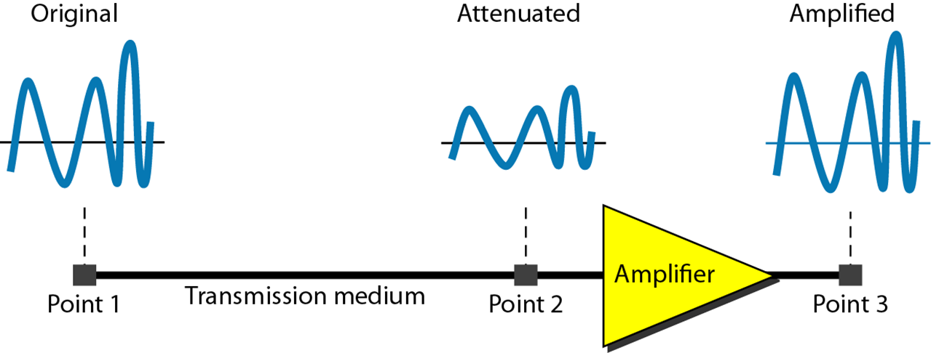
Attenuation

Slide 7
Attenuation

Slide 8
Attenuation

Slide 9
Attenuation

Slide 10
Measurement of Attenuation
To show the loss or gain of energy the unit “decibel” is used.
dB = 10log₁₀P₂/P₁
P₁ - input signal
P₂ - output signal

Slide 11
Example
Suppose a signal travels through a transmission medium and its power is reduced to one-half. This means that P2 is (1/2)P1. In this case, the attenuation (loss of power) can be calculated as
$10log10\frac{P2}{P1}=10 log10 \frac{0.5 P2}{P1}$ = $10 log10$.5 = 10(-0.3) = -3 dB
A loss of 3 dB (–3 dB) is equivalent to losing one-half the power.

Slide 12
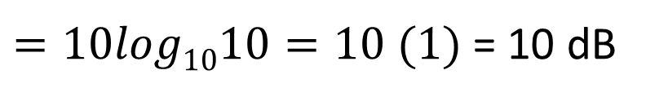
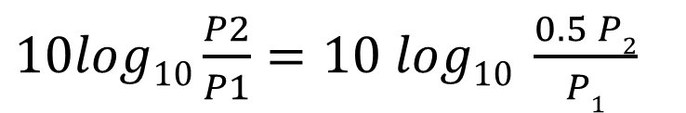
Example
A signal travels through an amplifier, and its power is increased 10 times. This means that P₂ = 10P₁ . In this case, the amplification (gain of power) can be calculated as
$10log10\frac{P2}{P1}=10 log10 \frac{0.5 P2}{P1}$
$=10log1010=10 (1)$= 10 dB

Slide 13
Example
One reason that engineers use the decibel to measure the changes in the strength of a signal is that decibel numbers can be added (or subtracted) when we are measuring several points (cascading) instead of just two.

Slide 14
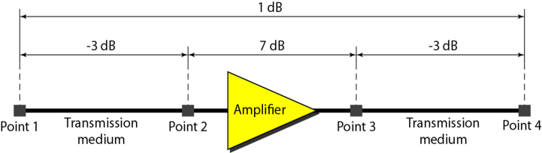
Example
A signal travels from point 1 to point 4. In this case, the decibel value can be calculated as
Here, dB = -3 + 7 – 3 = +1

Slide 15
Distortion
Means that the signal changes its form or shape.
Distortion occurs in composite signals.
Each frequency component has its own propagation speed traveling through a medium.

Slide 16
Distortion
The different components therefore arrive with different delays at the receiver.
That means that the signals have different phases at the receiver than they did at the source.

Slide 17
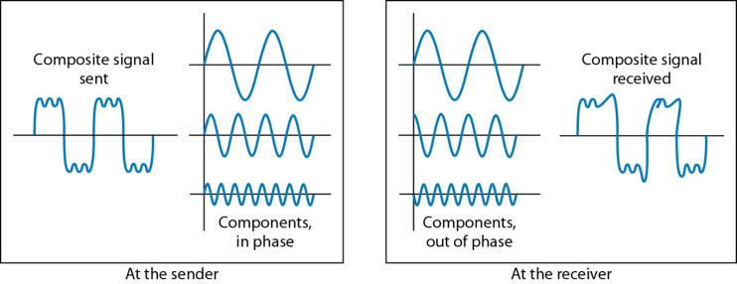
Example
At the sender
At the receiver

Slide 18
Noise
There are different types of noise
Thermal
Induced
Crosstalk
Impulse

Slide 19
Different types of noise
Thermal noise is the random motion of electrons in a wire which creates an extra signal not originally sent by the transmitter.

Slide 20
Different Types of Noise
Induced noise comes from sources such as motors and appliances. These devices act as a sending antenna, and the transmission medium acts as the receiving antenna

Slide 21
Different types of noise
Crosstalk is the effect of one wire on the other. One wire acts as a sending antenna and the other as the receiving antenna.

Slide 22
Different Types of Noise
Impulse noise is a spike (a signal with high energy in a very short time) that comes from power lines, lightning, and so

Slide 23
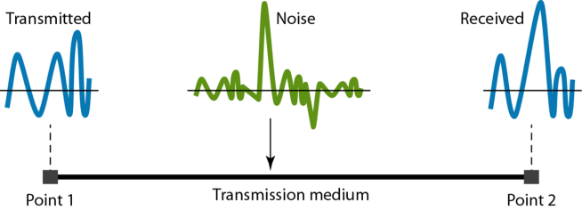
Noise

Slide 24
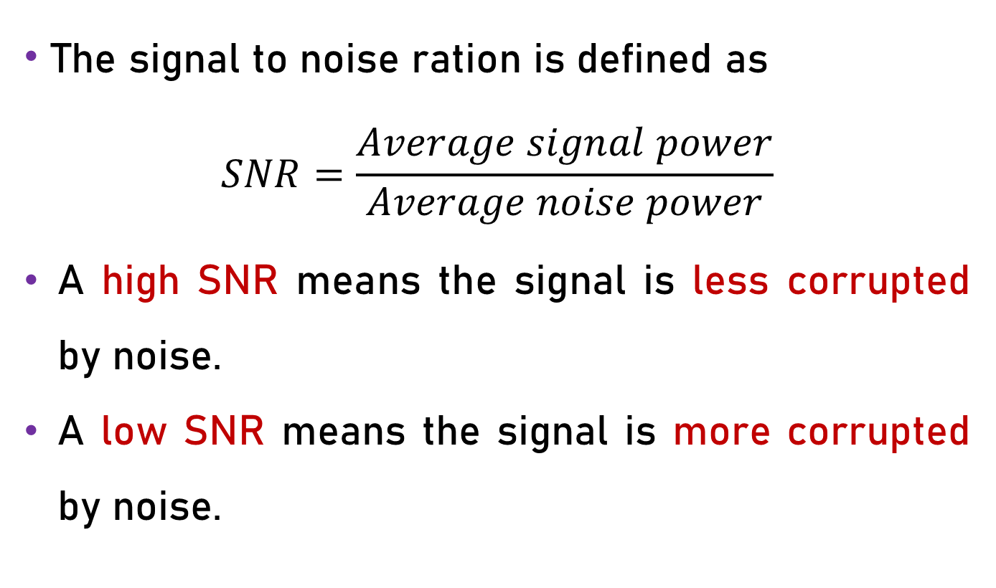
Signal to Noise Ratio (SNR)
The signal to noise ration is defined as
$$SNR=\frac{Average signal power}{Average noise power}$$
A high SNR means the signal is less corrupted by noise.
A low SNR means the signal is more corrupted by noise.

Slide 25
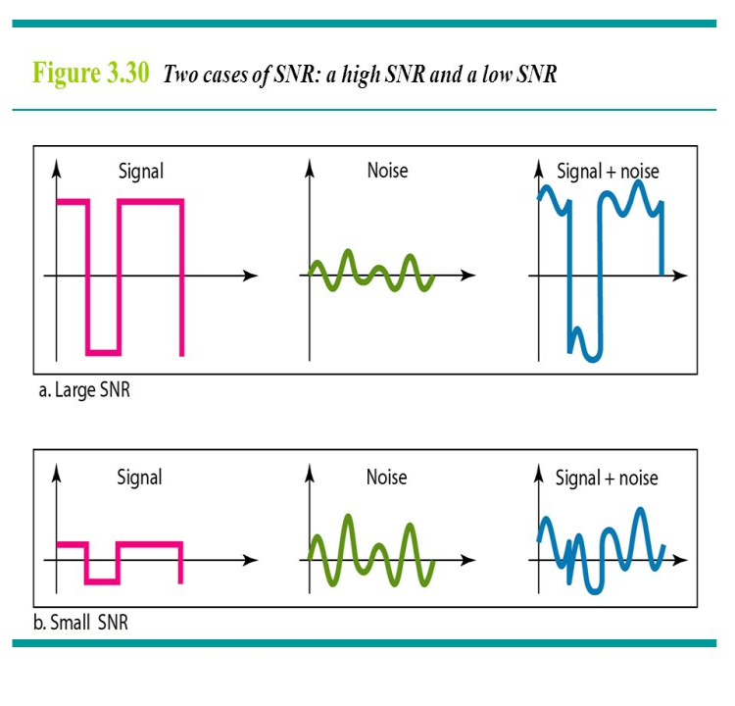
Signal to Noise Ratio (SNR)
A large SNR

Slide 26
Signal to Noise Ratio (SNR)
A small SNR

Slide 27
Signal to Noise Ratio (SNR)
To measure the quality of a system the SNR is often used. It indicates the strength of the signal.
Because SNR is the ratio of two powers, it is often described in decibel units, SNRdB, defined as
SNR cm = l0log_{l0} SNR

