Slide 2
After this lecture you will be able to
learn what is transmission mode.
understand different modes of transmission
understand what is performance metrics.
learn 7 essential network metrics to monitor.

Slide 3
Transmission Mode
Transmission mode refers to the mechanism of transferring of data between two devices connected over a network.
It is also called Communication Mode.
These modes direct the direction of flow of information.

Slide 4
Modes of Transmission
Transmission Mode
Simplex Mode
Half- Duplex Mode
Full-Duplex Mode

Slide 5
Simplex Mode
In this type of transmission mode, data can be sent only in one direction.
communication is unidirectional.
we cannot send a message back to the sender.

Slide 6

Example
Keyboard or mouse input to CPU

Slide 7
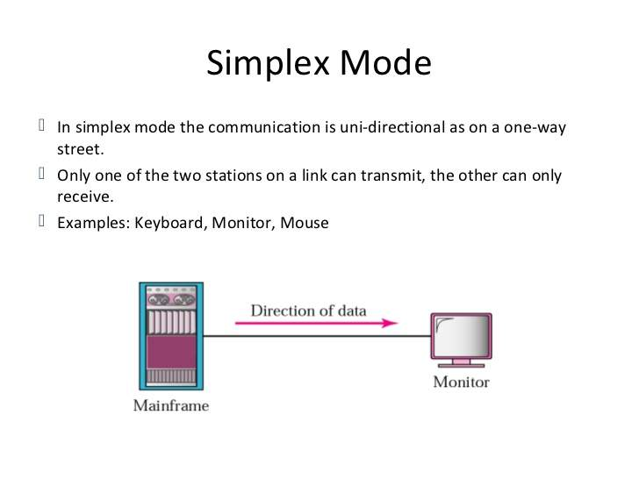

Example
CPU
Monitor
Direction of flow
Direction of flow
Keyboard
CPU Outputs to Monitor

Slide 8
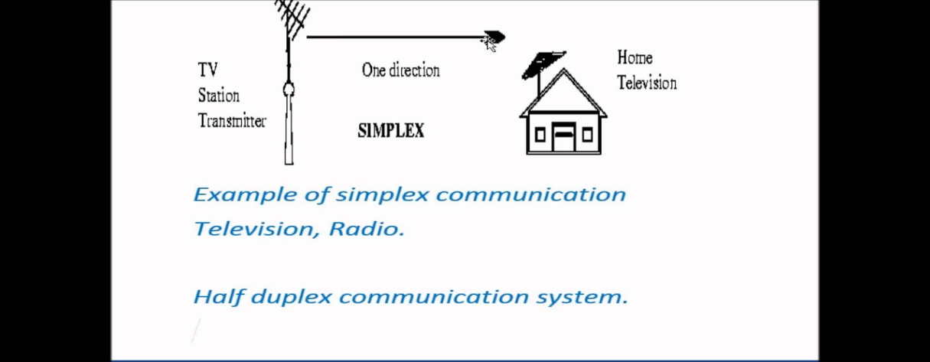
Example
Computer to printer
Scanner to computer
Radio and TV transmission
TV Station Transmitter
Home Television
One direction
Simplex

Slide 9

Example
Loudspeaker

Slide 10

Example
Changing channel using remote

Slide 11

Half-Duplex Mode
Half-duplex data transmission means that data can be transmitted in both directions on a signal carrier, but not at the same time
Direction of data 1
Direction of data 2

Slide 12
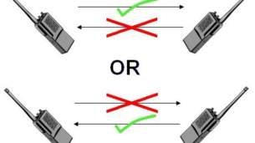

Examples
Walkie-Talkie
Internet Browser

Slide 13

Full-Duplex Mode
In full duplex system we can send data in both the directions as it is bidirectional at the same time.
Direction of data

Slide 14
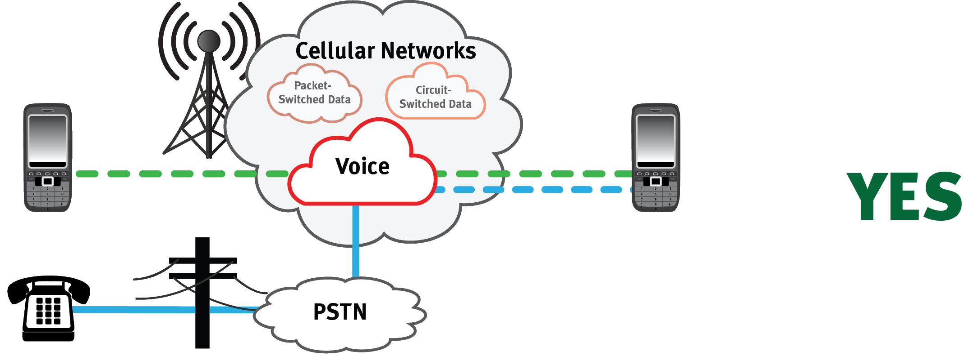
Example
Telephone Network

Slide 15
Performance Metrics
Network performance can be affected by a number of different factors.
It’s important for companies to know which network performance metrics are important to examine.

Slide 16
Performance Metrics
However, depending on the specific issues that plague your network, not every metric is going to be important for you to look at.
Despite this, there are some metrics that are essential for any businesses to consider.

Slide 17
Seven essential network performance metrics
Bandwidth usage
Throughput
Latency
Packet loss
Retransmission
Availability
Connectivity

Slide 18
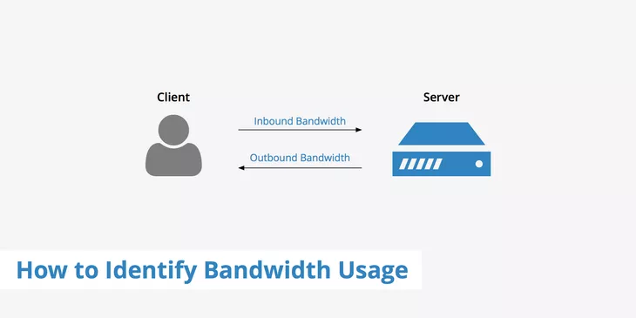
Bandwidth usage
Inbound Bandwidth
Outbound Bandwidth
How to Identify Bandwidth Usage

Slide 19
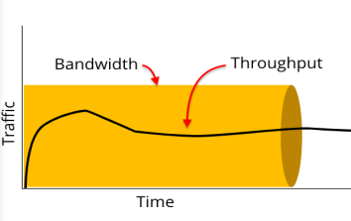
Throughput
How much data can be transferred from source to destination within a given timeframe.
Throughput measures how many packets arrive at their destinations successfully

Slide 20
Latency
Technically speaking, a network's latency is how long it takes to send data from one point on it to another.
So, the lower a network's latency, the faster it is. Latency in networks is measured in milliseconds.

Slide 21
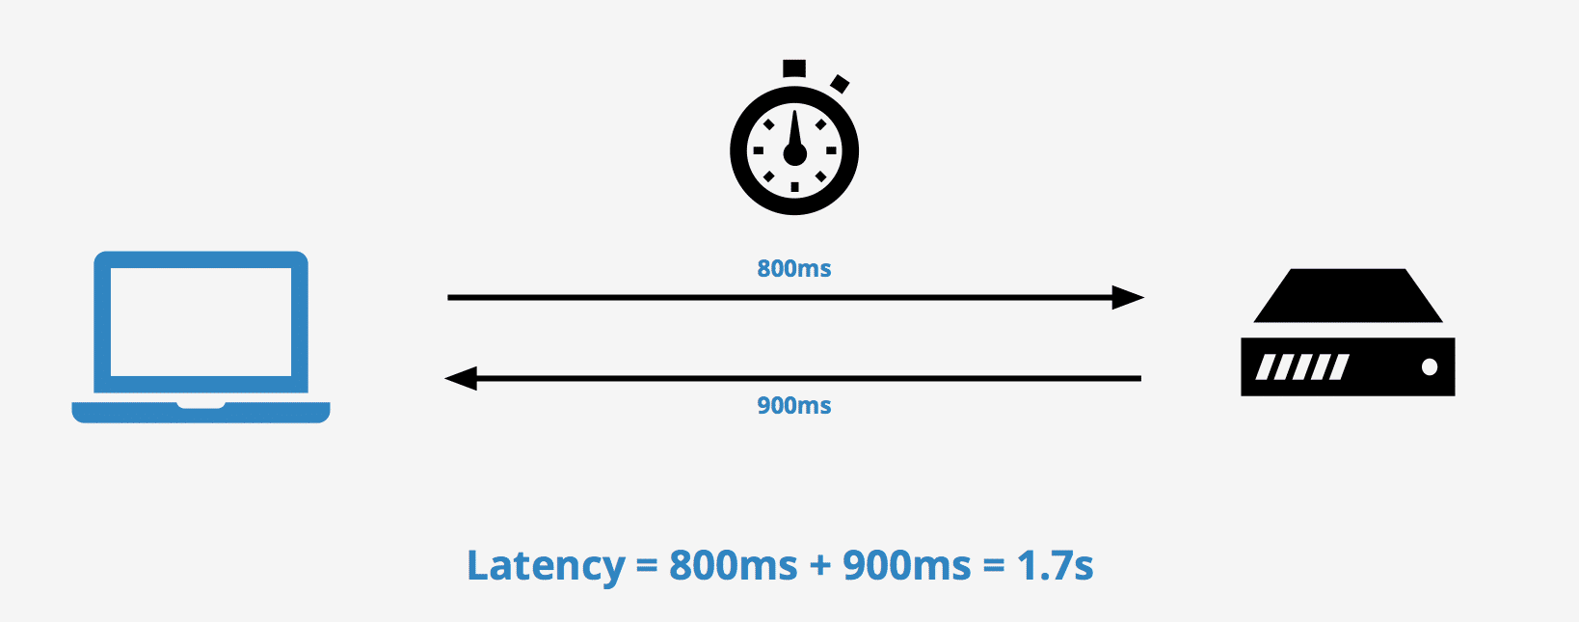
Latency
And therefore, if you need a high-speed connection you should ensure that your network has the lowest possible latency.

Slide 22
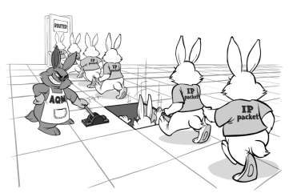
Packet Loss
Fail to reach their destination.
Packet loss is either caused by errors in data transmission, typically across wireless networks, or network congestion.

Slide 23
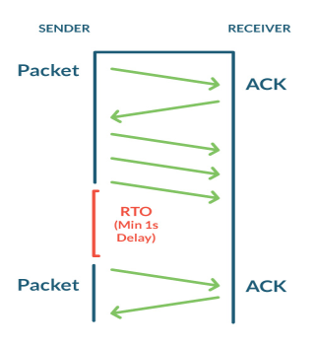
Retransmission

Slide 24
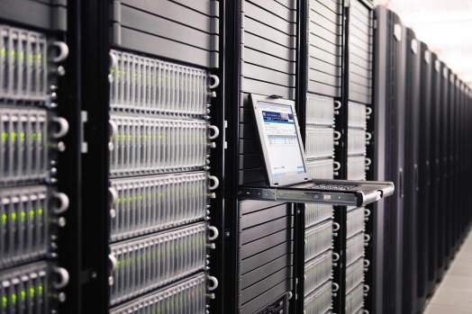
Availability

Slide 25

Connectivity

