Slide 2
After this lecture, student will be able to
represent digital data by using digital signals.
learning schemes to transmit data digitally.

Slide 3
Digital to Digital Conversion
The conversion involves three techniques:
line coding
block coding
scrambling

Slide 4
Digital to Digital Conversion
Line Coding is always needed.
Block Coding and Scrambling may or may not be needed.

Slide 5
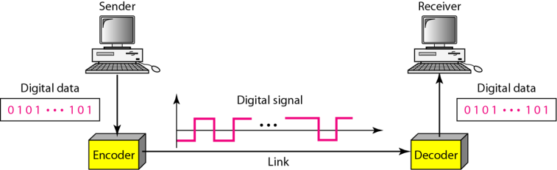
Line Coding
Converting digital data to digital signals

Slide 6
Common Characteristics
Signal element vs Data Element
Data rate vs Signal rate
Baseline Wandering
DC Components
Self-Synchronization.
Noise Interference
Error Detection
Complexity

Slide 7
Signal Element vs Data Element
A data element is the smallest entity that can represent a piece of information. This is the bit. Data elements are what we need to send.
A signal element carries data elements. Signal elements are what we can send.

Slide 8

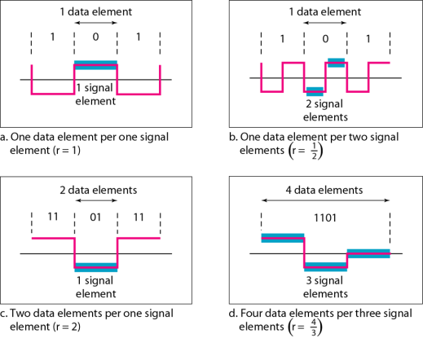

Signal Element vs Data Element
a) One data element per one signal element (r = 1)
b) One data element per two signal element $(r =(1/2))$
c) Two data element per one signal element (r = 2)
d) Four data element per three signal element (r = 4/3)

Slide 9
Data Rate vs Signal Rate
Data rate | Signal rate
The number of data elements(bits) sent in 1s. | The number of signal elements sent in 1s.
The unit is bits per second(bps). | The unit is the baud.
Also known as bit rate. | Also known as pulse rate.

Slide 10
Baseline Wandering
A receiver will evaluate the average power of the received signal (called the baseline).
If the incoming signal does not vary over a long period of time, the baseline will drift and thus cause errors in detection of incoming data elements.
A good line encoding scheme will prevent long runs of fixed amplitude.

Slide 11
DC Components
when the voltage level remains constant for long periods of time, there is an increase in the low frequencies of the signal.
Most channels are bandpass and may not support the low frequencies.
This will require the removal of the dc component of a transmitted signal.

Slide 12
Self Synchronization
The clocks at the sender and the receiver must have the same bit interval.
If the receiver clock is faster or slower, it will misinterpret the incoming bit stream.

Slide 13
Error Detection
Errors occur during transmission due to line impairments.
Some codes are constructed such that when an error occurs it can be detected.

Slide 14
Error Detection
For example,
a particular signal transition is not part of the code. When it occurs, the receiver will know that a symbol error has occurred.

Slide 15
Noise and Interference
There are line encoding techniques that make the transmitted signal “immune” to noise and interference.
This means that the signal cannot be corrupted, it is stronger than error detection.

Slide 16
Complexity
The more robust and resilient the code, the more complex it is to implement, and the price is often paid in baud rate or required bandwidth.

Slide 17
Line Coding Schemes
Unipolar
NRZ
Line Coding
Polar
NRZ, RZ and bi-phase (Manchester and differential Manchester)
Bipolar

Slide 18
Unipolar
Use single voltage to represent data.
1-high voltage is transmitted
0-low voltage is transmitted

Slide 19
Unipolar
0 | 1 | 0 | 0 | 1 | 1 | 1 | 0
Amplitude
Time

Slide 20
Polar Encoding
Uses multiple voltage to represent binary values.
It is available in 4 types: -
Polar Non-return to Zero.(NRZ)
Return to Zero(RZ)
Manchester
Differential Manchester

Slide 21
NRZ (Non-Return to Zero)
1
It has 2 level of amplitude:
NRZ-L (level Signals)
NRZ-I(Signals gets inverted)

Slide 22
NRZ-L
0 | 1 | 0 | 0 | 1 | 1 | 1 | 0
Amplitude
Time

Slide 23
NRZ-I
0 | 1 | 0 | 0 | 1 | 1 | 1 | 0
Amplitude
Time

Slide 24
Return to Zero
2
The main problem is receiver cannot conclude when a bit ended and when next bit is started, in case sender and receiver clock are not synchronized.
RZ uses 3 voltage levels
+ve volatge – 1
-ve voltage – 0
zero voltage - none

Slide 25
RZ Example
0 | 1 | 0 | 0 | 1 | 1 | 1 | 0
Amplitude
Time

Slide 26
Manchester
1
This encoding scheme is a combination of RZ and NRZ-L.
For Bit1 -> transition from –ve to +ve volts
For Bit0 -> transition from +ve to –ve volts.

Slide 27
Manchester
3
This encoding scheme is a combination of RZ and NRZ-L.
For Bit1 -> transition from –ve to +ve volts
For Bit0 -> transition from +ve to –ve volts.

Slide 28
Differential Manchester
4
Combination of RZ and NRZ-I
It also transit in the middle of the bit but change phase only when 1 is encountered.

Slide 29
Manchester
0 | 1 | 0 | 0 | 1 | 1 | 1 | 0
Amplitude
Time

Slide 30
Differential Manchester
0 | 1 | 0 | 0 | 1 | 1 | 1 | 0
Amplitude
Time

Slide 31
Problems Associated
The Manchester scheme overcomes several problems associated with NRZ-L, and differential Manchester overcomes several problems associated with NRZ-I as there is no baseline wandering and no DC component because each bit has a positive and negative voltage contribution.

Slide 32
Problems Associated
Only limitation is that the minimum bandwidth of Manchester and differential Manchester is twice that of NRZ.

Slide 33
Bipolar
It uses 3 voltage levels
+ve,
-ve
zero
Zero voltage represents binary 0 and bit 1 representing +ve and –ve volatges.

Slide 34
Bipolar
0 | 1 | 0 | 0 | 1 | 1 | 1 | 0
Amplitude
Time

