Slide 2
After this lecture, you will be able to
learn the digital to analog conversions.
understand the various modulation techniques.

Slide 3
Digital Signal
A digital signal is a signal that represents data as a sequence of discrete values
Digital Signal

Slide 4
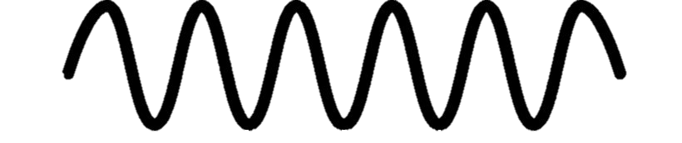
Analog Signal
An analog signal is any continuous signal.
Digital Signal

Slide 5
Techniques used for Digital to Analog Conversion
Amplitude Shift keying
Digital to Analog
Phase Shift keying
Frequency Shift keying

Slide 6
Amplitude Shift keying
Technique in which carrier signal is analog and data to be modulated is digital.
The amplitude of analog carrier signal is modified to reflect binary data.

Slide 7
Binary ASK or ON-OFF Keying
Amplitude
Bit rate: 5
0
1
0
Time
1 signal Element
1 signal Element
1 signal Element
1 signal Element
1 signal Element
1 s
Boud rate: 5

Slide 8
Example
Unipolar NRZ
1
0
1
1
0

Slide 9
Example
Unipolar NRZ
1
0
1
1
0
Cosw_{c}t
Carrier Signal

Slide 10
Example
Unipolar NRZ
1
0
1
1
0
Carrier Signal
Cosw_{c}t
Modulated Signal
Modulated Signal

Slide 11
Advantages of Amplitude Shift Keying
Transmit digital data over optical fiber.
The receiver and transmitter have a simple design
Uses lesser bandwidth

Slide 12
Disadvantages of Amplitude Shift Keying
Susceptible to noise interference
Lower power efficiency.

Slide 13
Frequency Shift keying
Frequency of analog carrier signal is modified in accordance with the message signal.

Slide 14
Frequency Shift Keying
Unipolar NRZ
1
0
1
1
0

Slide 15
Frequency Shift Keying
Unipolar NRZ
1
0
1
1
0
High Frequency Carrier Wave
CosW_{h} t

Slide 16
Frequency Shift Keying
Unipolar NRZ
1
0
1
1
0
High Frequency Carrier Wave
CosW_{h} t
Low Frequency Carrier Wave
CosW_{L} t
FSK Modulated Wave CosW_{h} t

Slide 17
Frequency Shift Keying
Unipolar NRZ
1
0
1
1
0
FSK Modulated Wave CosW_{h} t
CosW_{h} t
CosW_{l} t
CosW_{h} t
CosW_{h} t
CosW_{l} t

Slide 18
Advantages of frequency shift Keying
Help avoid the noise problems beset by ASK.
Lower chances of an error.
Provides high signal to noise ratio.
The transmitter and receiver implementations are simple.

Slide 19
Disadvantages of frequency shift Keying
Larger bandwidth as compared to ASK thus it offers less bandwidth efficiency.
It has lower power efficiency.

Slide 20
Phase Shift keying
The phase of the analog carrier signal is modified to according to the message signal.
PSK is of two types:
Binary Phase Shift Keying
Quadrature Phase Shift keying

Slide 21
Binary Phase Shift Keying
1
1
0
0
0
0
1
1
1
0
0
1
0
Unipolar NRZ
t

Slide 22
Binary Phase Shift Keying
1
1
0
0
0
0
1
1
1
0
0
1
0
Unipolar NRZ
t
Polar NRZ
+1
t
-1

Slide 23
Binary Phase Shift Keying
When we multiply polar NRZ with higher frequency we get coswt and -coswt
Polar NRZ
+1
-1
+1
-1
+1
-1
+1
-1
t
Higher Frequency
t
Cos(wt)
-Cos(wt)
Coswt
-Coswt
Coswt
-Coswt
Coswt
-Coswt

Slide 24
Take a carrier signal which is higher frequency
Binary Phase Shift Keying
Unipolar NRZ
1
1
0
0
0
0
1
1
1
0
0
1
0
t
Polar NRZ
t
Higher Frequency
t
Cos(wt+0)
Cos(wt+0)
Cos(wt+0)
Cos(wt+0)
-Cos(wt+π)
-Cos(wt+π)
-Cos(wt+π)
-Cos(wt+π)

Slide 25
Output Modulated Signal Representation
1
1
0
0
0
0
1
1
1
0
0
1
0
t
t
t
t
Modulated Signal

Slide 26
Output Modulated Signal Representation
1
1
0
0
0
0
1
1
0
1
0
0
1
0
t
t
Modulated Signal
Where, represents, phase shift from 1 → 0 represents, phase shift from 0 → 1

Slide 27
Quadrature Phase Shift keying
QPSK allows the signal to carry twice as much information as ordinary PSK using the same bandwidth.

Slide 28

Possibilities in QPSK
Four possible outcomes: -
1(+v) 0(-v)=> $π$/4
0(-v) 0(-v)=> 3$π$/4
0(-v) 1(+v)=> 5$π$/4
1(+v) 1(+v)=> 7$π$/4

Slide 29
Quadrature Phase Shift keying
1
2
3
4
5
6
7
8
9
10
11
12
13
14
15
1
1
0
0
0
0
1
1
0
1
0
0
1
0
+1
-1
t

Slide 30
Quadrature Phase Shift keying
1
2
3
4
5
6
7
8
9
10
11
12
13
14
15
1
1
0
0
0
0
1
1
0
1
0
0
1
0
+1
-1
t
bo(t)

Slide 31
Quadrature Phase Shift keying
1
2
3
4
5
6
7
8
9
10
11
12
13
14
15
1
1
0
0
0
0
1
1
0
1
0
0
1
0
+1
-1
t
bo(t)

Slide 32
Quadrature Phase Shift keying
1
2
3
4
5
6
7
8
9
10
11
12
13
14
15
1
1
0
0
0
0
1
1
0
1
0
0
1
0
+1
-1
t
bo(t)

Slide 33
Quadrature Phase Shift keying
1
2
3
4
5
6
7
8
9
10
11
12
13
14
15
1
1
0
0
0
0
1
1
0
1
0
0
1
0
+1
-1
t
bo(t)

Slide 34
Quadrature Phase Shift keying
1
2
3
4
5
6
7
8
9
10
11
12
13
14
15
1
1
0
0
0
0
1
1
0
1
0
0
1
0
+1
-1
t
bo(t)

Slide 35
Quadrature Phase Shift keying
1
2
3
4
5
6
7
8
9
10
11
12
13
14
15
1
1
0
0
0
0
1
1
0
1
0
0
1
0
+1
-1
t
bo(t)

Slide 36
Quadrature Phase Shift keying
1
2
3
4
5
6
7
8
9
10
11
12
13
14
15
1
1
0
0
0
0
1
1
0
1
0
0
1
0
+1
-1
t
bo(t)

Slide 37
Quadrature Phase Shift keying
1
2
3
4
5
6
7
8
9
10
11
12
13
14
15
1
1
0
0
0
0
1
1
0
1
0
0
1
0
+1
-1
t
bo(t)
be(t)

Slide 38
Quadrature Phase Shift keying
1
2
3
4
5
6
7
8
9
10
11
12
13
14
15
1
1
0
0
0
0
1
1
0
1
0
0
1
0
+1
-1
t
bo(t)
be(t)

Slide 39
Quadrature Phase Shift keying
1
2
3
4
5
6
7
8
9
10
11
12
13
14
15
1
1
0
0
0
0
1
1
0
1
0
0
1
0
+1
-1
t
bo(t)
be(t)

Slide 40
Quadrature Phase Shift keying
1
2
3
4
5
6
7
8
9
10
11
12
13
14
15
1
1
0
0
0
0
1
1
0
1
0
0
1
0
+1
-1
t
bo(t)
be(t)

Slide 41
Quadrature Phase Shift keying
1
2
3
4
5
6
7
8
9
10
11
12
13
14
15
1
1
0
0
0
0
1
1
0
1
0
0
1
0
+1
-1
t
bo(t)
be(t)

Slide 42
Quadrature Phase Shift keying
1
2
3
4
5
6
7
8
9
10
11
12
13
14
15
1
1
0
0
0
0
1
1
0
1
0
0
1
0
+1
-1
t
bo(t)
be(t)

Slide 43
Quadrature Phase Shift keying
1
2
3
4
5
6
7
8
9
10
11
12
13
14
15
1
1
0
0
0
0
1
1
0
1
0
0
1
0
+1
-1
t
bo(t)
be(t)

Slide 44
Quadrature Phase Shift keying
1
2
3
4
5
6
7
8
9
10
11
12
13
14
15
1
1
0
0
0
0
1
1
0
1
0
0
1
0
+1
-1
t
bo(t)
be(t)
Sinw_{c}t

Slide 45
Quadrature Phase Shift keying
1
2
3
4
5
6
7
8
9
10
11
12
13
14
15
1
1
0
0
0
0
1
1
0
1
0
0
1
0
+1
-1
t
bo(t)
be(t)
Sinw_{c}t
Cosw_{c}t

Slide 46
Output Signal
After that we will multiply bo(t) odd with Coswct and be(t) even with sinwct.
Output signal will be equal to: -
S_{t} = b_{o} (t) Cosw_{c} t+ b_{e} (t) Sin w_{c}t

Slide 47
Advantages of Phase Shift Keying
More power efficient modulation technique as compared to ASK and FSK.
Lower chances of an error.
Allows data to be carried along a communication signal much more efficiently as compared to FSK.

Slide 48
Disadvantages of phase shift Keying
Offers low bandwidth efficiency.
The detection and recovery algorithms of binary data is very complex.
It is a non coherent reference signal.

Slide 49
Analog to Analog Conversion

Slide 50
Analog to Analog Conversion
Analog-to-analog conversion, or analog modulation, is the representation of analog information by an analog signal.
An example is radio.

Slide 51
Types of Analog-to-Analog Modulation:-
Analog to analog can be represented in three ways:-
Amplitude Modulation
Frequency Modulation
Phase Modulation

Slide 52
What is Amplitude Modulation?
In order that a radio signal can carry audio or other information for broadcasting or for two-way radio communication, it must be modulated or changed in some way.

Slide 53
Amplitude Modulation
Amplitude
Base Band Signal
A_{m}
Time

Slide 54
Amplitude Modulation
Amplitude
Carrier signal
A_{c}
Time

Slide 55
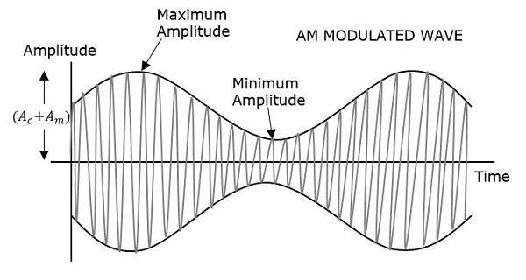
Amplitude Modulation

Slide 56
Advantages and Disadvantages of AM
Advantages | Disadvantages
It is simple to implement | It is not efficient in terms of its power usage
It can be demodulated using a circuit consisting of very few components | It is not efficient in terms of its use of bandwidth, requiring a bandwidth equal to twice that of the highest audio frequency.

Slide 57
Advantages and Disadvantages of AM
Advantages | Disadvantages
AM receivers are very cheap as no specialised components are needed. | It is prone to high levels of noise because most noise is amplitude based and obviously AM detectors are sensitive to it.

Slide 58
What is Phase Modulation?
Phase modulation, PM is sometimes used for analog transmission, but it has become the basis for modulation schemes used for carrying data.

Slide 59
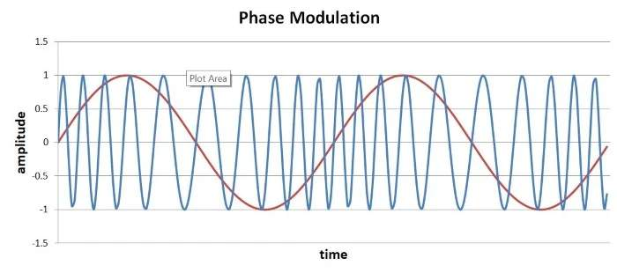
Phase modulation

Slide 60
Forms of Phase Modulation
More widely used as a digital form of modulation.
This is known as phase shift keying, PSK, and there are many flavors of this.

Slide 61
What is frequency modulation?
Frequency of the carrier wave is changes.
The frequency of the carrier wave is modified.
It cannot transmit over long distances, have a smaller range.
Its modulation index is always greater than one.
In frequency modulation amplitude and phase remain the same

Slide 62
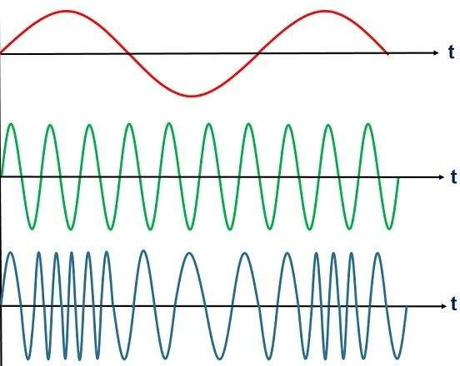
Frequency modulation

Slide 63
Difference between Amplitude and Frequency Modulation
AMPLITUDE MODULATION | FREQUENCY MODULATION
In amplitude modulation, the frequency and phase remain the same. | In frequency modulation amplitude and phase remain the same.
Its modulation index varies from 0 to 1. | Its modulation index is always greater than one.
It has only two sidebands. | It has an infinite number of sidebands.
It has simple circuit. | It has complex circuit.

Slide 64
Difference between Amplitude and Frequency Modulation
AMPLITUDE MODULATION | FREQUENCY MODULATION
The amplitude of the carrier wave is modified in order to send the data or information. | The frequency of the carrier wave is modified in order to send the data or information.
The amplitude of the carrier wave is modified in order to send the data or information. | The frequency of the carrier wave is modified in order to send the data or information.
It requires low bandwidth in the range of 10 kHz. | It requires high bandwidth in the range of 200 kHz.

Slide 65
Difference between Amplitude and Frequency Modulation
AMPLITUDE MODULATION | FREQUENCY MODULATION
It works in a frequency range of 535 to 1705 Kilohertz (KHz). | It works in a frequency range of 88 to 108 Megahertz (MHz).
It operates in the medium frequency (MF) and high frequency (HF). | It operates in the very high frequency.
It has poor sound quality. | It has better sound quality.

