Slide 2
After this lecture you will be able to
answer periodic analog signals

Slide 3
Periodic Analog Signals
Periodic analog signals can be classified as simple or composite. A simple periodic analog signal, a sine wave, cannot be decomposed into simpler signals. A composite periodic analog signal is composed of multiple sine waves.

Slide 4
Sine Wave

Slide 5
Example
The power in your house can be represented by a sine wave with a peak amplitude of 155 to 170 V. However, it is common knowledge that the voltage of the power in U.S. homes is 110 to 120 V. This discrepancy is due to the fact that these are root mean square (rms) values. The signal is squared and then the average amplitude is calculated. The peak value is equal to 2½ × rms value.

Slide 6
Example
The voltage of a battery is a constant; this constant value can be considered a sine wave, as we will see later.
For example, the peak value of an AA battery is normally 1.5 V.

Slide 7
Period and Frequency

Slide 8
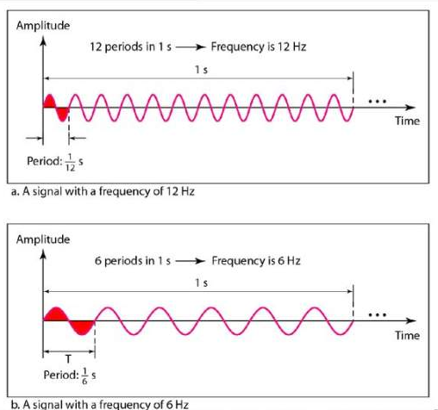
Two signals with the same amplitude and phase, but different frequencies

Slide 9
Units of period and frequency
Unit | Equivalent | Unit | Equivalent

Slide 10
Example
The power we use at home has a frequency of 60 Hz (50 Hz in Europe). The period of this sine wave can be determined.

Slide 11
Example
Express a period of 100 ms in microseconds.

Slide 12
Example
The period of a signal is 100 ms. What is its frequency in kilohertz?

Slide 13
Frequency

Slide 14
Frequency
Frequency is the rate of change with respect to time. Change in a short span of time means high frequency. Change over a long span of time means low frequency.

Slide 15
Two Extremes
What if a signal does not change at all? What if it maintains a constant voltage level for the entire time it is active? In such a case, its frequency is zero. Conceptually, this idea is a simple one. If a signal does not change at all, it never completes a cycle, so its frequency is 0 Hz.

Slide 16
Two Extremes
If a signal does not change at all, its frequency is zero.
If a signal changes instantaneously, its frequency is infinite

Slide 17
Phase
The term phase describes the position of the waveform relative to time O. If we think of the wave as something that can be shifted backward or forward along the time axis, phase describes the amount of that shift. It indicates the status of the first cycle.
Phase describes the position of the waveform relative to time O.

Slide 18
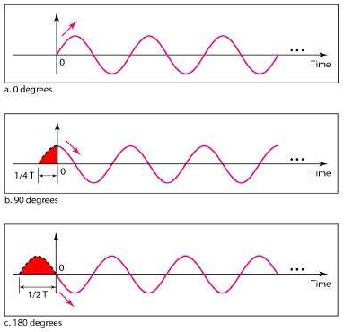
Three sine waves with the same amplitude and frequency, but different phases

Slide 19
Example
A sine wave is offset 1/6 cycle with respect to time 0. What is its phase in degrees and radians?

Slide 20
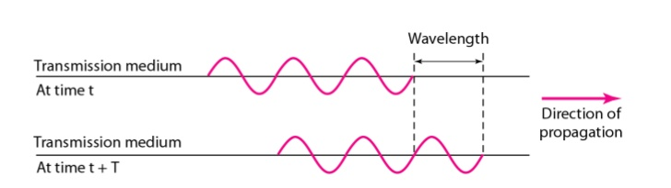
Wavelength
Wavelength is another characteristic of a signal traveling through a transmission medium. Wavelength binds the period or the frequency of a simple sine wave to the propagation speed of the medium.

Slide 21
Wavelength can be calculated
If one is given the propagation speed (the speed of light) and the period of the signal. However, since period and frequency are related to each other, if we represent wavelength by A, propagation speed by c (speed of light), and frequency by 1, we get

Slide 22
Time and Frequency Domain
A sine wave is comprehensively defined by its amplitude, frequency, and phase. We have been showing a sine wave by using what is called a time domain plot. The time-domain plot shows changes in signal amplitude with respect to time (it is an amplitude-versus-time plot). Phase is not explicitly shown on a time-domain plot.

Slide 24
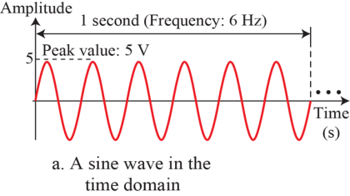
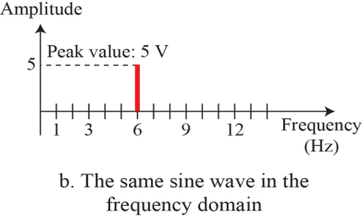
The time and frequency-domain plots of a sine wave

Slide 25
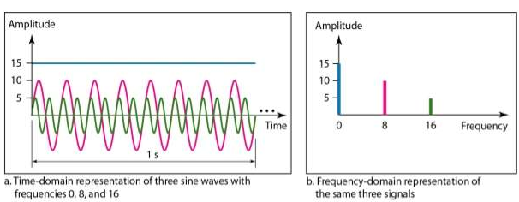
The time domain and frequency domain of three sine waves
The frequency domain is more compact and useful when we are dealing with more than one sine wave. For example, Figure shows three sine waves, each with different amplitude and frequency. All can be represented by three spikes in the frequency domain

Slide 26
Composite Signals
So far, we have focused on simple sine waves. Simple sine waves have many applications in daily life. We can send a single sine wave to carry electric energy from one place to another. For example, the power company sends a single sine wave with a frequency of 60 Hz to distribute electric energy to houses and businesses.

Slide 27
Composite Signals
As another example, we can use a single sine wave to send an alarm to a security center when a burglar opens a door or window in the house. In the first case, the sine wave is carrying energy; in the second, the sine wave is a signal of danger.

Slide 28
Composite Signal
In the early 1900s, the French mathematician Jean-Baptiste Fourier showed that any composite signal is actually a combination of simple sine waves with different frequencies, amplitudes, and phases. Fourier analysis is discussed in Appendix C; for our purposes, we just present the concept.

Slide 29
Composite Signal
A composite signal can be periodic or nonperiodic.

Slide 30
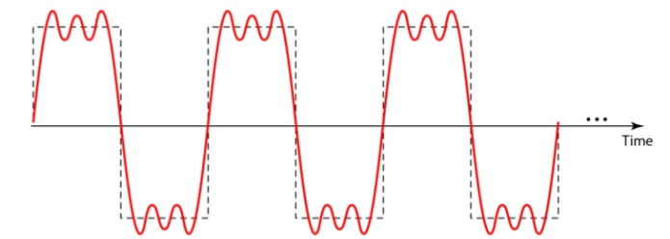
Composite Signal
It shows a periodic composite signal with frequency f

Slide 31
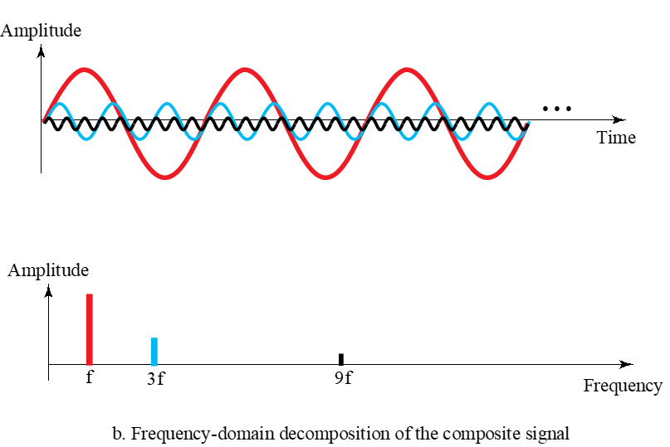
Decomposition of a composite periodic signal in the time and frequency domains

Slide 32
Decomposition of a composite periodic signal in the time and frequency domains
The frequency of the sine wave with frequency f is the same as the frequency of the composite signal; it is called the fundamental frequency, or first harmonic. The sine wave with frequency 3f has a frequency of 3 times the fundamental frequency; it is called the third harmonic. The third sine wave with frequency 9f has a frequency of 9 times the fundamental frequency; it is called the ninth harmonic.

Slide 33
Decomposition of a composite periodic signal in the time and frequency domains
Note that the frequency decomposition of the signal is discrete; it has frequencies f, 3f, and 9f Because f is an integral number, 3f and 9f are also integral numbers. There are no frequencies such as 1.2f or 2.6f. The frequency domain of a periodic composite signal is always made of discrete spikes.

Slide 34
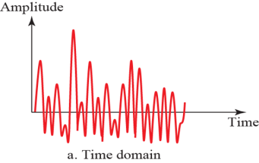
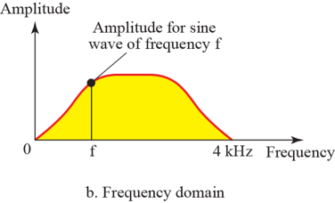
The time and frequency domains of a nonperiodic signal
This Figure shows a nonperiodic composite signal. It can be the signal created by a microphone or a telephone set when a word or two is pronounced. In this case, the composite signal cannot be periodic, because that implies that we are repeating the same word or words with exactly the same tone

Slide 35
Bandwidth
The range of frequencies contained in a composite signal is its bandwidth. The bandwidth is normally a difference between two numbers. For example, if a composite signal contains frequencies between 1000 and 5000, its bandwidth is 5000 − 1000, or 4000.

Slide 36
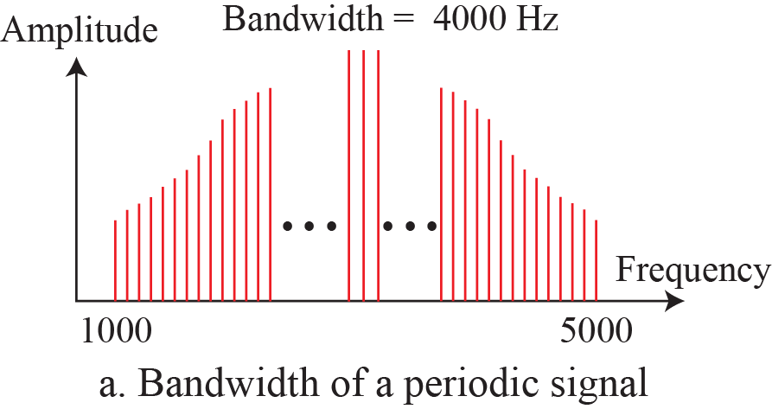
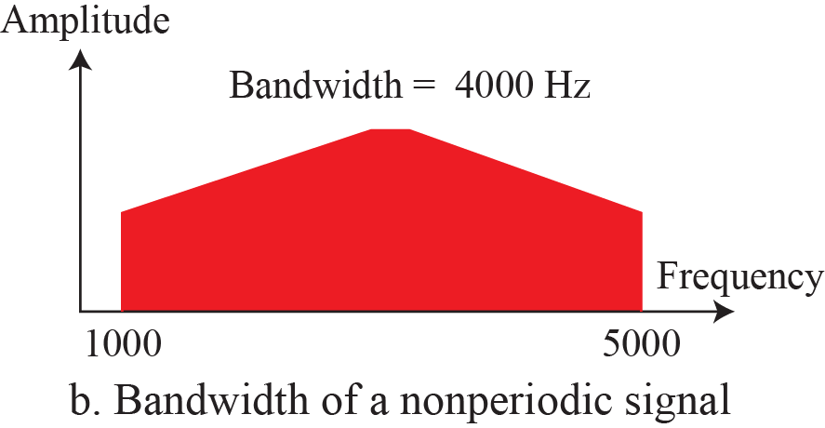
Bandwidth

Slide 37
Example
If a periodic signal is decomposed into five sine waves with frequencies of 100, 300, 500, 700, and 900 Hz, what is its bandwidth? Draw the spectrum, assuming all components have a maximum amplitude of 10 V.

Slide 38
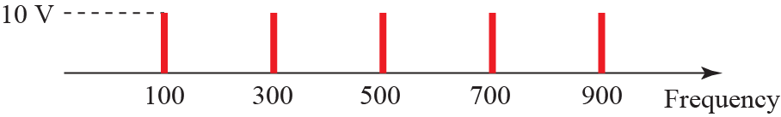

Example

Slide 39
Example
A periodic signal has a bandwidth of 20 Hz. The highest frequency is 60 Hz. What is the lowest frequency? Draw the spectrum if the signal contains all frequencies of the same amplitude.

Slide 40
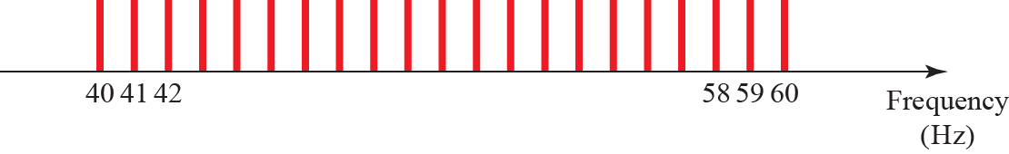
Example

Slide 41
Example
A nonperiodic composite signal has a bandwidth of 200 kHz, with a middle frequency of 140 kHz and peak amplitude of 20 V. The two extreme frequencies have an amplitude of 0. Draw the frequency domain of the signal.

