Slide 2
After this lecture you will be able to
learn the architecture of OSI model.
understand the layers of OSI model and their functions.

Slide 3
Layered Tasks
We use the concept of layers in our daily life. As an example, let us consider two friends who communicate through postal mail. The process of sending a letter to a friend would be complex if there were no services available from the post office.
Topics discussed in this section: Sender, Receiver, and Carrier Hierarchy.

Slide 4

Tasks involved in sending a letter
Sender
Reciever
The letter is written, put in an envelope, and dropped in a mailbox.
The letter is picked up, removed from the envelope; and read
Higher layers
The letter is carried from the mailbox to a post office.
The letter is carried from the post office to the mailbox
Middle layers
The letter is delivered to a carrier by the post office.
The letter is delivered from the carrier to the post office
Lower layers
The parcel is carried from the source to the destinations

Slide 5
The OSI Model
Established in 1947, the International Standards Organization (ISO) is a multinational body dedicated to worldwide agreement on international standards. An ISO standard that covers all aspects of network communications is the Open Systems Interconnection (OSI) model. It was first introduced in the late 1970s.
Topics discussed in this section: Layered Architecture, Peer-to-Peer Processes, Encapsulation.

Slide 6
OSI Model
OSI is the model
ISO is the organization

Slide 7
Seven layers of the OSI model
1
Application
2
Presentation
3
Session
4
Transport
5
Network
6
Data link
7
Physical

Slide 8
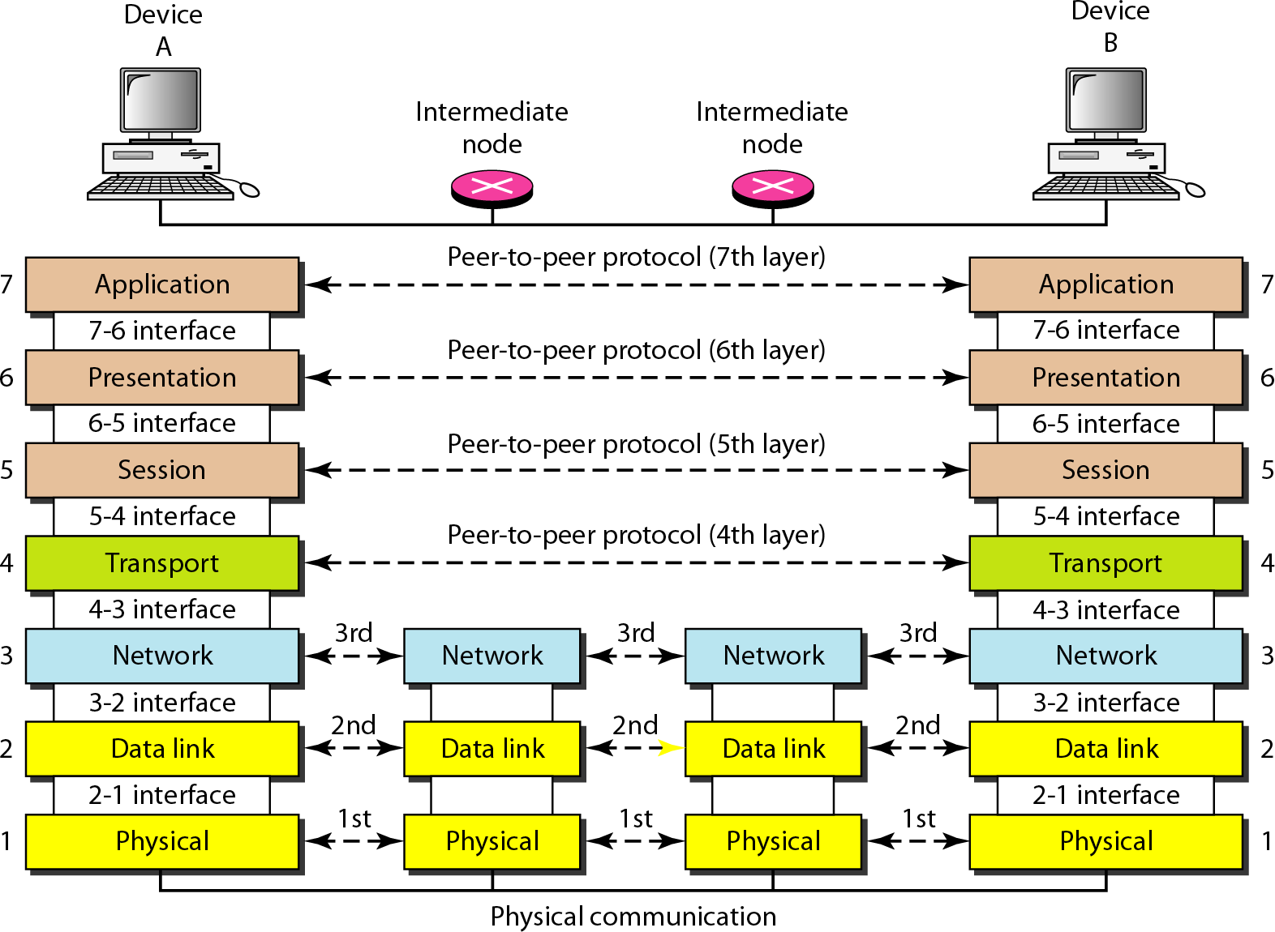
The Interaction between Layers in the OSI Model

Slide 9
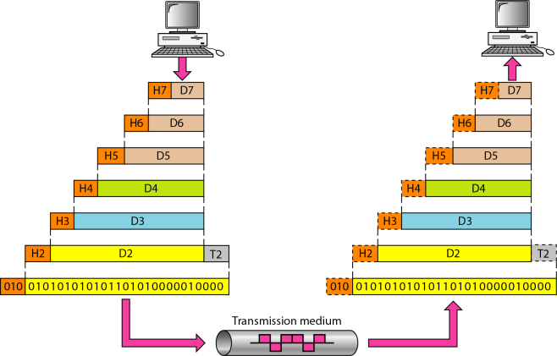
An exchange using the OSI model

Slide 10

Application Layer

Slide 11

Application Layer

Slide 12

Application Layer

Slide 13

Application Layer

Slide 14

Application Layer

Slide 15
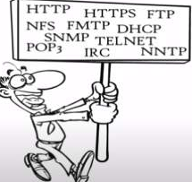
Application Layer

Slide 16
Specific Services Provided by the Application Layer
Network virtual Terminal
File transfer, access, and management.
Mail services.
Web Surfing

Slide 17
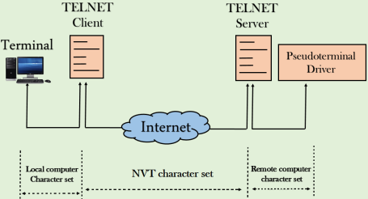
Specific Services Provided by the Application Layer
Network virtual Terminal
TELNET

Slide 18
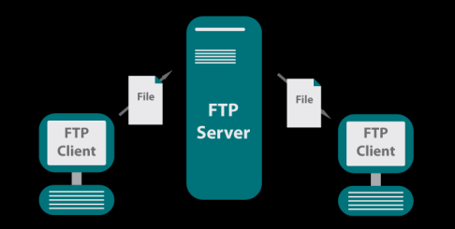
Specific Services Provided by the Application Layer
File transfer, access, and management.
FTP

Slide 19
Specific Services Provided by the Application Layer:
Mail services
SMTP
Internet
SMTP
SMTPPOP3 / IMAP
Sender’s Mail Server
Receiver’s Mail Server
Sender
Receiver

Slide 20
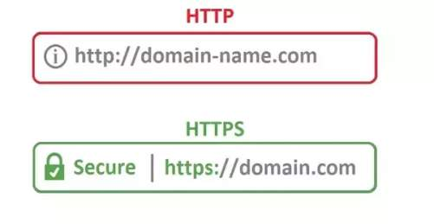

Web Surfing

Slide 21
NOTE
The application layer is responsible for providing services to the user.

Slide 22
Presentation Layer
Presentation layer
Application Layer

Slide 23
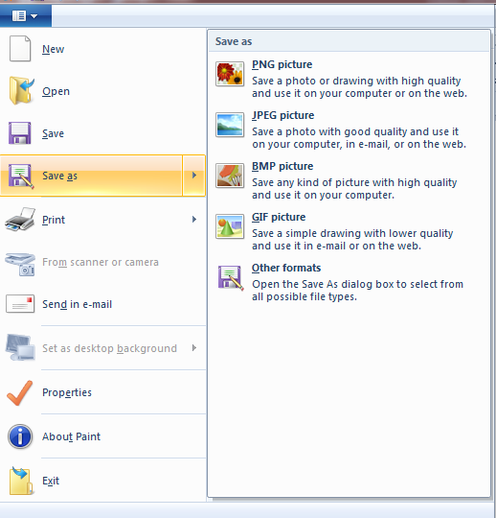
Presentation layer
What is the format of data?

Slide 24
Presentation Layer
Specific responsibilities of the presentation layer includes-
Translation
Encryption
Compression

Slide 25


Translation

Slide 26
Translation
Convert
101011100011100011000
Example conversion of ASCII to EBCDIC

Slide 27
Data compression
Presentation layer used to reduce the data before transmission that is known as Data compression.
That can be Lossy and Lossless compression.

Slide 28
Data Compression
Data Compression
Lossless Data
Compression
Lossy Data
Compression

Slide 29
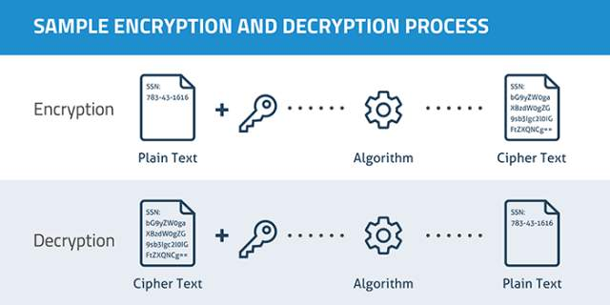
Encryption and Decryption

Slide 30
Note
The presentation layer is responsible for translation, compression, and encryption.

Slide 31
Session layer
Dialog Control
Authentication and Authorization
Session management
Synchronization

Slide 32

Session Layer
Party

Slide 33

Session Layer
Setting up

Slide 34

Session Layer
Assisting

Slide 35

Session Layer
Cleaning

Slide 36

Same case with Session Layer
Dialog control
Helping to setting up connection

Slide 37
Same case with Session Layer
APIs NETBIOS
APIs NETBIOS
Helping to setting up connection

Slide 38
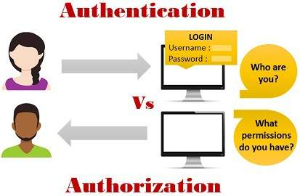
Authentication and Authorization
Authentication
Who are you?
VS
What permissions do you have?
Authorization

Slide 39

Authentication and Authorization

Slide 40
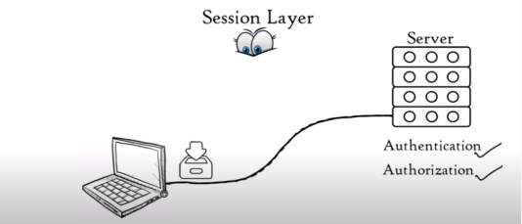
Session Management

Slide 41

Synchronization
System sending a file of 2000 pages

Slide 42

Synchronization
After 100 pages

Slide 43
Note
The session layer is responsible for dialog control and synchronization.

Slide 44
Transport layer
Segmentation and reassembly
Flow control
Error Control
Service point addressing

Slide 45
Segmentation and Reassembly
Session layer
Transport Layer

Slide 46
Segmentation and Reaasembly
Session layer
Transport Layer
Data Unit
Data Unit
Data Unit
Segments

Slide 47
Segmentation and Reassembly
Sequence no. and port number
data unit
Sequence no. and port number
data unit
Sequence no. and port number
data unit
Segments

Slide 48



Segmentation and Reassembly
Sequence no. and port number
data unit
Sequence no. and port number
data unit
Sequence no. and port number
data unit

Slide 49
Segmentation and Reassembly
Reassemble segments
Application Layer
Data
Segment 1
Segment 2
Segment 3

Slide 50


Flow Control
50Mbps
100Mbps
10Mbps

Slide 51
Error Control
Automatic repeat request
Data Unit
Data Unit
Data Unit
Missing
Data Unit
Data Unit

Slide 52
Error Control
Automatic repeat request
Data Unit
Data Unit
Checksum
Data Unit
Data Unit
Checksum
Data Unit
Data Unit
Checksum
Checksum
Corrupted

Slide 53
Protocols of Transport Layer
TCP | UDP
Connection Oriented transmission | Connectionless transmission
TCP is slower | UDP is faster
Acknowledgment | No Acknowledgment
Used where full data delivery is must | Does not matter whether we gave received all data

Slide 54
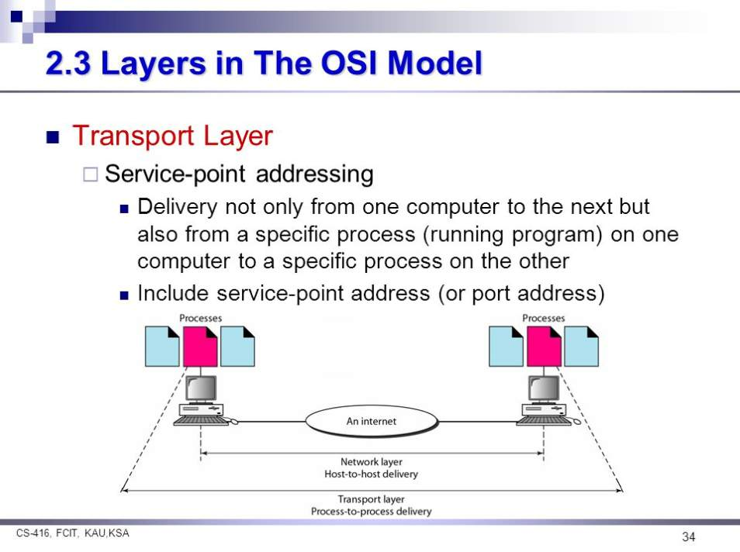
Service point addressing
Process
Process
Internet
Network layer
Host-to-host delivery
Transport layer
Process-to-process delivery

Slide 55
Note
The transport layer is responsible for the delivery of a message from one process to another.

Slide 56
Network Layer
Logical Addressing
Routing

Slide 57
Logical Addressing
Transport layer
Segments
Network Layer

Slide 58
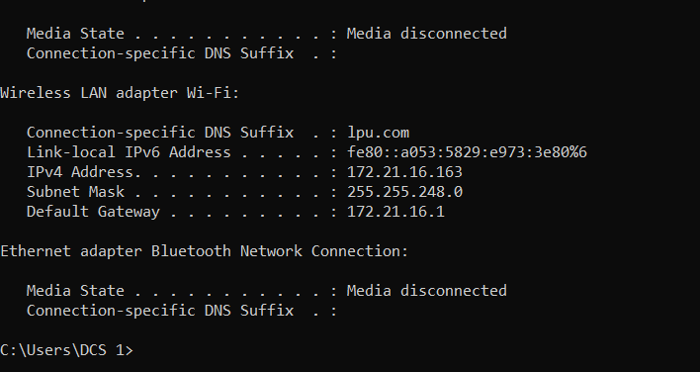
Logical Addressing
Ipconfig command

Slide 59
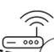
Logical Addressing
Transport Layer
Segment
Network Layer
Network 1
Packets
Network 2
Segment
IP1 IP2
IP 1
IP 2
Sender
Receiver

Slide 60
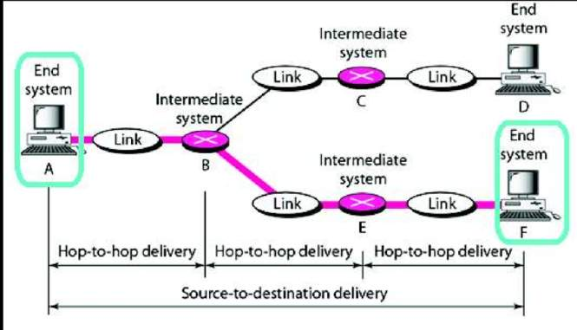
Routing

Slide 61
Note
The network layer is responsible for the delivery of individual packets from the source host to the destination host.

Slide 62
Data Link Layer
Data Link layer receives data packet from network layer. Data packets contains IP address of sender and receiver.
Network layer
Data Link Layer

Slide 63
Data Link Layer
Framing
Physical addressing
Flow control.
Error control
Access control.

Slide 64
Physical Addressing
If frames are to be distributed to different systems on the network, DataLink layer adds header to the frame.

Slide 65
Types of Addressing
Types of Addressing
Physical addressing
Logical addressing

Slide 66
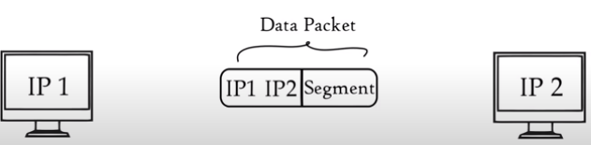
Types of Addressing
Types of Addressing
Logical Addressing | Physical addressing
Done at Network layer
Sender and receiver IP addressing are assigned to each segment to form a data packet

Slide 67
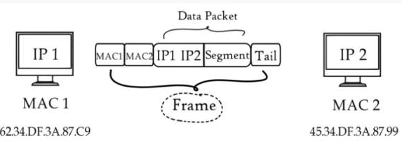
Types of Addressing
Types of Addressing
Logical Addressing | Physical addressing
Done at Network layer | Done at Data Link Layer

Slide 68
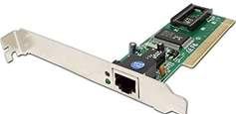
Types of Addressing
Types of Addressing
Logical Addressing | Physical addressing
Done at Network layer | Done at Data Link Layer

Slide 69
Types of Addressing
Types of Addressing
Logical Addressing | Physical addressing
Done at Network layer | Done at Data Link Layer
Network Interface card
Network Interface card

Slide 70
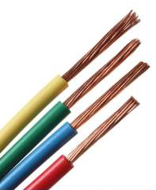
Types of Addressing
Local media includes

Slide 71

Types of Addressing
Local media includes

Slide 72
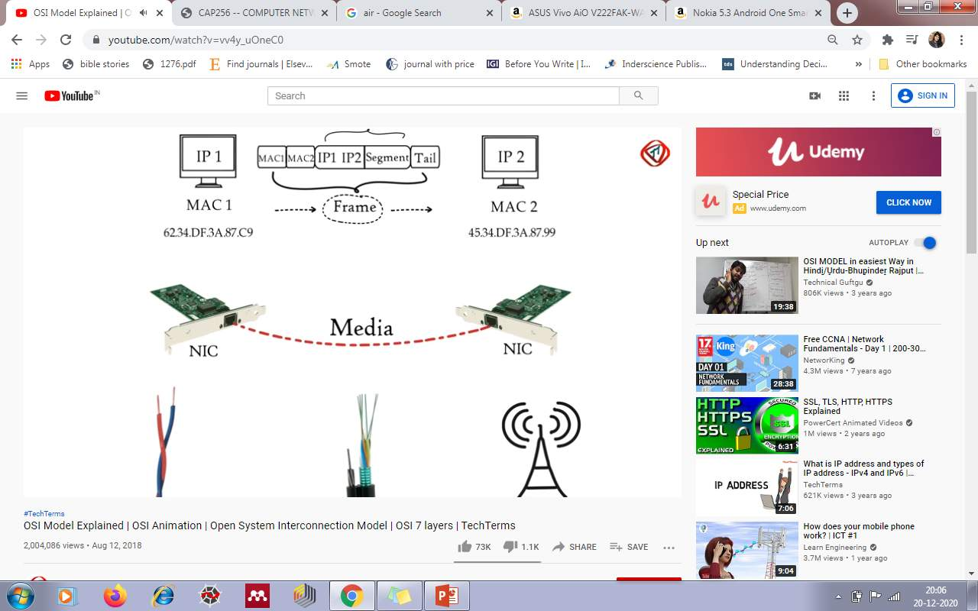
Types of Addressing
Local media includes

Slide 73
Flow Control
Data link layer imposes a flow control mechanism to avoid overwhelming the receiver.

Slide 74
Error Control
Adds reliability to the physical layer by adding mechanisms
Detect and retransmit damaged or lost frames.
Recognize duplicate frames.
Normally achieved through a trailer added to the end of the frame.

Slide 75

Access Control
Data link layer keeps an eye when shared media is Free that device can send data. This is called CSMA.

Slide 76
Note
The data link layer is responsible for moving frames from one hop (node) to the next.

Slide 77
Physical layer
Transport layer
Network layer
Data link layer
1000101010101000111000000(Bits)
Signals
Media

Slide 78
The physical layer is also concerned
Data rate
Synchronization of bits
Physical topology
Transmission mode

Slide 79
Note
The physical layer is responsible for movements of individual bits from one hop (node) to the next.

Slide 80
Summary
Application
To allow access to network resources
To translate, encrypt, and compress data
Presentation
Session
To establish, manage, and terminate sessions
To provide reliable process-to-process message delivery and error recovery
Transport
To move packets from source to destination; to provide internetworking
Network
To organize bits into frames; to provide hop-to-hop delivery
Data link
To transmit bits over a medium; to provide mechanical and electrical specifications
Physical

Slide 81
Protocol Data Unit (PDU)
Application
Presentation
Data
Session

Slide 82
Protocol Data Unit (PDU)
Application
Presentation
Data
Session
Transport
Segments

Slide 83
Protocol Data Unit (PDU)
Application
Presentation
Data
Session
Transport
Segments
Network
Packets

Slide 84
Protocol Data Unit (PDU)
Application
Presentation
Data
Session
Transport
Segments
Network
Packets
Data link
Frames

Slide 85
Protocol Data Unit (PDU)
Application
Presentation
Data
Session
Transport
Segments
Network
Packets
Data link
Frames
Physical
10101100

