Slide 2
After this lecture you will be able to
understand the architecture of TCP/IP protocol suite
differentiate between the OSI model and TCP/IP Suite.
differentiate between three types of internet addresses.

Slide 3
Why name TCP/IP?
TCP->Transmission control protocol
IP->Internet Protocol

Slide 4
Introduction
The OSI Model we just looked at is just a reference/logical model. It was designed to describe the functions of the communication system by dividing the communication procedure into smaller and simpler components.
But when we talk about the TCP/IP model, it was designed and developed by Department of Defense (DoD) in 1960s and is based on standard protocols.

Slide 5
TCP/IP Protocol Suite
The layers in the TCP/IP protocol suite do not exactly match those in the OSI model. The original TCP/IP protocol suite was defined as having four layers: host-to- network, internet, transport, and application. However, when TCP/IP is compared to OSI, we can say that the TCP/IP protocol suite is made of five layers: physical, data link, network, transport, and application.

Slide 6
First Model
Application Layer
Presentation layer
Session layer
Transport Layer
Network layer
Data link Layer
Physical
Application Layer
Transport Layer
Network layer
Data Link Layer
Physical layer

Slide 7
First Model
Application Layer
Presentation layer
Session layer
Transport Layer
Network layer
Data link Layer
Physical
Application Layer
Host-to Host Layer/Transport layer
Internet layer
Network Access layer

Slide 8
The protocol that makesup TCP/IP data define:-
How data is transmitted across a network.
How data should be formatted so other network can understand it.

Slide 9
Two key TCP/IP features support Decentralization
End Node Verification
The two end point of any data transfer are responsible for making sure it was successful- No centralized Control System.
Dynamic routing
End node can transfer data over multiple paths on the n/w chooses the best path for individual data transfer

Slide 10
TCP/IP key features
Addressing
Interoperability
Five Important issues on the network
Routing
Flow and Error Control
Name Resolution

Slide 11
TCP/IP key features
Addressing
To known MAC address if IP address is known.
or
To known IP address if MAC address is present.

Slide 12
Routing
How packet will move
Which path it will take to reach to the destination.

Slide 13
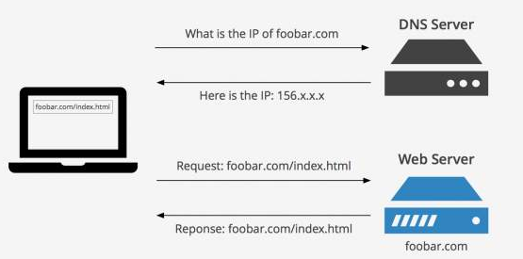
Name resolution

Slide 14
Flow and Error Control
Whatever data is moving from source to destination that must be error free.
Packet will loss due to speed. So flow control is required.
Sending data with 10MBPS SPEED
Receiving data with 2MBPS SPEED

Slide 15
Interoperability
Different protocols, different countries or different devices would also be able to communicate with one another.

Slide 16
TCP/IP and OSI model
Applications
Application
SMTP
FTP
HTTP
DNS
SNMP
TELNET
----
Presentation
Session
Transport
SCTP
TCP
UDP
Network
(Internet)
ICMP
IGMP
IP
RARP
ARP
Data link
Protocols defined by the underlying networks (host-to-network)
Physical

Slide 17
Internet protocol
IP(internetworking protocol)
Transmission mechanism used by the TCP/IP protocols.
Unreliable and connectionless .
Inform sender and receiver IP address.
Routing
Delivering packets from source to destination host

Slide 18
Internet protocol
Supports the Internetworking Protocol.
IP, in turn, uses four supporting protocols:
ARP, RARP, ICMP, and IGMP.

Slide 19
IP uses four supporting protocols
ARP
Associate a logical address with a physical address.
Reverse Address Resolution Protocol
It allows a host to discover its Internet address when it knows only its physical address.

Slide 20
IP uses four supporting protocols
Internet Control Message Protocol
Mechanism used by hosts and gateways to send notification of datagram problems back to the sender.
Internet Group Message Protocol
The Internet Group Message Protocol (IGMP) is used to facilitate the simultaneous transmission of a message to a group of recipients.

Slide 21
Network access layer
Combination of physical and data link layer.
It looks out hardware address i.e. Mac address.
Designed to be independent of the network access method, frame format and medium.
Bits.

Slide 22
Similarities and Difference between OSI and TCP/IP
It stands for Transmission Control Protocol/Internet Protocol. The TCP/IP model is a concise version of the OSI model. It contains four layers, unlike seven layers in the OSI model.

Slide 23
Similarities between OSI and TCP/IP
They share similar architecture.
They share a common application layer.
Knowledge by networking professionals.
Both models assume that packets are switched.

Slide 24
OSI VS TCP/IP
OSI model is a reference model while TCP/IP is an implementation of OSI model.

Slide 25
OSI VS TCP/IP
OSI
Application
Presentation
Session
Transport
Network
Data link
Physical
TCP/IP
Application
Transport
Network
Physical

Slide 26
OSI VS TCP/IP
All the layers from bottom till Transport Layer provides End to End Transport Service
All the layers above the Transport Layer are application oriented and use the Transport Service.

Slide 27
OSI VS TCP/IP
OSI Model | TCP/IP Model
The OSI model however is a "generic, protocol- independent standard | TCP/IP Protocols are considered to be standards around which the internet has developed.
OSI having presentation layer and session layer independently | TCP/IP combines the presentation and session layer issues into its application layer.
OSI having data link and physical layers independently | TCP/IP combines the OSI data link and physical layers into the network access layer.

Slide 28
OSI VS TCP/IP
OSI Model | TCP/IP Model
OSI appears to complex because of 7 layers | TCP/IP appears to be a more simpler model and this is mainly due to the fact that it has fewer layers.
Networks are not usually built around the OSI model as it is merely used as a guidance tool. | TCP/IP is considered to be a more credible model- This is mainly due to the fact because TCP/IP protocols are the standards around which the internet was developed therefore it mainly gains creditability due to this reason

Slide 29
OSI VS TCP/IP
OSI Model | TCP/IP Model
The OSI model is bottom to up process of network connection | TCP/IP is the top to bottom process structure for internet purpose.
OSI defines several more layers of standardized functions | TCP/IP makes no assumptions about what happens above the level of a network session
OSI model is a reference model | TCP/IP is an implementation of OSI model.

Slide 30
OSI VS TCP/IP
OSI MODEL | TCP/IP MODEL
OSI provides layer functioning and also defines functions of all the layers. | TCP/IP model is more based on protocols and protocols are not flexible with other layers.
In OSI model the transport layer guarantees the delivery of packets | In TCP/IP model the transport layer does not guarantees delivery of packets.
Follows horizontal approach | Follows vertical approach.

Slide 31
OSI VS TCP/IP
OSI Model | TCP/IP Model
OSI model defines services, interfaces and protocols very clearly and makes clear distinction between them | In TCP/IP it is not clearly separated its services, interfaces and protocols
OSI is a general model | TCP/IP model cannot be used in any other application.

Slide 32
OSI VS TCP/IP
OSI MODEL | TCP/IP MODEL
Network layer of OSI model provide both connection oriented and connectionless service. | The Network layer in TCP/IP model provides connectionless service.
It has 7 layers | It has 4 layers
Transport layer guarantees delivery of packets | Transport layer does not guarantees delivery of packets

Slide 33
OSI VS TCP/IP
OSI Model | TCP/IP Model
The protocol are better hidden and can be easily replaced as the technology changes. | It is not easy to replace the protocols
OSI truly is a general model | TCP/IP can not be used for any other application
OSI mode represents an idea | TCP/IP network model represents reality in the world,

Slide 34
Internet Addresses
Four levels of addresses are used in an internet employing the TCP/IP protocols: physical, logical, port, and specific.
Topics discussed in this
Physical Address
Logical Address
Port Address
Specific address

Slide 35
Addressing
Addresses
Physical addresses
Logical addresses
Port addresses
Specific addresses

Slide 36
Relationship of Layers and Addresses in TCP/IP
Application layer
Process
Specific addresses
Transport layer
SCTP
TCP
UDP
Port addresses
Network layer
IP and other protocols
Logical addresses
Data link layer
Underlying physical networks
Physical addresses
Physical layer

Slide 37
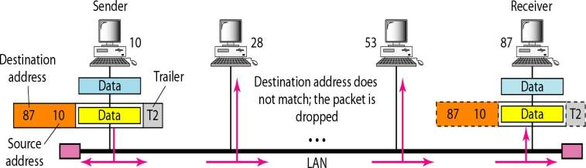
Example
In a node with physical address 10 sends a frame to a node with physical address 87. The two nodes are connected by a link (bus topology LAN). As the figure shows, the computer with physical address 10 is the sender, and the computer with physical address 87 is the receiver.

Slide 38
Example
Most local-area networks use a 48-bit (6-byte) physical address written as 12 hexadecimal digits; every byte (2 hexadecimal digits) is separated by a colon, as shown below:
07:01:02:01:2C:4B
A 6-byte (12 hexadecimal digits) physical address.

Slide 39
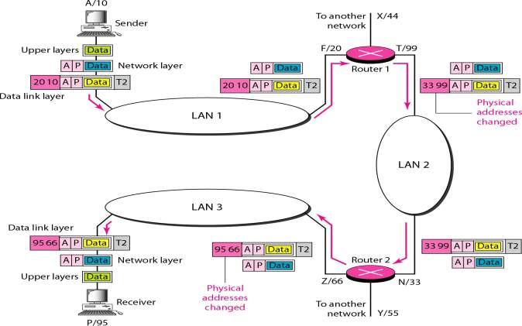
Logical Addresses

Slide 40
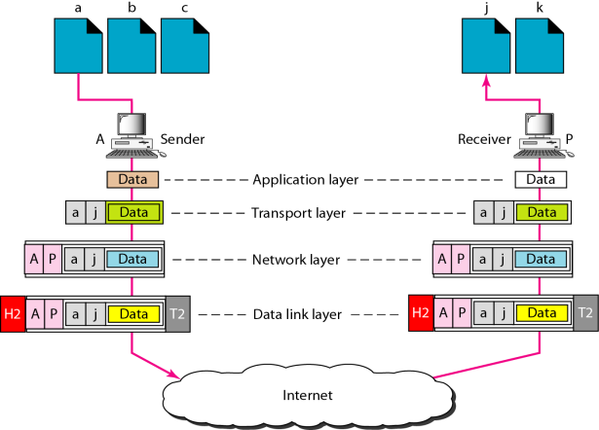
Port Addresses

Slide 41
Note
The physical addresses will change from hop to hop, but the logical addresses usually remain the same.

Slide 42
Example
a port address is a 16-bit address represented by one decimal number as shown.
753
A 16-bit port address represented as one single number

