Slide 2
After this lecture, you will be able to
learn what is transmission media.
differentiate between wired and wireless media.

Slide 3

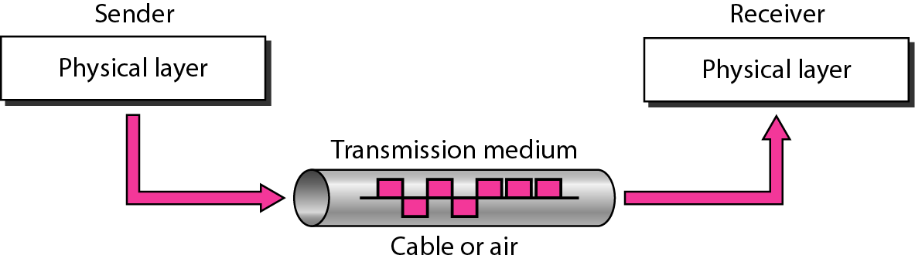
Transmission Medium
Transmission medium and physical layer

Slide 4
Classes of Transmission Media
Transmission media
Guided (wired)
Twisted-pair cable
Coaxial cable
Unguided (wireless)
Free space
Fiber-optic cable

Slide 5
Selecting Transmission Media
Transmission rate
Cost and ease of installation
Resistance to environmental condition
Distances

Slide 6
Guided Media
Wired media are the cables that are tangible or having physical existence.
Bounded transmission media
Twisted-pair cable
Coaxial cable
Fiber-optic cable

Slide 7
Why to Twist Wires ?
Noise Source
Effect of wire on parallel wires

Slide 8
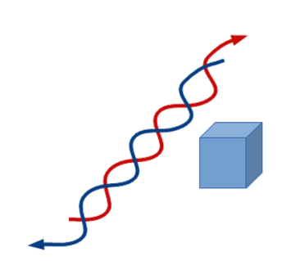
Why to Twist Wires ?
Twisted Wires
One of the wires is used to transmit data and the other is the ground reference

Slide 9
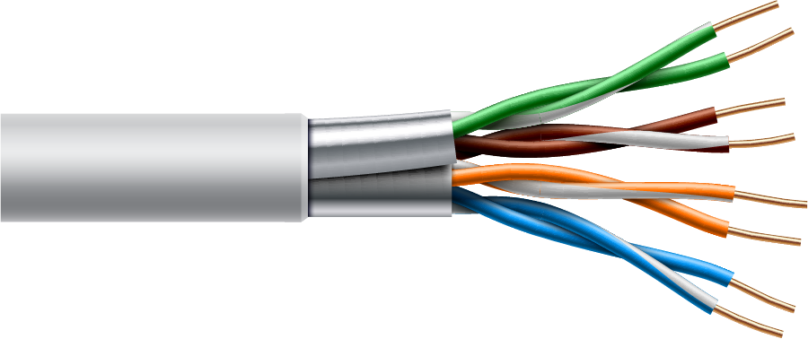
Twisted Pair Cable

Slide 10
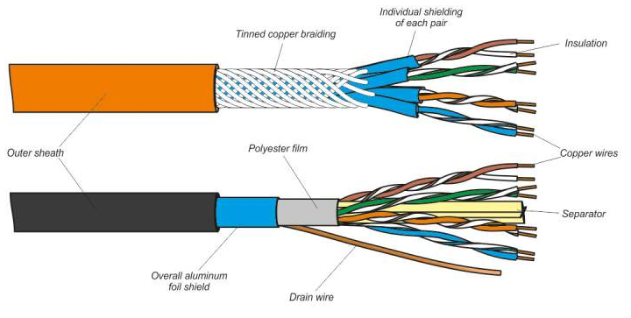
UTP and STP cables
Shielded Twisted Pair (STP) Cable
Unshielded Twisted Pair (STP) Cable

Slide 11
Category of Cables
CAT3: | Rarely used today, CAT3 is usually deployed in phone lines. It supports 10 Mbps for up to 100 meters.
CAT4 | : Typically used in token ring networks, CAT4 supports 16 Mbps for up to 100 meters
CAT5: | Used in Ethernet-based LANs, CAT5 contains two twisted pairs. It supports 100 Mbps for up to 100 meters.
CAT5e: | Used in Ethernet-based LANs, CAT5e contains four twisted pairs. It supports 1 Gbps for 100 meters.
CAT6: | Used in Ethernet-based LANs and data center networks, CAT6 contains four tightly wound twisted pairs. It supports 1 Gbps for up to 100 meters and 10 Gbps for up to 50 meters.

Slide 12
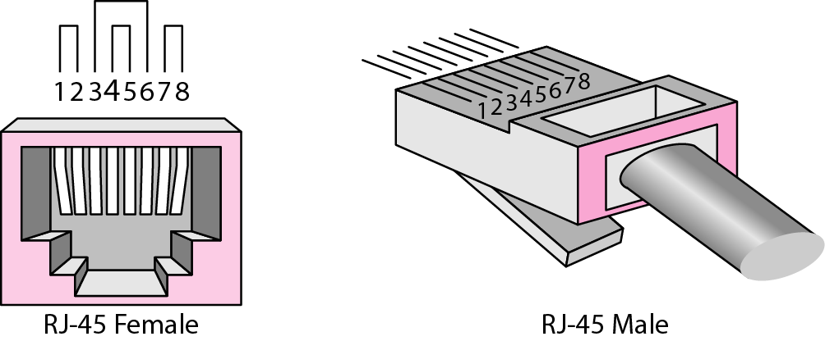
UTP connector

Slide 13
Advantages of Twisting
Reduces crosstalk
It also prevent from external form of signal interference.
Simple
Flexible
Connected
Easy to install and maintain
Low weight
Very cheap

Slide 14
Advantages of Twisting
Reduces crosstalk.
It also prevent from external form of signal interference
Simple
Flexible
Connected
Easy to install and maintain
Low weight
Very cheap

Slide 15
Advantages of Twisting
Reduces crosstalk.
It also prevent from external form of signal interference.
Simple
Flexible
Connected
Easy to install and maintain
Low weight
Very cheap

Slide 16
Advantages of Twisting
Reduces crosstalk.
It also prevent from external form of signal interference.
Simple
Flexible
Connected
Easy to install and maintain
Low weight
Very cheap

Slide 17
Advantages of Twisting
Reduces crosstalk.
It also prevent from external form of signal interference.
Simple
Flexible
Connected
Easy to install and maintain
Low weight
Very cheap

Slide 18
Advantages of Twisting
Reduces crosstalk.
It also prevent from external form of signal interference.
Simple
Flexible
Connected
Easy to install and maintain
Low weight
Very cheap

Slide 19
Advantages of Twisting
Reduces crosstalk.
It also prevent from external form of signal interference.
Simple
Flexible
Connected
Easy to install and maintain
Low weight
Very cheap

Slide 20
Advantages of Twisting
Reduces crosstalk.
It also prevent from external form of signal interference.
Simple
Flexible
Connected
Easy to install and maintain
Low weight
Very cheap

Slide 21
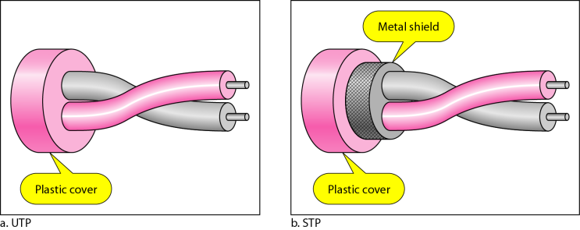
UTP and STP cables
foil
Copperwire

Slide 22
Disadvantages of Twisted Pair Cable
High attenuation(loss in signal) :carrying a signal for large distance without repeater is problem.
Low bandwidth.
Max data rate range from 1MBPS to 10 MBPS without any extra devices.

Slide 23
Disadvantages of Twisted Pair Cable
High attenuation(loss in signal) :carrying a signal for large distance without repeater is problem.
Low bandwidth.
Max data rate range from 1MBPS to 10 MBPS without any extra devices.

Slide 24
Disadvantages of Twisted Pair Cable
High attenuation(loss in signal) :carrying a signal for large distance without repeater is problem.
Low bandwidth.
Max data rate range from 1MBPS to 10 MBPS without any extra devices.

Slide 25

UTP Connector

Slide 26
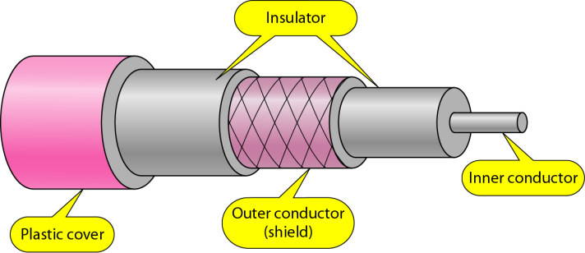
Coaxial Cable

Slide 27
Fill in the Blanks
Coaxial cables are widely used for ______________ connections and ______________________.

Slide 28
Fill in the Blanks
Coaxial cables are widely used for ______________ connections and ______________________.
Cable TV
LANs

Slide 29
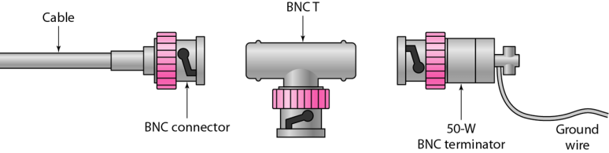
BNC Connectors

Slide 30
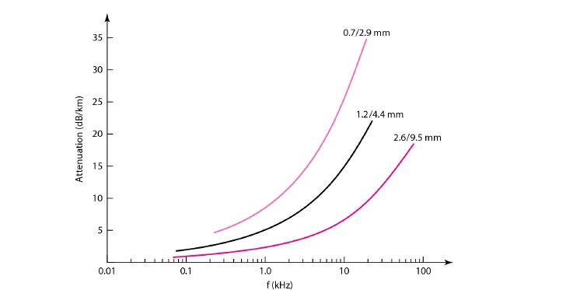
Performance of coaxial cable

Slide 31
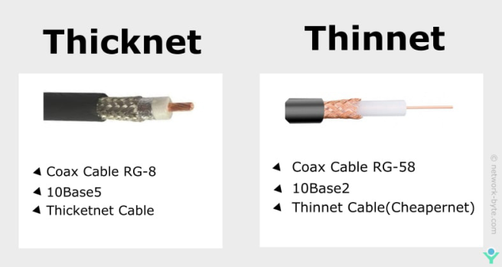
Categories of Coaxial Cables
Thicker | Thinnet
Coax Cable RG-8 10Base5 Thicknet Cable | Coax Cable RG-58 10Base2 Thinnet Cable (Cheapernet)
Category | Impedance | Use
RG-59 | 75 | Cable TV
RG-58 | 50 | Thin Ethernet
RG-11 | 50 | Thick Ethernet

Slide 32
Differences between Thicknet and Thinnet
Thicknet | Thinnet
Thicker than thinnet | Thinner
Max length 500 meters | Max length 185 meters

Slide 33
Advantages of Coaxial cable
Transmission (datarate) much better than twisted.
It can be used as shared cable n/w.
Mainly used for broadband transmission(all channels are on send simltaneously,all channels are on same wire).
High bandwidth -400mbps.

Slide 34
Disadvantages of Coaxial Cable
Expensive
Not compatible with twisted pair cable

Slide 35
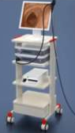
Fibre Optic Cables
Used in medical equipment

Slide 36
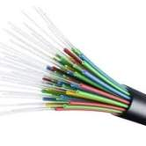
Fibre Optic Cables
Used in medical equipment
Made up of thousand of fiber strands

Slide 37
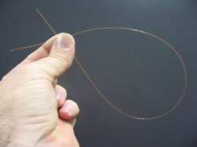
Fibre Optic Cables
Used in medical equipment
Made up of thousand of fiber strands
Single fiber strand is as thin as human hair

Slide 38
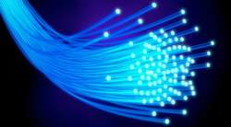
Fibre Optic Cables
Used in medical equipment
Made up of thousand of fiber strands
Single fiber strand is as thin as human hair
Carries information in the form of light

Slide 39
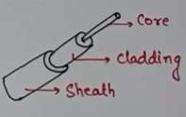
Fibre Optic Cable
It consist of inner glass core surrounded by a glass like material which has low refractive index.
Parts of fiber cable
Core
Cladding
Protective coating
It works on the concept of total internal reflection.
R.I(core) > R.I(cladding)
Angle of incidence > critical angle

Slide 40
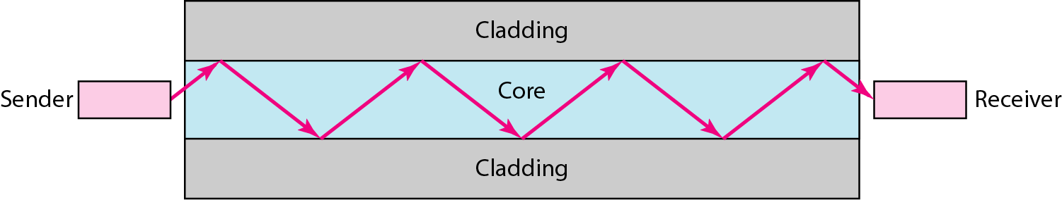
Fibre Optic Cable

Slide 41
Types of Fiber Optic Cable
Single node: max length 2 km
Multi node

Slide 42
Advantages
It is immune to electrical/mechanical interface.
Highly suitable for harsh environment
Secure transmission
Used for broadband transmission.

Slide 43
Disadvantages
Installation is difficult(glass is very fragile)
Connecting two fibers is difficult.
Connection loss
Most expensive

Slide 44
Fiber optics: Bending of light ray
Lets understand the fundamental behavior of light to understand the working of fiber optics
Medium Glass
Notes:
Refraction: When light pass from one medium to another then it ray of light deviate from path change it is called refraction.
Less dense medium is air and more dense medium is water.
In Dia1 light paases from more dense to less dense then it will deviate when it moves to less dense.
When value of Angle of incidence increase than critical then in 3rd diag gives tiR.
Core refractive index=1.52
Cladding refractive index = 1.48

Slide 45
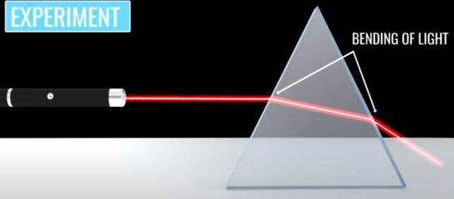
Fiber optic cable
Refraction: light passes through a prism. Lights gets bend instead of going straight. This known as refraction. N_{air} > N_{glass}

Slide 46

Fiber optic cable
Refraction is the reason pencil looks bend in the glass of water. This simple technique is used in fiber optic cable.

Slide 47
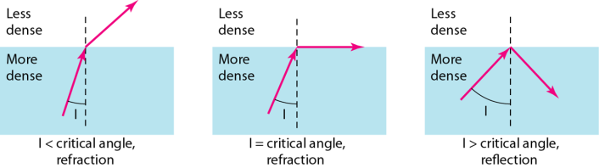
Fiber optics: Bending of light ray

Slide 48
Optical Fiber

Slide 49
Propagation Modes
Mode
Multi mode
Step index
Graded index
Single mode

Slide 50
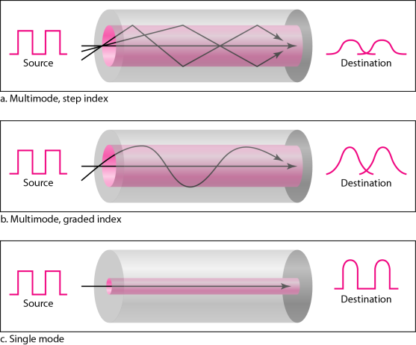
Modes
Multimode, Step Index
Multimode, Graded Index
Singlemode

Slide 51
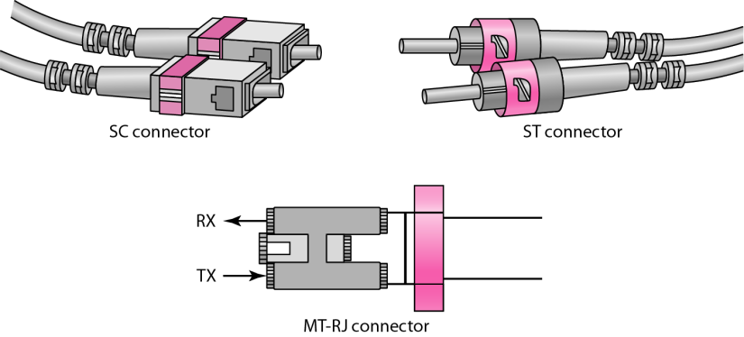
Fiber-optic Cable Connectors

Slide 52
Unguided Media: Wireless
Unguided media transport electromagnetic waves without using a physical conductor. This type of communication is often referred to as wireless communication.
Types of unguided media: -
Radio Waves
Microwaves
Infrared

Slide 53
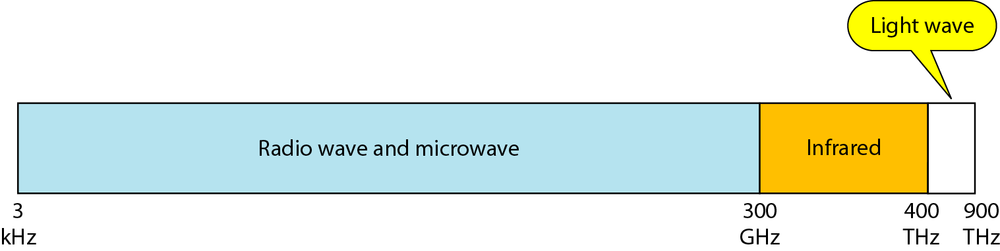
Electromagnetic Spectrum for Wireless Communication

Slide 54
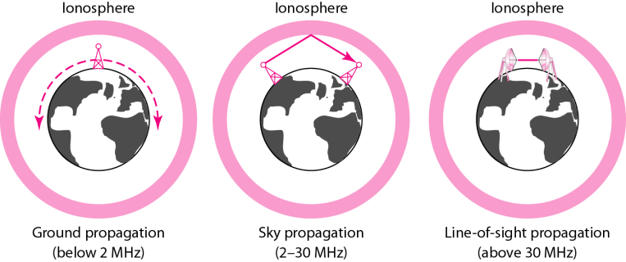
Propagation Methods

Slide 55
Wireless Transmission Waves
Wireless Transmission
Radio wave
Microwave
Infrared

Slide 56

Radio Wave
Radio waves are used for multicast communications, such as radio and television, and paging systems. They can penetrate through walls.
Highly regulated. Use omni directional antennas.

Slide 57
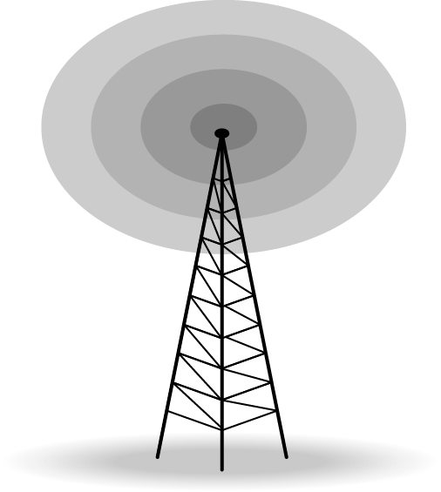
Omnidirectional Antenna

Slide 58
Advantages of Radio Wave
Inexpensive mode of information exchange.
No land needs to be acquired for laying cables.
Installation and maintenance of devices is cheap.

Slide 59
Disadvantages of Radio Wave
Insecure communication medium
Prone to weather changes like rain, thunderstorms, etc.

Slide 60
MicroWave
Microwaves are used for unicast communication such as cellular telephones, satellite networks, and wireless LANs.
Higher frequency ranges cannot penetrate walls.
Use directional antennas - point to point line of sight communications.

Slide 61
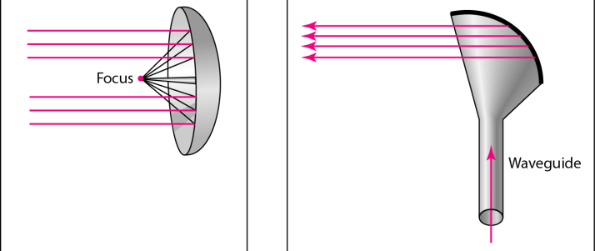
Unidirectional Antennas
Dish Antenna
Horn Antenna

Slide 62
Drawbacks
They cannot pass through microwave buildings.
Bad weather influences signal transmission.
They are frequency dependent.

Slide 63
Infrared Signals
Infrared signals can be used for short-range communication in a closed area using line-of-sight propagation.

Slide 64
Infrared Signals
Infrared signals can be used for short-range communication in a closed area using line-of-sight propagation.
Infrared communication is unreliable outside the building because the sun rays will interfere with the infrared waves.
Infrared waves cannot penetrate the walls.

