Slide 2
After this lecture, you will be able to
learn different types of switching techniques along with their advantages and disadvantages.
differentiate between virtual circuit and datagram.

Slide 3
Switching Techniques
In large networks, there can be multiple paths from sender to receiver.
This technique will decide the best route for data transmission.
It is used to connect the systems for making one-to-one communication.

Slide 4
Switching Methods
The two broad level switching methods are:
Switching Methods
Connection-oriented Switching
Connectionless Switching

Slide 5
Classification of Switching Techniques
Switching Techniques
Circuit switching
Packet switching
Message switching

Slide 6
Circuit Switching
Dedicated path
A circuit is established to transfer the data.
Circuits may be permanent or temporary.

Slide 7
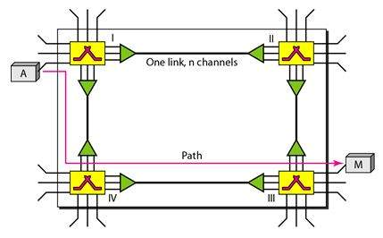
A Trivial Circuit-Switched Network
Each link is divided into n (n is 3 in this figure) channels by using FDM or TDM.
Trivial circuit-switched network with four switches and four links.

Slide 8
Different Phases in Circuit Switching
Applications that use circuit switching may have to go through three phases:-
Establishing a circuit.
Transferring the data.
Disconnecting the circuit.

Slide 9
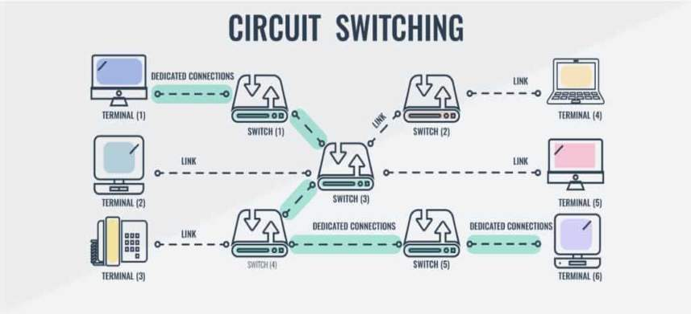
Different Phases in Circuit Switching
Dedicated connections
Link
Link
Link
Terminal (1)
Switch (1)
Switch (2)
Terminal (4)
Link
Link
Switch (3)
Terminal (2)
Terminal (5)
Dedicated connections
Dedicated connections
Link
Terminal (3)
Switch (4)
Switch (5)
Terminal (6)

Slide 10
Circuit Switching
In circuit switching, the resources need to be reserved during the setup phase; the resources remain dedicated for the entire duration of data transfer until the teardown phase.

Slide 11
Fill in the Blanks
Circuit switching was designed for _________________ applications.
The best suitable example of circuit switching is ______________________.
The connection is established using _____________ path.
Circuit switching takes place at the __________ layer.

Slide 12
Fill in the Blanks
Circuit switching was designed for voice applications.
The best suitable example of circuit switching is telephone.
The connection is established using Dedicated path.
Circuit switching takes place at the physical layer.

Slide 13
Circuit Switching
Efficiency
Not as efficient as the other two types of networks
Delay
Low efficiency
The delay in this type of network is minimal.
No waiting time at each switch.
Total delay is due to the time needed to create the connection, transfer data, and disconnect the circuit.

Slide 14
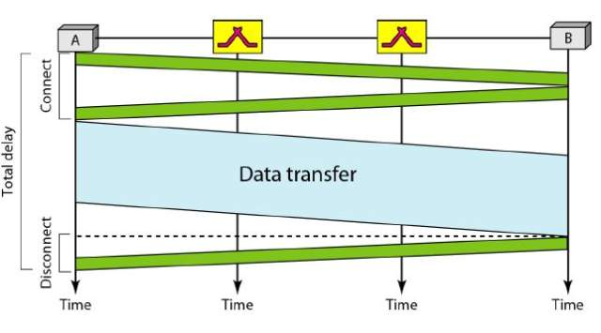
Circuit Switching
Delay in circuit switched network.

Slide 15
Advantages of Circuit Switching
Establishment of a dedicated channel
Improves data transmission rate
Improves data loss
Improves delay in the data flow

Slide 16
Disadvantages of Circuit Switching
The waiting time lasts long, and there is no data transfer.
Each connection has a dedicated path, and this gets expensive.
When connected systems do not use the channel, it is kept idle.

Slide 17
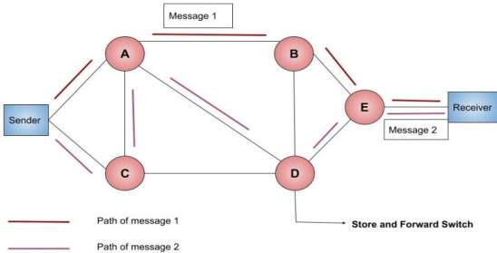
Message Switching
Whole message is treated as a data unit.
Receives the whole message and buffers it .
Stored and forwarded technique

Slide 18
Advantages of Message Switching
Stores the message when the next node is not available
Reduces traffic congestion.
Data channels are shared by network devices.
Manages traffic efficiently by assigning priorities.

Slide 19
Drawbacks of Message Switching
Transit path needs enough storage.
Message switching is very slow.
Message switching was not a solution for streaming media and real-time applications.

Slide 20
Fill in the Blanks
The whole message is treated as a ____________.
First receives the whole message and _________ it.
Message switching technique is also called _____________________ technique.

Slide 21
Fill in the Blanks
The whole message is treated as a data unit.
First receives the whole message and buffer it.
Message switching technique is also called Store and forward technique.

Slide 22
Packet Switching
Message is broken down into smaller chunks called Packets.
Packets of fixed or variable size.
The header of each packet contains the switching information .
Header
Source Node
Destination Node
Intermediate Node

Slide 23
Modes of Packet Switching
No resource allocation for a packet.
Resources are allocated on demand.
First come, first-served basis.
Packet Switching
Connectionless Switching
Connection-oriented Switching

Slide 24
Two Basic Forms of Packet Switching
Packets handled in two ways
Datagram networks
Virtual circuit

Slide 25
Datagram Networks
Each packet treated independently
Packets can take any practical route
Packets may arrive out of order
Packets may get lost or delayed
Up to receiver to re-order packets and recover from missing packets

Slide 26
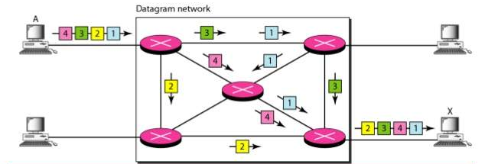
Datagram Example
The datagram networks are sometimes referred to as connectionless networks. The term connectionless here means that the switch (packet switch) does not keep information about the connection state.

Slide 27
Datagram Networks
Routing Table
Each switch (or packet switch) has a routing table which is based on the destination address.
Routing tables are dynamic and are updated periodically.
Destination addresses and the corresponding forwarding output ports are recorded in the tables.

Slide 28
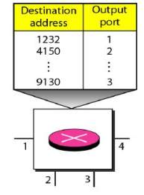
Datagram Networking
Routing table in a datagram network
The destination address in the header of a packet in a datagram network remains the same during the entire journey of the packet

Slide 29
Datagram Networks
Efficiency
Better than that of a circuit-switched network.
Resources are allocated only when there are packets to be transferred.

Slide 30
Datagram Network
Delay

Slide 31
Virtual Circuit
Preplanned route established before any packets sent
Call request and call accept packets establish connection (handshake)
Each packet contains a virtual circuit identifier instead of destination address

Slide 32
Virtual Circuit
No routing decisions required for each packet
Clear request to drop circuit
Not a dedicated

Slide 33
Working of Virtual Circuit
Nodes
Sender
Receiver
A
1
2
A
Call accept
Data Transfer
ack
Clear

Slide 34
Advantages of Virtual Circuit
Packets are delivered to the receiver in the same order sent by the sender.
Virtual circuit is a reliable network circuit.
There is no need for overhead in each packet.
Single global packet overhead is used in virtual circuit.

Slide 35
Disadvantages of Virtual Circuit
Virtual circuit is costly to implement.
It provides only connection-oriented service.
Always a new connection set up is required for transmission.

Slide 36
Difference Between Datagram Switching and Virtual Circuit
Datagram switching | Virtual circuit switching
Connectionless | Connection-oriented
No reservations | Reservations
Out of order | Same order
High overhead | Less overhead
Packet loss | Packet Lost
Cost | Cost
Delay | Delay

