Slide 2
After this lecture, you would be able to
learn about the various networking devices.
understand the working and functionality of various networking devices.

Slide 3
Introduction
Hardware devices that are used to connect computers, printers, fax machines and other electronic devices to a network are called network devices.
These devices transfer data in a fast, secure and correct way over same or different networks.

Slide 4
Uses of Networking Devices
Organizing a network
Connecting to a network
Routing the packets
Strengthening the signals
Communicating with others
Surfing the web
Sharing files on the network

Slide 5
Types of Networking Devices
1. Modem
2. Hub
3. Switch
4. Router
5. NIC
6. Repeater
7. Bridge
8. Gateway

Slide 6
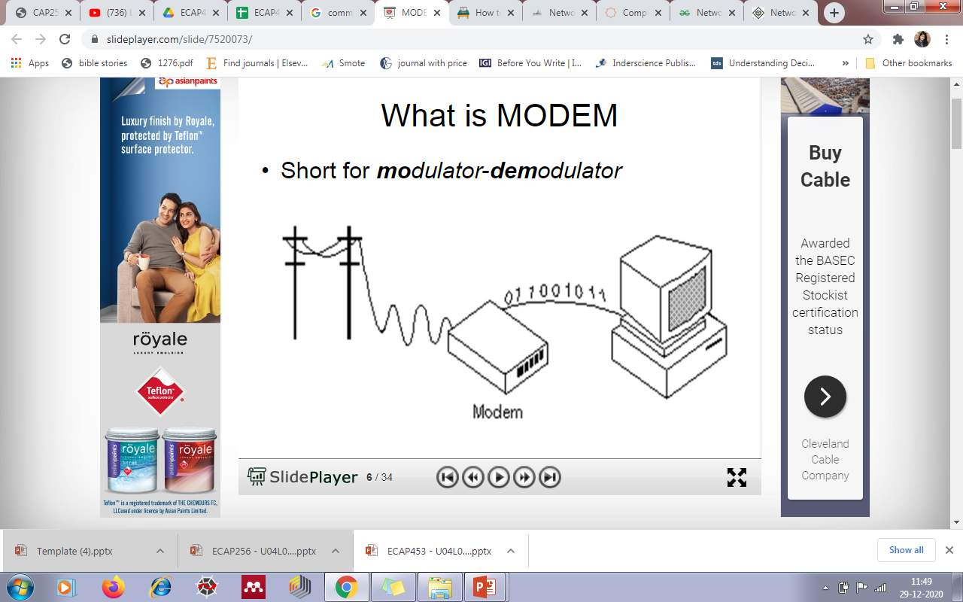
What is Modem?
Short for Modulator and Demodulator.

Slide 7
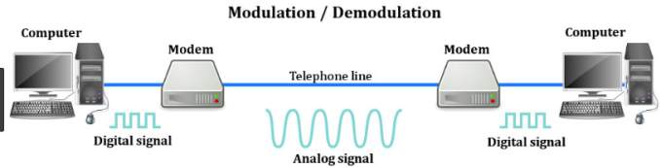
Modem
Modem is a device that converts digital signal to analog signal as a modulator and analog signal to digital signal as a demodulator.

Slide 8
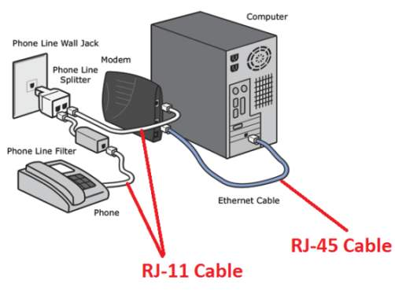
Modem
Communicate over telephone lines

Slide 9
Modem
Ques: How fast the modem can transfer and receive the data?
At Slow Speeds, modems are measured in baud rate.
At Higher Speeds, modems are measured in bits per second .
Higher the speed, the faster you can send and receive data over the network.

Slide 10
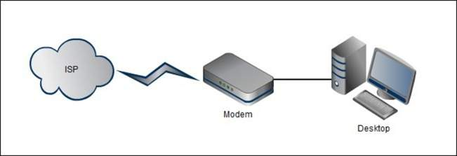
Modem
Used to connect computer to the internet

Slide 11
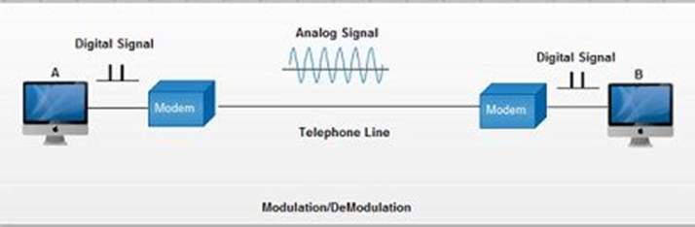
Modem
Working of MODEM

Slide 12
Modem
Working of MODEM
Consider a communication between two computers A and B.
Computer A transmits the digital signals to its modem in the form of binary 0's and 1's.

Slide 13
Modem
Working of MODEM
Modem of computer A converts these digital signals it into analog signals and sends over the telephone line. This process is called as modulator.
While at the other end, modem of computer B receives the analog signals and converts back into digital signals. This process is called as demodulator

Slide 14
Which Layer Modem Works in OSI Model?

Slide 15
Which Layer Modem Works in OSI Model?
Modem works at Physical Layer of the OSI model

Slide 16
Fill in the blanks
Modem is a device that converts digital signal to analog signal as a ____________.
Modem is a device that converts analog signal to digital signal as a ______________.
Modem works at the _____________ of the OSI model.
Speed of modem is measured in _____________.

Slide 17
Fill in the Blanks
Modem is a device that converts digital signal to analog signal as a modulator.
Modem is a device that converts analog signal to digital signal as a demodulator.
Modem works at the physical layer of the OSI model
Speed of modem is measured in bits per second.

Slide 18
Hub
Definition
Hub is a connecting device in which various types of cables are connected to centralize network traffic through a single connecting point.

Slide 19
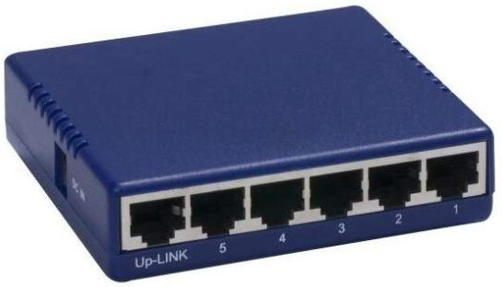
Hub
Working of Hub

Slide 20
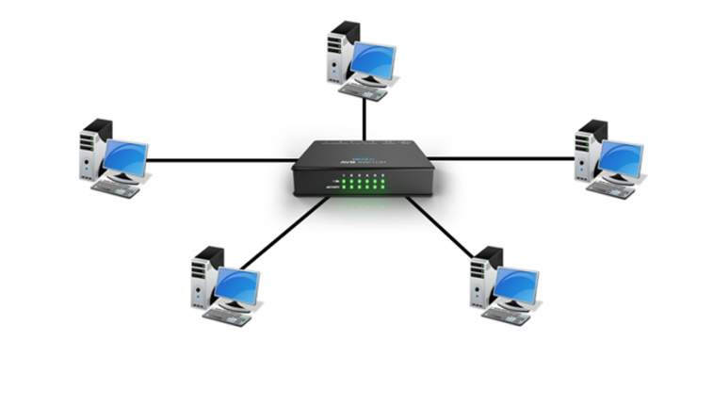
Hub
Central controller
B
A
C
E
D

Slide 21
Hub
When you want to send data from A to C
B
A
C
E
D

Slide 22
Hub
When you want to send data from A to C.
B
A
C
E
D

Slide 23
Hub
B
A
C
E
D

Slide 24
Hub
B
✓
A
C
E
D

Slide 25
Hub
B
ACK
A
C
E
D

Slide 26
Hub
B
✓
A
C
E
D

Slide 27
Hub
Hub with multiple ports are used to connect topologies, segments of LAN and to monitor network traffic.
It manages and controls the send and received data to and from the computers.
To avoid collision of data CSMA/CD protocol is used and protocol varies depending upon the vendor.

Slide 28
Hub
Types of Hub
Active Hub
Passive Hub
Intelligent Hub

Slide 29
Active Hub
These are the hubs which have their own power supply and can clean, boost, and relay the signal along with the network. It serves both as a repeater as well as wiring centre. These are used to extend the maximum distance between nodes.
It also works same as the passive Hub works. But before forwarding the data signals, it amplifies them. Due to this added feature, the active Hub is also known as the repeater.

Slide 30
Passive Hub
These are the hubs which collect wiring from nodes and power supply from active hub. These hubs relay signals onto the network without cleaning and boosting them and can’t be used to extend the distance between nodes.
It forwards data signals in the same format in which it receives them. It does not change the data signal in any manner.

Slide 31
Intelligent Hub
It work like active hubs and include remote management capabilities. They also provide flexible data rates to network devices. It also enables an administrator to monitor the traffic passing through the hub and to configure each port in the hub.

Slide 32
Which Layer Hub Operates?
Hub works on the physical layer of OSI or TCP/IP model.

Slide 33
Switch
Switch is a multiple LAN connecting device, which takes incoming data packet from any multiple input ports and passes the data packet to specific output port.
Switch is an intelligent device

Slide 34
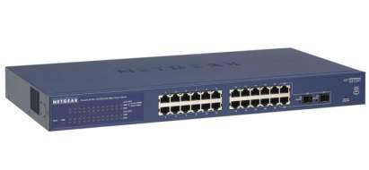
Switch
SWITCH TABLE
PORT | DEVICE | MAC ADDRESS
1 | DETECTED | 00-04-5A-63-AI-66
2 | DETECTED | 90-02-7B-C2-C0-67
3 | DETECTED | 32-07-9A-A2-00
4 | DETECTED | 72-00-FA-63-A9-66
Physical Addresses

Slide 35
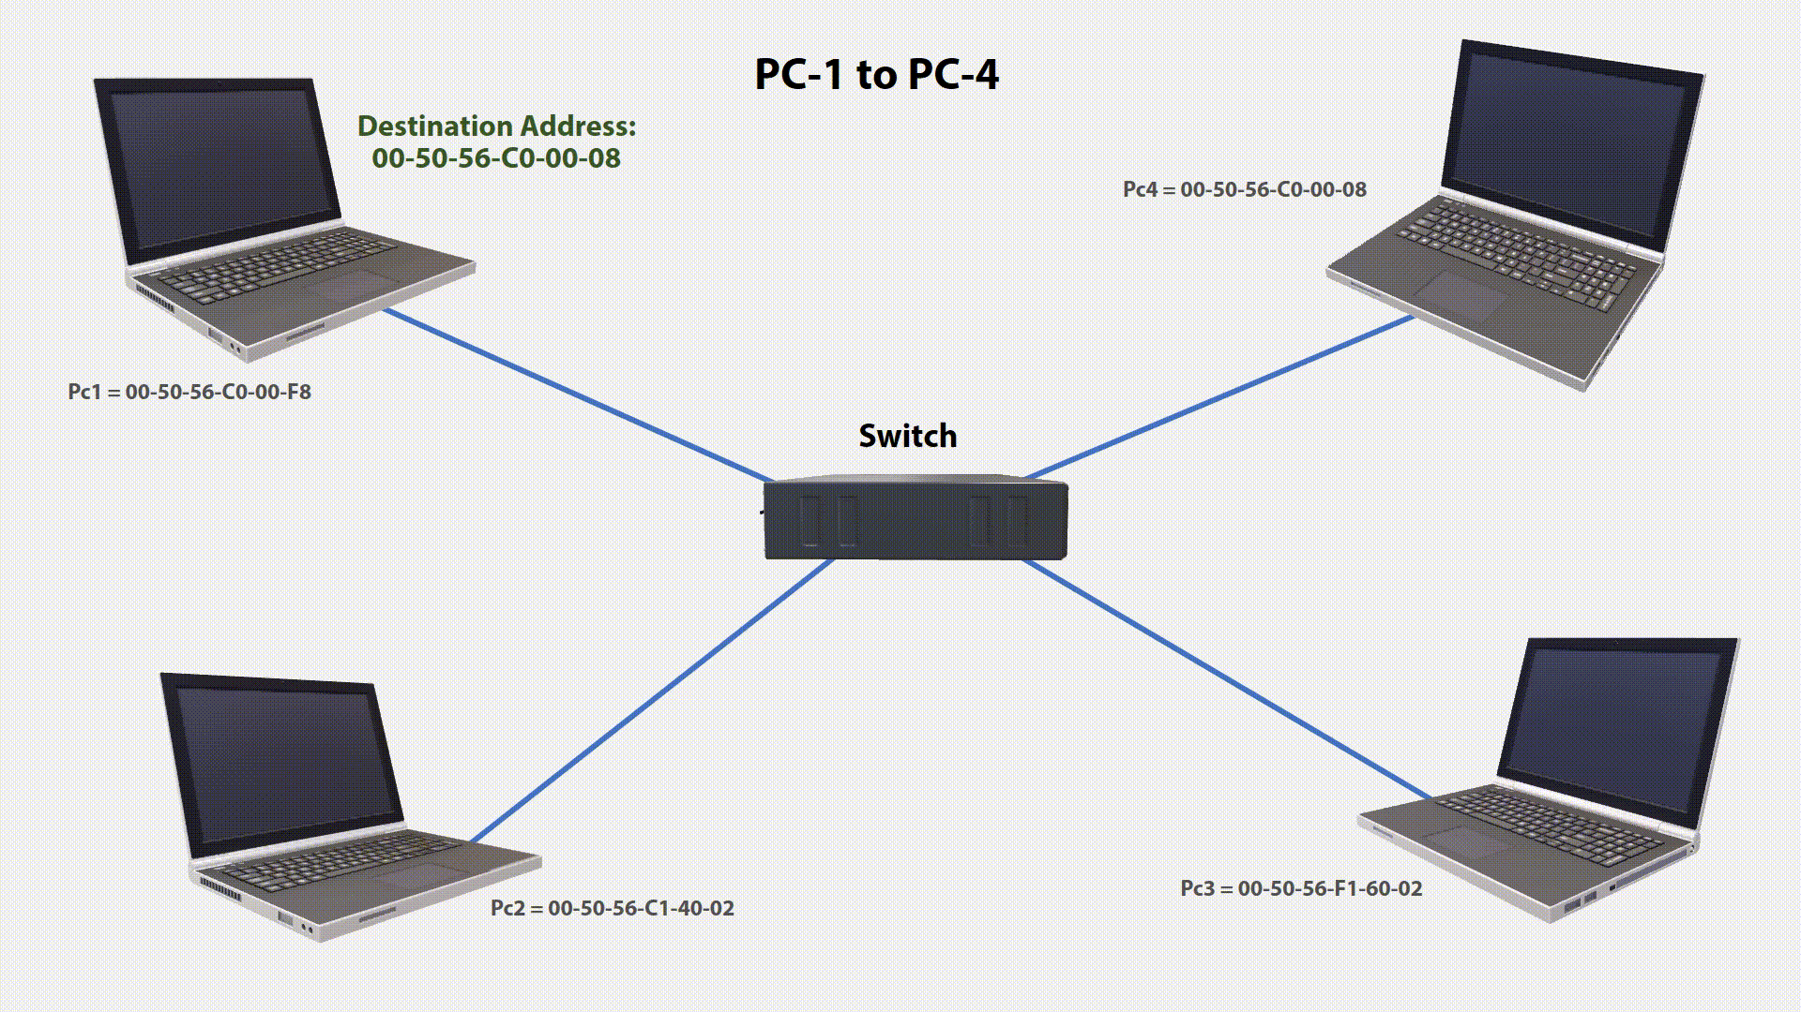
Switch Example

Slide 36
Switch Example

Slide 37
Switch
Far more preffered over hubs because they reduce any unnecessary traffic on the network.
Different methods of switching
Cut Through
Store and forward

Slide 38
Hub and switch
Hub | Switch
Only detects thata device is physically connected to it. | Can detect specific devices that are connected to it because it keeps a record of MAC ADDRESS of those devices.

Slide 39
Similarity Between Hub and Switch
Both are used to exchange data within a local area network.
Example
In your home network or in a business.
Not used to exchange data outside their own network such as out on the internet.
Hubs and switches do not read IP addresses. So that’s where the router comes in.

Slide 40
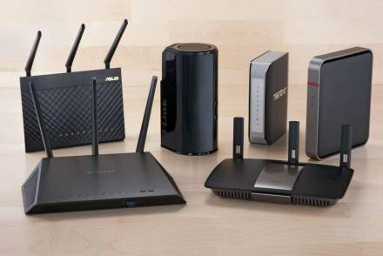
Router
Routes data from one network to another network based on their IP addresses.

Slide 41
Router
When data packer received it inspects IP address and determine if packet was meant for own network or it is meant for another network
Router is especially the gateway of a network.

Slide 42
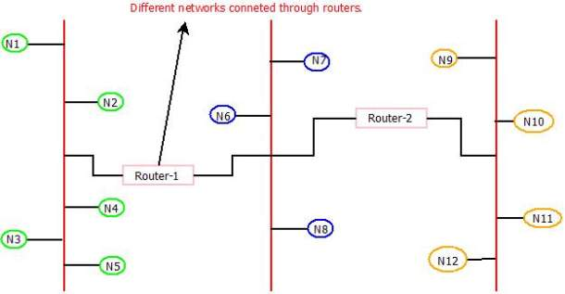
Description Router
Used to connect two or more similar or dissimilar topological LANs or WLANs.

Slide 43
Description Router
Used to connect two or more similar or dissimilar topological LANs or WLANs.

Slide 44
Description Router
Used to connect two or more similar or dissimilar topological LANs or WLANs
Shares available bandwidth with multiple computers in a network.

Slide 45
Description Router
Used to connect two or more similar or dissimilar topological LANs or WLANs
Shares available bandwidth with multiple computers in a network.
Provides a better protection as a hardware firewall against hacking.

Slide 46
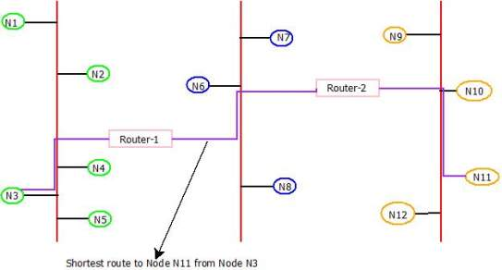
Description Router
Routers are intelligent enough to determine shortest and fastest path from source to destination in a network using algorithms.

Slide 47
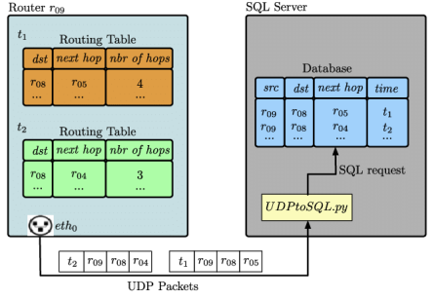
Description Router
To forward a data packet to its destination, router keeps the records of connected networks.

Slide 48
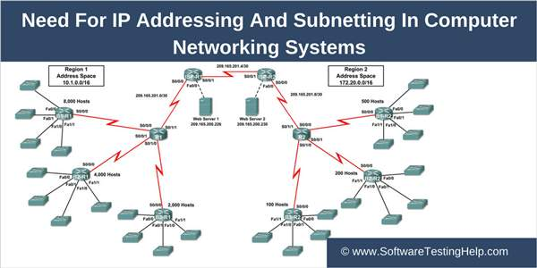
Description Router
To connect several smaller networks into a large network

Slide 49
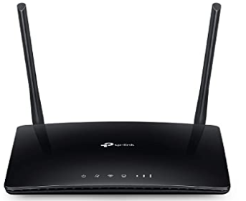
Description Router
Wireless routers are now widely used in home and offices as they allow a user to connect easily without installing any cables.

Slide 50
Which Layer Router Operates?

Slide 51
Which Layer Router Operates?
Operates at network layer of OSI model.

Slide 52
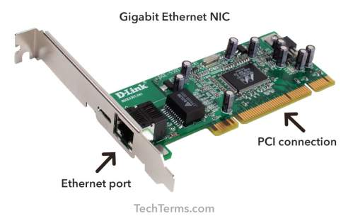
Network interface Card
A Network Interface Card (NIC) is circuit board or a card that allows computers to communicate over a network via cables or wirelessly.
Connects to a network via cables like CAT5, Co-axial, fiber-optics etc. And wirelessly by a small antenna

Slide 53
Network interface Card
It is also called as LAN adaptor, network adaptor or network card.

Slide 54
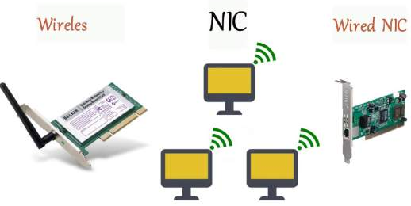
Network interface Card
Two types of NIC
Wired NIC
Wireless NIC

Slide 55
Wireless NIC
In laptop we use NIC card.
It can be connected through cable also.
If its wireless NIC, it connect through wireless modem
It works on radio frequency (Rf).

Slide 56
Wired NIC
On desktop computer, we use wired NIC.

Slide 57
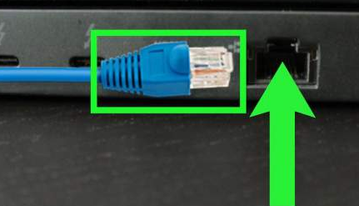
Wired NIC
On desktop computer, we use wired NIC.
If NIC is wired then connect through RJ45 port. By connection cable with RJ45 you communicate with internet.

Slide 58
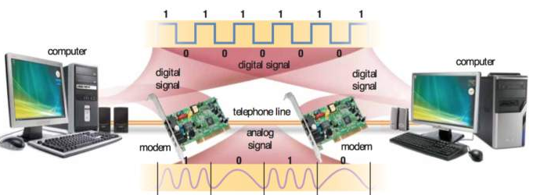
Wired NIC
It works on analog and digital signal.

Slide 59
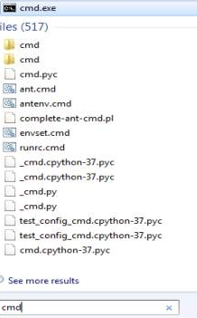
Network Interface Card
Ques:- How to check whether NIC card is working or not?
Step1

Slide 60
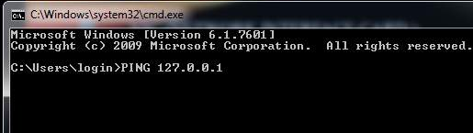
Network Interface Card
Step 2

Slide 61
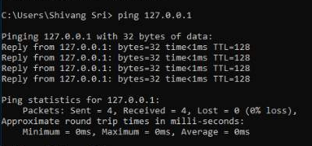
Network Interface Card

Slide 62
Network Interface Card
LAN Standards
ISO
ANSI
EIA/TIA
IEEE

Slide 63
Network Interface Card
Divided into two parts.
00-04-AC | F3-1C—D4
Manafacture ID | Serial number

Slide 64
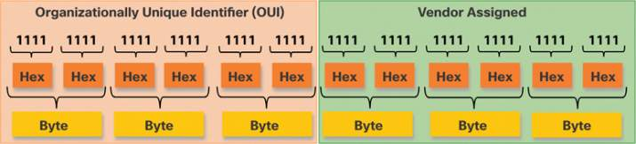
Network Interface Card
An Ethernet MAC address consists of a 48-bit binary value. Hexadecimal is used to identify an Ethernet address because a single hexadecimal digit represents 4 binary bits. Therefore, a 48-bit Ethernet MAC address can be expressed using only 12 hexadecimal values.

Slide 65
Which Layer NIC Operates?

Slide 66
Which Layer NIC Operates?
Operates on physical and data link layer of OSI model.

Slide 67
Repeater
Definition
Repeater is a electronic device that reshapes and amplifies the signal received from one LAN segment to another.
Description
Mostly used to boost the signals in the network.
Operates at physical layer in the OSI layer model.
Best suited for long distances network and bus topology.

Slide 68
Repeater
Description
Main advantage is that they remove unwanted noise from the incoming signals.
Requires separate power supply for functioning.
Repeater component parts varies from where they are used like in digital communication, wireless communication, fiber-optic system, cellular system etc.

Slide 69
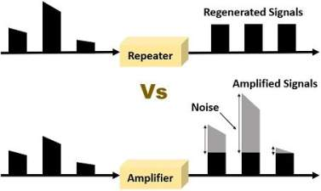
Repeater

Slide 70
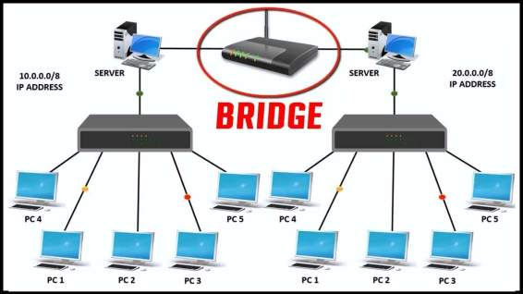
Bridge
Bridge is a networking device that connects two or more LAN's together.

Slide 71
Bridge
Bridge is used when number of LANs starts increasing, the network traffic begins on overwhelming to available bandwidth.
Reduces the network traffic of LAN by dividing it into segments.

Slide 72
Bridge
Can transfer data between two different protocols like Ethernet (802.3) and token bus (802.4).
Checks the MAC address of the frame and decides to forward the frame or to discard the frame.

Slide 73
Which Layer Bridge Operates?

Slide 74
Which Layer Bridge Operates?
Operates at data link layer of OSI model.

Slide 75
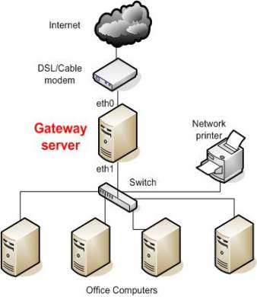
Gateway
Definition
Gateway is a network point that act as entry point to other network and translates one data format to another.

Slide 76
Gateway
Following are some common functions of the gateway :
Protocol translation
Network address translation
DHCP service
Monitoring and regulating each packet entering and leaving the network.

