Slide 2
After this lecture you will be able to
learn what is block coding
learn error detection and correction mechanism.

Slide 3
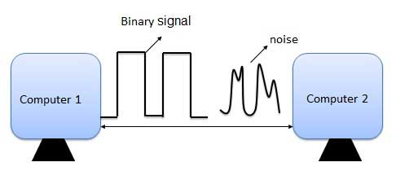
Introduction
Data can be corrupted during transmission. Some applications require that errors be detected and corrected.

Slide 4
Block Coding
In block coding, we divide our message into blocks, each of k bits, called datawords. We add r redundant bits to each block to make the length n = k + r. The resulting n-bit blocks are called codewords.

Slide 5
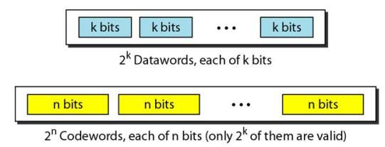
Block Coding
With k bits, we can create a combination of 2k datawords; with n bits, we can create a combination of 2n codewords.

Slide 6
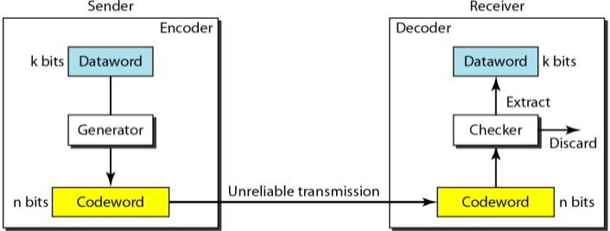
Error Detection
Ques:- How can errors be detected by using block coding?
Ans:- 1. The receiver has (or can find) a list of valid codewords. 2. The original codeword has changed to an invalid one.

Slide 7
Introduction
Let us first discuss some issues related, directly or indirectly, to error detection and correction.

Slide 8
Types of Errors
Whenever bits flow from one point to another, they are subject to unpredictable changes because of interference
Types of error
Single Bit error
Multi bit error
Burst error

Slide 9
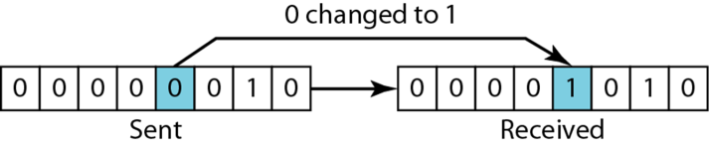
Single Bit Error

Slide 10
Multi-bit Error
Sent
Received
1 | 0 | 1 | 1 | 0 | 0 | 1 | 1
1 | 0 | 1 | 0 | 0 | 1 | 1 | 1
Frame is received with more than one bits in corrupted state.

Slide 11
Burst Error
Sent
Received
1 | 0 | 1 | 1 | 0 | 0 | 1 | 1
1 | 1 | 0 | 0 | 0 | 0 | 1 | 1
Frame contains more than1 consecutive bits corrupted.

Slide 12
Redundancy
To detect or correct errors, we need to send extra (redundant) bits with data

Slide 13
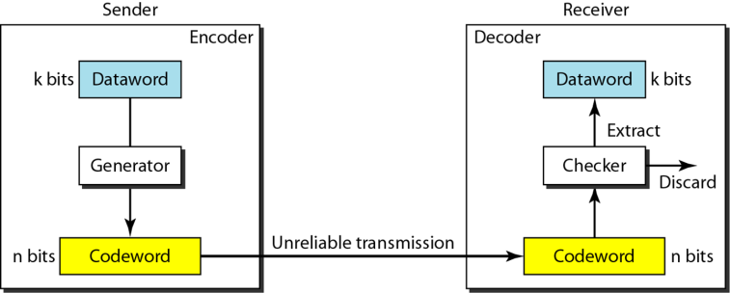
Coding
To detect or correct errors, we need to send redundant bits

Slide 14
Error Control Mechanism May Involve Two Possible Ways
Two possible ways
Error detection
Error correction

Slide 15
Detection Versus Correction
Error Detection | Error Correction
we are looking only to see if any error has occurred. | we need to know the exact number of bits that are corrupted and more importantly, their location in the message
Not even interested in the number of errors | The number of the errors and the size of the message are important factors
A single-bit error is the same for us as a burst error | If we need to correct one single error in an 8-bit data unit, we need to consider eight possible error locations;

Slide 16
Error Detection
Errors in the received frames are detected by means of
Simple Parity Check
Two Dimensional parity Check
Checksum
and Cyclic Redundancy Check (CRC).

Slide 17
Error Detection
In both cases, few extra bits are sent along with actual data to confirm that bits received at other end are same as they were sent. If the counter-check at receiver’ end fails, the bits are considered corrupted.

Slide 18
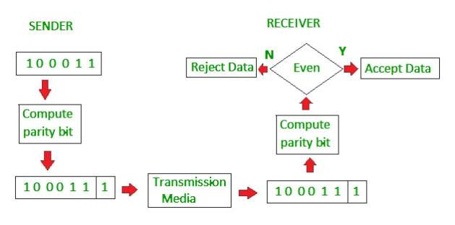
Simple Parity Check

Slide 19
Parity Check
One extra bit is sent along with the original bits to make number of 1s either even in case of even parity, or odd in case of odd parity.
Data Bits
Even Parity
1 | 0 | 0 | 1 | 0 | 0 | 1
1 | 0 | 0 | 1 | 0 | 0 | 1 | ?
1 | 1 | 0 | 1 | 0 | 0 | 1
1 | 1 | 0 | 1 | 0 | 0 | 1 | ?
0 | 1 | 0 | 1 | 1 | 1 | 1
0 | 1 | 0 | 1 | 1 | 1 | 1 | ?
0 | 1 | 0 | 1 | 0 | 1 | 0
0 | 1 | 0 | 1 | 0 | 1 | 0 | ?

Slide 20
Single Parity Bit
Ques:- When it is very hard for the receiver to detect the error ?
Ans:- ???

Slide 21
Single Parity Bit
Ques:- When it is very hard for the receiver to detect the error ?
Ans:- If a single bit flips in transit, the receiver can detect it by counting the number of 1s. But when more than one bits are erro neous, then it is very hard for the receiver to detect the error.

Slide 22
Two-dimensional Parity check
Original Data
10011001 | 11100010 | 00100100 | 10000100

Slide 23
Checksum
Original Data
10011001 | 11100010 | 00100100 | 10000100

Slide 24
Cyclic Redundancy Check (CRC)
The divisor is generated using polynomials.
Before sending the actual bits, the sender adds the remainder at the end of the actual bits.
The sender performs a division operation on the bits being sent and calculates the remainder.
Code word = Actual data bits + remainder
The sender transmits data bits as codewords.

Slide 25
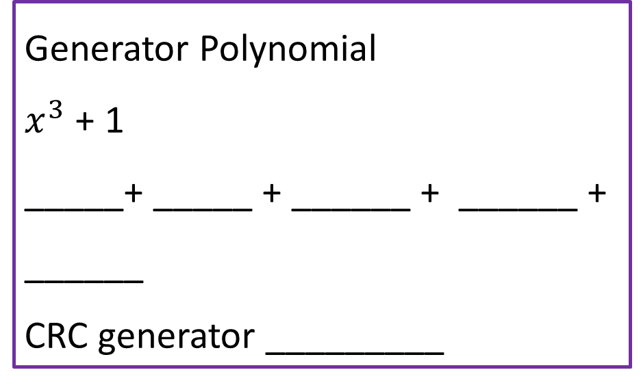
CRC
Original Message: 1 0 1 0 0 0 0
Generator Polynomial
$x^{3}$ + 1
_____+ _____ + ______ + ______ + ______
CRC generator _________

Slide 26
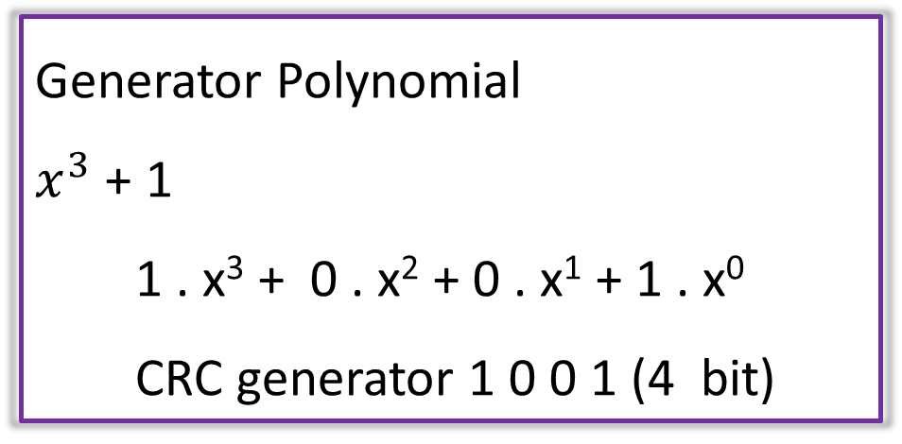
CRC
Original Message: 1 0 1 0 0 0 0
Generator Polynomial
$x^{3}$ + 1
1 . x³ + 0 . x² + 0 . x¹ + 1 . x⁰
CRC generator 1 0 0 1 (4 bit)

Slide 27
CRC
Original Message: 1 0 1 0 0 0 0
If CRC generator is of n
Bit then append (n-1) zeros in the end of the original message.

Slide 28
XOR (exclusive OR) Operation for Both Addition and Subtraction
Bit1 | Bit2 | XOR
0 | 0 | ?
0 | 1 | ?
1 | 0 | ?
1 | 1 | ?

Slide 29
XOR (exclusive OR) Operation for Both Addition and Subtraction
Bit1 | Bit2 | XOR
0 | 0 | 0
0 | 1 | 1
1 | 0 | 1
1 | 1 | 0

Slide 30
1st Example CRC at Sender Side
1 0 0 1
1 0 1 0 0 0 0 0 0 0

Slide 31
1st Example CRC at Receiver Side
1 0 0 1
1 0 1 0 0 0 0 0 0 0

Slide 32
2nd Example at Sender Side
Example
Original Data | 11100
Divisior | 1001

Slide 33
2nd Example CRC at Sender Side
1 0 0 1
1 1 1 0 0 0 0 0

Slide 34
2nd Example CRC at Receiver Side
1 0 0 1
1 1 1 0 0

Slide 35
Modular Arithmetic
We use only a limited range of integers.
We define an upper limit, called a modulus N.
We then use only the integers 0 to N – I.
This is modulo-N arithmetic.
If the modulus is 12, we use only the integers 0 to 11, inclusive

Slide 36
Modular Arithmetic
In modulo-N arithmetic, we use only the integers in the range 0 to N - 1, inclusive
Addition and subtraction in modulo arithmetic are simple. There is no carry when you add two digits in a column. There is no carry when you subtract one digit from another in a column.

Slide 37
Modulo-2 Arithmetic
In this arithmetic, the modulus N is 2.
We can use only 0 and 1. Operations in this arithmetic are very simple.
Adding | 0+0=0 | 0+1=1 | 1+0=1 | 1+1=0
Subtracting | 0-0=0 | 0-1=1 | 1-0=1 | 1-1=0

