Slide 2
After this lecture you will be able to
learn error correction mechanism.

Slide 3
Hamming Distance
Between two words (of the same size) is the number of differences between the corresponding bits. d(x, y).
Easily be found if we apply the XOR operation ( ) on the two words and count the number of 1s in the result.
⊕

Slide 4

Find the Hamming Distance Between Two Pairs of Words
Ques:- The Hamming distance d(OOO, 011) is
Ans:- $\frac{000}{011}$ = ?
$\frac{10101}{11110}$ = ?

Slide 5

Find the Hamming Distance Between Two Pairs of Words
Ques:- The Hamming distance d(OOO, 011) is
Ans:- $\frac{000}{011}$ = 2 ( two 1s)
$\frac{10101}{11110}$ = 3 (three 1s)

Slide 6
Minimum Hamming Distance
The minimum Hamming distance is the smallest Hamming distance between all possible pairs.
d_{min} to define the minimum Hamming distance in a coding scheme.
To find this value, we find the Hamming distances between all words and select the smallest one.

Slide 7
Minimum Hamming Distance
The minimum Hamming distance is the smallest Hamming distance between all possible pairs in a set of words.

Slide 8
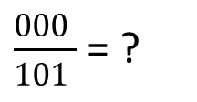
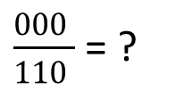
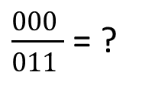
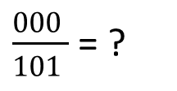
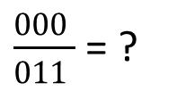
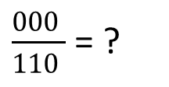
Find the Minimum Hamming Distance of the Coding Scheme
d(000, 011) = ?
d(000, 101) = ?
d(000, 110) = ?
d(011, 101) = ?
d(011, 110) = ?
d(101, 110) = ?
d_{min} is equal to ????
$\frac{000 }{011 }$ = ?
$\frac{000 }{101 }$ = ?
$\frac{000 }{110 }$ = ?
$\frac{000 }{011 }$ = ?
$\frac{000 }{101 }$ = ?
$\frac{000 }{110 }$ = ?

Slide 9
Find the Minimum Hamming Distance of the Coding Scheme
d(000, 011) = 2
d(000, 101) = 2
d(000, 110) = 2
d(011, 101) = 2
d(011, 110) = 2
d(101, 110) = 2
d_{min} is equal to 2

Slide 10
Find The Minimum Hamming Distance of the Coding Scheme?
d(00000, 01011) = ?
d(01011, 10101) = ?
d(00000, 10101) = ?
d(01011, 11110) = ?
d(00000, 11110) = ?
d(10101, 11110) = ?

Slide 11
Find The Minimum Hamming Distance of the Coding Scheme?
d(00000, 01011) = 3
d(01011, 10101) =4
d(00000, 10101) =3
d(01011, 11110) = 3
d(00000, 11110) = 4
d(10101, 11110) =3

Slide 12
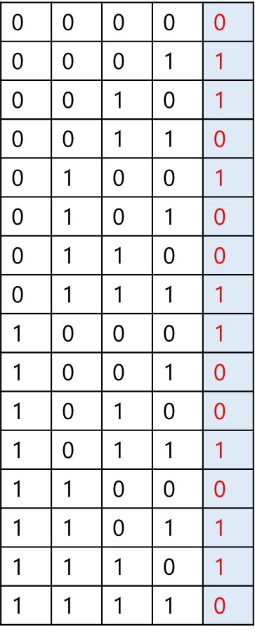
Hamming Distance
Valid Codewords
It can detect d-1 error.

Slide 13
Hamming Distance and Error
When a codeword is corrupted during transmission, the hamming distance between the sent and received codewords is the number of bits affected by the error.
If the codeword 00000 is sent and 01101 is received
_________ bits are in the error.
Hamming distance between the two is d(00000,01101) = ?

Slide 14
Hamming Code
Parity bits
Even parity
Odd Parity

Slide 15
Algorithm of Hamming Code
An information of 'd' bits are added to the redundant bits 'r' to form d+r.
The location of each of the (d+r) digits is assigned a decimal value.

Slide 16
Algorithm of Hamming Code
The 'r' bits are placed in the positions 1,2,.....2^{k-1}.
At the receiving end, the parity bits are recalculated. The decimal value of the parity bits determines the position of an error.

Slide 17
Suppose the Original Data is 1010 Which is to be Sent
Total number of data bits ‘d’ = 4.
Number of redundant bits r : 2^{r} >= d+r+1. 2^{r} >= 4+r+1.
Therefore, the value of r is 3 that statisfies the above relation.
Total number of bits = d+r = 4+3 = 7

Slide 18
Determining the position of the redundant bits
Position | 7 | 6 | 5 | 4 | 3 | 2 | 1
Bit | d | d | d | p2 | d | p1 | p0
Example of redundancy bit calculation in case of 11 bits
d | d | d | r8 | d | d | d | r4 | d | r2 | r1
Input data 1001101

Slide 19
Hamming Code
Input data 1001101
1 | 0 | 0 | r8 | 1 | 1 | 0 | r4 | 1 | r2 | r1

Slide 20
Hamming Code at Receiving Side
Input data 1001101
1 | 0 | 0 | 1 | 1 | 1 | 0 | 0 | 1 | 0 | 1

