Slide 2
After this lecture, you will be able to
Recall link layer services.
Understand flow control.
Understand all techniques for noiseless channels.

Slide 3



Introduction
Catch
Throw

Slide 4
Introduction
Buffer
Catch
Throw

Slide 5
Types of Data Link Protocols
Error control
Framing
Basic Functions in the Datalink Layer
Flow control

Slide 6
Types of Data Link Protocols
Error control
Framing
Basic Functions in the Datalink Layer
Flow control

Slide 7
Types of Data Link Protocols
Error control
Framing
Basic Functions in the Datalink Layer
Flow control

Slide 8
Types of Data Link Protocols
Error control
Framing
Basic Functions in the Datalink Layer
Flow control

Slide 9
Types of Data Link Protocols
Data Link Protocols
For Noiseless Channels
For Noisy Channels
Simplex
Stop and Wait ARQ
Stop and wait
Go- back-N ARQ
Selective Repeat ARQ

Slide 10
Noiseless Channels
An ideal channel in which no frames are lost, duplicated or corrupted is regarded as Noiseless Channel.
It provides flow-control mechanism but does not provide any error control mechanism.

Slide 11
Difference Between Protocols
Unidirectional | Bidirectional
Data frames travel from one node, called the sender, to another node, called the receiver | Data flow in both directions
Less Complex | Bidirectional protocols are more complex

Slide 12
Simplex Protocol
No flow or error control
Unidirectional protocol.
Receiver can immediately handle any frame it receives.
No sequence number or acknowledgements are used here.

Slide 13
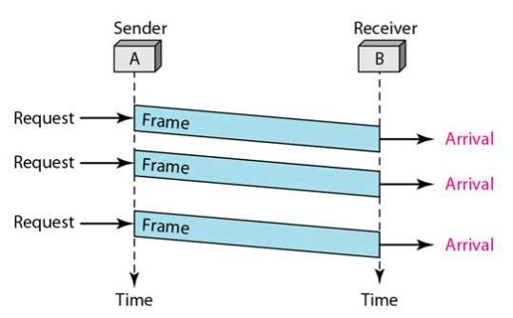
Simplest Protocol

Slide 14
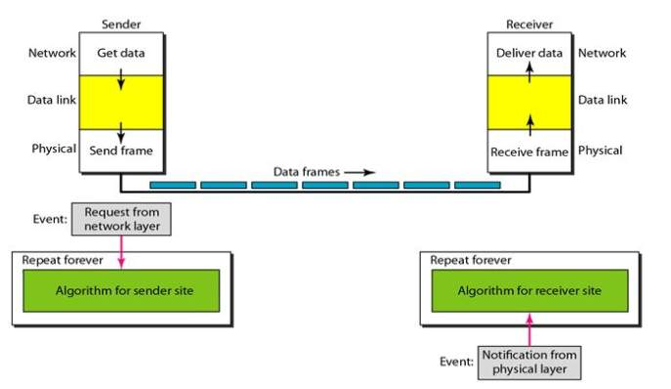
Simplest Protocol
Design of the simplest protocol with no flow control and error control

Slide 15
Simplest Protocol (Sender Aide Algorithm)
while(true) | //repeat forever
{
WaitForEvent(); | //Sleep until an event occurs
if(Event(RequestToSend) | //There is a packet to send
{
GetData(); | //takes a data packet from the network layer
MakeFrame(); | //adds a header and delimiter flags to the data packet to make a frame
SendFrame(); | //delivers the frame to the physical layer for transmission.
} }

Slide 16
Simplest Protocol (Receiver Side Algorithm)
while(true) | //repeat forever
{
WaitForEvent(); | //Sleep until an event occurs
if(Event(Arrivalnotification) | //There is a packet to send
{
ReceiveFrame(); | //receives the frame from the physical layer
ExtractData(); | //extracts the data from the frame
Deliverdata(); | //delivers the data to the network layer.
} }

Slide 17
STOP and WAIT Protocol

Slide 18
Stop-and-Wait Protocol
Sender
Receiver
Data
Ack
Data
Ack
Flow Control
Data
Ack
After Consumption

Slide 19
Stop and Wait protocol
S_{n} next Frame to send
0 | 1 | 0 | 1 | 0
R_{n} next Frame to receive
0 | 1 | 0 | 1 | 0

Slide 20
Stop and Wait protocol
Dataframe
\
Seq No
ACK frame
\
ackNo

Slide 21
Stop and Wait Protocol (Sender Side Algorithm)
while(true) | //repeat forever
canSend=true | //Allow the first frame to go
{
WaitForEvent(); | //Sleep until an event occurs
if(Event(RequestToSend) And canSend | //There is a packet to send
{
GetData(); | //takes a data packet from the network layer
MakeFrame(); | //adds a header and delimiter flags to the data packet to make a frame
SendFrame(); | //delivers the frame to the physical layer for transmission.
canSend=false; } | //cannot send until ack arrives

Slide 22
Stop and Wait Protocol (Sender Side Algorithm)
WaitForEvent() | //Sleep until an event occurs
If(Event(Arrival Notification) { | //An ACK has arrived
ReceiveFrame(); canSend=true; }} | //Receive ACK frame

Slide 23
Stop and Wait Protocol (Receiver Side Algorithm)
while(true) | //repeat forever
{ WaitForEvent(); | //Sleep until an Event occurs
If(Event(Arrival Notification) { | //An ACK has arrived
ReceiveFrame();
ExtractData();
Deliverdata(); | //Deliver data to network layer
SendFrame(); | //Send an ACK Frame
}}

Slide 24
Problem with Stop and Wait - Lost Data
Sender
Receiver
Data
X
Sender waits for Ack Receiver waits for data
For infinite amount of time

Slide 25
Problem with Stop and Wait – Lost Acknowledgment
Sender
Receiver
Data
X
Sender waits for Ack For infinite amount of time

Slide 26
Problem Due to Delayed Data or Acknowledgment
Sender
Receiver
Data

