Slide 2
After this lecture, student will be able to
understand bit-oriented protocol.
know the frame format and types of HDLC frame.
know the byte oriented protocol.
understand the frame format of PPP.
understand the byte stuffing in PPP Frame.

Slide 3
Bit Oriented Approach
It simply views the frame as a collection of bits.
Bit Oriented protocol is HDLC

Slide 4
HDLC
High Level Data Link Control(HDLC) basically provides reliable delivery of data frames over a network or communication link.
HDLC provides various operations such as
framing, data transparency, error detection, and correction, and even flow control

Slide 5
HDLC
The Synchronous Data link control(SDLC) protocol developed by IBM is an example of bit-oriented protocol.
SDLC was standardized by the ISO as the High-level data link control (HDLC) protocol.
Bit-Oriented Protocol.
Point to Point and Multipoint Communications.

Slide 6

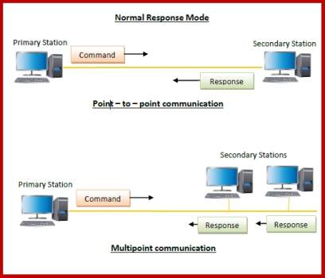
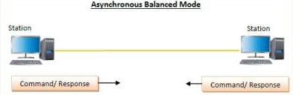
Transfer Modes of HDLC

Slide 7
HDLC-Frame Format
8
Beginning Sequence

Slide 8
HDLC-Frame Format
16
Header

Slide 9
HDLC-Frame Format
Body

Slide 10
HDLC-Frame Format
16
CRC

Slide 11
HDLC-Frame Format
8
Ending Sequence

Slide 12
HDLC-Frame Format
8 | 16 |  | 16 | 8
Beginning Sequence | Header | Body | CRC | Ending Sequence

Slide 13
HDLC-Frame Format
Beginning and Ending Sequences: 01111110
This sequence is also transmitted during any times that the link is idle so that the sender and receiver can keep their clocks synchronized.
Header: Address and control field.
Body: Payload?(Variable Size)
CRC-Cyclic Redundancy Check-Error Detection.
8 | 16 |  | 16 | 8
Beginning Sequence | Header | Body | CRC | Ending Sequence

Slide 14
Types of HDLC Frames
The type of frame is determined by the control
Types of Frame
I-frame : Information Frame.
S-Frame: Supervisory Frame
U-Frame: Un-numbered Frame

Slide 15
Types of HDLC Frames
I-Frame | 1st bit is 0
S-Frame | 1st two bits is 10
U-Frame | 1st two bits is 11

Slide 16
PPP(point-to-point) Protocol

Slide 17
Byte Oriented Protocol
It simply views the frame as a collection of bytes or characters.
Basically, we have 3 protocols
BISYNC <-> Binary Synchronous Communication Protocol.
PPP <-> Point-to-Point Protocol.
DDCMP <-> Digital Data Communication Message Protocol.

Slide 18
PPP
Data link layer protocol.
PPP is a WAN protocol and which is commonly run over internet.
It is widely used in broadband communications having heavy loads and high speeds.
It is also used to transmit multiprotocol data between two directly connected ?(point-to-point) computers.

Slide 19
Components of PPP
Encapsulation Component
Link Control Protocol (LCP)
Authentication Protocols (AP)
Network Control Protocols (NCPs)
NCP
AP
LCP
IPCP
PAP
Control Protocols
OSINLCP
CHAP
IPXCP
…………

Slide 20
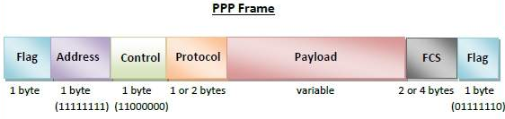
PPP-Frame Format

Slide 21
Byte Stuffing in PPP Frame
Byte stuffing is used is PPP payload field whenever the flag sequence appears in the message, so that the receiver does not consider it as the end of the frame. The escape byte, 01111101, is stuffed before every byte that contains the same byte as the flag byte or the escape byte. The receiver on receiving the message removes the escape byte before passing it onto the network layer.

