Slide 2
After this lecture student will be able to
understand multiple access protocol.
know the versions of aloha.
difference between pure aloha and slotted aloha.

Slide 3
Multiple Access Protocol
Multiple-access Protocols
Random-access Protocols
Control-access Protocols
Channelization Protocols
ALOHA
Reservation
FDMA
CSMA
Polling
TDMA
CSMA/CD
Token Passing
CDMA
CSMA/CA

Slide 4
Access Control
Controls the access of stations to the transmission link.
Broadcast links require access control mechanism.

Slide 5
Aloha
Aloha is a random-access protocol.
It was designed for WLAN but it is also applicable for shared medium.
Multiple station can transmit data at the same time and can hence lead to collision and data being garbled.

Slide 6


Collision

Slide 7
Collision

Slide 8
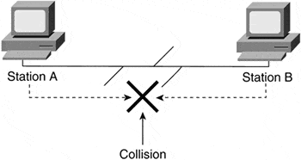
Collision

Slide 9
Aloha
Two Different versions of Aloha
Pure Aloha
Slotted Aloha

Slide 10
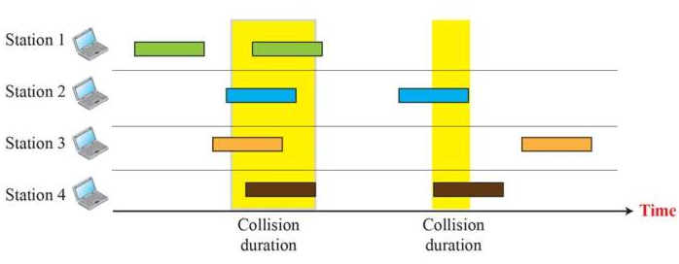
Frame 1.1
Frame 1.2
Frame 2.1
Frame 2.2
Frame 3.1
Frame 3.2
Frame 4.1
Frame 4.2

Slide 11
Pure Aloha
It allows the stations to transmit data at any time whenever they want.
After transmitting the data packet, station waits for some time.
CASE-1
CASE-2

Slide 12
Pure Aloha
CASE-1
Transmitting station receives an acknowledgement from the receiving station.
In this case, transmitting station assumes that the transmission is successful.

Slide 13
Pure Aloha
CASE-2
Transmitting station does not receive any acknowledgement within specified time from the receiving station.
In this case, transmitting station assumes that the transmission is unsuccessful.
Then,
Back OFF Strategy
The throughput of aloha is maximized when frames are of uniform length.

Slide 14
Flowchart for Pure Aloha
Start
Set back off to zero
Wait back off time
Wait
No
Reached Limit
Increment back off
Received ACK?
No
Yes
Yes
Abort
Success

Slide 15
Flowchart for Pure Aloha
Start
Set back off to zero
Wait back off time
Wait
No
Reached Limit
Increment back off
Received ACK?
No
Yes
Yes
Abort
Success

Slide 16
Flowchart for Pure Aloha
Start
Set back off to zero
Wait back off time
Wait
No
Reached Limit
Increment back off
Received ACK?
No
Yes
Yes
Abort
Success

Slide 17
Flowchart for Pure Aloha
Start
Set back off to zero
Wait back off time
Wait
No
Reached Limit
Increment back off
Received ACK?
No
Yes
Yes
Abort
Success

Slide 18
Flowchart for Pure Aloha
Start
Set back off to zero
Wait back off time
Wait
No
Reached Limit
Increment back off
Received ACK?
No
Yes
Yes
Abort
Success

Slide 19
Flowchart for Pure Aloha
Start
Set back off to zero
Wait back off time
Wait
No
Reached Limit
Increment back off
Received ACK?
No
Yes
Yes
Abort
Success

Slide 20
Flowchart for Pure Aloha
Start
Set back off to zero
Wait back off time
Wait
No
Reached Limit
Increment back off
Received ACK?
No
Yes
Yes
Abort
Success

Slide 21
Flowchart for Pure Aloha
Start
Set back off to zero
Wait back off time
Wait
No
Reached Limit
Increment back off
Received ACK?
No
Yes
Yes
Abort
Success

Slide 22
Flowchart for Pure Aloha
Start
Set back off to zero
Wait back off time
Wait
No
Reached Limit
Increment back off
Received ACK?
No
Yes
Yes
Abort
Success

Slide 23
Flowchart for Pure Aloha
Start
Set back off to zero
Wait back off time
Wait
No
Reached Limit
Increment back off
Received ACK?
No
Yes
Yes
Abort
Success

Slide 24
Flowchart for Pure Aloha
Start
Set back off to zero
Wait back off time
Wait
No
Reached Limit
Increment back off
Received ACK?
No
Yes
Yes
Abort
Success

Slide 25
Flowchart for Pure Aloha
Start
Set back off to zero
Wait back off time
Wait
No
Reached Limit
Increment back off
Received ACK?
No
Yes
Yes
Abort
Success

Slide 26
Flowchart for Pure Aloha
Start
Set back off to zero
Wait back off time
Wait
No
Reached Limit
Increment back off
Received ACK?
No
Yes
Yes
Abort
Success

Slide 27
Flowchart for Pure Aloha
Start
Set back off to zero
Wait back off time
Wait
No
Reached Limit
Increment back off
Received ACK?
No
Yes
Yes
Abort
Success

Slide 28
Pure Aloha
Vulnerable Time
If the first bit of a new frame overlaps with just last bit of a frame almost finished ,both frames totally be destroyed, and both will have to retransmitted later.
B is about to complete only few more data with frame B but A also transmitted then there will be collision

Slide 29
Pure Aloha
B’s end collides with A’s begining
A’s end collides with C’s begining
B
Begin
End
A
Begin
End
C
Begin
End
t - T_{fr}
t
t + T_{fr}
Time
Vulnerable Time = 2 X T_{fr}

Slide 30
Pure Aloha
Vulnerable time= 2* T_{fr}

Slide 31
Pure Aloha
Efficiency of pure aloha
Efficiency of Pure Aloha (η) = G x e^{-2G}
where G = Number of stations willing to transmit data at same time.
Maximum Efficiency
Maximum throuhput = 0.184 for G=0.5(1/2)
The maximum efficiency of Pure Aloha is very less due to large number of collisions.

Slide 32
Slotted Aloha
It was developed to improve efficiency of pure aloha as the chances for collision in pure aloha are high.

Slide 33
Slotted Aloha
Slotted Aloha divides the time of shared channel into discrete intervals called as time slots.
Any station can transmit its data in any time slot.
Sending of data is allowed only at the beginning of these slots.
If the beginning of the slot is missed, then station has to wait until the beginning of the next time slot.
A collision may occur if two or more stations try to transmit data at the beginning of the same time slot.

Slide 34
Slotted Aloha
Slotted Aloha divides the time of shared channel into discrete intervals called as time slots.
Any station can transmit its data in any time slot.
Sending of data is allowed only at the beginning of these slots.
If the beginning of the slot is missed, then station has to wait until the beginning of the next time slot.
A collision may occur if two or more stations try to transmit data at the beginning of the same time slot.

Slide 35
Slotted Aloha
Slotted Aloha divides the time of shared channel into discrete intervals called as time slots.
Any station can transmit its data in any time slot.
Sending of data is allowed only at the beginning of these slots.
If the beginning of the slot is missed, then station has to wait until the beginning of the next time slot.
A collision may occur if two or more stations try to transmit data at the beginning of the same time slot.

Slide 36
Slotted Aloha
Slotted Aloha divides the time of shared channel into discrete intervals called as time slots.
Any station can transmit its data in any time slot.
Sending of data is allowed only at the beginning of these slots.
If the beginning of the slot is missed, then station has to wait until the beginning of the next time slot.
A collision may occur if two or more stations try to transmit data at the beginning of the same time slot.

Slide 37
Slotted Aloha
Slotted Aloha divides the time of shared channel into discrete intervals called as time slots.
Any station can transmit its data in any time slot.
Sending of data is allowed only at the beginning of these slots.
If the beginning of the slot is missed, then station has to wait until the beginning of the next time slot.
A collision may occur if two or more stations try to transmit data at the beginning of the same time slot.

Slide 38
Slotted Aloha
A Collides with C
B
Begin
End
A
Begin
End
C
Begin
End
t - T_{fr}
Time
Vulnerable Time = T_{fr}

Slide 39
Slotted Aloha
Efficiency
Efficiency of Slotted Aloha (η) = G x e^{-G}
where G = Number of stations willing to transmit data at the beginning of the same time
Maximum Efficiency
Maximum throughput=0.368 for G=1
The maximum efficiency of Slotted Aloha is high due to less number of collisions.

Slide 40
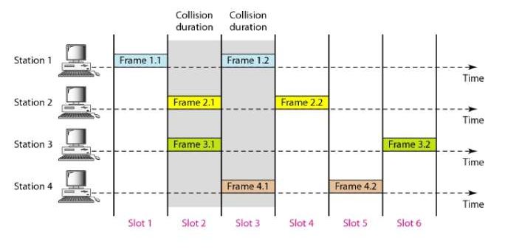
Slotted Aloha

Slide 41
Pure Aloha v/s Slotted Aloha
Pure Aloha | Slotted Aloha
In Pure Aloha, any station can transmit data at any time. | In Slotted Aloha, any station can transmit data only at beginning of any time slot.
In Pure Aloha, time is continous and is not globally syncronized. | In Slotted Aloha, time is discrete and is globally syncronized.
Vulnerable time for pure aloha = 2 x T_{fr} | Vulnerable time for Slotted aloha = T_{fr}
In Pure Aloha, Probability of successful transmission of data packet= G x e^{-2G} | In Slotted Aloha, Probability of successful transmission of data packet= G x e^{-G}

Slide 42
Pure Aloha v/s Slotted Aloha
Pure Aloha | Slotted Aloha
Pure aloha doesn’t reduce the number of collisions to half. | Slotted aloha reduces the number of collisions to half and doubles the efficiency of pure aloha.
Maximum efficiency = 18.4% (Occurs at g = ½) | Maximum efficiency = 36.8% (Occurs at g = 1)

