Slide 2
After this lecture, you will be able to
understand CSMA/CD and CSMA/CA

Slide 3

CSMA/CD
Have you ever wondered how computer send data without interfering with data from other computers?

Slide 4
CSMA/CD
Used on early Ethernet networks.

Slide 5
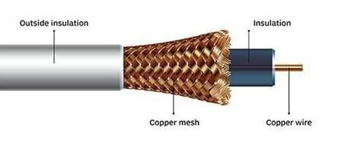
CSMA/CD
Coaxial Cable

Slide 6
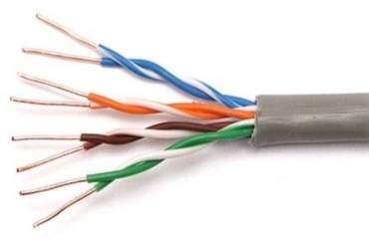
CSMA/CD

Slide 7


CSMA/CD
Each computer first senses if the wire is idle.
If wire is idle, it sends its data.
Frame
A
B
C
D

Slide 8
CSMA/CD
But if 2 computers sends data at the same time.
Frame
Frame
A
B
C
D

Slide 9
CSMA/CD
But if 2 computers sends data at the same time, a collision will happen.
Frame
Frame
A
B
C
D

Slide 10
CSMA/CD
If collision happens, the computer will wait a random amount of time and retries to send their data.
Frame
Frame
A
B
C
D

Slide 11
CSMA/CD
A
B
C
D

Slide 12
CSMA/CD
This cable must be regulated so that no computers send data at the same time which would result in a collision.
And when a collision happens, it causes data loss or data corruption.
Frame
Frame
A
B
C
D

Slide 13
CSMA/CD
When computers that are sending that data detect a collision, they immediately stop sending data.
Transmit a jamming signal out on the network.
Frame
Frame
A
B
C
D

Slide 14
CSMA/CD
Attention network, we had a collision
Sending a jamming signal
Frame
Frame
A
B
C
D

Slide 15
CSMA/CD
Random amount of time before sending data again.
00 | 09
00 | 05
Frame
Frame
A
B
C
D

Slide 16
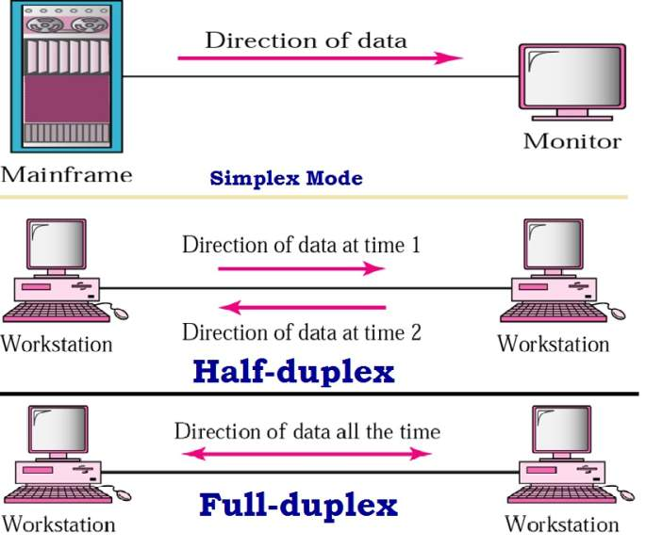
CSMA/CD
Used on early Ethernet network.
Not as relevant today.

Slide 17
CSMA/CD
Today we Use Full-Duplex networks.

Slide 18
CSMA/CA(Carrier Sense Multiple Access/Collision Avoidance)

Slide 19
CSMA/CA
This is access method that’s used for carrier transmission in wireless networks.
Nut just like wired networks, wireless networks need to avoid collisions as well.

Slide 20
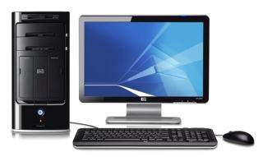

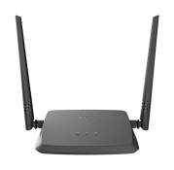
Working
Can’t sense or hear.
No cable is involved.

Slide 21
Working
Listening

Slide 22
Working
I hear a transmission. I have to wait

Slide 23
Working
All clear I can send now

Slide 24
Working
What happened if sending computer does not receive any acknowledgment from receiving computer?

Slide 25
Working
What happened if sending computer does not receive any acknowledgment from receiving computer?
Sending computer will start the process all over again.

Slide 26
CSMA/CA
Uses the optional RTS/CTS protocol.
Stands for Ready to Send/Clear to Send

Slide 27



Slide 28
You are clear to send (CTS)

