Slide 2
After this lecture student will be able to
what is an ip address.
types of ip address.
how to find public ip address
classification of ip addresses
comparison between ipv4 and ipv6

Slide 3
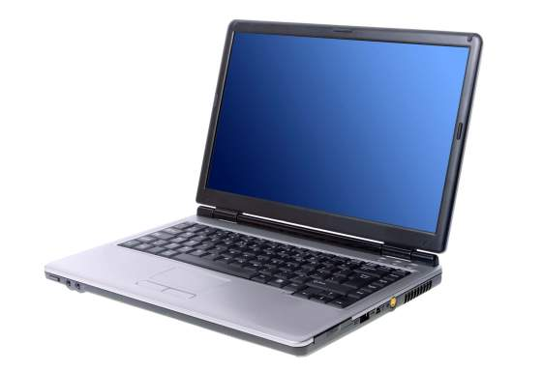
IP Address

Slide 4
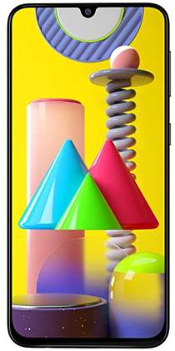
IP Address

Slide 5

IP Address

Slide 6

IP Address

Slide 7

IP Address

Slide 8
IP Address
ADDRESS

Slide 9
IP Address
IP ADDRESS

Slide 10

IP Address
HOME ADDRESS

Slide 11

IP Address
ADDRESS

Slide 12
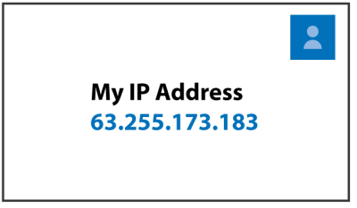
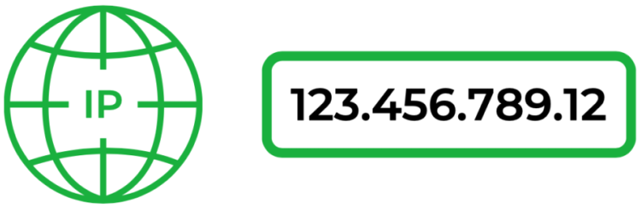
IP Address

Slide 13
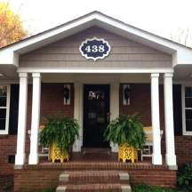
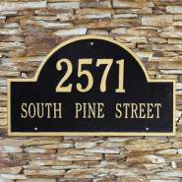

Comparison of Home Address with IP Address

Slide 14


Comparison of Home Address with IP Address
123.42.56.78

Slide 15
IP Address
Internet Protocol Address.
Internet protocol is a set of rules that makes internet work.
You can watch this lecture online because your computer and smart phone has an IP address.

Slide 16
IP Address
IPv4
IP Addresses
IPv6

Slide 17
IPv4
N . N . N . N
0-255 . 0-255 . 0-255 . 0-255

Slide 18
IPv4
N . N . N . N
(0-255 . 0-255 . 0-255 . 0-255)₁₀

Slide 19

IPv4
N . N . N . N
(0-255 . 0-255 . 0-255 . 0-255)₁₀

Slide 20
IPv4
N . N . N . N
(0-255 . 0-255 . 0-255 . 0-255)₁₀
(00000000 .00000000 . 00000000 . 00000000)
OR
(11111111 .11111111 . 11111111 . 11111111)
BINARY FORM

Slide 21
IPv4
(00000000 .00000000 . 00000000 . 00000000)
OR
(11111111 .11111111 . 11111111 . 11111111)
BINARY FORM
IPv4 is a 32-bit address

Slide 22
IPv4
IPv4 is a 32-bit address
2³² = | 4,294,967,296 Devices

Slide 23


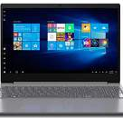
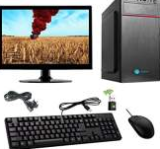
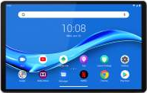
ISSUE with 32-bit IPv4
We can connect only 4,294,967,296 devices.

Slide 24
ISSUE with 32-bit IPv4
We have far more than 4 billion so slowly we are moving towards IPV6.

Slide 25
IPV6

Slide 26
IPV6
IPV6 is 128-bit address
NNNN:NNNN:NNNN:NNNN:NNNN:NNNN:NNNN:NNNN

Slide 27
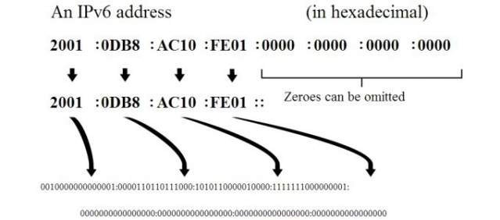
IPV6
NNNN:NNNN:NNNN:NNNN:NNNN:NNNN:NNNN:NNNN
Human Understandable Form

Slide 28
IPV6
Converted into 128 ones or zeros

Slide 29
IPV6
Total 2¹²⁸ devices can be connected to internet.
2¹²⁸ = 340,282,366,920,938,463,463,374,607,431,768,211,456

Slide 30
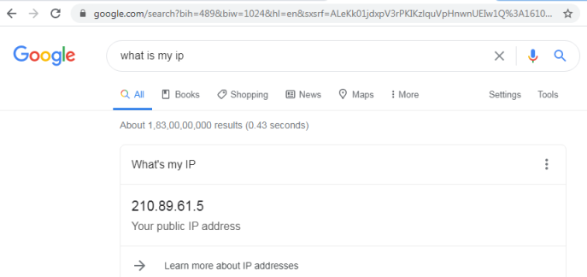
How to Find Your Computer Public IP Address?

Slide 31
IP Address
IPv4
IP Addresses
IPv6

Slide 32
Think About It…
How would you check your Smartphone public IP address???

Slide 33


Important
Without IPV4 and IPV6, we won't be able to connect with internet.
IP address is must for internet connection.

Slide 34
Classification of IP address
Classification of IP addresses
Dynamic IP address
Static IP addresses

Slide 35
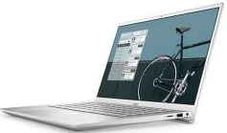
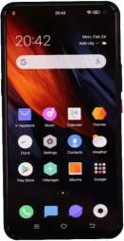
Dynamic IP Address
Internet
192.168.1.104
192.168.1.107

Slide 36
Dynamic IP Address
Internet
192.168.1.104
ISP
192.168.1.101
192.168.1.254
Internet
Service
Provider
192.168.1.107

Slide 37
Dynamic IP Address
Internet
192.168.1.104
ISP
192.168.1.101
192.168.1.254
Internet
Service
Provider
192.168.1.107

Slide 38
Static IP address
Never change.
Permanent internet address.
DNS server uses Static IP address.

Slide 39
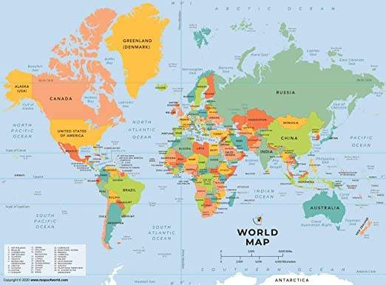
Static IP Address
Country

Slide 40
Static IP Address
Country
City

Slide 41
Static IP Address
Country
City
ISP

Slide 42
Static IP Address
IP address allows billion of devices to be pinpointed
Less secure because easier to track.

Slide 43
Comparison between IPv4 and IPV6
IPV4 | IPV6
IPv4 uses a 32-bit address for its Internet addresses | IPv6 utilizes 128-bit Internet addresses.
it can provide support for 2^32 IP addresses | it can support 2^128 Internet addresses
IPv4 is a numeric address, and its binary bits are separated by a dot (.) | IPv6 is an alphanumeric address whose binary bits are separated by a colon (:). It also contains hexadecimal.
Number of header fields 12 | Number of header fields 8

Slide 44
Comparison between IPv4 and IPV6
IPV4 | IPV6
Has checksum fields | Does not have checksum fields
Types of addresses are Unicast, broadcast, and multicast. | Unicast, multicast, and anycast.
Networks need to be configured either manually or with DHCP. IPv4 had several overlays to handle Internet growth, which require more maintenance efforts. | IPv6 support autoconfiguration capabilities.

