Slide 2
After this lecture, you will be able to
understand NAT, ICMP, ARP and RARP

Slide 3
NAT
It is technique of translating private IP addresses into public IP addresses & vice versa.
First described in RFC 1631.

Slide 4
NAT
Ques:- What is the motive to introduce NAT?
Ans:- A short term solution to the problem of the depletion or Exhaustion of IP addresses.
One is Long term solution.
Other is short term solution.

Slide 5

NAT
Long term solution

Slide 6
NAT
Short term Solution
CIDR

Slide 7
NAT
Short term Solution
NAT

Slide 8
NAT
It is a way to conserve IP addresses.
10.0.0.0 | - | 255.255.255.255
172.16.0.0 | - | 172.32.255.255
192.168.0.0 | - | 192.168.255.255

Slide 9




Example
INSIDE
SA
10.0.0.1
NAT TABLE
Inside Local IP Address | Inside Global IP address
10.0.0.1 10.0.0.2 | 171.69.58.80 171.69.58.81

Slide 10
Example
INSIDE
OUTSIDE
SA
10.0.0.1
SA
172.69.58.80
INTERNET
NAT TABLE
Inside Local IP Address | Inside Global IP address
10.0.0.1 10.0.0.2 | 171.69.58.80 171.69.58.81

Slide 11
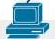
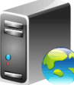
Outgoing Web Client Through NAT
Web Server
10.0.0.2
Internet
NAT
10.0.0.3
10.0.0.4

Slide 12
Outgoing Web Client Through NAT
Web Server
10.0.0.2
Internet
NAT
10.0.0.3
10.0.0.4

Slide 13
Outgoing Web Client Through NAT
Request Received and Accepted
10.0.0.4 , port 1025
Mapped to
204.1.1.10, port 2000
10.0.0.2
Internet
NAT
Web Server
10.0.0.3
Connection request from c forwarded to <web server> source 204.1.1.10, port 2000
Inside IP | Inside Port | OutIP | OutPort
10.0.0.3 10.0.0.4 | 1034 1025 | 204.1.1.10 204.1.1.10 | 2005 2000
10.0.0.4

Slide 14
Outgoing Web Client Through NAT
10.0.0.4 , port 1025
Mapped to 204.1.1.10, port 2000
Response sent to 204.1.1.10, port 2000.
10.0.0.2
204.1.1.10
Internet
NAT
10.0.0.3
Web Server
Translate 204.1.1.10, port 2000 to 10.0.0.4 port 1025
10.0.0.4

Slide 15
NAT
Types of NAT
Static NAT
Dynamic NAT
NAT/PAT

Slide 16
Static NAT
10.0.0.2 translated to 122.x.1.1
10.0.0.3 translated to 122.x.1.2
10.0.0.4 translated to 122.x.1.3
Web Server
10.0.0.2
10.0.0.1
Internet
NAT
10.0.0.3
122.x.1.10
10.0.0.4

Slide 17
Dynamic NAT
Pool
122.x.1.1 to 122.x.1.4
Web Server
10.0.0.2
10.0.0.1
Internet
NAT
10.0.0.3
122.x.1.10
10.0.0.4

Slide 18
NAT/PAT
Single IP address woth port number is used
122.x.1.1
Web Server
10.0.0.2
10.0.0.1
Internet
NAT
10.0.0.3
122.x.1.10
10.0.0.4

Slide 19
Internet Control Message Protocol (ICMP)

Slide 20
ICMP
Which layer it operates?
Network Layer

Slide 21
ICMP
Ques:- Which packet has a highest possibility that will be discarded?
ICMP<IGMP<UDP<TCP

Slide 22
ICMP
Two condition in which we use ICMP
Error handling
Request & Reply

Slide 23
ICMP
Error handling
Source
R1
R2
Destination

Slide 24
ICMP
Error handling
Source
R1
R2
Destination

Slide 25
ICMP
Error handling
Source
R1
R2
Destination
Destination

Slide 26
ICMP
Error handling
Source
R1
R2
Destination
Destination
ICMP
ICMP

Slide 27
ICMP
Request and reply
Sender will make a request to destination using ICMP packet.
Source
R1
R2
Destination
Destination

Slide 28
ICMP
Some Basic Rules
If IP packet is discarded
We can use ICMP packet as a feedback.
If ICMP packet is discarded
No ICMP packet will be used as a feedback.

Slide 29
Example
IP packet
Source
R1
R2
Destination
Destination

Slide 30
Example
IP packet
Source
R1
R2
Destination
Destination

Slide 31
Example
IP packet
Source
R1
R2
Destination
Destination
ICMP(R2,S)

Slide 32
Example
Source
R1
R2
Destination
Destination
ICMP(R2,S)

Slide 33
Example
ICMP(R1,R2)
Source
R1
R2
Destination
Destination
ICMP(R2,S)

Slide 34
Example
ICMP(R1,R2)
Source
R1
R2
Destination
Destination
ICMP(R2,S)
ICMP(R2,R1)

Slide 35
Example
ICMP(R1,R2)
Source
R1
R2
Destination
Destination
ICMP(R2,S)
ICMP(R2,R1)

Slide 36
Example
ICMP(R1,R2)
ICMP(R1,R2)
Source
R1
R2
Destination
ICMP(R2,S)
ICMP(R2,R1)
Infiinite loop will occur because of violation of rule

Slide 37

ICMP
IP -> | ICMP(can generate ICMP feedback for IP packet)
ICMP -> | ICMP

Slide 38
ICMP
Question:- What type of information source must know when packet is discarded?
I_{s} -> Source
I_{d} -> Destination
Packet
 | I_{s} | I_{d}
Source
R1
R2
Destination

Slide 39
ICMP
Who discarded packet
I_{s} -> Source
I_{d} -> Destination
Packet
 | I_{s} | I_{d}
Source
R1
R2
Destination

Slide 40
ICMP
Who discarded packet?
Why packet is discarded?
I_{s} -> Source
I_{d} -> Destination
Packet
 | I_{s} | I_{d}
Source
R1
R2
Destination

Slide 41
ICMP
Who discarded packet?
Why packet is discarded?
Which packet is discarded?
I_{s} -> Source
I_{d} -> Destination
Packet
 | I_{s} | I_{d}
Source
R1
R2
Destination

Slide 42
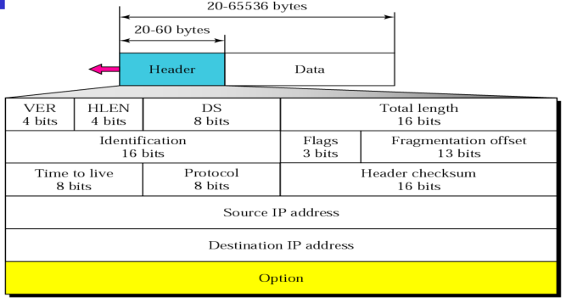
ICMP

Slide 43
Who Discarded Packet?
DIP | SIP
I_{s} | I_{R2}
Type | I_{s} | I_{D} | 8
IP Datagram
Packet
 | I_{s} | I_{d}
Source
R1
R2
Destination

Slide 44
Why Packet is Discarded?
DIP | SIP
I_{s} | I_{R2}
Type | I_{s} | I_{D} | 8
IP Datagram
Packet
 | I_{s} | I_{d}
Source
R1
R2
Destination

Slide 45
Which Packet is Discarded?
DIP | SIP
I_{s} | I_{R2}
Type | I_{s} | I_{D} | 8
IP Datagram
Packet
 | I_{s} | I_{d}
Source
R1
R2
Destination

Slide 46
Address Resolution Protocol(ARP)
Get the destination MAC address which helps in communicating with other devices.
Translate IP address to physical address.
The ARP's main task is to convert the 32-bit IP address (for IPv4) to a 48-bit MAC address.
IP
ARP
MAC

Slide 47
ARP finds the hardware address, also known as Media Access Control (MAC) address, of a host from its known IP address.

Slide 48
ARP
Most important protocols of the Network layer in the OSI model.
ICMP
IGMP
IP
ARP
RARP
NETWORK LAYER

Slide 49
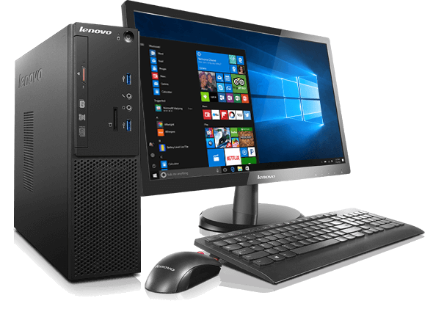
ARP
Host A 192.168.1.1
0002-6779-0f4c
Host B 192.168.1.2
00a0-2470-febd
Sender MAC address
0002-6779-0f4c
Target MAC address
0000-0000-0000
Sender IP address
192.168.1.1
Target IP address
192.168.1.1
Sender MAC address
00a2-2470-febd
Target MAC address
0002-6779-0f4c
Sender IP address
192.168.1.1
Target IP address
192.168.1.1

Slide 50
ARP
Important ARP terms
ARP Cache
ARP Cache Timeout
ARP request
ARP response/reply

Slide 51
Reverse Address Resolution Protocol (RARP)
Request its Internet Protocol address (IPv4) from the gateway-router’s ARP table.
Used to map the MAC address to corresponding IP address.

Slide 52

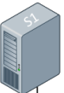
RARP
RARP Server
Broadcasts MAC. Neds to know its IP.
Receives MAC and tells IP of the ‘Device’.

