Slide 2
After this lecture you will be able to
what is Unicast Routing.
three major protocols for unicast routing.
classification of Routing Algorithms.

Slide 3
Unicast
Unicast means the transmission from a single sender to a single receiver.
It is a point to point communication between sender and receiver.
There are various unicast protocols such as
TCP, HTTP, etc.

Slide 4
Routing Protocol
Routing Protocol
Interdomain
Intradomain
Path Vector
Distance Vector
Link State
BGP
BGP
OSPF

Slide 5
Types of Protocol
Distance Vector Routing
Three major protocols for unicast routing
Link State Routing
Path-Vector Routing

Slide 6
Distance Vector Routing
The least-cost route between any two nodes is the route with minimum distance.
Each node maintains a vector(table) of minimum distances to every node.
The table at each node also guides the packets to the desired node by showing the showing the next hop routing.

Slide 7
Distance Vector Routing
Example:
Assume each nodes as the cities. Lines as the roads connecting them.

Slide 8
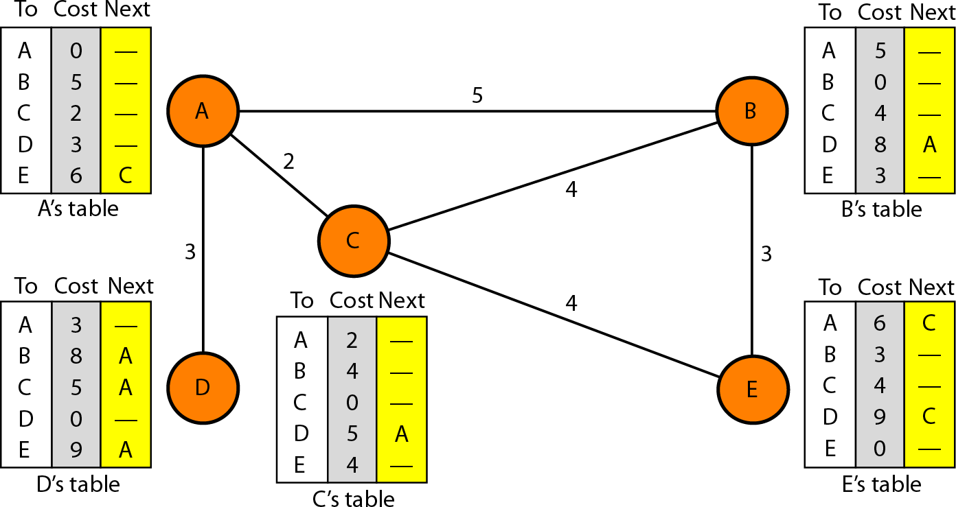
Final Distance Vector Routing Table

Slide 9
Initialization
The table in figure are stable.
Each node knows how to reach any other node and their cost.
At the beginning, each node know the cost of itself and its immediate neighbor.[those node directly connected to it.]

Slide 10
Initialization
Assume that each node send a message to the immediate neighbors and find the distance between itself and these neighbors.
The distance of any entry that is not a neighbor is marked as infinite (unreachable)

Slide 11
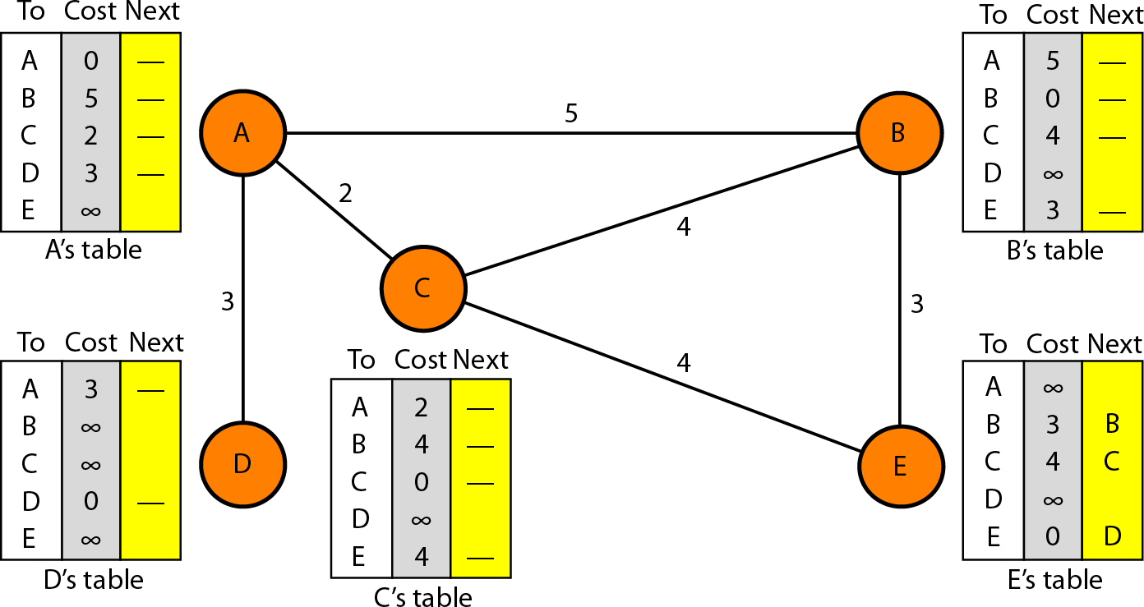
Initialization of tables in distance vector routing (DVR)

Slide 12
Sharing in distance vector routing (DVR)
How much of the table must be shared with each neighbor?
The third column of the table (next hop) is not useful for the neighbor.
When the neighbour receives a table, this column needs to be replaced with the sender's name.

Slide 13
Sharing in distance vector routing (DVR)
If any of the rows can be used, the next node column filled with sender of the table.
Therefore, a node can send only the first two column of its table to any neighbor.

Slide 14
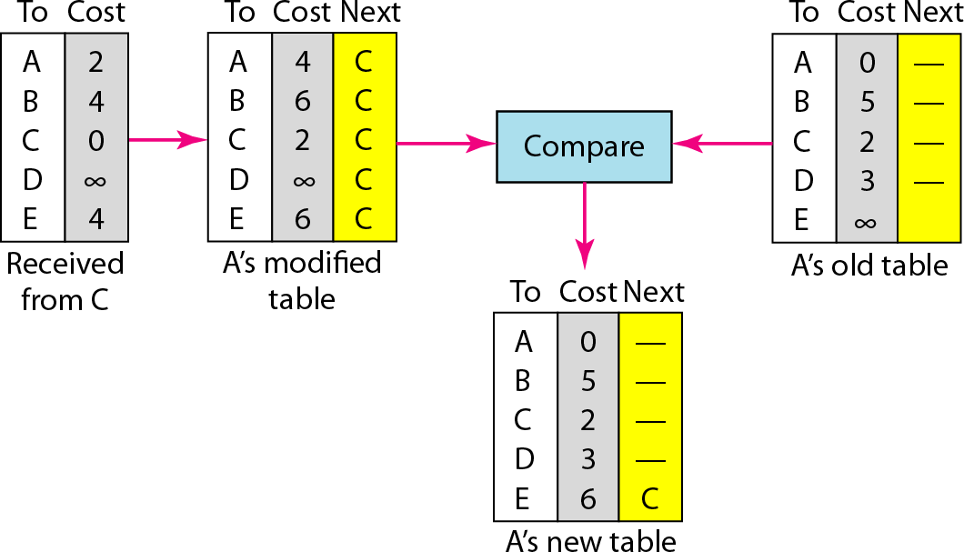
Updating in distance vector routing example: C to A
A to A via C: ACA = AC+ CA = 2+2
A to B via C: ACB = AC + CB = 2+4
A to D via C: ACD = AC + CD = 2+ inf. A to E via C: ACD = AC + CE = 2+4
A to C via C: ACB = AC + CC = 2+0

Slide 15
When to Share in distance vector routing (DVR)
Periodic Update: A node sends its table, normally every 30s, in a periodic update, it depends on the protocol that is using DVR.
Triggered Update: A node sends its two-column routing table to its neighbors anytime there is a change in its routing table.

Slide 16
When to Share in distance vector routing (DVR)
This is called triggered update the change can result from the following:
A node receives a table from a neighbor, resulting in changes in its own table after updating.
A node detects some failure in the neighboring links which results in a distance change to infinity.

Slide 17
Distance vector routing
3 keys to understand how this algorithm works:
Sharing knowledge about the entire AS. Each router shares its knowledge about the entire AS with neighbours. It sends whatever it has.
Sharing only with immediate neighbours. Each router sends whatever knowledge it has thru all its interface.

Slide 18
Distance vector routing
Sharing at regular intervals. sends at fixed intervals, e.g. every 30 sec.
Problems: Tedious comparing/updating process, slow response to infinite loop problem, huge list to be maintained!!

Slide 19
LINK State Routing

Slide 20
Link State routing
If each node in the domain has the entire topology of the domain the list of nodes and links, how they are connected including the type, cost (metric), and condition of the links (up or down)-the node can use Dijkstra's algorithm to build a routing table.

Slide 21
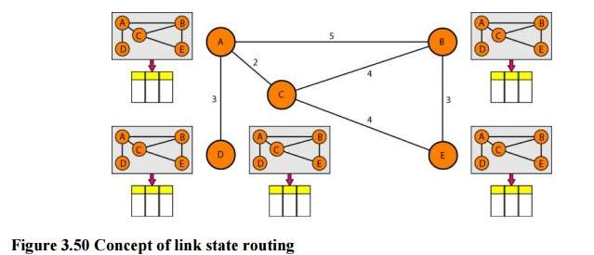
Link State Routing
A
B
A
B
C
5
C
A
B
D
E
2
D
E
4
3
C
3
4
A
B
A
B
A
B
C
D
C
E
C
D
E
D
E
D
E

Slide 22
Link State Routing
The topology must be dynamic, representing the latest state of each node and each link.
If there are changes in any point in the network (a link is down, for example), the topology must be updated for each node.

Slide 23
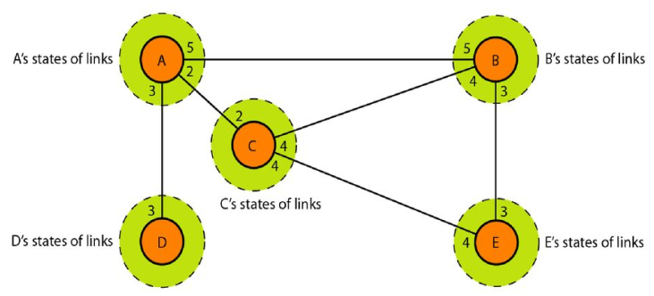
Link State Knowledge

Slide 24
Link State routing
6
R2
7
R4
8
R1
2
R6
1
3
R3
R5
4
9
Link state table will be generated before routing table.

Slide 25
Link State Routing
Link state table for R1
6
R2
7
R4
8
R1
2
R6
1
3
R3
R5
4
9
R1
Seqno
TTL
R2 | 6
R3 | 3

Slide 26
Link State Routing
Link state table for R3
6
R2
7
R4
8
R1
2
R6
1
3
R3
R1
Seqno
TTL
R2 | 6
R3 | 3
R5
4
9
R3
Seqno
TTL
R1 | 3
R2 | 2
R5 | 9

Slide 27
Link State Routing
Link state table for R5
6
R2
7
R4
8
R1
2
R6
1
3
R3
R5
4
R1
Seqno
TTL
R2 | 6
R3 | 3
9
R3
Seqno
TTL
R1 | 3
R2 | 2
R5 | 9
R5
Seqno
TTL
R3 | 9
R4 | 1
R6 | 4

Slide 28
Link State Routing
Link state table for R6
R6
Seqno
TTL
R4 | 8
R5 | 4
6
R2
7
R4
8
R1
2
R6
1
3
R3
R5
4
R1
Seqno
TTL
R2 | 6
R3 | 3
9
R3
Seqno
TTL
R1 | 3
R2 | 2
R5 | 9
R3
Seqno
TTL
R3 | 9
R4 | 1
R6 | 4

Slide 29
Link State Routing
R4
Seqno
TTL
R2 | 7
R5 | 1
R6 | 8
Link state table for R4
6
R2
7
R4
R6
Seqno
TTL
R4 | 8
R5 | 4
8
R1
2
R6
1
3
R3
R5
4
9
R1
Seqno
TTL
R2 | 6
R3 | 3
R3
Seqno
TTL
R3 | 9
R4 | 1
R6 | 4
R3
Seqno
TTL
R1 | 3
R2 | 2
R5 | 9

Slide 30
Link State Routing
R2
Seqno
TTL
R1 | 6
R3 | 2
R4 | 7
R4
Seqno
TTL
R2 | 7
R5 | 1
R6 | 8
R6
Seqno
TTL
R4 | 8
R5 | 4
Link state table for R2
6
R2
7
R4
R1
Seqno
TTL
R2 | 6
R3 | 3
8
R1
2
R6
1
3
R3
R5
4
9
R3
Seqno
TTL
R1 | 3
R2 | 2
R5 | 9
R5
Seqno
TTL
R3 | 9
R4 | 1
R6 | 4

Slide 31
Sharing
Dissemination of LSPs to every other router, called flooding, in an efficient and reliable way.

Slide 32
Link State Routing
At R1
6
R2
R1
2
3
R3

Slide 33
Link State Routing
At R1, when R3 will share information
6
R2
R1
2
3
R3
R5
9

Slide 34
Link State Routing
At R1->When R5 will share information
6
R2
R4
R1
2
R6
1
3
R3
R5
4

Slide 35
Link State Routing
At R1->Similarly all with share information with R1.
Global Knowledge (not in distance vector routing).
6
R2
7
R4
8
R1
2
R6
1
3
R3
R5
4
Next step is single source shortest path(Dijkstra Algorithm)

Slide 36
Working of Dijstra Algorithm
6
R2
7
R4
8
R1
R6
2
1
3
R3
R5
4
9
R1 | R2 | R3 | R4 | R5 | R6
 | 6 | 3 | ∞ | ∞ | ∞

Slide 37
Working of Dijstra Algorithm
6
R2
7
R4
8
R1
R6
3
R3
R5
4
9
R1 | R2 | R3 | R4 | R5 | R6
 | 6 | 3 | ∞ | ∞ | ∞
Minimum Distance is R3, So
R1,R3 will become source

Slide 38
Working of Dijstra Algorithm
6
R2
7
R4
8
R1
2
R6
1
3
R3
R5
4
9
R1 | R2 | R3 | R4 | R5 | R6
 | 6 | 3 | ∞ | ∞ | ∞
R1,R3 | 5 |  | ∞ | 12 | ∞
R1,R3,R2 |  |  | 12 | 12 | ∞

Slide 39
Working of Dijstra Algorithm
6
R2
7
R4
8
R1
2
R6
1
3
R3
R5
4
9
R1 | R2 | R3 | R4 | R5 | R6
 | 6 | 3 | ∞ | ∞ | ∞
R1,R3 | 5 |  | ∞ | 12 | ∞
R1,R3,R2 |  |  | 12 | 12 | ∞
R1,R3,R2,R4 |  |  |  | 12 | 21

Slide 40
Working of Dijstra Algorithm
6
R2
7
R4
8
R1
2
R6
1
3
R3
R5
4
9
R1 | R2 | R3 | R4 | R5 | R6
 | 6 | 3 | ∞ | ∞ | ∞
R1,R3 | 5 |  | ∞ | 12 | ∞
R1,R3,R2 |  |  | 12 | 12 | ∞
R1,R3,R2,R4 |  |  |  | 12 | 21
R1,R3,R2,R4 ,R5 |  |  |  |  | 16

Slide 41
Will make routing table
R1 | R2 | R3 | R4 | R5 | R6
 | 6 | 3 | ∞ | ∞ | ∞
R1,R3 | 5 |  | ∞ | 12 | ∞
R1,R3,R2 |  |  | 12 | 12 | ∞
R1,R3,R2,R4 |  |  |  | 12 | 21
R1,R3,R2,R4,R5 |  |  |  |  | 16
R1 | 0
R2 | 5
R3 | 3
R4 | 12
R5 | 12
R6 | 16

Slide 42
Will make routing table
6
R2
7
R4
8
R1
2
R6
1
3
R3
R5
4
9
R1 |  | Next Node
R1 | 0 | R1
R2 | 5 | R1
R3 | 3 | R1
R4 | 12 | R3,R2
R5 | 12 | R3
R6 | 16 | R3,R5

Slide 43
Path Vector Routing

Slide 44
Path Vector Routing
Distance vector and link state routing are both intradomain routing protocols.
They can be used inside an autonomous system, but not between autonomous systems.

Slide 45
Path Vector Routing
These two protocols are not suitable for interdomain routing mostly because of scalability.
Path vector routing proved to be useful for interdomain routing

Slide 46
Path
It is an exterior routing protocol provided to be useful for inter-domain or inter- As routing.
In this routing, a router has a list of n/w’s that can be reached with the path to reach each one.
As the name suggests,it tells the path.

Slide 47
Reachability
A2
A1
B1
B2
A3
A4
B4
B3
AS1
AS2
C1
C2
C3
C4
AS3
A4,B4 and C1 are a speaker nodes.
Speaker nodes will communicate with another
In each autonoumous system, each speaker node maintain routing table

Slide 48
Reachability
A2
A1
B1
B2
A3
A4
B4
B3
Routing table of A4
Destination | Path
A1 | As1
A2 | As1
A3 | As1
A4 | As1
C1
C2
C3
C4

Slide 49
Path Vector routing
Routing tables:
A path vector routing for each router can be created if ‘AS’ share their reachability list with each other.
Destination | Path
A1 | AS1
A2 | AS1
A3 | AS1
A4 | AS1
B1 | AS1-AS2
B2 | AS1-AS2
B3 | AS1-AS2
B4 | AS1-AS2
Destination | Path
C1 | AS1-AS3
C2 | AS1-AS3
C3 | AS1-AS3
C4 | AS1-AS3

Slide 50
Path Vector routing
Loop prevention
The instability of distance vector routing and the creation of loops can be avoided in path vector routing.
When a router receives a message, it checks to see if its autonomous system is in the path list to the destination.
If it is, looping is involved and the message is ignored.

Slide 51
Routing Algorithm
Routing is process of establishing the routes that data packets must follow to reach the destination.
In this process, a routing table is created which contains information regarding routes which data packets follow.

Slide 52
Classification of Routing Algorithms
Isolated
Adaptive Algorithms
Centralized
Distributed
Classification of Routing Algorithms
Flooding
Non-Adaptive Algorithms
Random walk

Slide 53
Comparison
Routing | Flooding
Routing table is required | No routing table is required
May give shortest path | Always gives shortest path
Less reliable | More reliable
Traffic is less | Traffic is high
No duplicate packets | Duplicate packets are present

