Slide 2
After this lecture you will be able to
learn basic concepts of graphs
Digkstra Algorithm

Slide 3
Basic Concepts
Graphs are data structures used to represent "connections" between pairs of elements.
These elements are called nodes. They represent real-life objects, persons, or entities.
The connections between nodes are called edges.

Slide 4
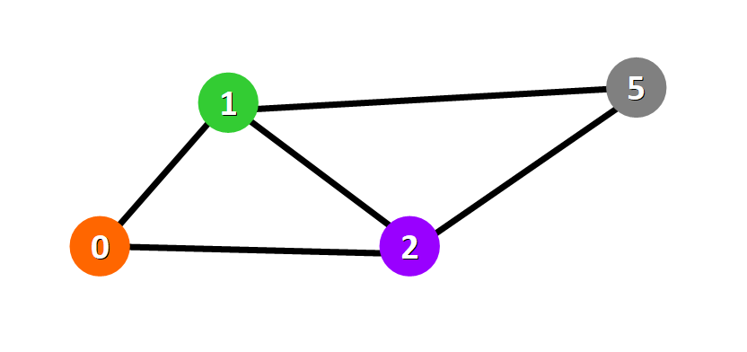
Graphical representation of a graph
Nodes are represented with colored circles and edges are represented with lines that connect these circles.

Slide 5
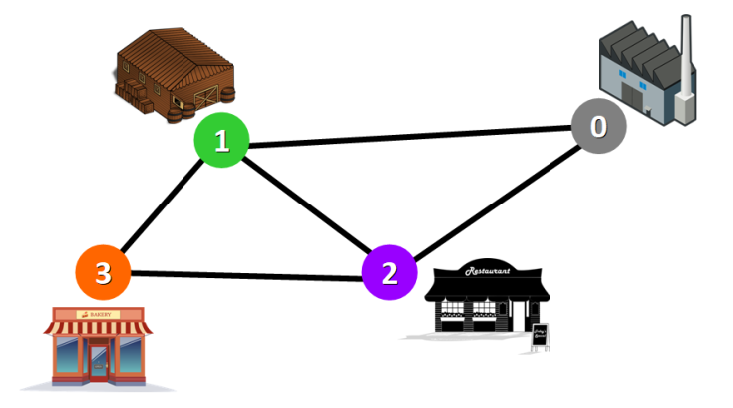

Slide 6
Tip
Two nodes are connected if there is an edge between them.

Slide 7
Applications
Graphs are directly applicable to real-world scenarios.
For example, we could use graphs to model a transportation network where nodes would represent facilities that send or receive products and edges would represent roads or paths that connect them.

Slide 8
Network represented with a graph

Slide 9
Types of Graphs
Undirected graph
Types of graphs
Directed graph
Weighted graph

Slide 10
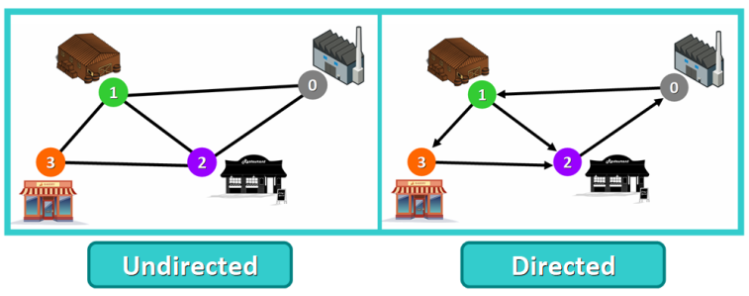
Types of Graphs
Undirected
If for every pair of connected nodes, you can go from one node to the other in both directions.

Slide 11
Types of Graphs
Directed
If for every pair of connected nodes, you can only go from one node to another in a specific direction. We use arrows instead of simple lines to represent directed edges.

Slide 12
Weighted Graphs
Weighted Graph
A graph whose edges have a "weight" or "cost". The weight of an edge can represent distance, time, or anything that models the "connection" between the pair of nodes it connects.
For example, in the weighted you can see a blue number next to each edge. This number is used to represent the weight of the corresponding edge

Slide 13
Weighted Graphs
Weighted Graph
A graph whose edges have a "weight" or "cost". The weight of an edge can represent distance, time, or anything that models the "connection" between the pair of nodes it connects.
For example, in the weighted you can see a blue number next to each edge. This number is used to represent the weight of the corresponding edge

Slide 14
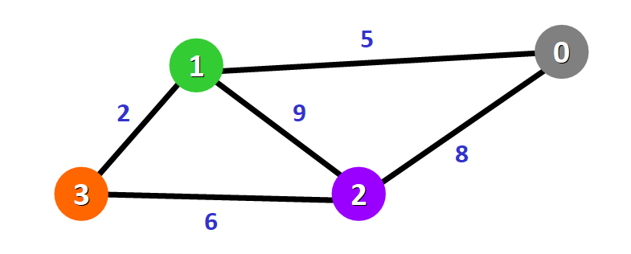
Example of weighted graph

Slide 15
Tip
These weights are essential for Dijkstra's Algorithm.

Slide 16
Basics of Dijkstra's Algorithm
Dijkstra's Algorithm basically starts at the node that you choose (the source node) and it analyzes the graph to find the shortest path between that node and all the other nodes in the graph.

Slide 17
Basics of Dijkstra's Algorithm
The algorithm keeps track of the currently known shortest distance from each node to the source node and it updates these values if it finds a shorter path.

Slide 18
Basics of Dijkstra's Algorithm
Once the algorithm has found the shortest path between the source node and another node, that node is marked as "visited" and added to the path.

Slide 19
Basics of Dijkstra's Algorithm
The process continues until all the nodes in the graph have been added to the path. This way, we have a path that connects the source node to all other nodes following the shortest path possible to reach each node.

Slide 20
Requirements
Dijkstra's Algorithm can only work with graphs that have positive weights. This is because, during the process, the weights of the edges have to be added to find the shortest path.

Slide 21
Requirements
If there is a negative weight in the graph, then the algorithm will not work properly. Once a node has been marked as "visited", the current path to that node is marked as the shortest path to reach that node. And negative weights can alter this if the total weight can be decremented after this step has occurred.

Slide 22
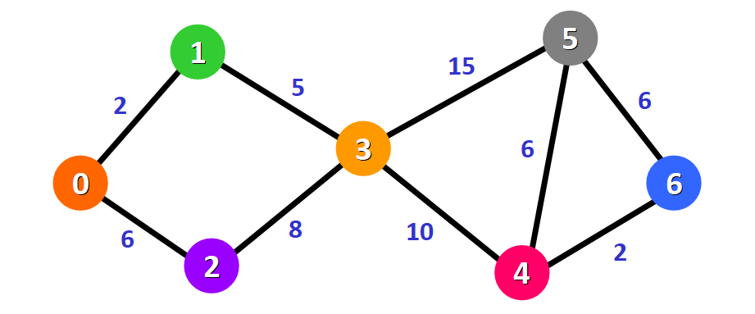
Example of Dijkstra's Algorithm

Slide 23
Example of Dijkstra's Algorithm

