Slide 2
After this lecture you will be able to
understanding services of transport layer

Slide 3
Transport layer services
Transport layer services
End-to-end delivery.
Addressing.
Reliable delivery.
Flow control.
Multiplexing.

Slide 4
End-to-end delivery:
The transport layer transmits the entire message to the destination.
Therefore, it ensures the end-to-end delivery of an entire message from a source to the destination.

Slide 5
End-to-end delivery:
The transport layer transmits the entire message to the destination.
Therefore, it ensures the end-to-end delivery of an entire message from a source to the destination.

Slide 6
Reliable delivery
Four Aspects of Relable delivery
Error control
Sequence control
Loss control
Duplication control

Slide 7
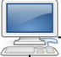
Error Control
Errors not checked at the data link layer
Errors checked at the data link layer

Slide 8
Flow Control
Prevent the sender from overwhelming the receiver.
If the receiver is overloaded with too much data, then the receiver discards the packets and asking for the retransmission of packets. This increases network congestion and thus, reducing the system performance.

Slide 9
Flow Control
Prevent the sender from overwhelming the receiver.
If the receiver is overloaded with too much data, then the receiver discards the packets and asking for the retransmission of packets. This increases network congestion and thus, reducing the system performance.

Slide 10
Flow Control
Prevent the sender from overwhelming the receiver

Slide 11
Flow Control
Prevent the sender from overwhelming the receiver
TCP Sender Sending at 10 messages/Second
TCP Receiver receiving at 5 messages/Second
TCP/IP
TCP/IP
Sender Buffer Size 100
Receiver Buffer Size 100

Slide 12
Multiplexing
UPPER LAYERS STACK
UPPER LAYERS STACK
UPPER LAYERS STACK
1
2
3
One virtual circuit
Upward

Slide 13
Demultiplexing
UPPER LAYERS STACK
2
One virtual circuit
Downward

Slide 14
Addressing
According to the layered model, the transport layer interacts with the functions of the session layer.
Many protocols combine session, presentation, and application layer protocols into a single layer known as the application layer. In these cases, delivery to the session layer means the delivery to the application layer. Data generated by an application on one machine must be transmitted to the correct application on another machine. In this case, addressing is provided by the transport layer.

Slide 15
Addressing
According to the layered model, the transport layer interacts with the functions of the session layer.
Many protocols combine session, presentation, and application layer protocols into a single layer known as the application layer. In these cases, delivery to the session layer means the delivery to the application layer. Data generated by an application on one machine must be transmitted to the correct application on another machine. In this case, addressing is provided by the transport layer.

Slide 16
Addressing
The transport layer provides the user address which is specified as a station or port. The port variable represents a particular TS user of a specified station known as a Transport Service access point (TSAP). Each station has only one transport entity.
The transport layer protocols need to know which upper-layer protocols are communicating.

Slide 17
Addressing
The transport layer provides the user address which is specified as a station or port. The port variable represents a particular TS user of a specified station known as a Transport Service access point (TSAP). Each station has only one transport entity.
The transport layer protocols need to know which upper-layer protocols are communicating.

Slide 18
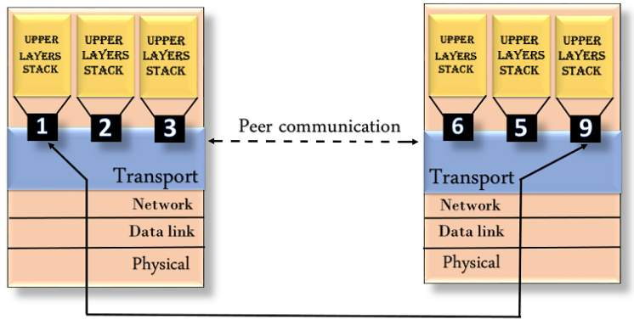
Addressing

Slide 19
Connectionless V/S Connection-Oriented Service

Slide 20
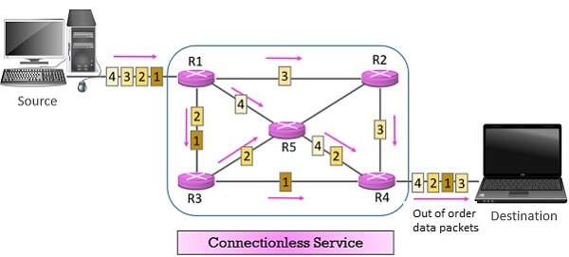
Connectionless Service
UDP is connectionless.

Slide 21
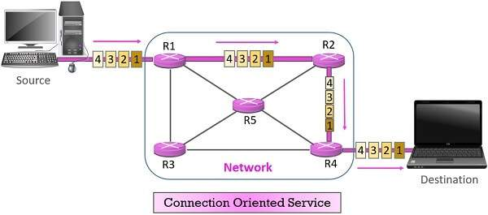
Connection-oriented Service
TCP and SCTP are connection-oriented protocols.

Slide 22
Reliable V/S Unreliable

Slide 23
Reliable vs Unreliable
If the application layer program needs reliability, we use a reliable transport layer protocol by implementing flow and error control at the transport layer.
This means a slower and more complex service.
In the Internet, there are three common different transport layer protocols. UDP is connectionless and unreliable.
TCP and SCTP are connection oriented and reliable.

Slide 24
Reliable vs Unreliable
If the application layer program needs reliability, we use a reliable transport layer protocol by implementing flow and error control at the transport layer.
This means a slower and more complex service.
In the Internet, there are three common different transport layer protocols. UDP is connectionless and unreliable.
TCP and SCTP are connection oriented and reliable.

Slide 25
Reliable vs Unreliable
If the application layer program needs reliability, we use a reliable transport layer protocol by implementing flow and error control at the transport layer.
This means a slower and more complex service.
In the Internet, there are three common different transport layer protocols. UDP is connectionless and unreliable.
TCP and SCTP are connection oriented and reliable.

Slide 26
Reliable vs Unreliable
If the application layer program needs reliability, we use a reliable transport layer protocol by implementing flow and error control at the transport layer.
This means a slower and more complex service.
In the Internet, there are three common different transport layer protocols. UDP is connectionless and unreliable.
TCP and SCTP are connection oriented and reliable.

Slide 27

Error Control
Transport
Transport
Network
Network
Data link
Data link
Physical
Physical
LAN
WAN
LAN
Error is checked in these paths by the data link layer
Error is checked in these paths by the data link layer

