Slide 2
After this lecture, you will be able to
explain process-to-process communication.
know the format of a UDP user datagram.
calculate a UDP checksum.
understand the operation of UDP.
know when it is appropriate to use UDP.

Slide 3

Position of UDP in the TCP/IP protocol suite
Application layer
SMTP
FTP
TFTP
DNS
SNMP
….
BOOTP
Transport layer
SCTP
TCP
UDP
Network layer
IGMP
ICMP
IP
ARP
RARP
Data link layer
Underlying LAN or WAN technology
Physical layer

Slide 4
User Datagram Protocol
Connectionless.
Unreliable transport protocol.
Process-to process communication
Limited error checking.

Slide 5
User Datagram Protocol
Advantages of UDP
Minimum of overhead.
If a process wants to send a small message and does not care much about reliability, it can use UDP.
Less interaction between the sender and receiver than using TCP or SCTP.

Slide 6
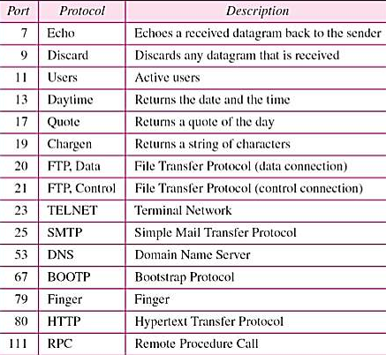
Well-Known Ports for UDP
Some port numbers can be used by both UDP and TCP.

Slide 7
FTP can use port 21 with either UDP or TCP.
SNMP uses two port numbers (161 and 162), each for a different purpose

Slide 8
User Datagram
UDP packets, called user datagrams, have a fixed-size header of 8 bytes.

Slide 9
PROCESS-TO-PROCESS COMMUNICATION
Before we examine UDP, we must first understand
host-to-host and the
communication and process-to-process communication
difference between them.
The topics discussed in this section include:
Port Numbers Socket Addresses

Slide 10
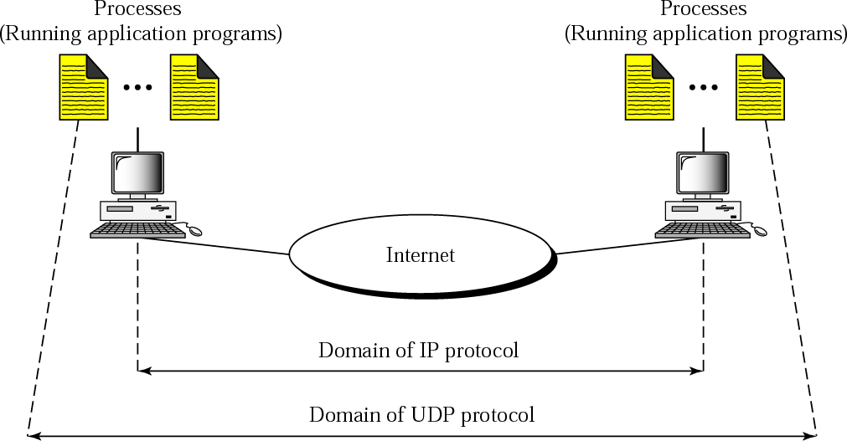
UDP versus IP

Slide 11
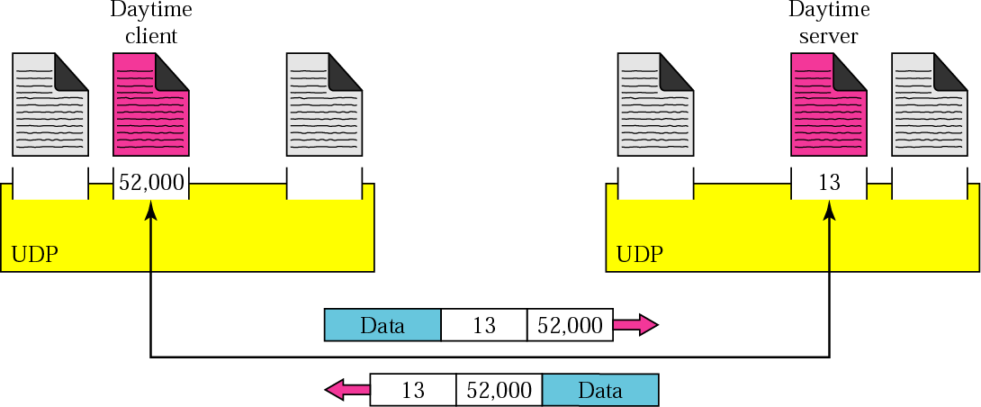
Port Numbers

Slide 12
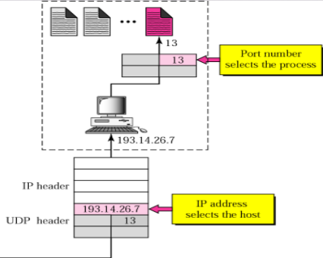
IP addresses versus port numbers

Slide 13
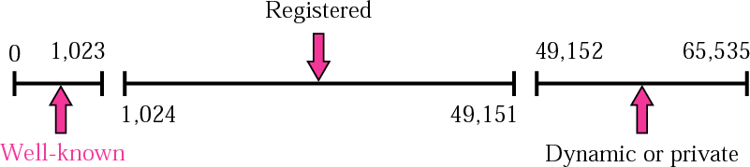
ICANN Ranges

Slide 14

Note:
The well-known port numbers are less than 1024.

Slide 15
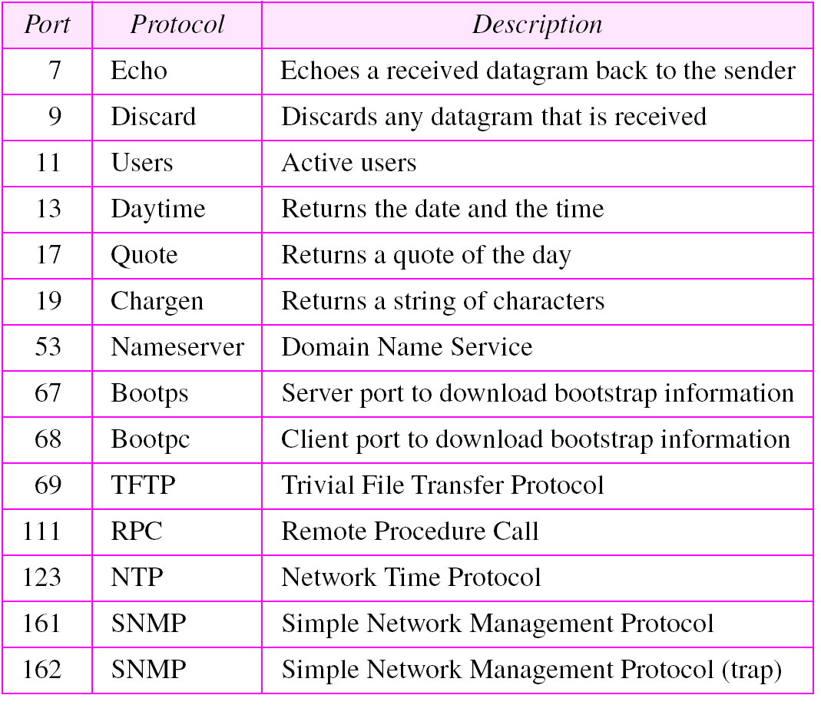
Well-known Ports Used with UDP

Slide 16
Example
In UNIX, the well-known ports are stored in a file called
/etc/services. Each line in this file gives the name of the server and the well-known port number. We can use the grep utility to extract the line corresponding to the desired application. The following shows the port for TFTP. Note TFTP can use port 69 on either UDP or TCP.
$ grep tftp /etc/services
tftp 69/tcp
tftp 69/udp
See Next Slide

Slide 17
Example
SNMP uses two port numbers (161 and 162), each for a different purpose.
$ grep snmp /etc/services
snmp | 161/tcp | #Simple Net Mgmt Proto
snmp | 161/udp | #Simple Net Mgmt Proto
snmptrap | 162/udp | #Traps for SNMP

Slide 18
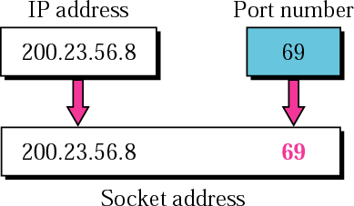
Example

Slide 19
USER DATAGRAM
UDP packets are called user datagrams and have a fixed-size header of 8 bytes.

Slide 20
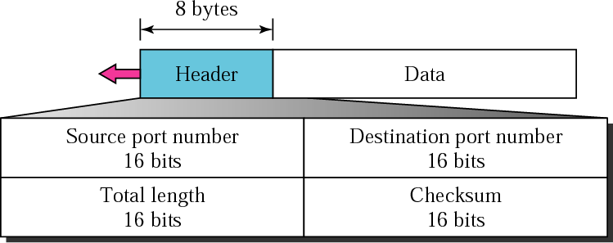
USER DATAGRAM FORMAT

Slide 21

Note:
UDP length =
IP length − IP header’s length

Slide 22
CHECKSUM
UDP checksum calculation is different from the one for IP and ICMP. Here the checksum includes three sections: a pseudoheader, the UDP header, and the data coming from the application layer.

Slide 23
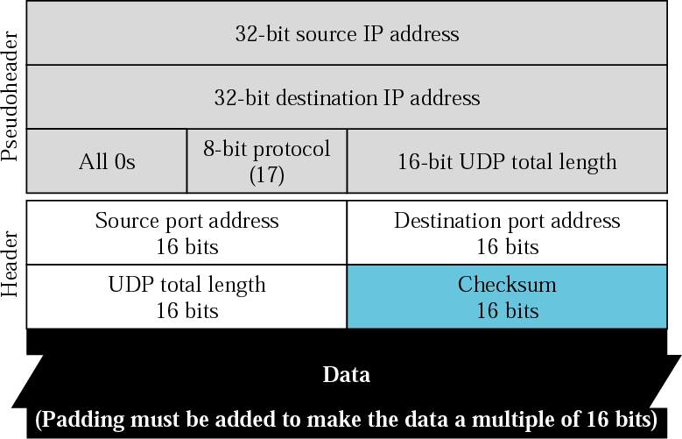
Pseudoheader for checksum calculation

Slide 24
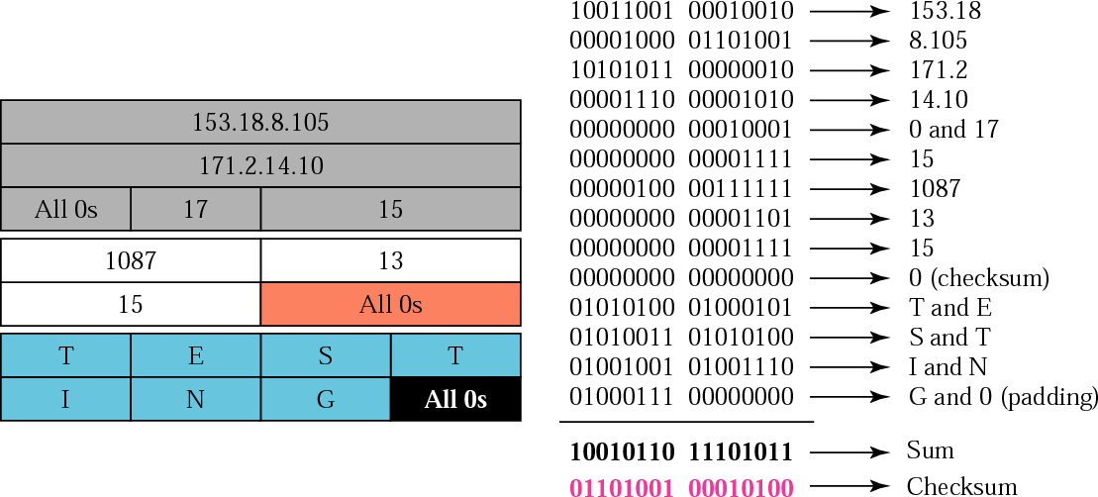
Checksum calculation of a simple UDP user datagram

Slide 25
UDP Operation
UDP uses concepts common to the transport layer. These concepts will be discussed here briefly, and then expanded in the next chapter on the TCP protocol.
The topics discussed in this section include:
Connectionless Services Flow and Error Control
Encapsulation and Decapsulation Queuing
Multiplexing and Demultiplexing

Slide 26
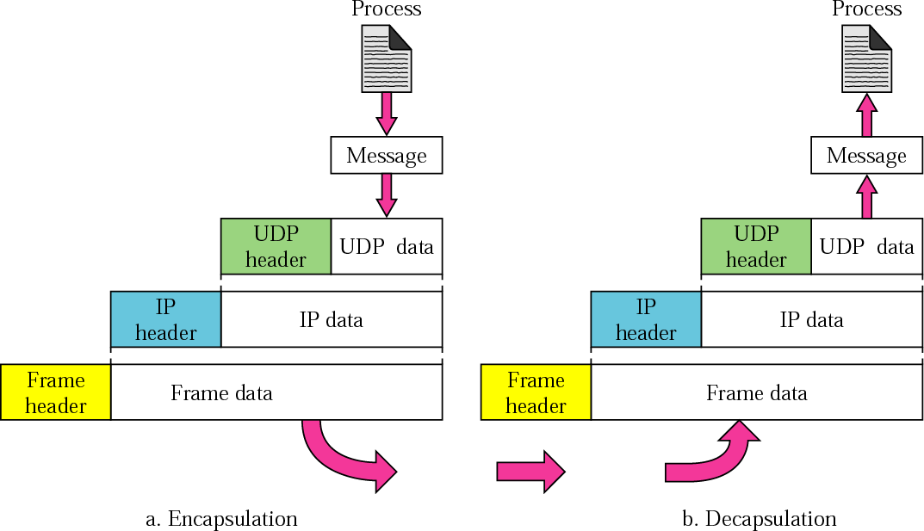
Encapsulation and Decapsulation

Slide 27
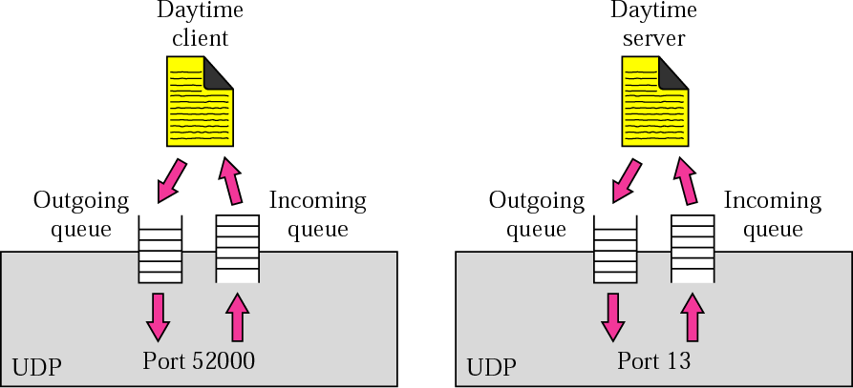
Queues in UDP

Slide 28
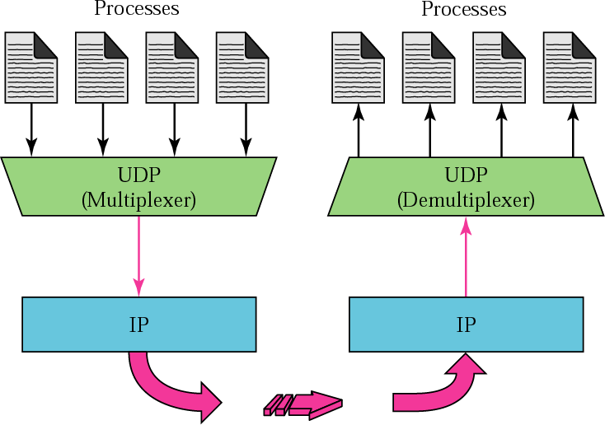
Multiplexing and Demultiplexing

Slide 29
Use of UDP
UDP is suitable for a process that requires simple request-response communication with little concern for flow and error control. It is not usually used for a process such as FrP that needs to send bulk data.
UDP is suitable for a process with internal flow and error control mechanisms. For example, the Trivial File Transfer Protocol (TFTP) process includes flow and error control. It can easily use UDP.

Slide 30
Use of UDP
UDP is a suitable transport protocol for multicasting. Multicasting capability is embedded in the UDP software but not in the TCP software.
UDP is used for management processes such as SNMP.
UDP is used for some route updating protocols such as Routing Information Protocol(RIP).

Slide 31
TCP
TCP is a connection-oriented protocol; it creates a virtual connection between two TCPs to send data. In addition, TCP uses flow and error control mechanisms at the transport level.

Slide 32
Topics to be discussed
TCP Services
TCP Features
Segment
A TCP Connection
Flow Control
Error Control

Slide 33
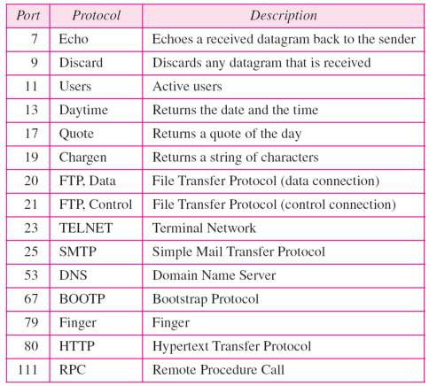
Well Known Ports Used by TCP

Slide 34
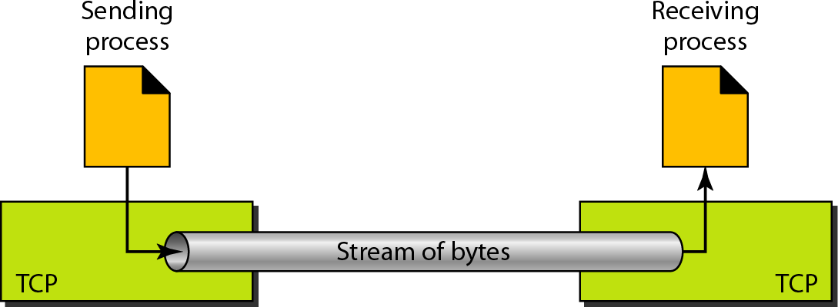
Stream Delivery

Slide 35
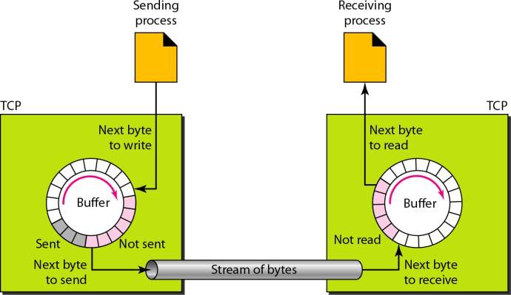
Sending and Receiving Buffers

Slide 36
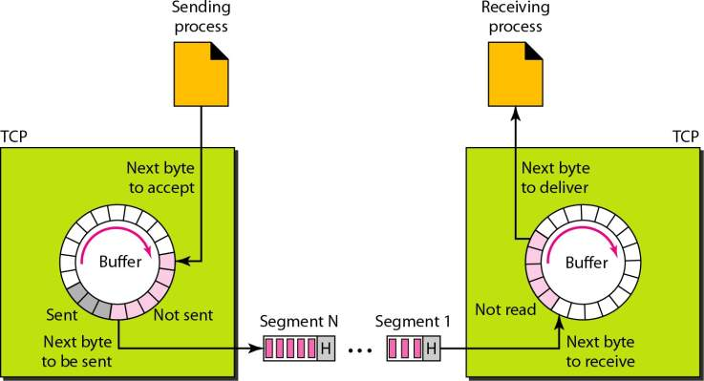
TCP Segments

Slide 37

Note
The bytes of data being transferred in each connection are numbered by TCP. The numbering starts with a randomly generated number.

Slide 38
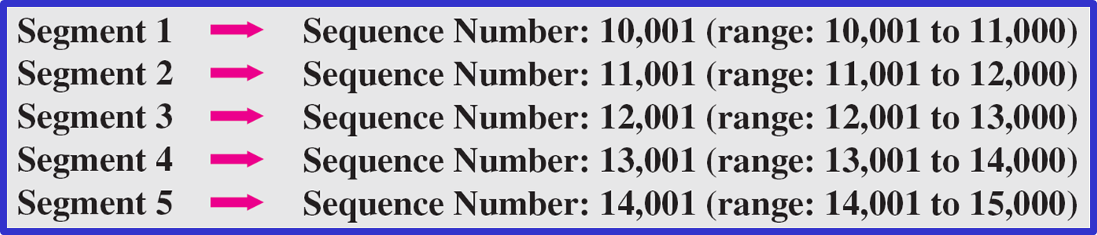
The following shows the sequence number for each segment:

Slide 39
Note
The value in the sequence number field of a segment defines the number of the first data byte contained in that segment.

Slide 40
Note
The value of the acknowledgment field in a segment defines the number of the next byte a party expects to receive.
The acknowledgment number is cumulative.

Slide 41
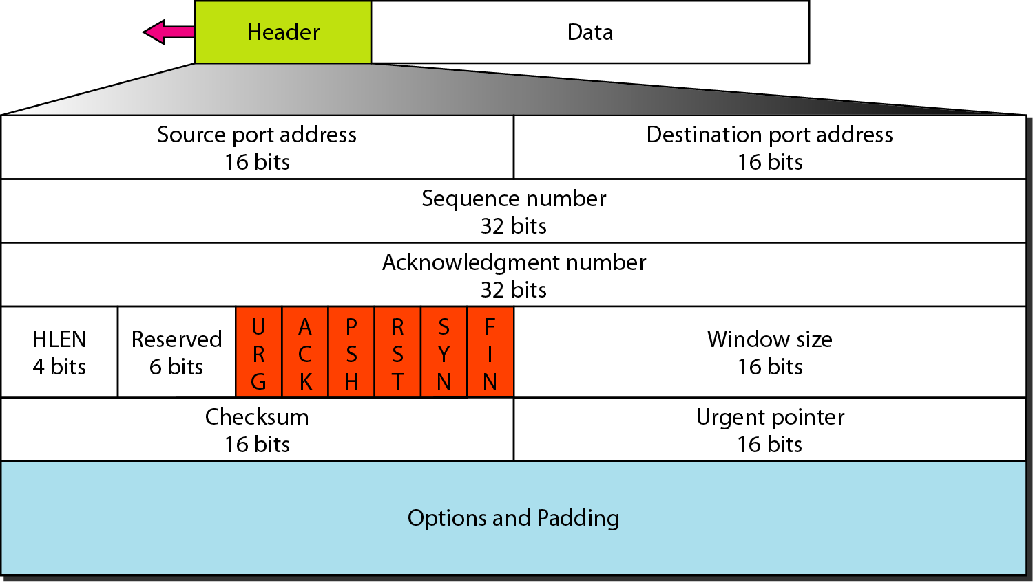
TCP Segment Format

Slide 42
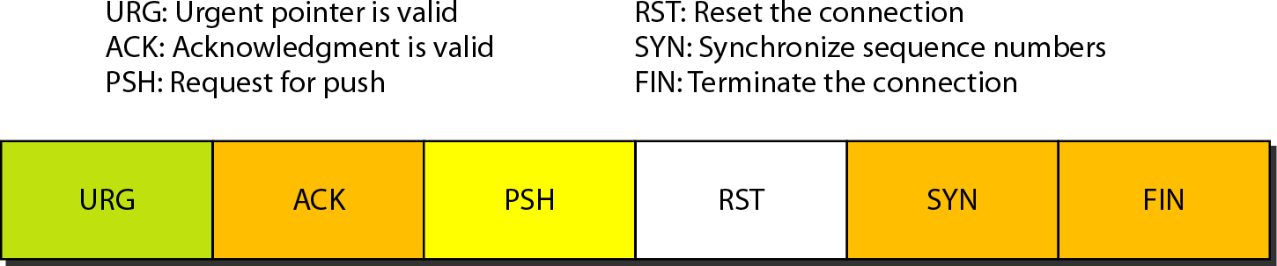
Control Field

Slide 43
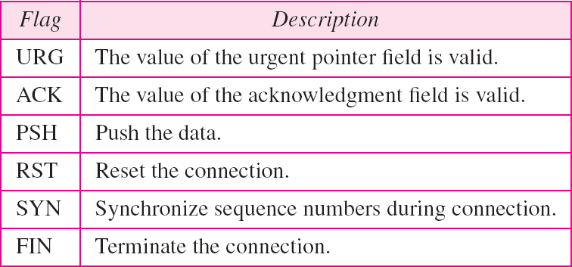
Description of Flags in the Control Field

Slide 44
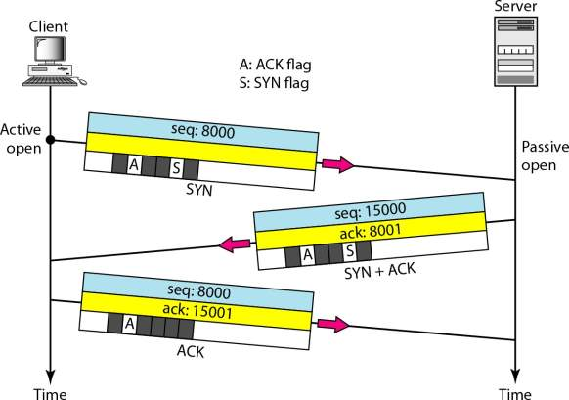
Connection establishment using three-way handshaking

Slide 45
Note
A SYN segment cannot carry data, but it consumes one sequence number.

Slide 46
Note
A SYN + ACK segment cannot carry data, but does consume one sequence number.

Slide 47
Note
An ACK segment, if carrying no data, consumes no sequence number.

Slide 48
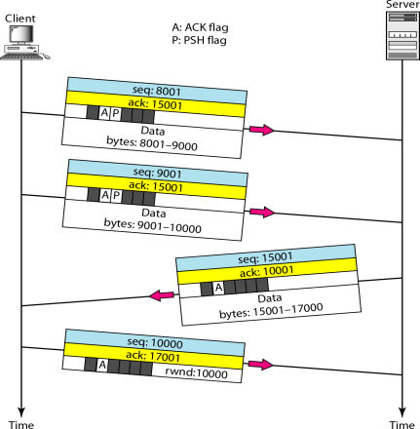
Data Transfer

Slide 49
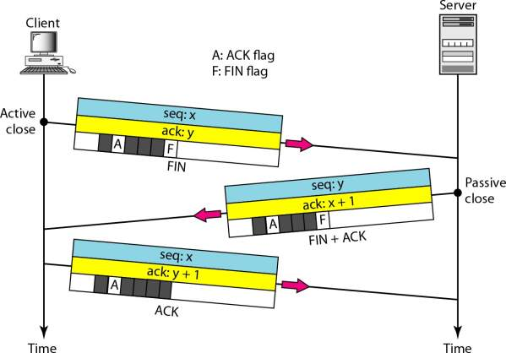
Connection Termination Using Three-way Handshaking

Slide 50
Note
The FIN segment consumes one sequence number if it does
not carry data.

Slide 51
Note
The FIN + ACK segment consumes one sequence number if it does not carry data.

Slide 52
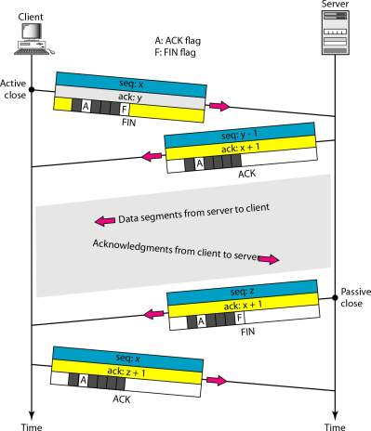
Half-close

Slide 53
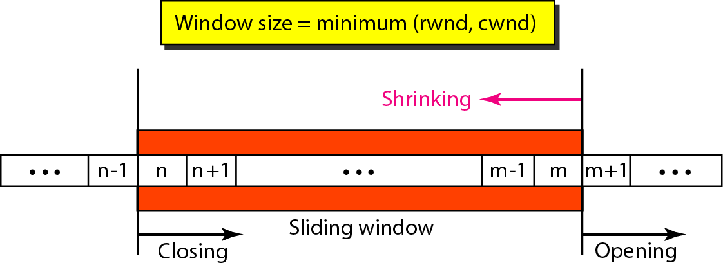
Sliding Window

Slide 54
Note
A sliding window is used to make transmission more efficient as well as to control the flow of data so that the destination does not become overwhelmed with data.
TCP sliding windows are byte-oriented.

Slide 55
Example
What is the value of the receiver window (rwnd) for host A if the receiver, host B, has a buffer size of 5000 bytes and 1000 bytes of received and unprocessed data?

Slide 56
Example
What is the value of the receiver window (rwnd) for host A if the receiver, host B, has a buffer size of 5000 bytes and 1000 bytes of received and unprocessed data?
Solution
The value of rwnd = 5000 − 1000 = 4000. Host B can receive only 4000 bytes of data before overflowing its buffer. Host B advertises this value in its next segment to A.

Slide 57
Example
What is the size of the window for host A if the value of rwnd is 3000 bytes and the value of cwnd is 3500 bytes?

Slide 58
Example
What is the size of the window for host A if the value of rwnd is 3000 bytes and the value of cwnd is 3500 bytes?
Solution
The size of the window is the smaller of rwnd and cwnd, which is 3000 bytes.

Slide 59
Some Points About TCP Sliding Windows
The size of the window is the lesser of rwnd and cwnd.

Slide 60
Some Points About TCP Sliding Windows
The size of the window is the lesser of rwnd and cwnd.
The source does not have to send a full window’s worth of data.

Slide 61
Some Points About TCP Sliding Windows
The size of the window is the lesser of rwnd and cwnd.
The source does not have to send a full window’s worth of data.
The window can be opened or closed by the receiver, but should not be shrunk.

Slide 62
Some Points About TCP Sliding Windows
The size of the window is the lesser of rwnd and cwnd.
The source does not have to send a full window’s worth of data.
The window can be opened or closed by the receiver, but should not be shrunk.
The destination can send an acknowledgment at any time as long as it does not result in a shrinking window.

Slide 63
Some Points About TCP Sliding Windows
The size of the window is the lesser of rwnd and cwnd.
The source does not have to send a full window’s worth of data.
The window can be opened or closed by the receiver, but should not be shrunk.
The destination can send an acknowledgment at any time as long as it does not result in a shrinking window.
The receiver can temporarily shut down the window; the sender, however, can always send a segment of 1 byte after the window is shut down.

Slide 64
Note
ACK segments do not consume sequence numbers and are not acknowledged.

Slide 65
Note
In modern implementations, a retransmission occurs if the retransmission timer expires or three duplicate ACK segments have arrived.

Slide 66
Note
In modern implementations, a retransmission occurs if the retransmission timer expires or three duplicate ACK segments have arrived.

Slide 67
Note
No retransmission timer is set for an ACK segment.

Slide 68
Note
Data may arrive out of order and be temporarily stored by the receiving TCP, but TCP guarantees that no out-of-order segment is delivered to the process.

Slide 69
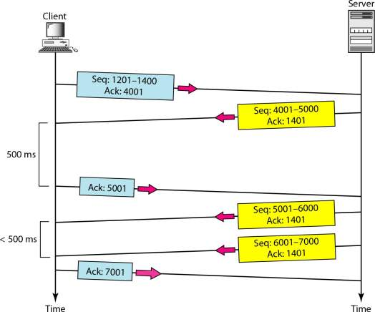
Normal Operation

Slide 70
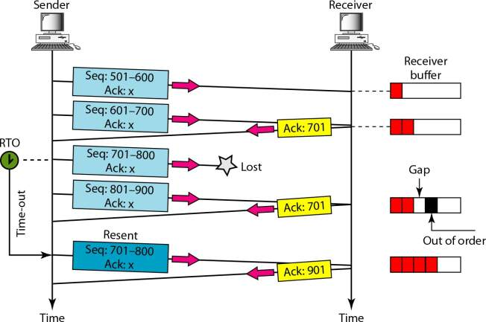
Lost Segment

Slide 71
Note
The receiver TCP delivers only ordered data to the process.

Slide 72
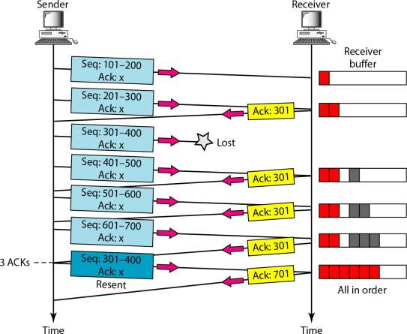
Fast Retransmission

