Slide 2
After this lecture you will be able to
understand traffic descriptor and traffic profiles.
understanding congestion control categories.

Slide 3
Data Traffic
The main focus of congestion control and quality of service is data traffic. In congestion control we try to avoid traffic congestion. In quality of service, we try to create an appropriate environment for the traffic. So, before talking about congestion control and quality of service, we discuss the data traffic itself.

Slide 4
Data Traffic
Topics discussed in this section:
Traffic Descriptor
Traffic Profiles

Slide 5
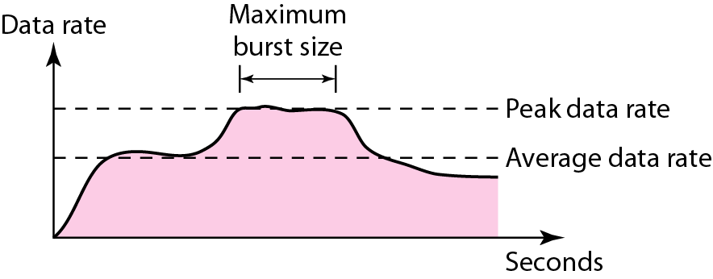
Traffic Descriptors

Slide 6
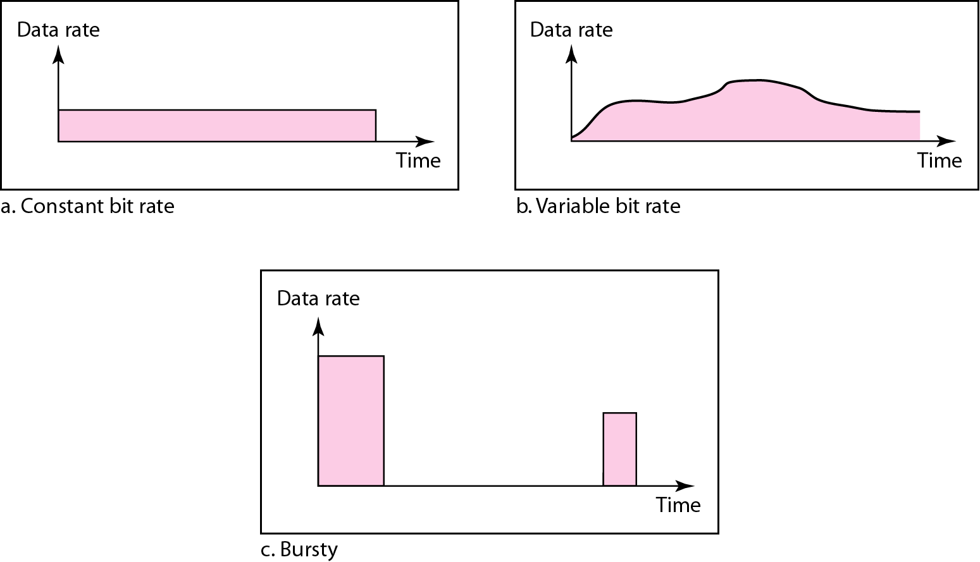
Three Traffic Profiles

Slide 7
Congestion
Congestion in a network may occur if the load on the network (the number of packets sent to the network) bis greater than the capacity of the network (the number of packets a network can handle).
Congestion control refers to the mechanisms and techniques to control the congestion and keep the load below the capacity.

Slide 8
Congestion
Topic discussed in this section:
Network Performance

Slide 9
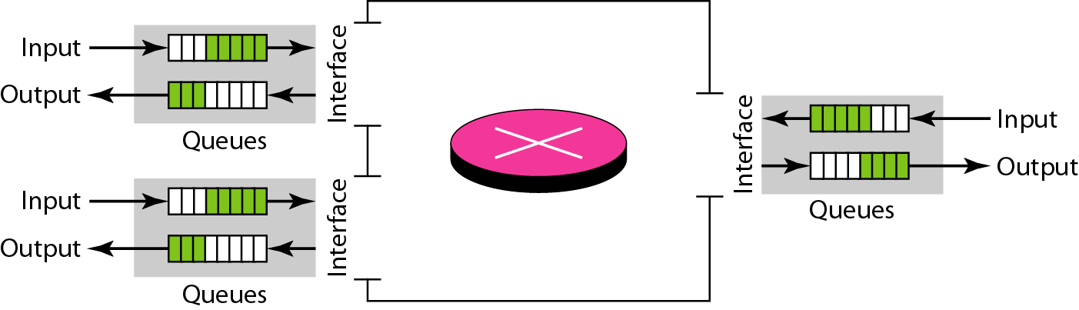
Queues in a Router

Slide 10
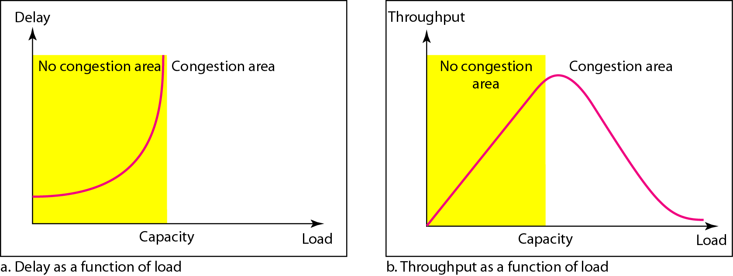
Packet Delay and Throughput as Functions of Load

Slide 11
Congestion Control
Congestion control refers to techniques and mechanisms that can either prevent congestion, before it happens, or remove congestion, after it has happened. In general, we can divide congestion control mechanisms into two broad categories:
open-loop congestion control (prevention) and
closed-loop congestion control (removal).

Slide 12
Congestion Control
Topics discussed in this section:
Open-Loop Congestion Control
Closed-Loop Congestion Control

Slide 13
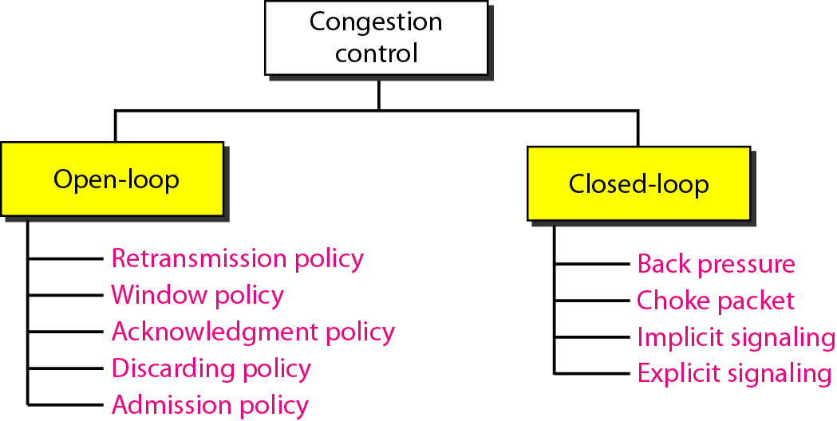
Congestion Control Categories
Congestion Control
Open Loop
Closed Loop

Slide 14
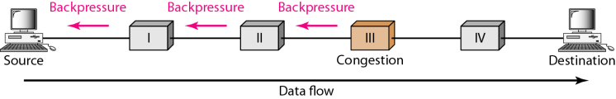
Backpressure Method for Alleviating Congestion

Slide 15
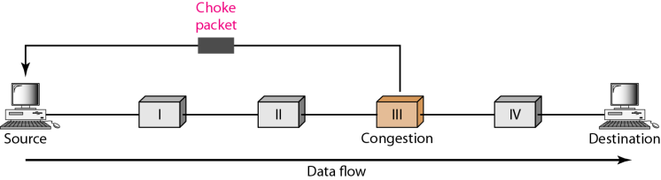
Choke Packet

Slide 16
Implicit Signaling
Implicit signaling, there is no communication between the congested nodes and the source. The source guesses that there is congestion in a network. For example when sender sends several packets and there is no acknowledgment for a while, one assumption is that there is a congestion.

Slide 17
Explicit Signaling
In explicit signaling, if a node experiences congestion it can explicitly sends a packet to the source or destination to inform about congestion. Explicit signaling can occur in either forward or backward direction.

Slide 18
Explicit Signaling
Forward Signaling: In forward signaling signal is sent in the direction of the congestion. The destination is warned about congestion. The receiver in this case adopt policies to prevent further congestion.
Backward Signaling: In backward signaling signal is sent in the opposite direction of the congestion. The source is warned about congestion and it needs to slow down.

