Slide 2
After this lecture you will be able to
learning flow characteristics.
techniques to improve quality of service.
learning traffic shaping techniques.

Slide 3
So what is it?
Quality of service is the ability to provide different priority to different applications, users, or data flows, or to guarantee a certain level of performance to a data flow

Slide 4
Flow Characteristics
Flow Characteristics
Reliability
Bandwidth
Delay
Jitter

Slide 5
Flow Characteristics
Reliability:
Lack of Reliability means losing a packet or ack.

Slide 6
Flow Characteristics
Delay:
Different applications can tolerate delay in different degrees.

Slide 7
Flow Characteristics
Jitter:
jitter is the variation in packets belonging to same flow.

Slide 8
Flow Characteristics
Bandwidth:
different application need different b/w.

Slide 9
Techniques to Improve the Quality of Service.
Scheduling
FIFO QUEUING
PRIORITY QUEUING
WEIGHTED FAIR QUEUING
Traffic Shaping
LEAKY BUCKET
Resource Réservation
Admission Control
TOKEN BUCKET

Slide 10
Techniques to Improve the Quality of Service.
Scheduling
FIFO QUEUING
PRIORITY QUEUING
WEIGHTED FAIR QUEUING

Slide 11
Scheduling
Packets from different flow arrive at switch or router for processing
A good scheduling technique treats the different flow in a fair and appropriate manner

Slide 12
Scheduling
Packets from different flow arrive at switch or router for processing
A good scheduling technique treats the different flow in a fair and appropriate manner

Slide 13
FIFO QUEUING
Full?
N
Processor
Departure
Arrival
Queue
Y
Discard

Slide 14

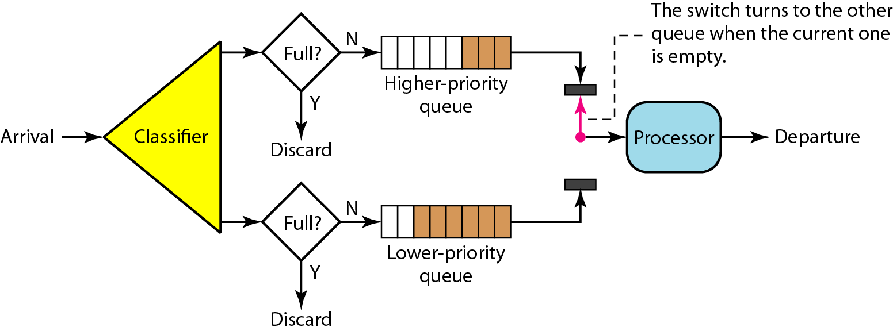
Priority Queuing

Slide 15
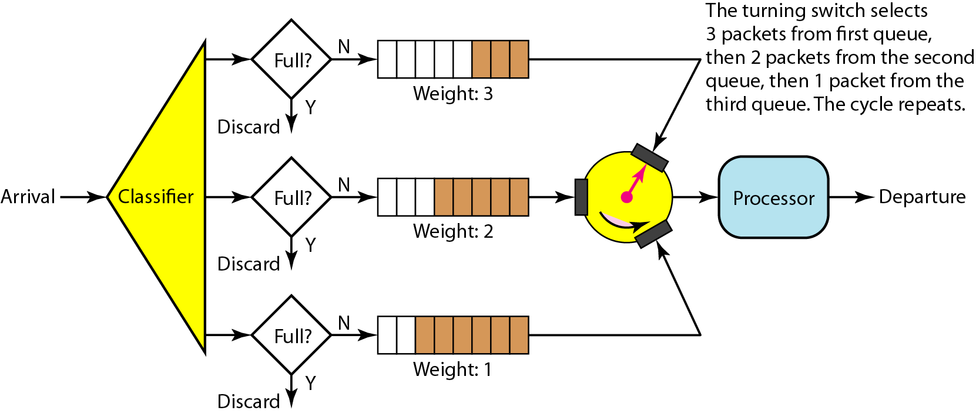
Weighted Fair Queuing

Slide 16
Techniques to Improve the Quality of Service.
Traffic Shaping
LEAKY BUCKET
TOKEN BUCKET

Slide 17
Traffic Shaping
Is the mechanism to control the amount and the rate of the traffic sent to the network ?

Slide 18
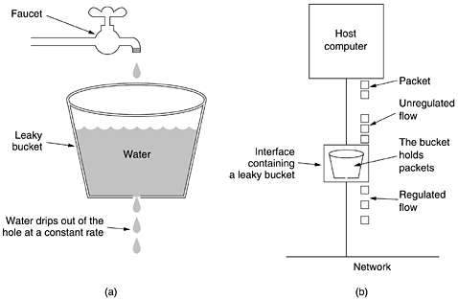
Leaky Bucket

Slide 19
Leaky Bucket Implementation
Leaky bucket algorithms
Remove packets at a constant rate
Full?
N
Processor
Departure
Arrival
Queue
Y
Discard

Slide 20
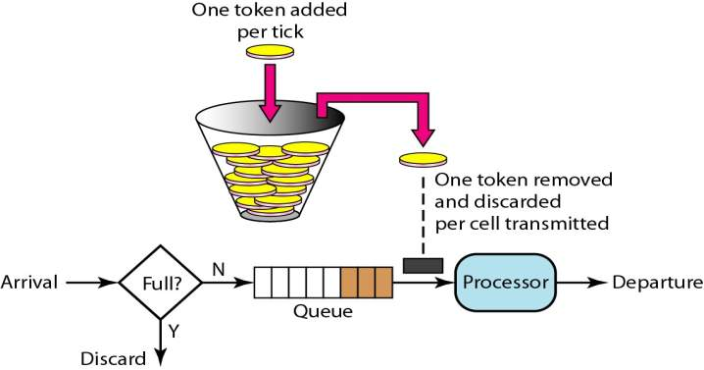
Token Bucket

Slide 21
Techniques to Improve the Quality of Service
Resource Reservation

Slide 22
Resource Reservation
A flow of data needs resources such as buffer, bandwidth, CPU time, and so on .
QoS can be improved if these resources are reserved beforehand.

Slide 23
Resource Reservation
A flow of data needs resources such as buffer, bandwidth, CPU time, and so on .
QoS can be improved if these resources are reserved beforehand.

Slide 24
Techniques to Improve the Quality of Service
Admission Control

Slide 25
Admission Control
Routers or switches puts restrictions on the admission of packets from host.
Before a router accepts the flow , it checks the flow for specifications in terms of bandwidth , buffer size ,cpu speed etc.

Slide 26
Admission Control
Routers or switches puts restrictions on the admission of packets from host.
Before a router accepts the flow , it checks the flow for specifications in terms of bandwidth , buffer size ,CPU speed etc.

