Slide 2
After this lecture you will be able to
understand Telnet, FTP

Slide 3
Topics to be discussed
Timesharing environment
Logging
Network virtual terminal
Embedding
Options
Mode of Operation

Slide 4
TELNET
Teletype Network protocol
Terminal Network

Slide 5
When it is developed?
Telnet, developed in 1969

Slide 6
Who proposed TELNET ?
It is the standard TCP/IP protocol for virtual terminal service as proposed by the International Organization for Standards (ISO).
It is a general purpose client/server application program

Slide 7
What is TELNET?
TELNET enables the establishment of a connection to a remote system in such a way that the local terminal appears to be a terminal at the remote system.

Slide 8
TELNET is a general-purpose client/server application program.

Slide 9
TELNET
Timesharing Enviroment
TELNET was designed at a time when most operating systems, such as UNIX, were operating in a timesharing environment.
In such an environment, a large computer supports multiple users.
The interaction between a user and the computer occurs through a terminal, which is usually a combination of keyboard, monitor, and mouse.
Even a microcomputer can simulate a terminal with a terminal emulator.

Slide 10
TELNET
Logging
When a users logs into a local timesharing system, it is called log-in | When a user wants to access an application program or utility located on a remote machine, it is called remote log-in.

Slide 11
TELNET
Logging
To access the system, user logs into the system with user-id. The system also includes password checking to prevent an unauthorized user accessing the resources.
Logging process can be local logging or remote logging.

Slide 12
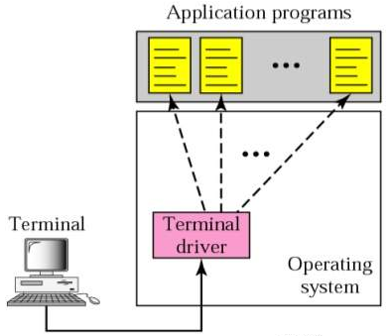
TELNET
Local log-in
Local log-in

Slide 13
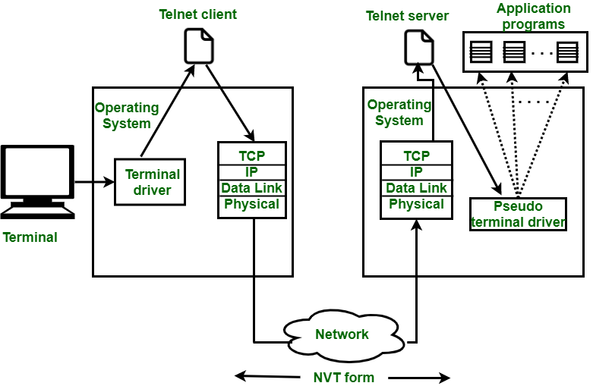
TELNET
Logging
Remote log-in

Slide 14
TELNET
The user sends the keystrokes to the terminal driver, where the local operating system accepts the characters but does not interpret them.
The characters are sent to the TELNET client, which transforms the characters to a universal character set called network virtual terminal(NVT) characters and delivers them to the local TCP/IP protocol stack.

Slide 15
TELNET
The text in NVT form travel through the internet and arrive at the TCP/IP stack at the remote machine.
The characters are delivered to the operating system and passed to the TELNET server which changes the characters to the corresponding characters understandable by the remote computer.

Slide 16
TELNET
However, the characters cannot be passed directly to the operating system because the remote operating system is not designed to receive characters from a TELNET server.
It is designed to receive characters from a terminal driver.
A software called a pseudo terminal driver is added which pretends that the characters are coming from a terminal.

Slide 17
TELNET
Network Virtual Terminal
Access a remote computer is complex.
This is so because every computer and its operating system accept a special combination of characters as tokens.
For example, the end-of-file token in a computer running the DOS operating system is Ctrl+z, while the UNIX operating system recognizes Ctrl+d.

Slide 18
TELNET
Network Virtual Terminal
install the specific terminal emulator
network virtual terminal (NVT) character set.
Via this interface, the client TELNET translates characters (data or commands) that come from the local terminal into NVT form and delivers them to the network.

Slide 19
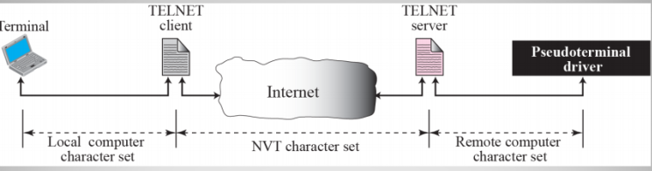
TELNET
Concept of NVT

Slide 20
TELNET
The client telnet translates characters that come from local terminal into NVT form and delivers them to the network.
The server telnet translates data and commands from NVT form into the form acceptable by the remote computer.

Slide 21
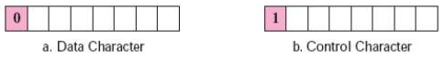
TELNET
NVT Character Set
It uses two sets of characters one for data and one for control.

Slide 22
TELNET
EMBEDDING
Telnet uses only one TCP connection.
The same connection is used for sending both data and control characters.
Telnet accomplishes this by embedding the control characters in the data stream.
To distinguish data from control characters, each sequence of control characters is preceded by a special control character called interpret as control(IAC).

Slide 23
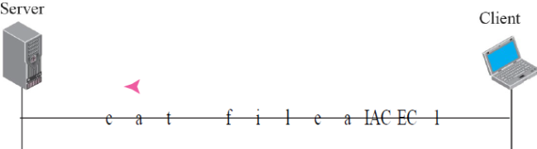
TELNET
An example of embedding

Slide 24
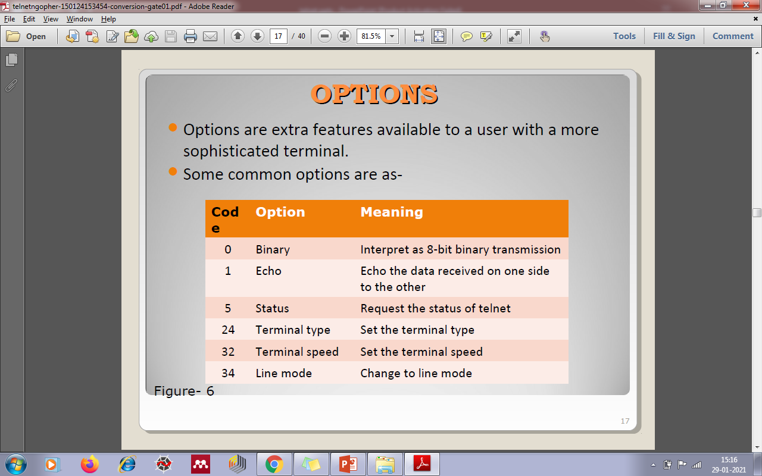
OPTIONS
Options are extra features available to a user with a more sophisticated terminal.
Some common options are as-
CODE | OPTION | MEANING

Slide 25
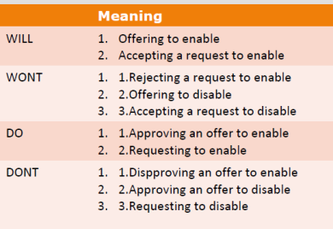
Option Negotiation
Telnet lets the client and server negotiate options before or during the use of the service.
Four control characters are used for this purpose

Slide 26
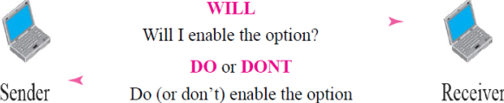
Offer to Enable an Option

Slide 27
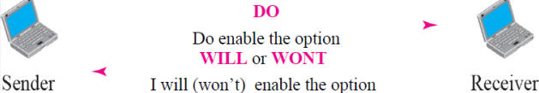
Request to Enable an Option

Slide 28
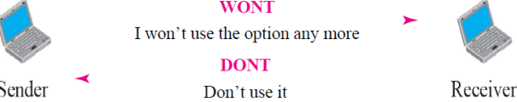
Offer to Disable an Option

Slide 29
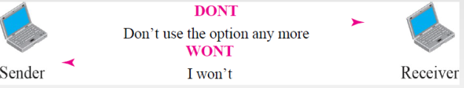
Request to Disable an Option

Slide 30
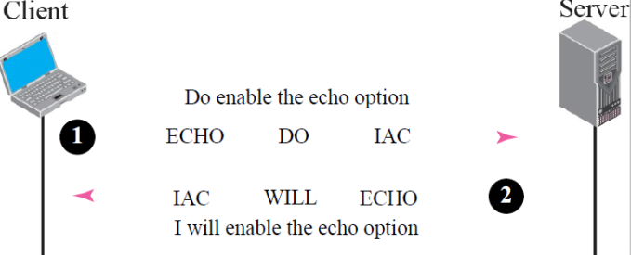
Example of Option ‘Echo’

Slide 31
Mode of Operation
Most Telnet implementation operate in one of the three modes-
Default mode
Character mode
Line mode

Slide 32
Default Mode
This mode is used if no other modes are invoked through option negotiation
Echoing is done by the client.
The user types the character , client echoes the character but does not send it until a whole line is completed.

Slide 33
Character Mode
Each character typed is sent by the client to the server.
The server echoes the character back to be displayed on the client screen.
Echoing of the character can be displayed if the transmission time is long.
It also creates overhead for the network

Slide 34
Line Mode
It is proposed to compensate for the deficiencies of default mode and character mode.
In this line echoing is done by the client.
The client then sends the whole line to the server.

Slide 35
FILE TRANSFER PROTOCOL(FTP)

Slide 36
FTP
Transferring files from one computer to another is one of the most common tasks expected from a networking or internetworking environment.
As a matter of fact, the greatest volume of data exchange in the Internet today is due to file transfer

Slide 37
File Transfer Protocol (FTP)
File Transfer Protocol (FTP) is the standard mechanism provided by TCP/IP for copying a file from one host to another

Slide 38
FTP uses the services of TCP. It needs two TCP connections. The well-known port 21 is used for the control connection and the well-known port 20 for the data connection.

Slide 39
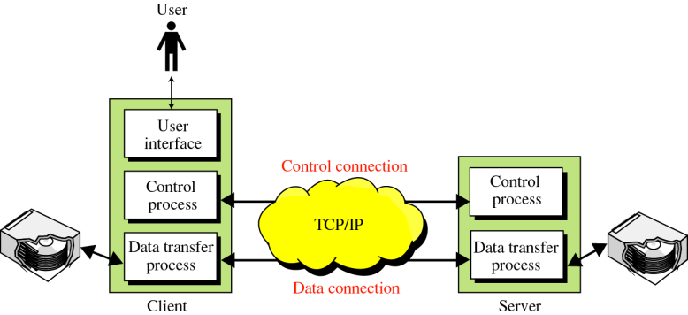
FTP

Slide 40
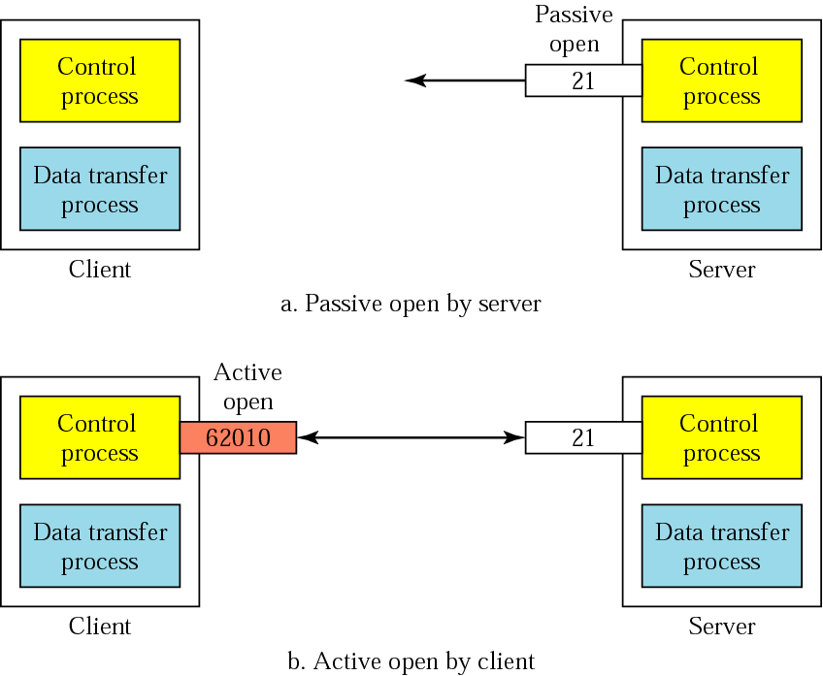
Connections: The Control Connection

Slide 41
The Data Connection
Uses Server’s well-known port 20
Client issues a passive open on an ephemeral port, say x.
Client uses PORT command to tell the server about the port number x.
Server issues an active open from port 20 to port x.
Server creates a child server/ephemeral port number to serve the client

Slide 42

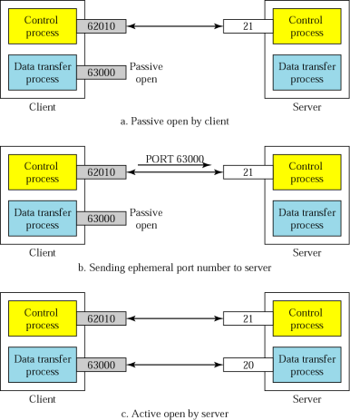
Creating the Data Connection

Slide 43
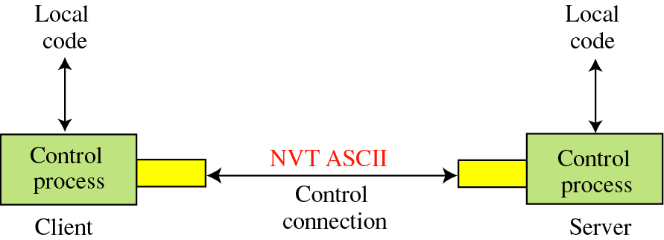
Communication Using the Control Connection

Slide 44
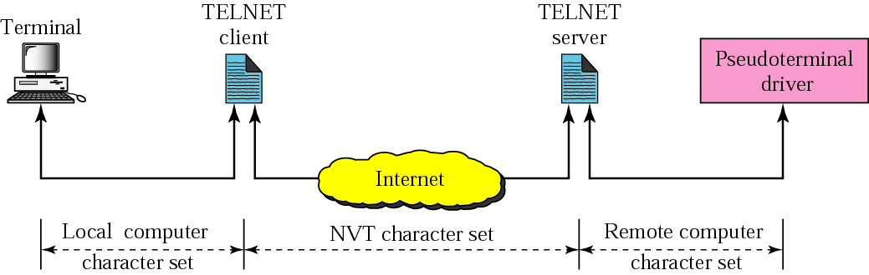
NVT
FTP
FTP

Slide 45
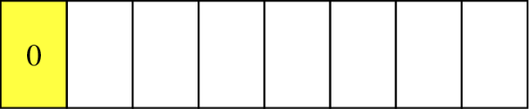
Format of NVT ASCII characters

Slide 46
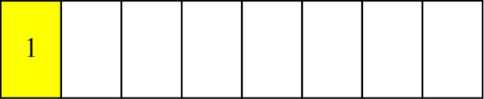
Format of NVT Control Characters

Slide 47
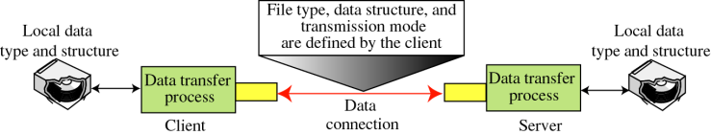
Using the Data Connection

Slide 48
File Type
ASCII or EBCDIC
Nonprint
TELNET
Image

Slide 49
Data Structure
File Structure
Record Structure
Page Structure

Slide 50
Transmission Mode
Stream mode
Block mode
Compressed mode

Slide 51
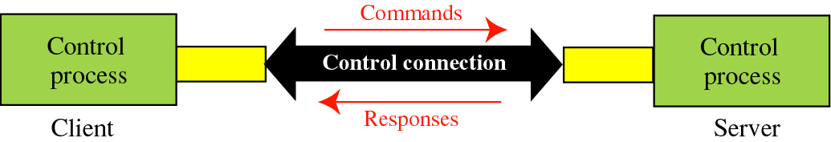
Command Processing

Slide 52
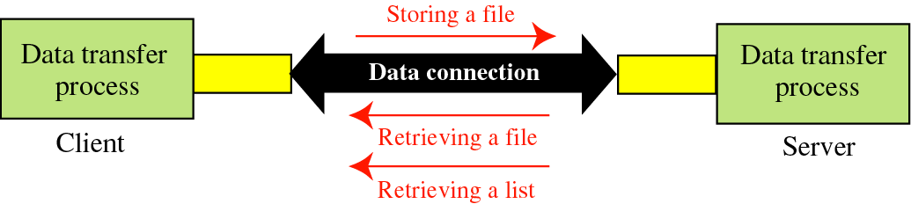
File Transfer Protocol

Slide 53
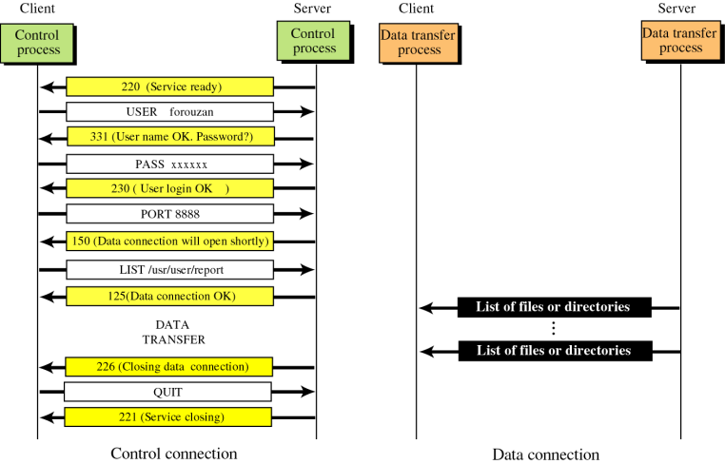
Example 1

Slide 54
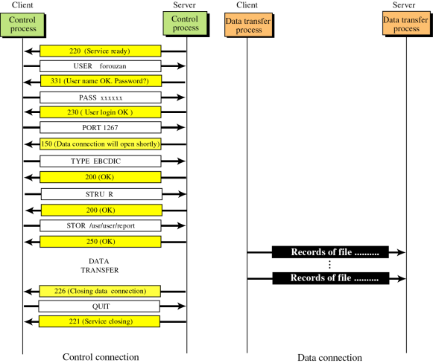
Example 2

Slide 55
USER
INTERFACE

Slide 56
Solution
% ftp challenger.atc.fhda.edu
Connected to challenger.atc.fhda.edu
220 Server ready
Name: forouzan
Password: xxxxxxx
ftp > ls /usr/user/report
200 OK

Slide 57
Solution
150 Opening ASCII mode
...........
226 transfer complete
ftp > close
221 Goodbye
ftp > quit

Slide 58
ANONYMOUS
FTP

Slide 59
Solution
% ftp internic.net
Connected to internic.net
220 Server ready
Name: anonymous
331 Guest login OK, send “guest” as password
Password: guest
ftp > pwd
257 ’/’ is current directory

Slide 60
Solution
ftp > ls
200 OK
150 Opening ASCII mode
bin
…
ftp> close
221 Goodbye
ftp> quit

