Slide 2
After this lecture you will be able to
understand E-mail, POP, IMAP

Slide 3
Electronic Mail
One of the most popular Internet services is electronic mail (e-mail). The designers of the Internet probably never imagined the popularity of this application program. Its architecture consists of several components that we discuss in this chapter.
Topics discussed in this section:
Architecture
User Agent
Message Transfer Agent: SMTP
Message Access Agent: POP and IMAP
Web-Based Mail

Slide 4

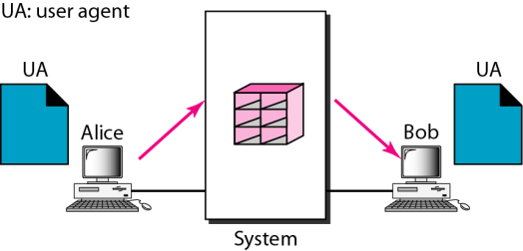
First Scenario In Electronic Mail
MUA: mail user agent

Slide 5
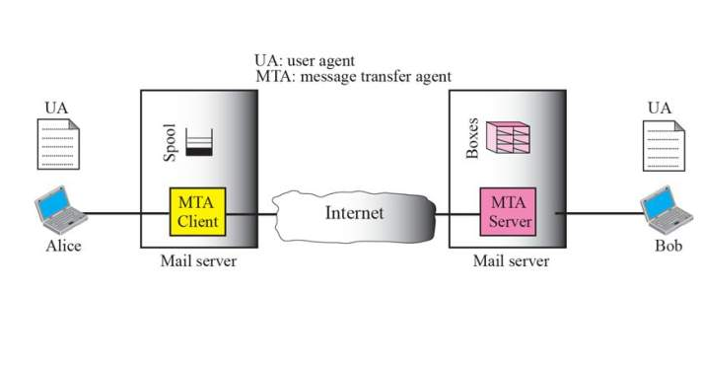
Second Scenario

Slide 6
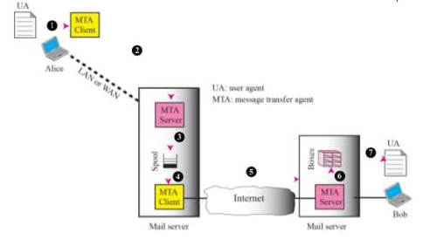
Third Scenario

Slide 7
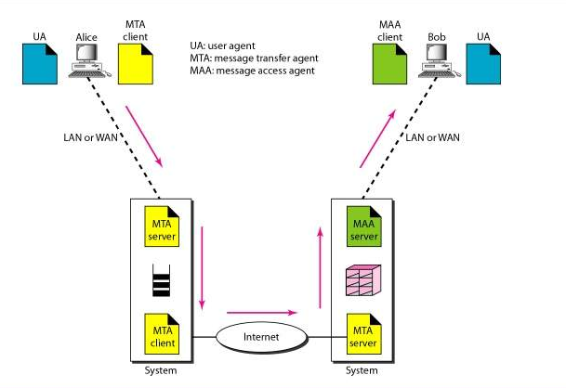
Fourth Scenario

Slide 8

Note
When the sender and the receiver of an e-mail are on the same system,
we need only two user agents.
MUA:Outlook Express, Netscape Messenger, Mozilla Thunderbird, Eudora, Foxmail,…….

Slide 9
Note
When the sender and the receiver of an e-mail are on different systems, Wikipedia shows a good example of email operation (next page)

Slide 10
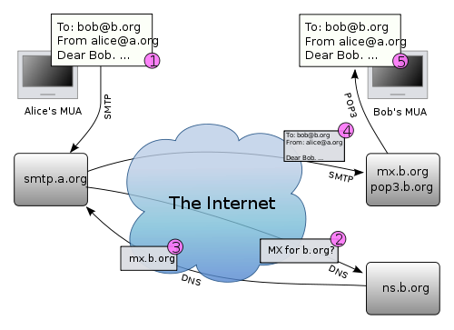
Typical Email Operation
Could also be IMAP4
Email server’s DNS name and IP
DNS query for MX RR

Slide 11
Client’s Email Operation Mode
Remote terminal using SSH to email server directly
Then uses MUA on email server
Such as Pine, Elm on Unix machines
Use MUA on a client’s own computer
The MUA formats and sends email to sender’s email server
Web-based email systems using web browser
Gmail, yahoo mail, hotmail,….
Spammer: program a simple code sending email to email servers via SMTP protocol

Slide 12
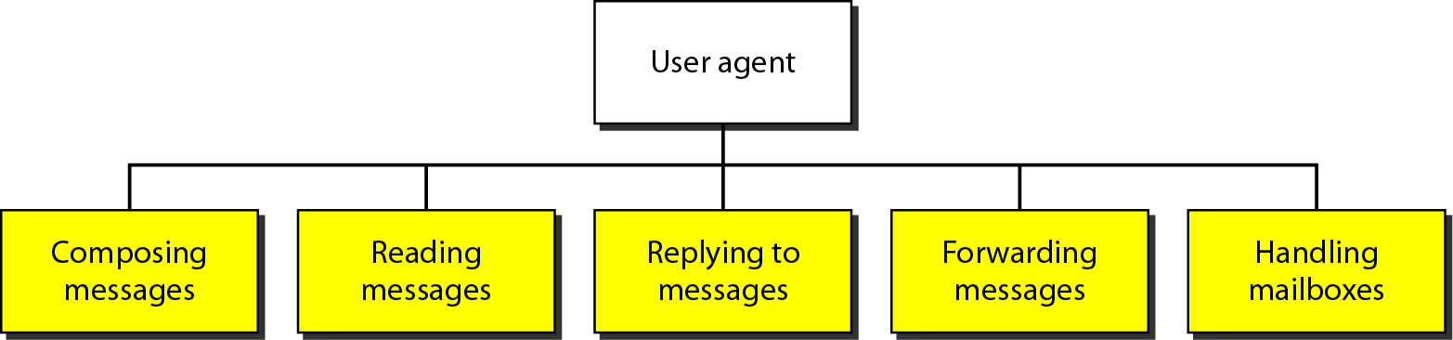
Services of User Agent

Slide 13
Note
Some examples of command-driven user agents are mail, pine, and elm (under Unix).

Slide 14
Note
Some examples of GUI-based user agents are Eudora, Outlook, and Netscape.

Slide 15
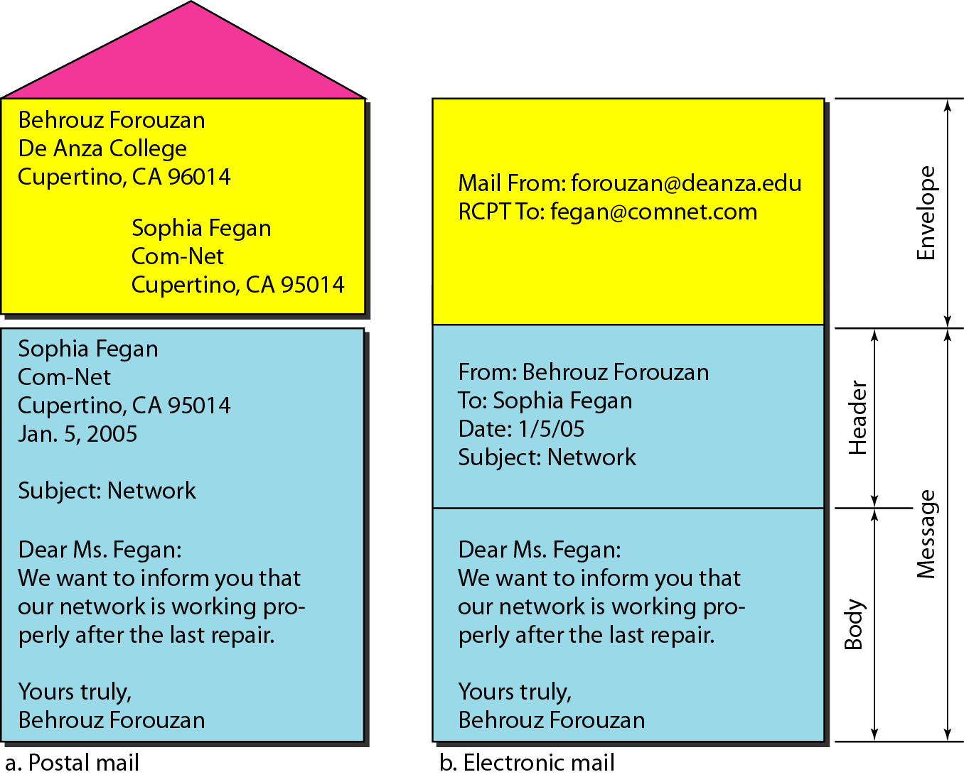
Format of an e-mail

Slide 16
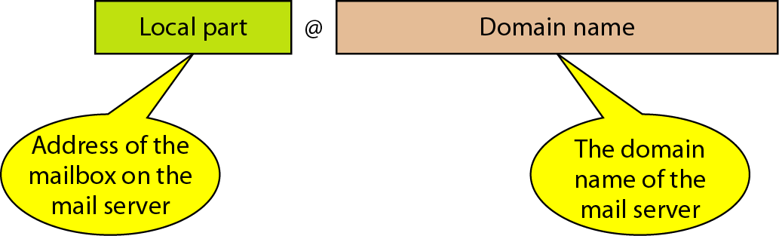
E-mail Address
Sender uses DNS query for MX record on the domain name in order to find the name and IP of the target email server

Slide 17
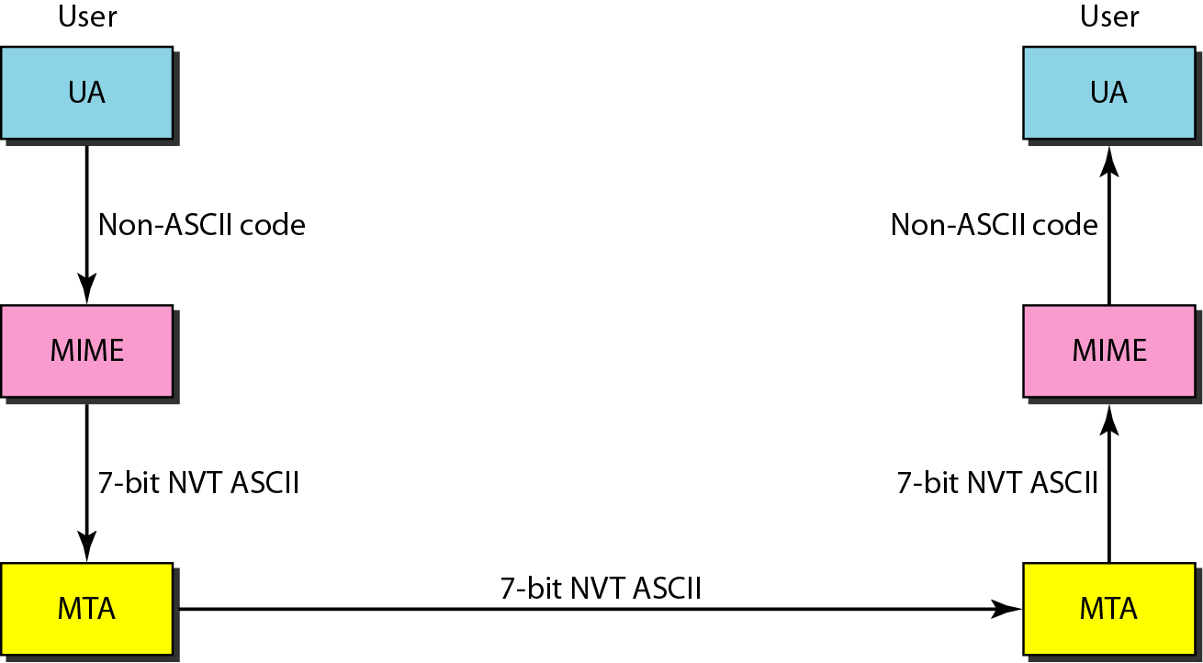
MIME (Multipurpose Internet Mail Extensions)
NVT: network virtual terminal
(telnet)
SMTP protocol only this data

Slide 18
MIME
User agents makes the translation between non-ASCII data and ASCII email message
If you check the source file of an email that has attachment, you will find the MIME usage
This is the main reason why your email with an attachment becomes bigger?

Slide 19
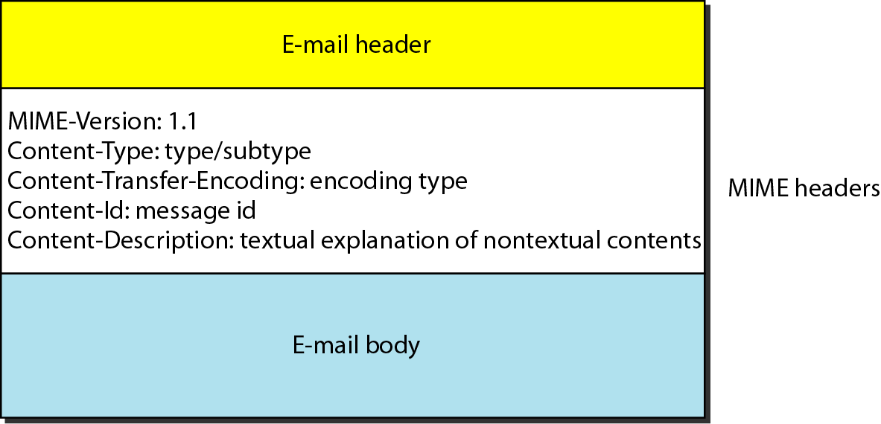
MIME Header

Slide 20
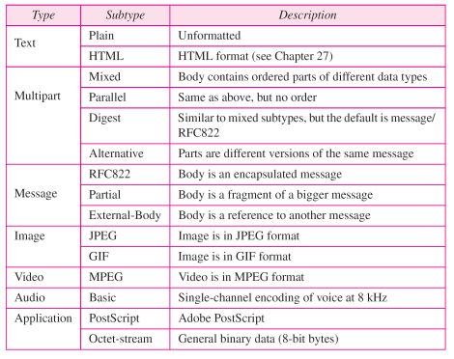

Slide 21
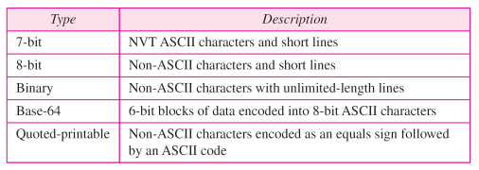
Content-transfer-encoding

Slide 22
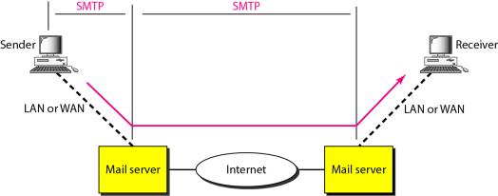
SMTP (Simple Mail Transfer Protocol) Range
POP3 or IMAP4

Slide 23
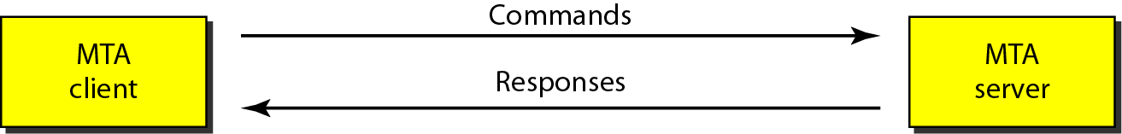
Commands and Responses

Slide 24
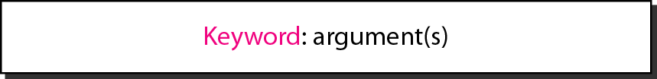
Command Format

Slide 25
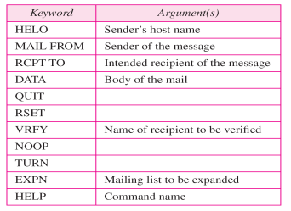

Commands

Slide 26
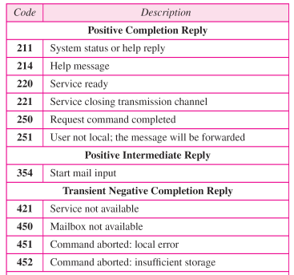
Responses

Slide 27
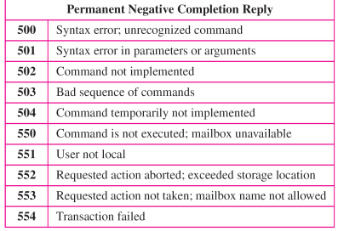
Responses

Slide 28
Let us see how we can directly use SMTP to send an e-mail and simulate the commands and responses we described in this section. We use TELNET to log into port 25 (the service port for SMTP). We then use the commands directly to send an e-mail.
Through this process, you can see why you cannot trust the “sender” or any part of a received email, why email spam is so easy to be generated.

Slide 29
Sample email sending using telnet “telnet longwood.cs.ucf.edu 25”
C: HELO fake.domain
S: 250 Hello crepes.fr, pleased to meet you
C: MAIL FROM: <alice@crepes.fr>
S: 250 alice@crepes.fr... Sender ok
C: RCPT TO: <bob@gmail.com>
S: 250 bob@gmail.com ... Recipient ok
C: DATA
S: 354 Enter mail, end with "." on a line by itself
C: from: “fake man” <fake@fake.fake.fake>
C: to: “dr. who” <who@who>
C: subject: who am I?
C: Do you like ketchup?
C: How about pickles?
C: .
S: 250 Message accepted for delivery
C: QUIT
S: 221 longwood.cs.ucf.edu closing connection

Slide 30
Try SMTP interaction for yourself:
telnet servername 25
see 220 reply from server
enter HELO, MAIL FROM, RCPT TO, DATA, QUIT commands
“mail from” the domain may need to be existed
“rcpt to” the user needs to be existed
A mail server may or may not support “relay”
Enable you send email without using email user agent

Slide 31
What is “email open relay”?
An open mail relay is an SMTP server configured in such a way that it allows anyone on the Internet to send e-mail through it, not just mail destined to or originating from known users.
This used to be the default configuration in many mail servers and it was the way the Internet was initially set up
But open mail relays have become unpopular due to their exploitation by spammers. Many relays were closed, or were placed on blacklists by other servers.
From wikipiedia: http://en.wikipedia.org/wiki/Open_mail_relay

Slide 32
Email Server in Our Department
EECS email server: longwood.eecs.ucf.edu
Before this year, CS email server supports relay from inside campus
You can use telnet to send manual email from any computer inside campus network
Now it is more restrict, only support relay from some fixed computers (such as eustis Unix machine)
Eustis machine: eustis.eecs.ucf.edu

Slide 33
NOTES: Ethnical Issue on Manual Sending Email
Do not try to use telnet on department email server except for the homework!
Do not try to use it to spam your friends without upfront notice!

Slide 34
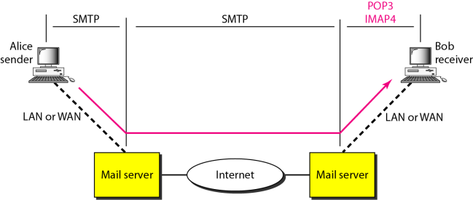
POP3 (Post Office Protocol) and IMAP4 (Internet Mail Access Protocol)

Slide 35
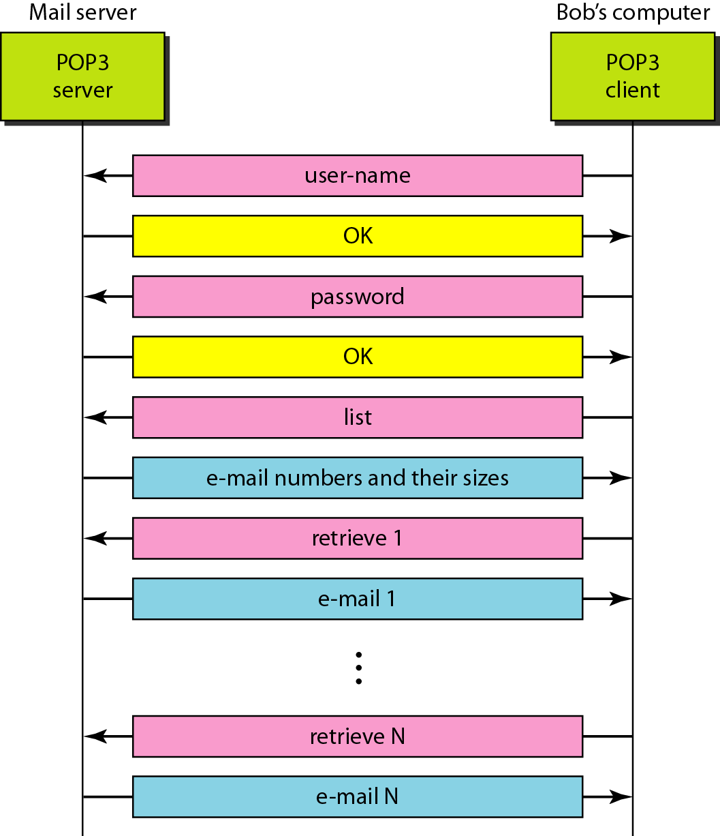
The exchange of commands and responses in POP3

Slide 36
POP3 protocol (tcp: 110)
S: +OK POP3 server ready
C: user bob
S: +OK
C: pass hungry
S: +OK user successfully logged on
authorization phase
client commands:
user: declare username
pass: password
server responses
+OK
-ERR
transaction phase, client:
list: list message numbers
retr: retrieve message by number
dele: delete
quit
C: list
S: 1 498
S: 2 912
S: .
C: retr 1
S: <message 1 contents>
S: .
C: dele 1
C: retr 2
S: <message 1 contents>
S: .
C: dele 2
C: quit
S: +OK POP3 server signing off
Length(bytes)
Telnet example

Slide 37
POP3 and IMAP4
IMAP4 provides more functionalities
Both POP3 and IMAP4 have corresponding encrypted protocols

Slide 38
Web-based Email
Email clients use web browser for all interactions
A user can access his/her email at any where, via any computer that has Internet access
Email provider may provide more functions
Gmail has very good search capability
Gmail has the message grouping function
Many provide bundled services with their other products
Voice/video, photo sharing, ….

