Slide 2
After this lecture you will be able to
understand domain name system.

Slide 3
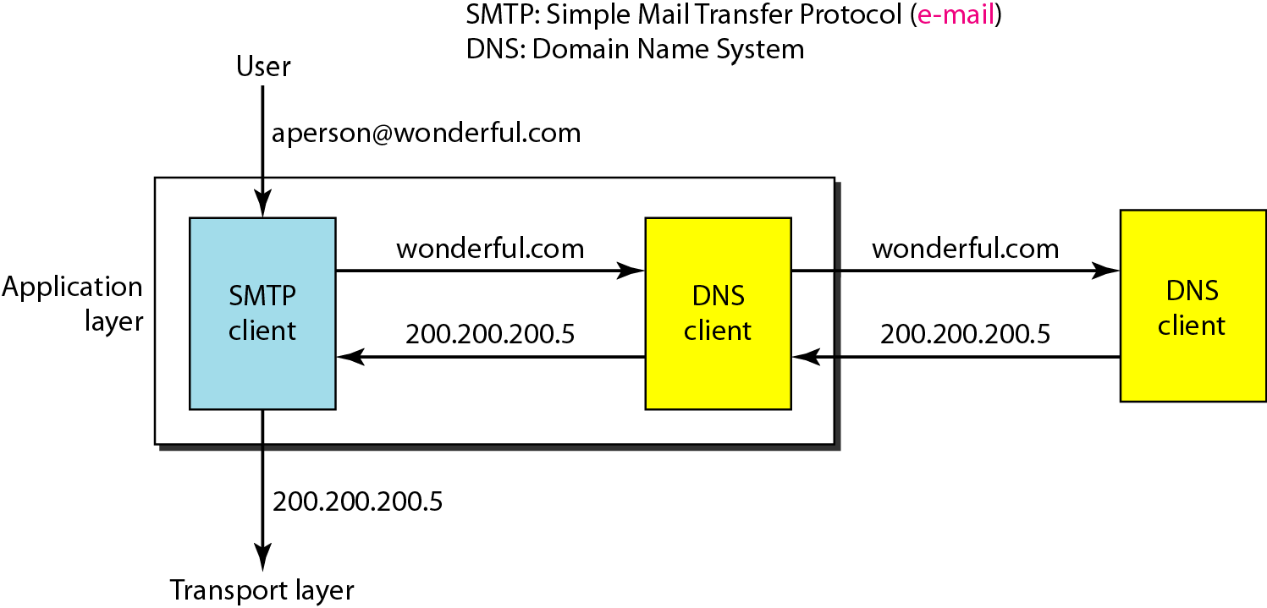
Example of using the DNS service

Slide 4
Name Space
To be unambiguous, the names assigned to machines must be carefully selected from a name space with complete control over the binding between the names and IP addresses.
Topics discussed in this section:
Flat Name Space Hierarchical Name Space

Slide 5
Domain Name Space
To have a hierarchical name space, a domain name space was designed. In this design the names are defined in an inverted-tree structure with the root at the top. The tree can have only 128 levels: level 0 (root) to level 127.
Topics discussed in this section:
Label
Domain Name Domain

Slide 6
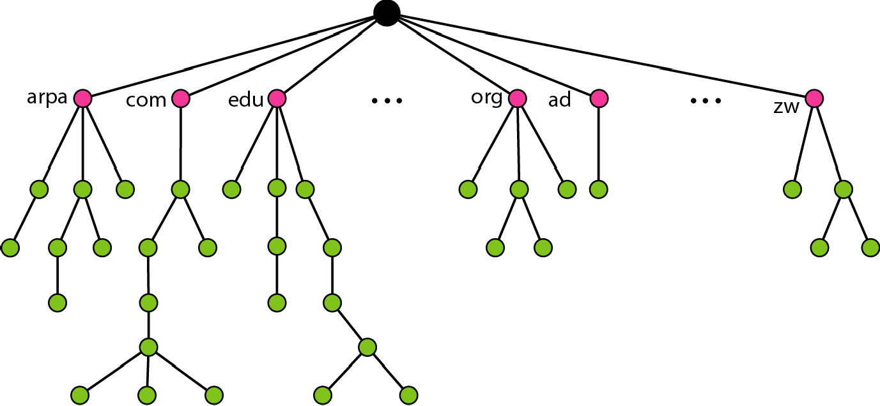
Domain Name Space

Slide 7
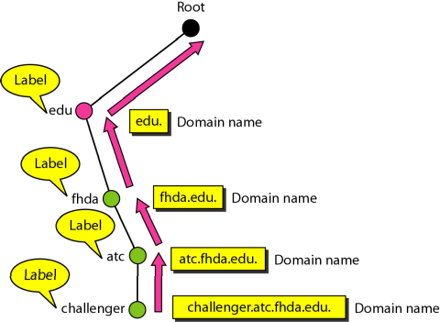
Label

Slide 8
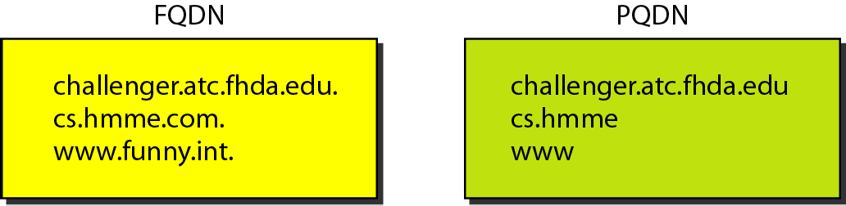
FQDN and PQDN

Slide 9
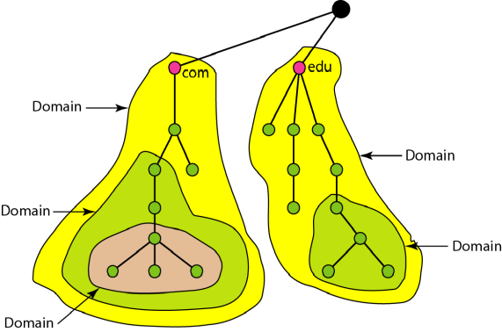
Domains

Slide 10
Distribution of Name Space
The information contained in the domain name space must be stored. However, it is very inefficient and also unreliable to have just one computer store such a huge amount of information. In this section, we discuss the distribution of the domain name space..
Topics discussed in this section:
Hierarchy of Name Servers Zone
Root Server
Primary and Secondary Servers

Slide 11
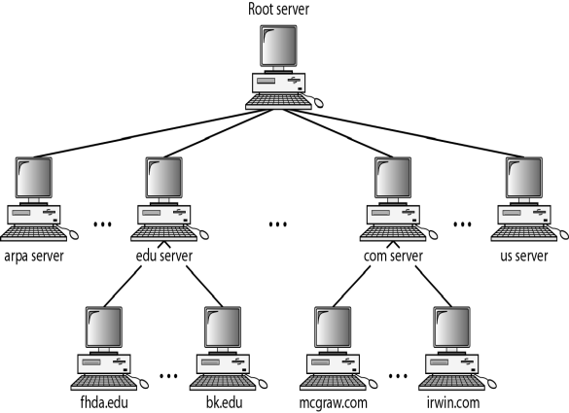
Hierarchy of Name Servers

Slide 12
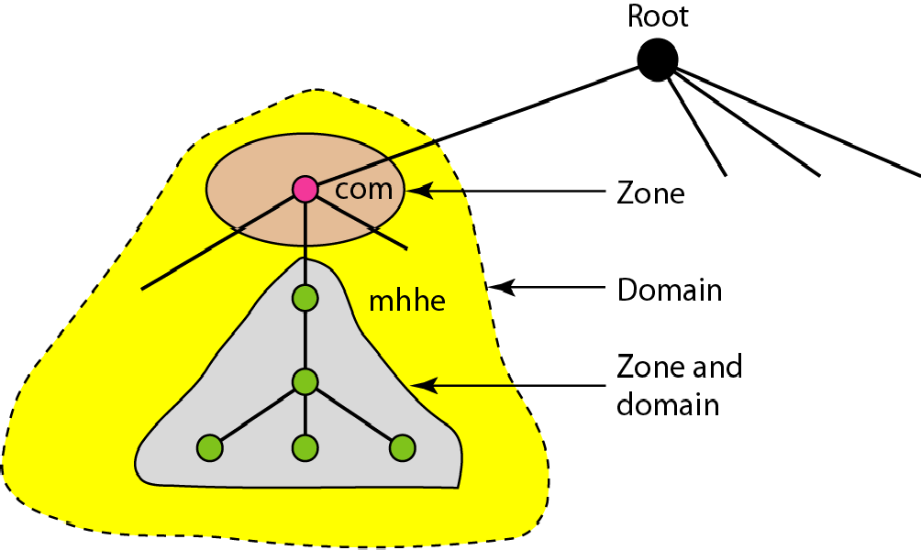
Zones and Domains

Slide 13

Note
A primary server loads all information from the disk file; the secondary server loads all information from
the primary server.
When the secondary downloads information from the primary, it is called zone transfer.

Slide 14
DNS In The Internet
DNS is a protocol that can be used in different platforms. In the Internet, the domain name space (tree) is divided into three different sections: generic domains, country domains, and the inverse domain.
Topics discussed in this section:
Generic Domains Country Domains Inverse Domain

Slide 15
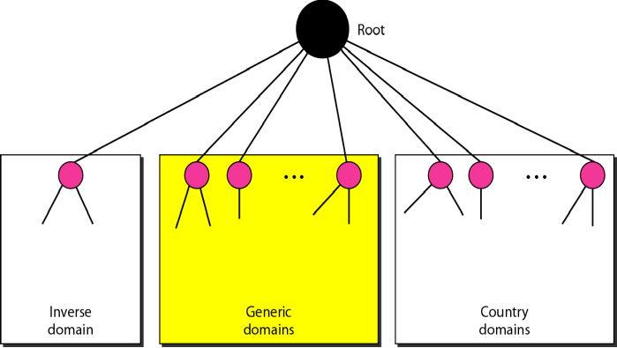
DNS In The Internet

Slide 16
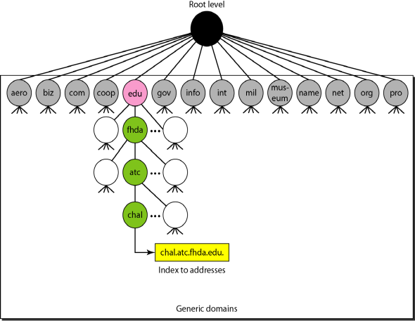
Generic Domain

Slide 17
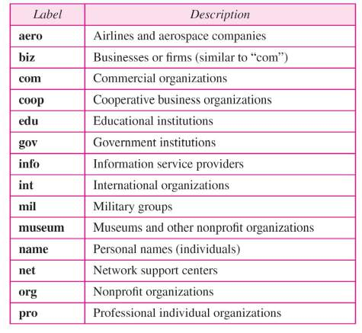
Table

Slide 18
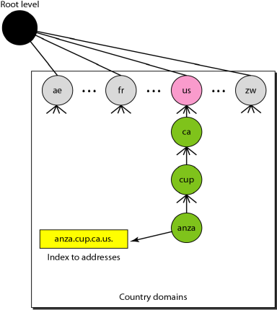
Country Domain

Slide 19
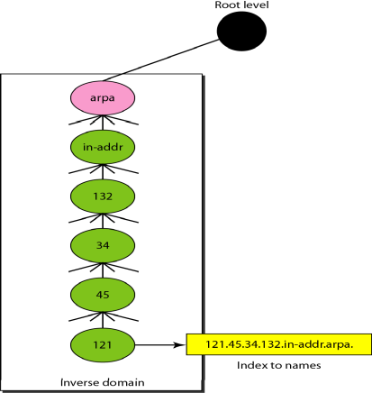
Inverse Domain

Slide 20
Resolution
Mapping a name to an address or an address to a name is called name-address resolution.
Topics discussed in this section:
Resolver
Mapping Names to Addresses Mapping Addresses to Names Recursive Resolution Caching

Slide 21
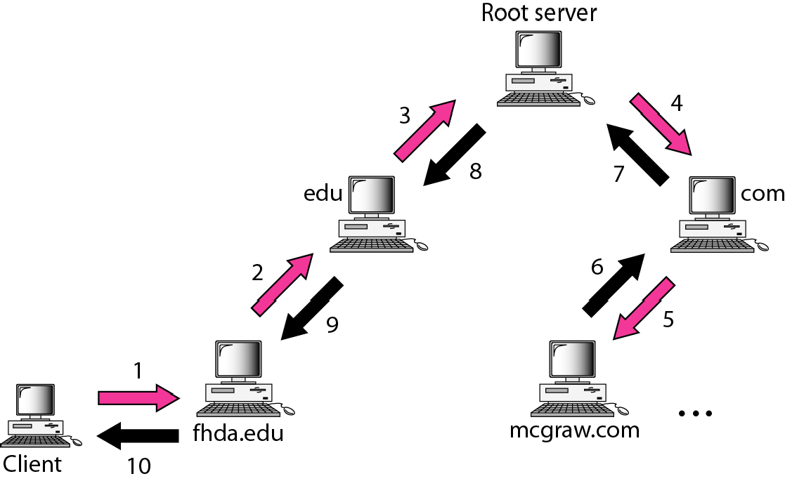
Recursive Resolution

Slide 22
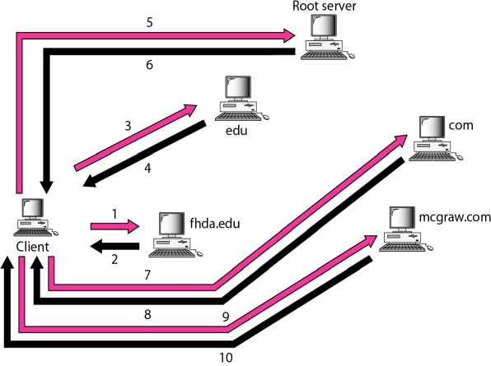
Iterative Resolution

Slide 23
DNS Messages
DNS has two types of messages: query and response.. Both types have the same format. The query message consists of a header and question records; the response message consists of a header, question records, answer records, authoritative records, and additional records.
Topics discussed in this section:
Header

Slide 24
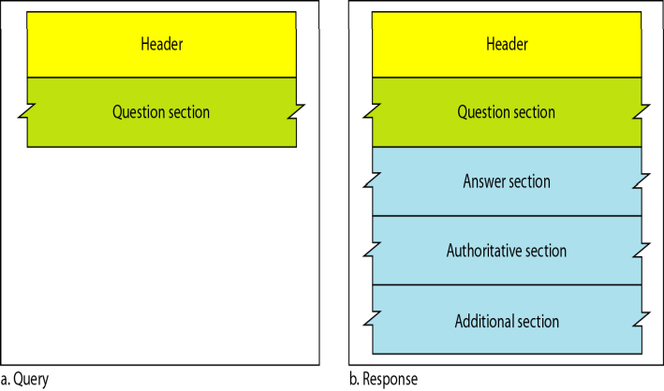
Query and Response Messages

Slide 25
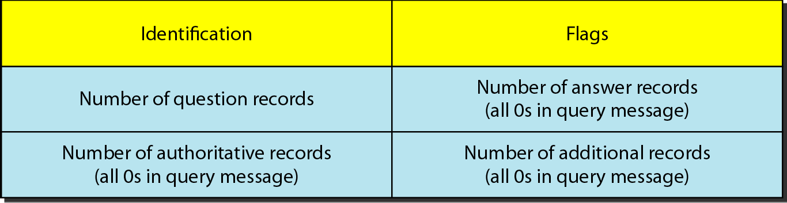
Header Format

Slide 26
Types of Records
As we saw in Section 25.6, two types of records are used in DNS. The question records are used in the question section of the query and response messages.. The resource records are used in the answer, authoritative, and additional information sections of the response message.
Topics discussed in this section:
Question Record Resource Record

Slide 27
Registrars
How are new domains added to DNS? This is done through a registrar, a commercial entity accredited by ICANN.. registrar first verifies that the requested domain name is unique and then enters it into the DNS database.. A fee is charged.

Slide 28
Dynamic Domain Name System (DDNS)
The DNS master file must be updated dynamically.. The Dynamic Domain Name System (DDNS) therefore was devised to respond to this need.. In DDNS, when a binding between a name and an address is determined, the information is sent, usually by DHCP to a primary DNS server. The primary server updates the zone.. The secondary servers are notified either actively or passively.

Slide 29
Encapsulation
DNS can use either UDP or TCP. In both cases the well-known port used by the server is port 53. UDP is used when the size of the response message is less than 512 bytes because most UDP packages have a 512-byte packet size limit.. If the size of the response message is more than 512 bytes, a TCP connection is used.

Slide 30
Note
DNS can use the services of UDP or TCP using the well-known port 53.

