Slide 2
After this lecture you will be able to
understand IP security (IPsec)
understanding Email Security

Slide 3
IP security (IPSec)
The IP security (IPSec) is an Internet Engineering Task Force (IETF) standard suite of protocols between 2 communication points across the IP network that provide data authentication, integrity, and confidentiality.
It also defines the encrypted, decrypted and authenticated packets. The protocols needed for secure key exchange and key management are defined in it.

Slide 4
IP security (IPSec)
The IP security (IPSec) is an Internet Engineering Task Force (IETF) standard suite of protocols between 2 communication points across the IP network that provide data authentication, integrity, and confidentiality.
It also defines the encrypted, decrypted and authenticated packets. The protocols needed for secure key exchange and key management are defined in it.

Slide 5
Uses of IP Security
To encrypt application layer data.
To provide security for routers sending routing data across the public internet.
To provide authentication without encryption, like to authenticate that the data originates from a known sender.

Slide 6
Uses of IP Security
To encrypt application layer data.
To provide security for routers sending routing data across the public internet.
To provide authentication without encryption, like to authenticate that the data originates from a known sender.

Slide 7
Uses of IP Security
To encrypt application layer data.
To provide security for routers sending routing data across the public internet.
To provide authentication without encryption, like to authenticate that the data originates from a known sender.

Slide 8
Uses of IP Security
To protect network data by setting up circuits using IPsec tunneling in which all data is being sent between the two endpoints is encrypted, as with a Virtual Private Network(VPN) connection.

Slide 9
Components of IP Security
Authentication Header (AH)
IP HDR | AH | TCP | DATA

Slide 10
Components of IP Security
Internet Key Exchange (IKE)
IPHDR | TCP | DATA
IP HDR | ESR HDR | TCP | Data | ESP Trailer | ESP Authentication

Slide 11
Working of IP Security
The host checks if the packet should be transmitted using IPsec or not. These packet traffic triggers the security policy for themselves. This is done when the system sending the packet apply an appropriate encryption. The incoming packets are also checked by the host that they are encrypted properly or not.

Slide 12
Working of IP Security
Then the IKE Phase 1 starts in which the 2 hosts (using IPsec) authenticate themselves to each other to start a secure channel. It has 2 modes. The Main mode which provides the greater security and the Aggressive mode which enables the host to establish an IPsec circuit more quickly.

Slide 13
Working of IP Security
The channel created in the last step is then used to securely negotiate the way the IP circuit will encrypt data across the IP circuit.

Slide 14
Working of IP Security
Now, the IKE Phase 2 is conducted over the secure channel in which the two hosts negotiate the type of cryptographic algorithms to use on the session and agreeing on secret keying material to be used with those algorithms.

Slide 15
Working of IP Security
Then the data is exchanged across the newly created IPsec encrypted tunnel. These packets are encrypted and decrypted by the hosts using IPsec SAs.
When the communication between the hosts is completed or the session times out then the IPsec tunnel is terminated by discarding the keys by both the hosts.

Slide 16
Working of IP Security
Then the data is exchanged across the newly created IPsec encrypted tunnel. These packets are encrypted and decrypted by the hosts using IPsec SAs.
When the communication between the hosts is completed or the session times out then the IPsec tunnel is terminated by discarding the keys by both the hosts.

Slide 17
E-mail Security

Slide 18
E-mail Hacking
Email hacking can be done in any of the following ways:
Spam
Virus
Phishing

Slide 19

E-mail Spam

Slide 20

Virus

Slide 21

Phishing

Slide 22
E-mail Spamming and Junk Mails
Email spamming is an act of sending Unsolicited Bulk E-mails (UBI) which one has not asked for. Email spams are the junk mails sent by commercial companies as an advertisement of their products and services.

Slide 23
Spams may cause the following problems
Floods your e-mail account with unwanted e-mails.
Time and energy are wasted
Consumes the bandwidth
Some unsolicited email may contain virus

Slide 24
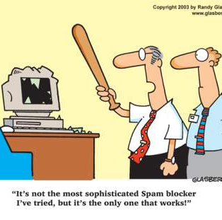
Blocking Spams
While posting letters to newsgroups or mailing list, use a separate e-mail address than the one you used for your personal e-mails.

Slide 25
Blocking Spams
Don’t give your email address on the websites as it can easily be spammed.

Slide 26
Blocking Spams
Avoid replying to emails which you have received from unknown persons

Slide 27
Blocking Spams
Never buy anything in response to a spam that advertises a product.

Slide 28
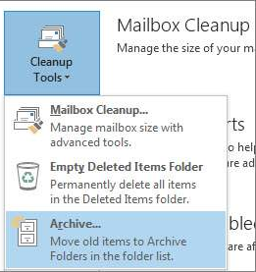
E-mail Cleanup and Archiving

Slide 29
E-mail Clean up and Archiving
Select Archive this folder and all subfolders option and then click on the folder that you want to archive. Select the date from the Archive items older than: list. Click Browse to create new .pst file name and location. Click OK.

