Slide 2
After this lecture you will be able to
understand VPN
VPN Privacy
difference between Paid VPN and Free VPN

Slide 3
Virtual Private Network (VPN)

Slide 4
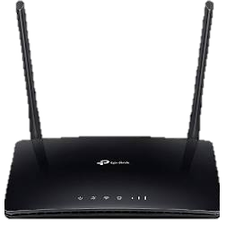
What is a Network?

Slide 5
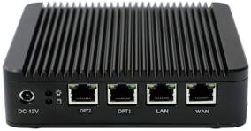
What is a Network?

Slide 6

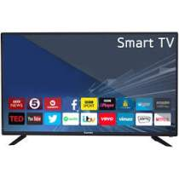
What is a Network?

Slide 7

What is a Network?

Slide 8
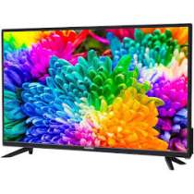
Virtual Private Network

Slide 9

Virtual Private Network

Slide 10
Internal Network

Slide 11

Virtual Private Network

Slide 12

Virtual Private Network

Slide 13

Virtual Private Network

Slide 14
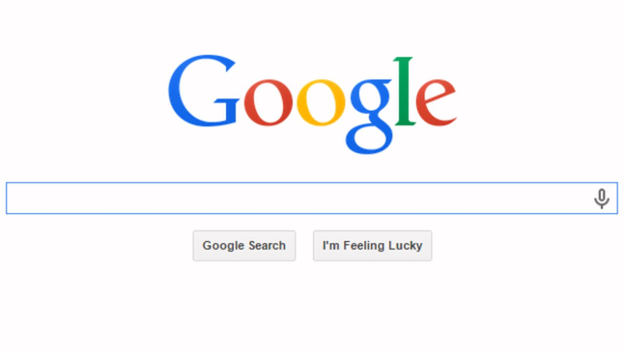
Virtual Private Network

Slide 15
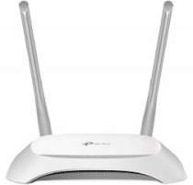
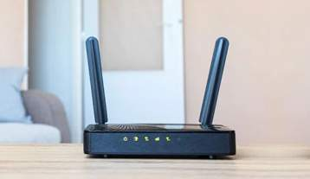
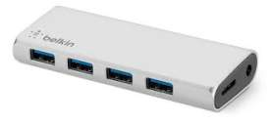
Virtual Private Network

Slide 16
Advantage
With this Address, you are able to connect with internet.

Slide 17
ISP can track
ISP knows your IP address
Disadvantages
Your data would steal.
Hacker hack your data.
Data restricted to some region

Slide 18
ISP can track
ISP knows your IP address
Disadvantages
Your data would steal.
Hacker hack your data.
Data restricted to some region

Slide 19
ISP can track
ISP knows your IP address
Disadvantages
Your data would steal.
Hacker hack your data.
Data restricted to some region

Slide 20
ISP can track
ISP knows your IP address
Disadvantages
Your data would steal.
Hacker hack your data.
Data restricted to some region

Slide 21
ISP can track
ISP knows your IP address
Disadvantages
Your data would steal.
Hacker hack your data.
Data restricted to some region

Slide 22

Virtual Private Network

Slide 23

Virtual Private Network

Slide 24

Virtual Private Network

Slide 25
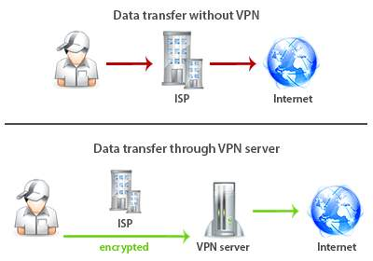
Virtual Private Network

Slide 26
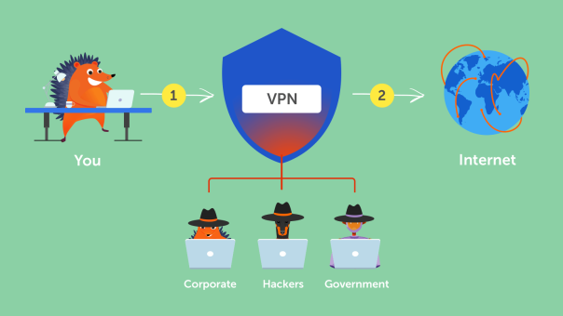
Virtual Private Network

Slide 27
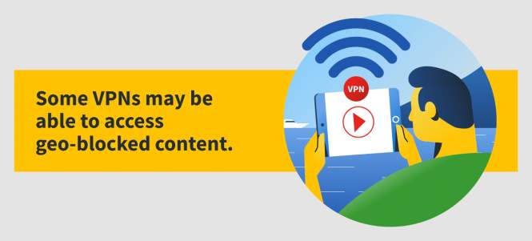
Virtual Private Network

Slide 28
Virtual Private Network
Virtual Private Network is a type of private network that uses public telecommunication, such as the Internet, instead of leased lines to communicate.

Slide 29
Virtual Private Network
Became popular as more employees worked in remote locations.

Slide 30
Virtual Private Network
Terminologies to understand how VPNs work.

Slide 31
Virtual Private Network
Employees can access the network (Intranet) from remote locations.
Secured networks.
The Internet is used as the backbone for VPNs
Saves cost tremendously from reduction of equipment and maintenance costs.
Scalability

Slide 32
Virtual Private Network
Employees can access the network (Intranet) from remote locations.
Secured networks.
The Internet is used as the backbone for VPNs
Saves cost tremendously from reduction of equipment and maintenance costs.
Scalability

Slide 33
Virtual Private Network
Employees can access the network (Intranet) from remote locations.
Secured networks.
The Internet is used as the backbone for VPNs
Saves cost tremendously from reduction of equipment and maintenance costs.
Scalability

Slide 34
Virtual Private Network
Employees can access the network (Intranet) from remote locations.
Secured networks.
The Internet is used as the backbone for VPNs
Saves cost tremendously from reduction of equipment and maintenance costs.
Scalability

Slide 35
Virtual Private Network
Employees can access the network (Intranet) from remote locations.
Secured networks.
The Internet is used as the backbone for VPNs
Saves cost tremendously from reduction of equipment and maintenance costs.
Scalability

Slide 36
VPN Privacy: What does a VPN Hide?
Your browsing history
Your IP address and location
Your location for streaming
Your devices
Your web activity — to maintain internet freedom

Slide 37
VPN Privacy: What does a VPN Hide?
Your browsing history
Your IP address and location
Your location for streaming
Your devices
Your web activity — to maintain internet freedom

Slide 38
VPN Privacy: What does a VPN Hide?
Your browsing history
Your IP address and location
Your location for streaming
Your devices
Your web activity — to maintain internet freedom

Slide 39
VPN Privacy: What does a VPN Hide?
Your browsing history
Your IP address and location
Your location for streaming
Your devices
Your web activity — to maintain internet freedom

Slide 40
VPN Privacy: What does a VPN Hide?
Your browsing history
Your IP address and location
Your location for streaming
Your devices
Your web activity — to maintain internet freedom

Slide 41
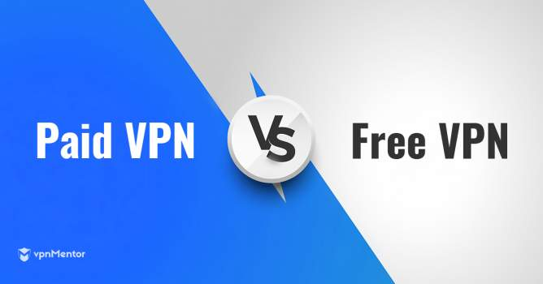
Virtual Private Network

Slide 42
Risks and Problems with Using a Free VPN?
They track you online and sell your personal or browsing data.
They give other users access to your connection.
They provide weak and easily crackable security.
Your browsing will be constantly interrupted by ads.
They will slow down your internet connection.
They offer limited features so you’ll upgrade to a paid service.

Slide 43
Risks and Problems with Using a Free VPN?
They track you online and sell your personal or browsing data.
They give other users access to your connection.
They provide weak and easily crackable security.
Your browsing will be constantly interrupted by ads.
They will slow down your internet connection.
They offer limited features so you’ll upgrade to a paid service.

Slide 44
Risks and Problems with Using a Free VPN?
They track you online and sell your personal or browsing data.
They give other users access to your connection.
They provide weak and easily crackable security.
Your browsing will be constantly interrupted by ads.
They will slow down your internet connection.
They offer limited features so you’ll upgrade to a paid service.

Slide 45
Risks and Problems with Using a Free VPN?
They track you online and sell your personal or browsing data.
They give other users access to your connection.
They provide weak and easily crackable security.
Your browsing will be constantly interrupted by ads.
They will slow down your internet connection.
They offer limited features so you’ll upgrade to a paid service.

Slide 46
Risks and Problems with Using a Free VPN?
They track you online and sell your personal or browsing data.
They give other users access to your connection.
They provide weak and easily crackable security.
Your browsing will be constantly interrupted by ads.
They will slow down your internet connection.
They offer limited features so you’ll upgrade to a paid service.

Slide 47
Risks and Problems with Using a Free VPN?
They track you online and sell your personal or browsing data.
They give other users access to your connection.
They provide weak and easily crackable security.
Your browsing will be constantly interrupted by ads.
They will slow down your internet connection.
They offer limited features so you’ll upgrade to a paid service.

Slide 48
Paid VPNs – Complete Protection and Premium Features
They offer genuine protection for your private data online.
They have topnotch network security.
They do not impose bandwidth or speed limits.
They give you access to more server locations.
They can unblock Netflix and even work in China.
They offer a host of other features for a better experience.

Slide 49
Paid VPNs – Complete Protection and Premium Features
They offer genuine protection for your private data online.
They have topnotch network security.
They do not impose bandwidth or speed limits.
They give you access to more server locations.
They can unblock Netflix and even work in China.
They offer a host of other features for a better experience.

Slide 50
Paid VPNs – Complete Protection and Premium Features
They offer genuine protection for your private data online.
They have topnotch network security.
They do not impose bandwidth or speed limits.
They give you access to more server locations.
They can unblock Netflix and even work in China.
They offer a host of other features for a better experience.

Slide 51
Paid VPNs – Complete Protection and Premium Features
They offer genuine protection for your private data online.
They have topnotch network security.
They do not impose bandwidth or speed limits.
They give you access to more server locations.
They can unblock Netflix and even work in China.
They offer a host of other features for a better experience.

Slide 52
Paid VPNs – Complete Protection and Premium Features
They offer genuine protection for your private data online.
They have topnotch network security.
They do not impose bandwidth or speed limits.
They give you access to more server locations.
They can unblock Netflix and even work in China.
They offer a host of other features for a better experience.

Slide 53
Paid VPNs – Complete Protection and Premium Features
They offer genuine protection for your private data online.
They have topnotch network security.
They do not impose bandwidth or speed limits.
They give you access to more server locations.
They can unblock Netflix and even work in China.
They offer a host of other features for a better experience.

Slide 54
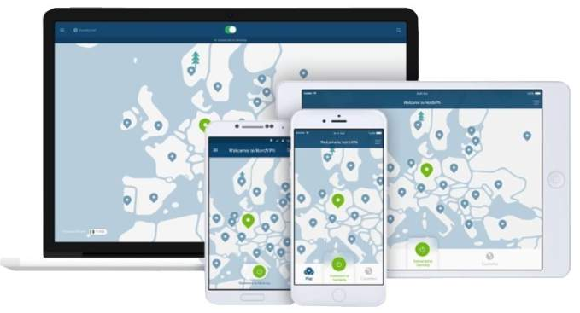
Five Best Paid VPNs
NordVPN

Slide 55
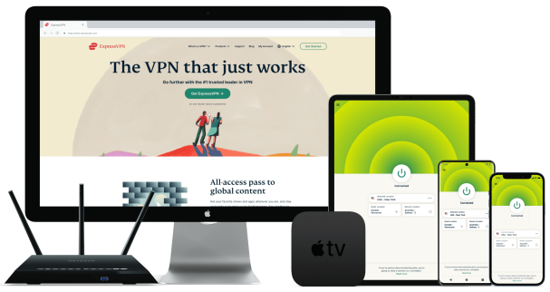
Five Best Paid VPNs
Express VPN

Slide 56
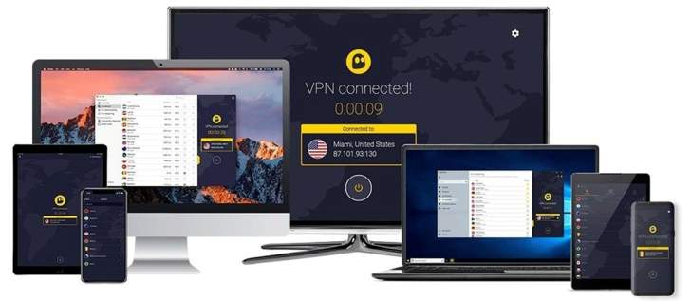
Five Best Paid VPNs
CyberGhost

Slide 57
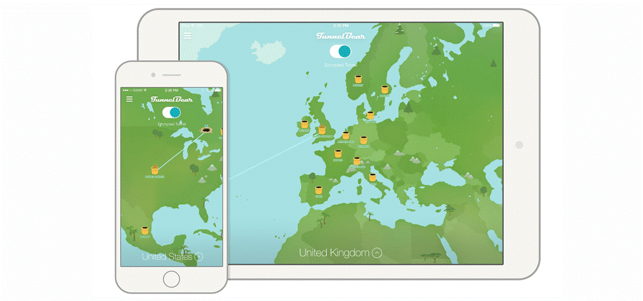
Five Best Paid VPNs
TunnelBear

Slide 58
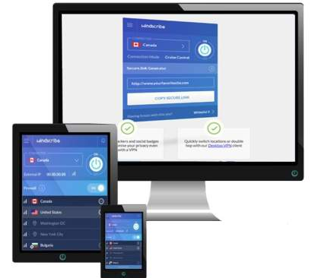
Five Best Paid VPNs
Windscribe

