Slide 2
After this lecture you will be able to
understand digital signature.
understand digital certificate.
differentiate between digital signature and digital certificate.

Slide 3
What is Signature
Signature is nothing but proof in the hand of receiver.
It is coming from correct verified person.

Slide 4
What is Digital Signature
A Digital Signature is nothing more than a numeric string that can be affixed to emails, documents, certificates almost anything.
We use digital signatures to help determine authenticity and to validate identity.

Slide 5
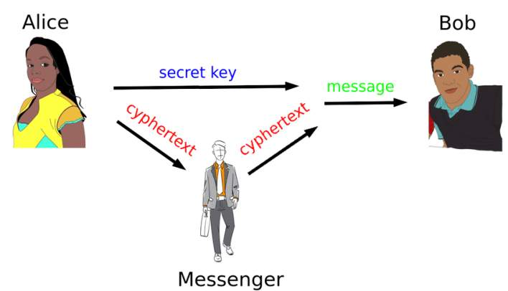
Alice Wants to Send Message to Bob

Slide 6
Alice Send Message to Bob

Slide 7

Alice Send Message to Bob

Slide 8

What is Key
An encryption key is typically a random string of bits generated specifically to scramble and unscramble data.

Slide 9

Private Key and Public Key
Alice Public Key
Bob Public Key
Alice Private Key
Bob Private Key

Slide 10
Private Key and Public Key
Both have an information about each other public key
Alice Public Key
Bob Public Key
Alice Private Key
Bob Private Key

Slide 11
Private Key and Public Key
But they don’t have an information about each other private key.
Alice Public Key
Bob Public Key
Alice Private Key
Bob Private Key

Slide 12
Private Key and Public Key
Bob will use his own private key
Bob Private Key

Slide 13
Private Key and Public Key
Message
Private Key

Slide 14
Private Key and Public Key
Message
Private Key
DS Generation Algorithm

Slide 15
Private Key and Public Key
Message
Private Key
DS Generation Algorithm
Signature

Slide 16
Private Key and Public Key
Message
Private Key
DS Generation Algorithm
Message
Signature
Signature

Slide 17
Private Key and Public Key
Message
DS Generation Algorithm
Message
DS Verification Algorithm
Private Key
Signature
Signature

Slide 18
Private Key and Public Key
Public Key of Bob
Message
DS Generation Algorithm
Message
DS Verification Algorithm
Private Key
Signature
Signature
Valid or Not

Slide 19
Benefits of Digital Signature
Authentication
Integrity
Reliability

Slide 20
Digital Certificate

Slide 21
What is Digital Certificate
Digital certificates work in the same way as ID cards, such as passports and driving licenses.
Government issue digital certificates.
When someone requests it, the authority checks the identity of the requesting person, certifies that it meets all the requirements for obtaining the certificate, and then issues it.

Slide 22
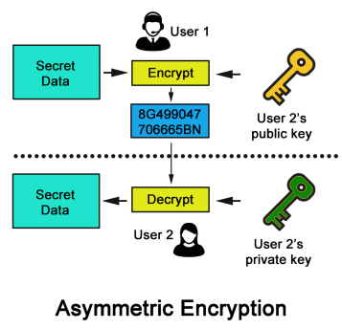
PKI(Public Key Infrastructure)
It is a standard for digital certificate.
Related to the idea of Asymmetric key cryptography.
Includes Message digest, Digital signature and encryption services.

Slide 23
Public Key Infrastructure
Message digest -> Integrity
Digital signature ->Authentication and Non-repudiation
Encryption services -> Confidentiality
To enable all the services DIGITAL CERTIFICATES are required.

Slide 24
What is a Digital certificate?
Small file on a computer/Electronic device.

Slide 25
What is a Digital certificate?
Small file on a computer/Electronic device.
File extension can be .pem, .crt, .cer, or .key.

Slide 26
What is a Digital certificate?
Small file on a computer/Electronic device.
File extension can be .pem, .crt, .cer, or .key.
It establishes a relationship between a user and the public key.

Slide 27
What is a Digital certificate?
Small file on a computer/Electronic device.
File extension can be .pem, .crt, .cer, or .key.
It establishes a relationship between a user and the public key.
It must be issued by trusted party.

Slide 28
What is a Digital certificate?
Small file on a computer/Electronic device.
File extension can be .pem, .crt, .cer, or .key.
It establishes a relationship between a user and the public key.
It must be issued by trusted party.
Must contain username and the public key.

Slide 29
Example of Sample Digital certificate
Username : XYZ

Slide 30
Example of Sample Digital certificate
Username : XYZ
Public Key : 12&5@>

Slide 31
Example of Sample Digital certificate
Username : XYZ
Public Key : 12&5@>
Serial number : 12355

Slide 32
Example of Sample Digital certificate
Username : XYZ
Public Key : 12&5@>
Serial number : 12355
Other information : Email-id

Slide 33
Example of Sample Digital certificate
Username : XYZ
Public Key : 12&5@>
Serial number : 12355
Other information : Email-id
Valid From : 20 Jan 2000

Slide 34
Example of Sample Digital certificate
Username : XYZ
Public Key : 12&5@>
Serial number : 12355
Other information : Email-id
Valid From : 20 Jan 2000
Valid To : 20 Jan 2011

Slide 35
Example of Sample Digital certificate
Username : XYZ
Public Key : 12&5@>
Serial number : 12355
Other information : Email-id
Valid From : 20 Jan 2000
Valid To : 20 Jan 2011
Issuer Name : Verisign

Slide 36
X.509 define the standard of digital certificate

Slide 37
Field of digital certificate
Version : X.509
Signature Algo identifier
Issuer user-id
CA Digital Signature

Slide 38

What is Certificate Authority
CA are trusted agencies that can issue digital certificates
Request to Issue Digital certificate
C . A
.
.
.
.
.
.
.
Request to Issue Digital certificate

Slide 39
What is Certificate Authority
CA are trusted agencies that can issue digital certificates
Request to Issue Digital certificate
C . A
.
.
.
.
.
.
.
Database
Keep a copy
Request to Issue Digital certificate

Slide 40
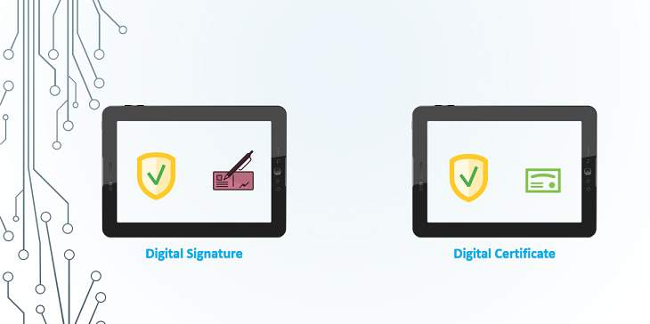
Difference between digital signature and digital certificate

Slide 41
Difference between digital signature and digital certificate
Digital signature | Digital certificate
A digital signature is a string of decimals that is affixed to a file to assist with identifying the signer and ensuring its integrity. | A digital certificate is itself a file that is used to assert identity and to facilitate encrypted connections.

Slide 42
Difference between digital signature and digital certificate
Digital signature | Digital certificate
Digital signature must ensure that the data or information remains secure from the moment it is sent | Digital certificate is that the certificate binds the digital signature to the object
Digital signatures are used to validate the sent data. | Digital certificates are used to validate the identity of the sender,

