Slide 2
After this lecture you will be able to
understand basic of network security.
understand network security issues

Slide 3
Basics of Network Security
Plain text
Cipher text
Encryption
Decryption
Cryptography
Cryptanalyst
Key

Slide 4
Plain Text
A
B
Plain Text

Slide 5

Plain Text

Slide 6
Plain Text
Intruder
A
B
Plain Text

Slide 7
Encryption
Plain Text
Encryption

Slide 8
Encryption
Plain Text
Encryption
Cipher Text

Slide 9

How receiver would be able to understand cipher text?

Slide 10
How receiver would be able to understand cipher text?
Plain Text
Encryption
Cipher Text

Slide 11
How receiver would be able to understand cipher text?
Cipher Text
Decryption
Plain Text

Slide 12

Cryptography

Slide 13
Cryptanalyst
Cryptanalyst
Intruder
A
B
Plain Text

Slide 14
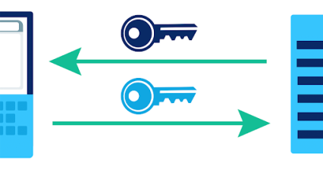
Key

Slide 15
Network Security
Networking offers endless possibilities and opportunities to every user.
But the convenience and endless benefits are not free from risks as there are from risks as there are many risks to network security.
To make sure that only legal or authorized users and programs hgain access to information resources like database.
Security mechanisms like authorization, authentication, encrypted smart cards, biometric, firewalls etc. are implemented.

Slide 16
Various Network Security Issues
Physical security holes
Software security holes
Inconsistent Usage holes

Slide 17
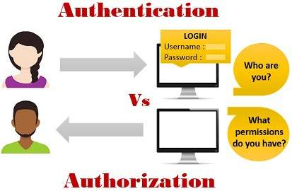
Protection methods
Authorization
Authentication

Slide 18
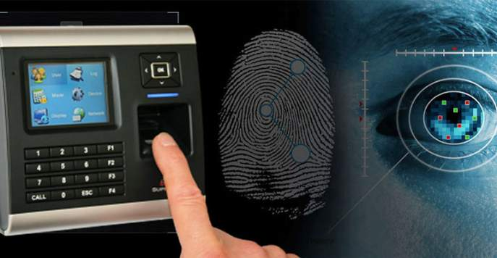
Biometric System

Slide 19
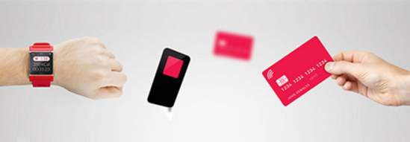

Encrypted smart cards

Slide 20
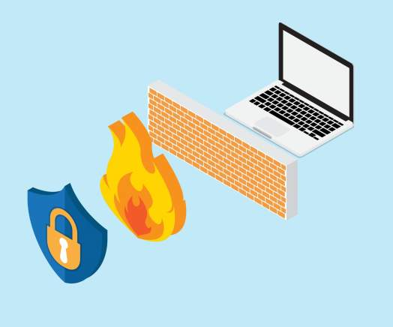
Firewall

Slide 21
Several types of firewall techniques are:
Packet filters
Application Gateways
Proxy Server
Circuit-level Gateways

Slide 22
Cookies
Cookies are messages that a Web server transmits to a Web browser so that the Web server can keep track of the users activity on a specific Web site.
The browser stores the message in a text file. The message is then sent back to the server each time the browser requests a page from the server.
Cookies do not act maliciously on computer systems. They are merely text files that can be deleted at any time.

Slide 23
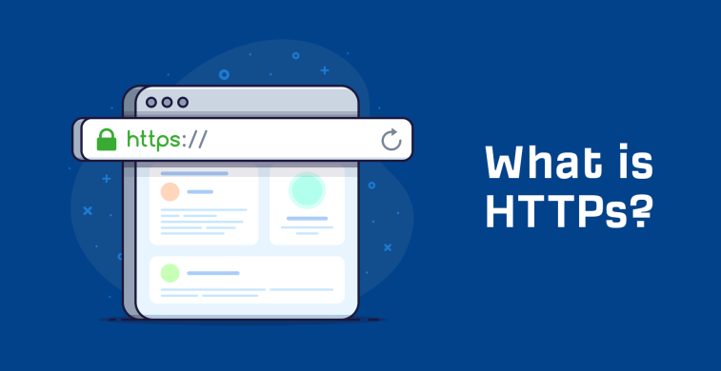
https

Slide 24
3 key layers of protection:-
Encryption
Data Integrity
Authentication

Slide 25

Hackers vs crackers

Slide 26

Computer Virus

Slide 27
Three types of viruses:-
File infector
Boot Sector Virus
Macro viruses

Slide 28
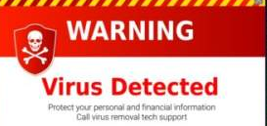
Characteristics of a Computer Virus
It is able to replicate.
It requires a host program as a carrier.
It is activated by external action.
Its replication ability is limited to the (virtual) system.

Slide 29

How Computer Viruses Spread?

Slide 30
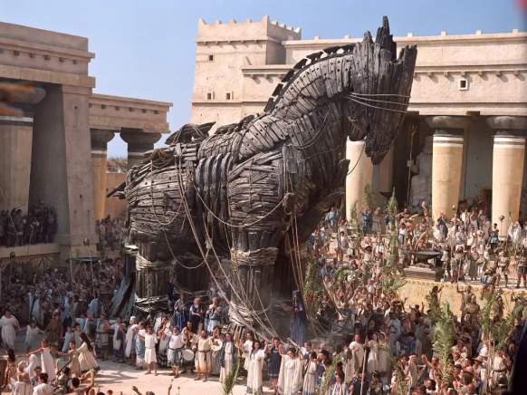
Trojan Horse

Slide 31
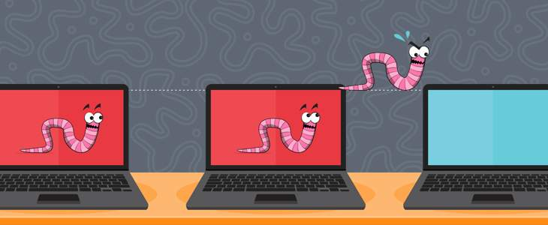
Worm

Slide 32

Spam

Slide 33
Virus Prevention
Never use a foreign disk or CD without scanning it for viruses.
Always scan files downloaded from the internet or other sources.
Never boot your PC from a pen drive unless you are certain that it is virus free.
Write protect your disks.

Slide 34
Virus Prevention
Use licensed software.
Password protect your PC to prevent unattented modification.
Make regular backups.
Install and use antivirus software.
Keep antivirus software up to date.

