Slide 2
After this lecture, you will be able to
learn security goals
understand security services

Slide 3
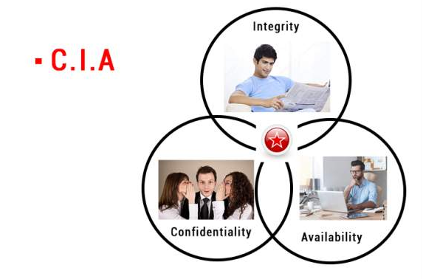
Security Goals

Slide 4
CIA Triangle
The primary goal of network security are Confidentiality, Integrity, and Availability. These three pillars of Network Security are often represented as CIA triangle.

Slide 5
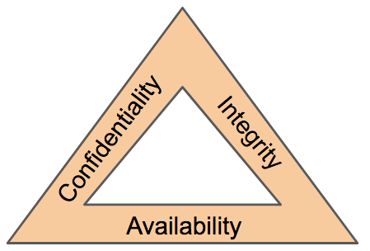
CIA Triangle

Slide 6
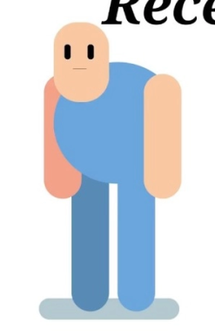

Confidentiality
Receiver
Confidentiality Maintain Here

Slide 7
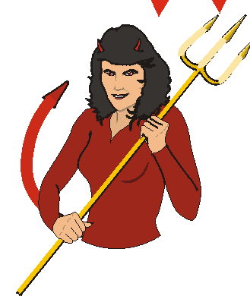
Confidentiality
Receiver
Intruder

Slide 8

Integrity
Integrity Measures Protect Information
From Unauthorized Alteration.

Slide 9

Integrity
Available balance 10,000
Withdraw 2000
Balance 8000

Slide 10
Integrity
Available balance 10,000
Withdraw 2000
Integrity not maintain
Balance 8000

Slide 11


Availability
Data must be available to the authorized user.
For Transaction

Slide 12
Availability
Information is useless, if we cannot use it.
For Transaction

Slide 13
Availability
Data should be available all the time.
For Transaction

Slide 14

Availability
Data is not showing in bank.

Slide 15
Security Services
Security Services
Data Confidentiality
Data Integrity
Authentication
Non Repudiation
Access Control

Slide 16
Security Services
Security services
Data confidentiality
Data Integrity
Authentication
Non repudiation
Access control
Protect Data From Attackers
Protect Data From Modification
Verifying Authenticity Of User
Assurance Someone Cannot Deny
Whom Access Given

Slide 17
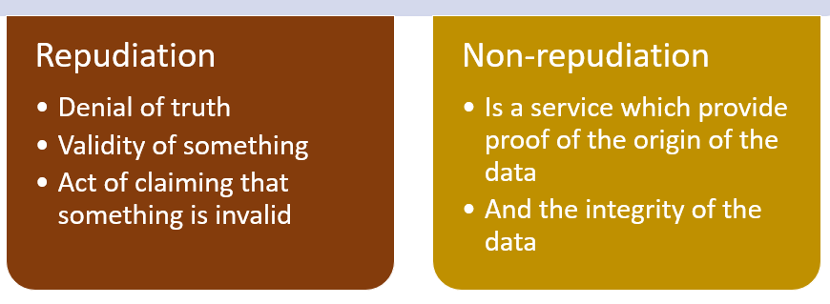
Security Services

Slide 18

Non-Repudiation

Slide 19

Non-Repudiation
Other person cannot deny if A has a proof.

Slide 20
Access Control
To whom the access should be given can be decided.
The prevention of unauthorized use of resource
(this service controls who can access our information, under what conditions).

Slide 21
Access Control
To whom the access should be given can be decided.
The prevention of unauthorized use of resource
(this service controls who can access our information, under what conditions).

Slide 22
Access Control
To whom the access should be given can be decided.
The prevention of unauthorized use of resource
(this service controls who can access our information, under what conditions).

