Slide 2
After this lecture you will be able to
approaches of network security

Slide 3
Security Approaches
Security Approaches
Prevention
Protection
Resilience

Slide 4

Prevention
Prevention generally comes before protection and is meant to prevent the threat before it occurs.

Slide 5

Prevention
An example of prevention for business security includes a set of rules or reminders about best safety practices for cyber security.

Slide 6
How to prevent security threats?
To prevent a security threat means to reduce risk. Consider implementing some prevention strategies into your business security plan to minimize threats.

Slide 7
How to prevent security threats?
Security Audits.
Access Control.
Cyber Security Policies.
Secure Your Network.

Slide 8
Protection
Protection is the next step and usually takes over if prevention fails.

Slide 9
Protection
Protection is a combination of security equipment and safety procedures used to defend against and eliminate threats.

Slide 10


Examples of Quality Protection
Monitored Fire Alarm
Emergency Evacuation Plan

Slide 11
Prevention
Although prevention and protection are different, use both simultaneously to secure your business from possible threats.

Slide 12
How to Protect Against Security Threats
The main focus of protection is to guard your business in the event of a threat. There are a number of ways you can protect your business and increase security. Consider utilizing the following security equipment for protection

Slide 13

Install Alarm

Slide 14

Video Surveillance

Slide 15
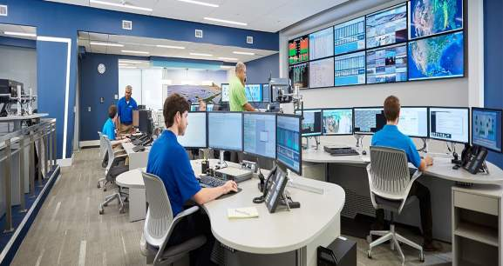
Monitoring Centre

Slide 16

Water Leak Detection

Slide 17

Smoke Detector

Slide 18

Carbon Monoxide Detectors

Slide 19
Cyber Resilience
Cyber resilience is the ability to plan, respond and recover from cyber-attacks and data breaches while continuing to work effectively.

Slide 20
Cyber Resilience
An Enterprise is cyber resilient when it can protect against cyber attacks, provide appropriate risk control for information protection, and ensure continuity of operation during and after cyber incidents.

Slide 21
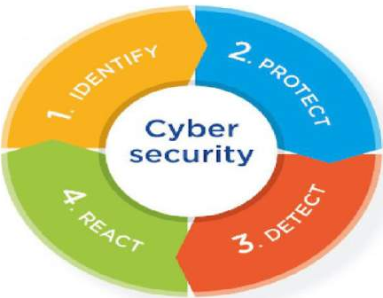
Cyber Resilience

Slide 22
Four Cyber Resilience Elements?
Manage And Protect
Identify And Detect
Respond And Recover
Govern And Assure

Slide 23
How Does Cyber Resilience Work?
Cyber resilience has grown to cover four main components:
Threat Protection
Recovery
Adaptability
Durability

Slide 24



Threat Protection
Email Attacks

Slide 25
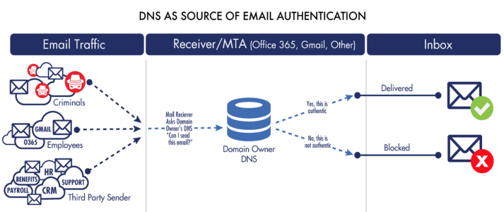
Threat Protection
DNS authentication mechanisms

Slide 26
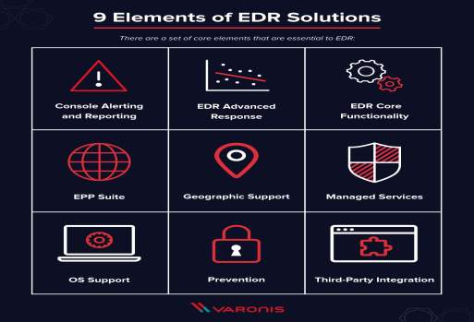
Threat Protection
Endpoint Detection and Response

Slide 27
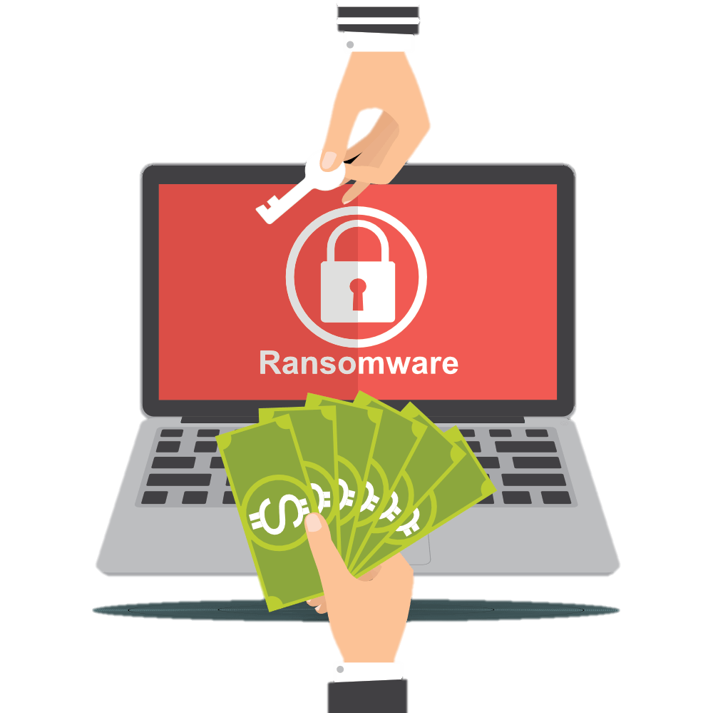
Ransomware

Slide 28
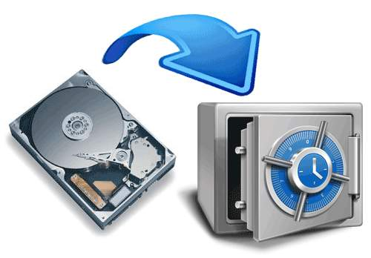
Ransomware

Slide 29
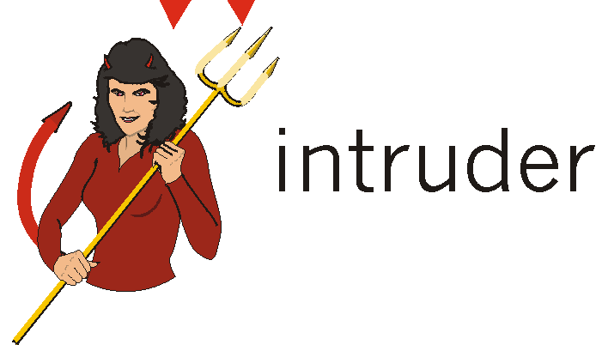
Adaptability

Slide 30
Durability
Capacity of organization to operate effectively after a cyberattack.

Slide 31
Durability
Durability aspect will improve with the IT team’s daily updates and device enhancements.

Slide 32
Durability
Cyber resilience’s primary aim is to protect the entire business. As the consequences of a data breach can be technical, social, and financial, prioritizing cyber resilience by integrating business operations with IT is imperative for every business.

Slide 33
Why Cyber Resilience is Important?
To maintain the integrity of an organization
Having regulatory and judicial specifications
Enhanced protection of the systems
More trust in the customer and vendor ecosystem
Improving the work culture and the process from inside
Reducing the losses

Slide 34
Why Cyber Resilience is Important?
To maintain the integrity of an organization
Having regulatory and judicial specifications
Enhanced protection of the systems
More trust in the customer and vendor ecosystem
Improving the work culture and the process from inside
Reducing the losses

Slide 35
Why Cyber Resilience is Important?
To maintain the integrity of an organization
Having regulatory and judicial specifications
Enhanced protection of the systems
More trust in the customer and vendor ecosystem
Improving the work culture and the process from inside
Reducing the losses

Slide 36
Why Cyber Resilience is Important?
To maintain the integrity of an organization
Having regulatory and judicial specifications
Enhanced protection of the systems
More trust in the customer and vendor ecosystem
Improving the work culture and the process from inside
Reducing the losses

Slide 37
Why Cyber Resilience is Important?
To maintain the integrity of an organization
Having regulatory and judicial specifications
Enhanced protection of the systems
More trust in the customer and vendor ecosystem
Improving the work culture and the process from inside
Reducing the losses

Slide 38
Why Cyber Resilience is Important?
To maintain the integrity of an organization
Having regulatory and judicial specifications
Enhanced protection of the systems
More trust in the customer and vendor ecosystem
Improving the work culture and the process from inside
Reducing the losses

Slide 39
Common Cyber Resilience Threats:
Cybercrime

Slide 40
Common Cyber Resilience Threats:
Cybercrime
Cyber ‘hacktivism’

Slide 41
Common Cyber Resilience Threats:
Cybercrime
Cyber ‘hacktivism’
Cyber espionage

Slide 42
Common Cyber Resilience Threats:
Cybercrime
Cyber ‘hacktivism’
Cyber espionage
Business continuity management.

