Slide 2
After this lecture you will be able to
know about cryptography
learn principals of cryptography.
types of cryptography
difference between private and public key

Slide 3

Cryptography

Slide 4
Core principles of modern-day cryptography
Data Confidentiality
Data Integrity
Authentication
Non-repudiation

Slide 5
Core principles of modern-day cryptography
Data Confidentiality
Data Integrity
Authentication
Non-repudiation

Slide 6
Core principles of modern-day cryptography
Data Confidentiality
Data Integrity
Authentication
Non-repudiation

Slide 7
Core principles of modern-day cryptography
Data Confidentiality
Data Integrity
Authentication
Non-repudiation

Slide 8


Data Confidentiality

Slide 9
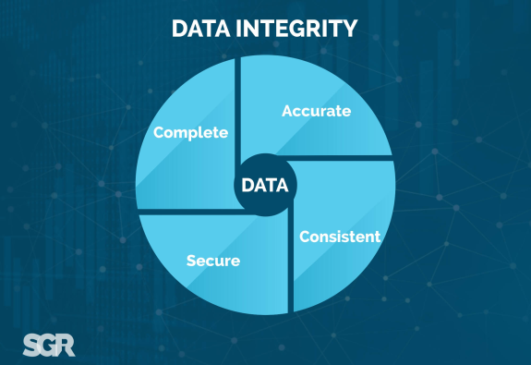
Data integrity

Slide 10

Authenticate

Slide 11
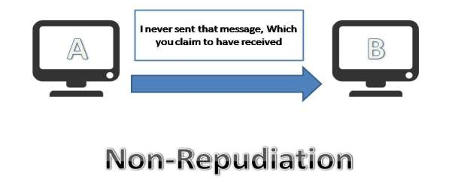
Non-repudiation

Slide 12
Types of cryptography
Symmetric Key Cryptography
Hash Functions
Asymmetric Key Cryptography

Slide 13
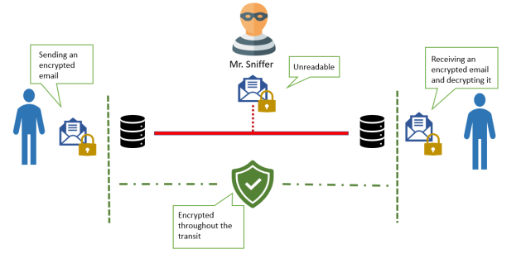
What is encryption?
Encryption is the process of converting normal message (plaintext) into meaningless message (Ciphertext)

Slide 14
What is decryption?
Decryption is the process of converting meaningless message (Ciphertext) into its original form (Plaintext)
Key
Decryption
Cliphertext
Plaintext

Slide 15
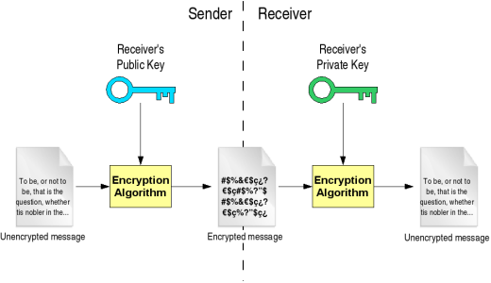
Private Key

Slide 16
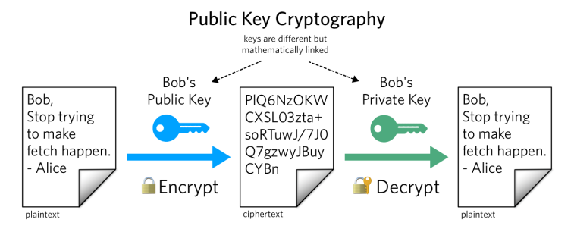
Public Key

Slide 17
Difference between private key and public key
Private Key | Public Key
Private key is faster than public key. | It is slower than private key.
In this, the same key (secret key) and algorithm is used to encrypt and decrypt the message. | In public key cryptography, two keys are used, one key is used for encryption and while the other is used for decryption.
In private key cryptography, the key is kept as a secret. | In public key cryptography, one of the two keys is kept as a secret.
Private key is Symmetrical because there is only one key that is called secret key. | Public key is Asymmetrical because there are two types of key: private and public key.
In this cryptography, sender and receiver need to share the same key. | In this cryptography, sender and receiver does not need to share the same key.
In this cryptography, the key is private. | In this cryptography, public key can be public and private key is private.

