Slide 2
After this lecture you will be able to
learn Firewalls
understand types of firewall technology
function of IP packet screening filter.
limitations of firewall

Slide 3

What is Firewall
Monitors and control incoming and outgoing
Traffic based on predefined rules.

Slide 4
What is Firewall
Acts like a Barrier

Slide 5
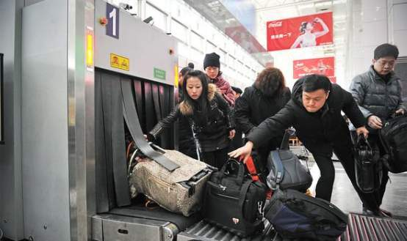
EXAMPLE

Slide 6
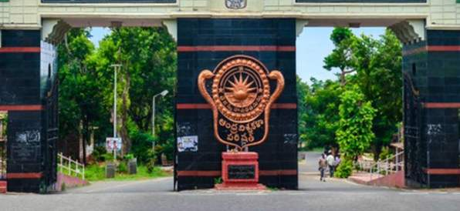
EXAMPLE
MAIN GATE

Slide 7
What is Firewall
Host Based Firewall and Network Based Firewall.

Slide 8
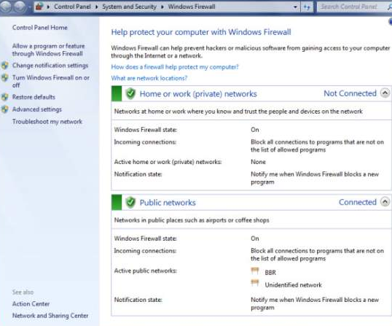
Control Panel -> Firewall

Slide 9
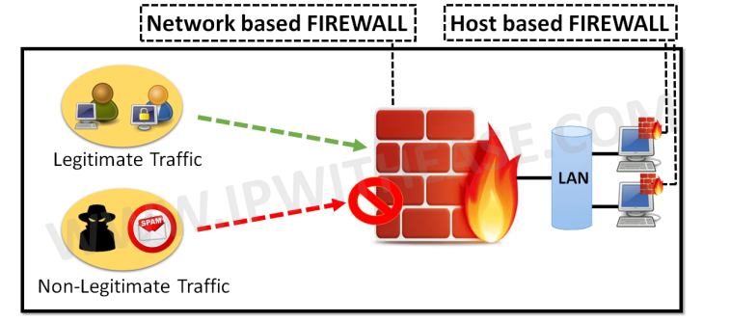
Network Based Firewall and Host Based Firewall

Slide 10
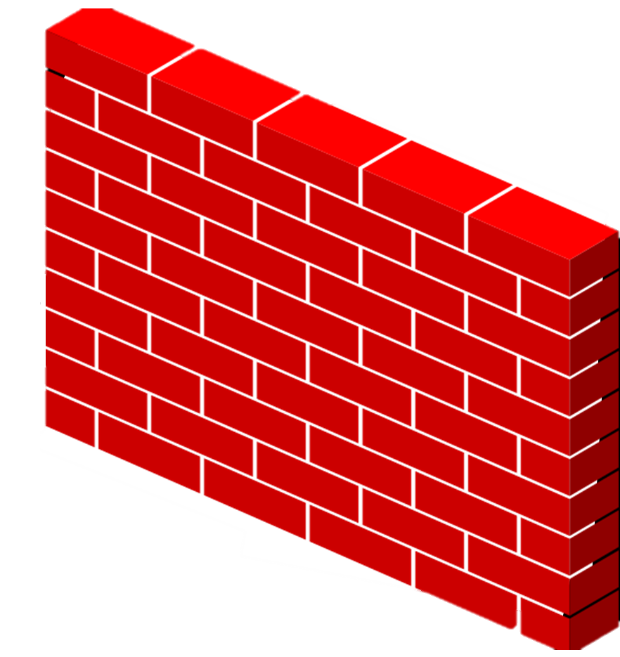
EXAMPLE
Trusted
Untrusted
Internal Network(Private)
External Network(Public)
FIREWALL

Slide 11
Types of firewalls
Packet-filtering Firewalls
Circuit-level Gateways
Stateful Multi-layer Inspection (SMLI) Firewalls
Next-generation Firewalls (NGFW)
Software Firewalls
Application-level Gateways (Proxy Firewalls)
Cloud Firewalls
Hardware firewalls

Slide 12
FIREWALL
Packet filtering firewall
Layer 4
Transport Layer
IP Header | TCP Header

Slide 13
FIREWALL
Packet filtering firewall
Works on network and transport layer.
Can block IP address.
Can block Full network.
Can block a service(http, ftp etc).

Slide 14
Table
Rule No | Source IP | Source Port | Destination IP | Destination Port
1 | 179.2.4.80 | Any | Any | Any
2 | 152.32.0.0 | Any | Any | Any
3 | Any | Any | 172.9.0.3 | Any
4 | Any | 80 | Any | Any
5 | Any | Any | Any | 21

Slide 15
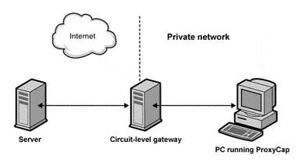
Circuit level gateway

Slide 16
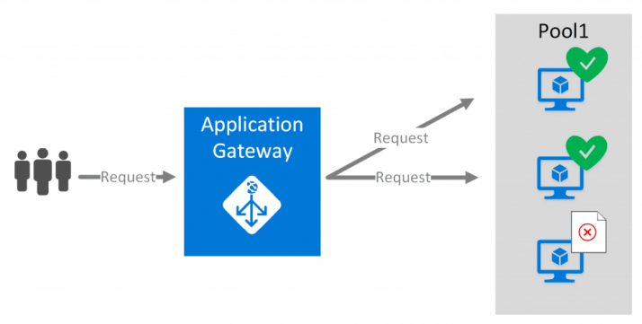
Application Level Gateway

Slide 17
Stateful Multi-layer Inspection (SMLI) Firewalls
Firewall
5. Application
4. Transport
3. Internet Protocol
2. Data Link
1. Physical
Client
Server

Slide 18

Next Generation Firewalls

Slide 19
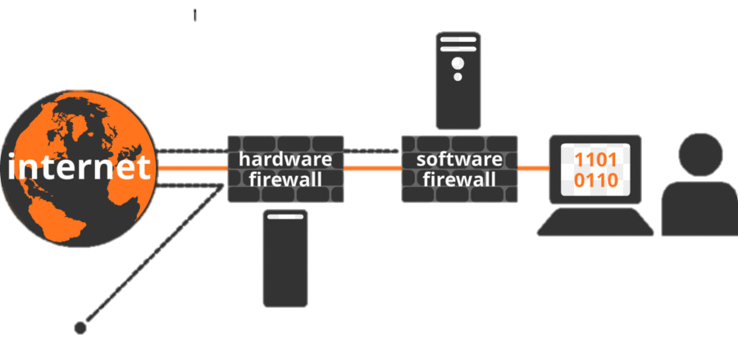
Software firewall
malware
User’s PC
Unsecured connections
Router

Slide 20
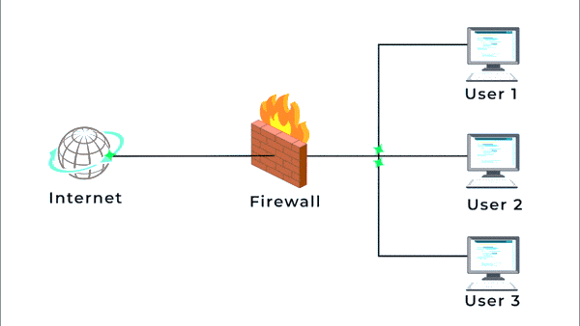
Hardware Firewalls

Slide 21
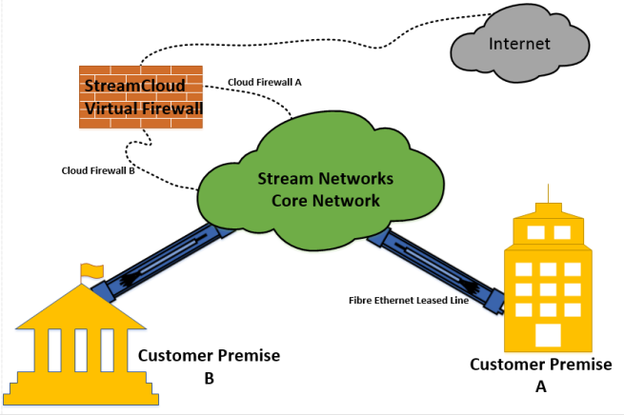
Cloud firewall

Slide 22
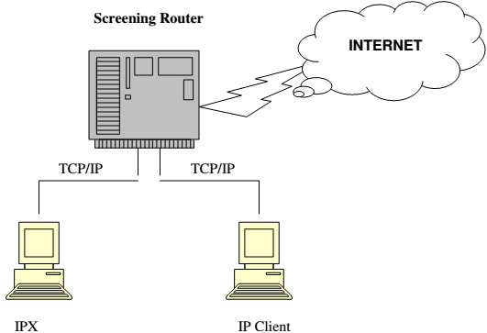
Function of IP packet screening Filter

Slide 23
Limitations of Firewall
Firewalls cannot protect against what has been authorized
It cannot stop social engineering attacks or an unauthorized user intentionally using their access for unwanted purposes
Firewalls cannot fix poor administrative practices or poorly designed security policies

Slide 24
Limitations of Firewall
It cannot stop attacks if the traffic does not pass through them
They are only as effective as the rules they are configured to enforce.

