Slide 1
Linux and Shell Scripting

Slide 2
Learning Outcomes
Understand some more utilities
Understand the compressing and archiving of files
Understand the locating commands

Slide 3
Four More Utilities
echo
date
script
unix2dos

Slide 4
echo: Displays Text
The echo utility copies the characters you type on the command line after echo to the screen.
You can also send messages from shell scripts to the screen.

Slide 5
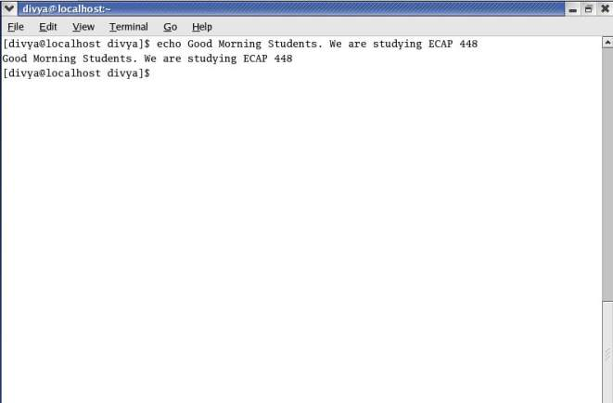
echo: Displays Text

Slide 6
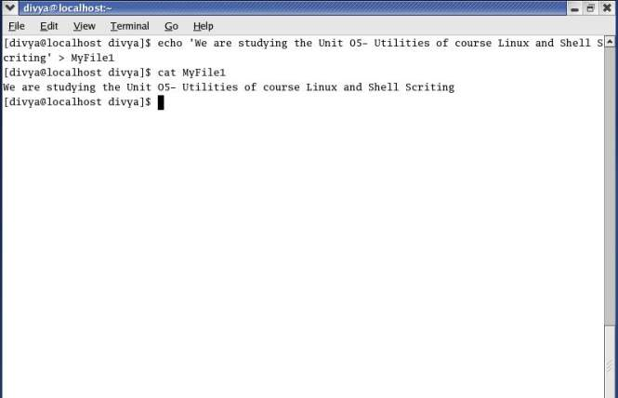
echo: Displays Text

Slide 7
date: Displays the Time and Date
The date utility displays the current date and time.
You can choose the format and select the contents of the output of date.
Default Format:
Day Mon DD HH:MM:SS TIMEZONE YEAR
Fri Jun 30 07:21:25 IST 2023

Slide 8
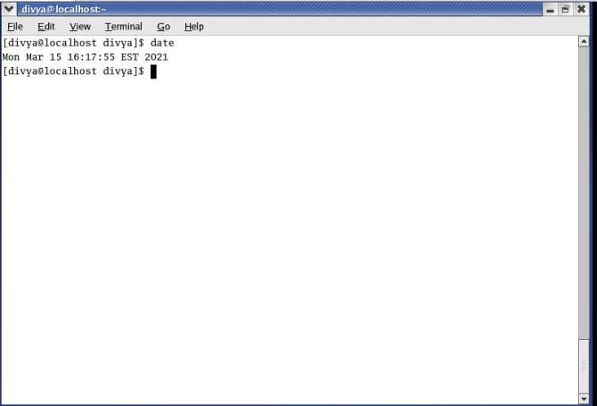
date: Displays the Time and Date

Slide 9
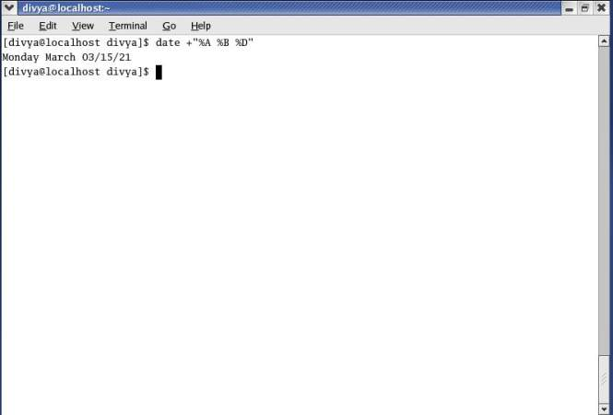
date: Displays the Time and Date

Slide 10
script: Records a Shell Session
The script utility records all or part of a login session, including your input and the system’s responses.
This utility is useful only from character-based devices.
By default script captures the session in a file named typescript. To specify a different filename, follow the script command with a SPACE and the filename

Slide 11
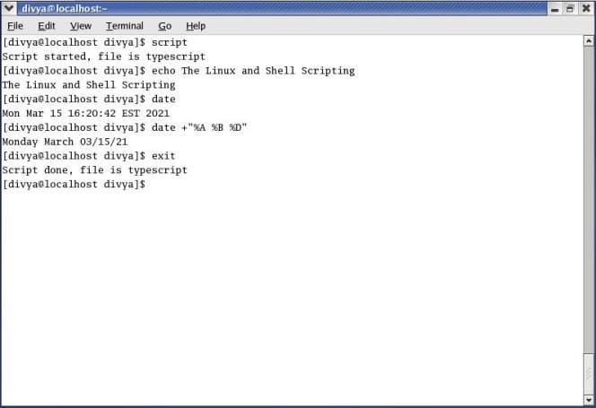
script: Records a Shell Session

Slide 12
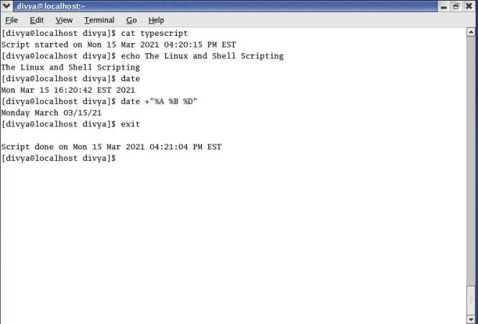
script: Records a Shell Session

Slide 13
todos/unix2dos: Converts Linux Files to Windows Format
If you want to share a text file you created on a Linux system with someone on a system running Windows, you need to convert the file before the person on the other system can read it easily.
The todos (to DOS; part of the tofrodos package) or unix2dos (UNIX to DOS; part of the unix2dos package) utility converts a Linux text file so it can be read on a Windows system.

Slide 14
todos/unix2dos: Converts Linux Files to Windows Format
You can use the fromdos (from DOS; part of the tofrodos package) or dos2unix (DOS to UNIX; part of the dos2unix package) utility to convert Windows files so they can be read on a Linux system.

Slide 15
Compressing and Archiving Files
Large files use a lot of disk space and take longer than smaller files to transfer from one system to another over a network.
If you do not need to look at the contents of a large file often, you may want to save it on a CD, DVD, or another medium and remove it from the hard disk.

Slide 16
Compressing and Archiving Files
If you have a continuing need for the file, retrieving a copy from another medium may be inconvenient.
To reduce the amount of disk space a file occupies without removing the file, you can compress the file without losing any of the information it holds.

Slide 17
Compressing and Archiving Files
Similarly a single archive of several files packed into a larger file is easier to manipulate, upload, download, and email than multiple files. You may download compressed, archived files from the Internet.

Slide 18
bzip2: Compresses a File
The bzip2 utility compresses a file by analyzing it and recoding it more efficiently.
The new version of the file looks completely different. In fact, because the new file contains many nonprinting characters, you cannot view it directly.
The –v (verbose) option causes bzip2 to report how much it was able to reduce the size of the file.

Slide 19
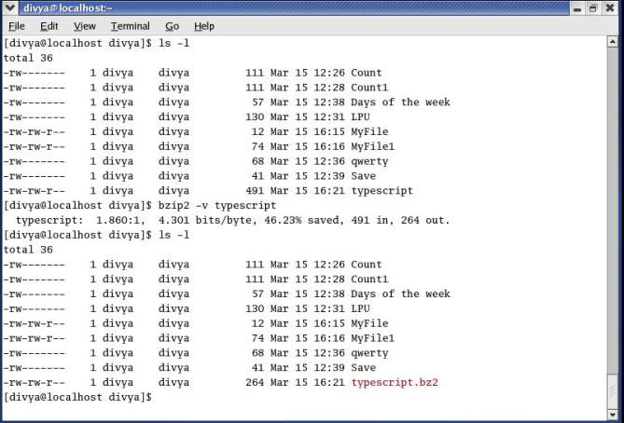
bzip2: Compresses a File

Slide 20
bzip2: Compresses a File
The bzip2 utility also renamed the file, appending .bz2 to its name.
This naming convention reminds you that the file is compressed; you would not want to display or print it, for example, without first decompressing it.

Slide 21
bunzip2 and bzcat: Decompress a File
The bzcat utility displays a file that has been compressed with bzip2.
The equivalent of cat for .bz2 files, bzcat decompresses the compressed data and displays the decompressed data.
Like cat, bzcat does not change the source file.

Slide 22
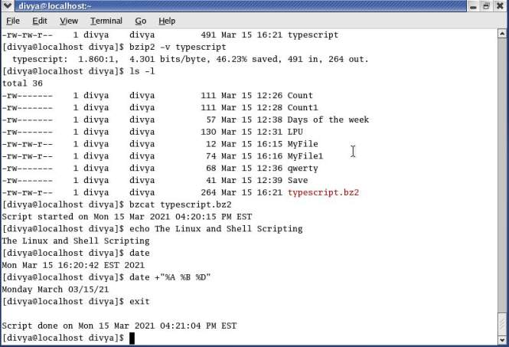
bunzip2 and bzcat: Decompress a File

Slide 23
bunzip2 and bzcat: Decompress a File
You can use the bunzip2 utility to restore a file that has been compressed with bzip2.

Slide 24
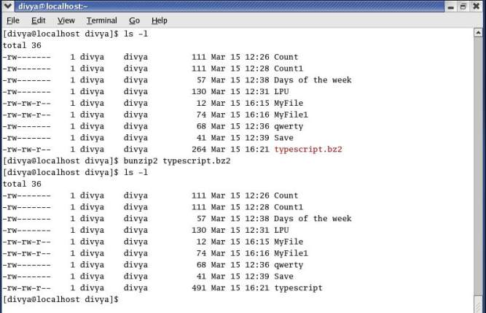
bunzip2 and bzcat: Decompress a File

Slide 25
gzip: Compresses a File
The gzip (GNU zip) utility is older and less efficient than bzip2.
Its flags and operation are very similar to those of bzip2.
A file compressed by gzip is marked by a .gz filename extension.

Slide 26
gzip: Compresses a File
Linux stores manual pages in gzip format to save disk space; likewise, files you download from the Internet are frequently in gzip format.
The gunzip utility to restore a file that has been compressed with gzip.
zcat decompresses the compressed data and displays the decompressed data.

Slide 27
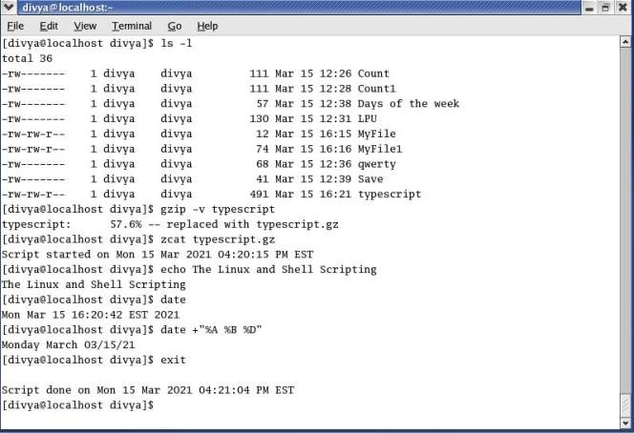
gzip: Compresses a File

Slide 28
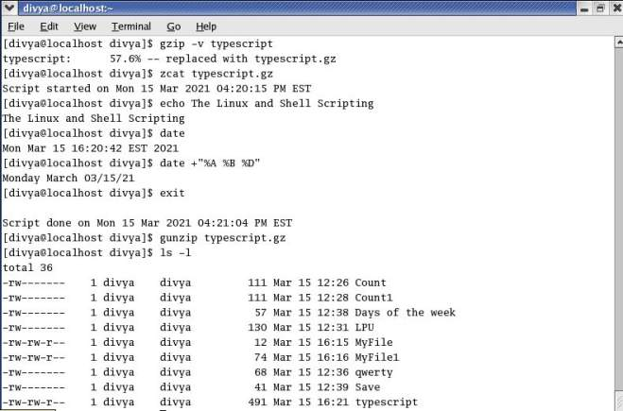
gzip: Compresses a File

Slide 29
gzip: Compresses a File
Do not confuse gzip and gunzip with the zip and unzip utilities.
These last two are used to pack and unpack zip archives containing several files compressed into a single file that has been imported from or is being exported to a system running Windows.

Slide 30
tar: Packs and Unpacks Archives
The tar utility performs many functions. Its name is short for tape archive, as its original function was to create and read archive and backup tapes.
Today it is used to create a single file (called a tar file, archive, or tarball) from multiple files or directory hierarchies and to extract files from a tar file.

Slide 31
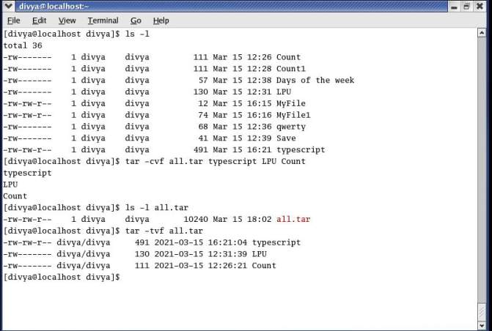
tar: Packs and Unpacks Archives

Slide 32
tar: Packs and Unpacks Archives
Tar uses the –c (create), –v (verbose), and –f (write to or read from a file) options to create an archive named all.tar from these files.
Each line of output displays the name of the file tar is appending to the archive it is creating. The tar utility adds overhead when it creates an archive.
The final command uses the –t option to display a table of contents for the archive.

Slide 33
tar: Packs and Unpacks Archives
You can use bzip2, compress, or gzip to compress tar files, making them easier to store and handle.
Many files you download from the Internet will already be in one of these formats.

Slide 34
tar: Packs and Unpacks Archives
Files that have been processed by tar and compressed by bzip2 frequently have a filename extension of .tar.bz2 or .tbz.
Those processed by tar and gzip have an extension of .tar.gz, .tgz, or .gz, whereas files processed by tar and compress use .tar.Z as the extension.

Slide 35
Locating Commands
The whereis and slocate utilities can help you find a command whose name you have forgotten or whose location you do not know.
When multiple copies of a utility or program are present, which tells you which copy you will run.
The slocate utility searches for files on the local system.

Slide 36
which and whereis: Locate a Utility
When you give Linux a command, the shell searches a list of directories for a program with that name and runs the first one it finds. This list of directories is called a search path.
If you do not change the search path, the shell searches only a standard set of directories and then stops searching. However, other directories on the system may also contain useful utilities.

Slide 37
which and whereis: Locate a Utility
The which utility locates utilities by displaying the full pathname of the file for the utility.
The local system may include several utilities that have the same name.
When you type the name of a utility, the shell searches for the utility in your search path and runs the first one it finds.
You can find out which copy of the utility the shell will run by using which.

Slide 38
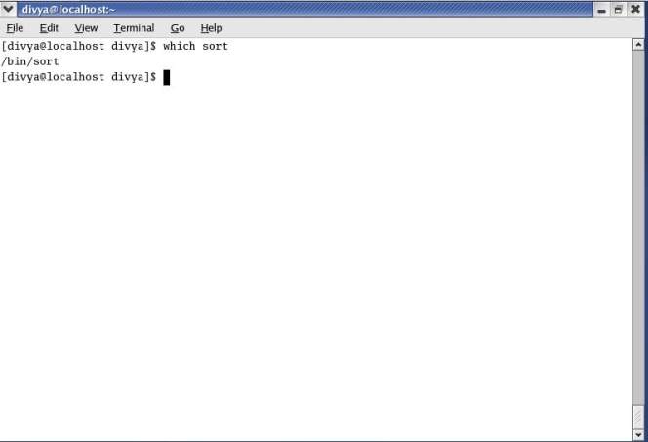
which and whereis: Locate a Utility

Slide 39
which and whereis: Locate a Utility
The whereis utility searches for files related to a utility by looking in standard locations instead of using your search path.

Slide 40
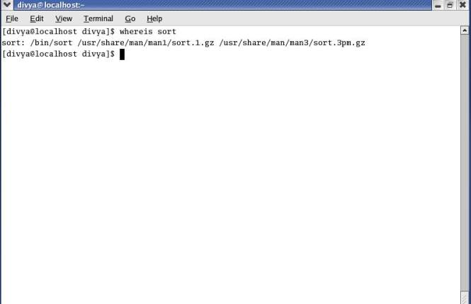
which and whereis: Locate a Utility

Slide 41
which and whereis: Locate a Utility
whereis finds three references to sort: the sort utility file, a sort header file, and the sort man page.

Slide 42
slocate/locate: Searches for a File
The slocate (secure locate) or locate utility searches for files on the local system.

Slide 43
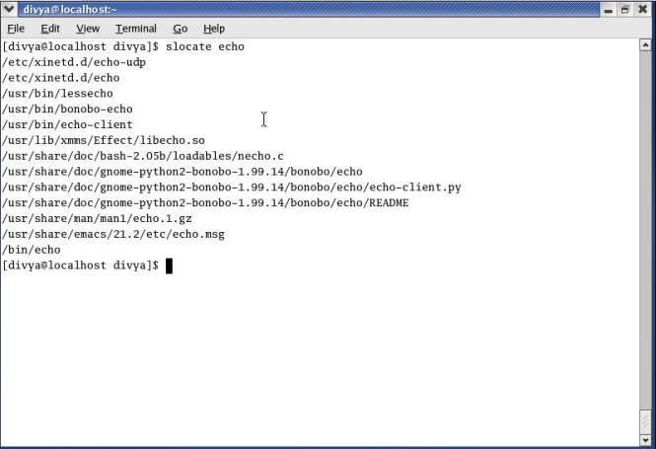
slocate/locate: Searches for a File

