Slide 2
Understand basics of statistics and probability.
Learn concepts of set theory.
Define basic terms of Sampling .

Slide 3

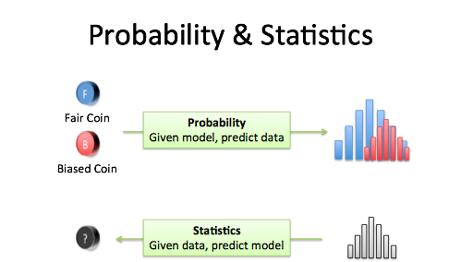
Probability and Statistics
Probability and Statistics are the two important concepts in Maths. Probability is all about chance. Whereas statistics is more about how we handle various data using different techniques.

Slide 4
Probability
Probability denotes the possibility of the outcome of any random event. The meaning of this term is to check the extent to which any event is likely to happen. For example, when we flip a coin in the air, what is the possibility of getting a head? The answer to this question is based on the number of possible outcomes.
Here the possibility is either head or tail will be the outcome. So, the probability of a head coming as a result is 1/2.

Slide 5
Statistics
Statistics is the study of the collection, analysis, interpretation, presentation, and organization of data. It is a method of collecting and summarizing the data. This has many applications, from a small scale to large scale. Whether it is the study of the population of the country or its economy, stats are used for all such data analysis.

Slide 6
Statistics
Statistics have a huge scope in many fields, such as sociology, psychology, geology, weather forecasting, etc. The data collected here for analysis could be quantitative or qualitative.

Slide 7
Set Theory and Its Importance
The branch of mathematics deals with the formal properties of sets as units and the expression of other branches of mathematics in terms of sets.
Set theory is important mainly because it serves as a foundation for the rest of mathematics--it provides the axioms from which the rest of mathematics is built up.

Slide 8
Set Theory and Its Importance
Set theory can assist in planning and operations. Every element of business can be grouped into at least one set, such as accounting, management, operations, production and sales.
Applications of set theory are most commonly utilized in science and mathematics fields like biology, chemistry and physics as well as in computer and electrical engineering.

Slide 9
Sets and Elements
A set consists of objects or elements. The elements can be numbers, letters, etc. Elements are listed inside curly brackets.
Sets can have a finite or infinite number of elements, or they can be empty.
Empty sets, called the null set, have no elements and are denoted by the symbol ∅.
∅

Slide 10

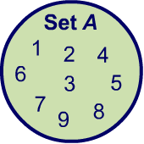
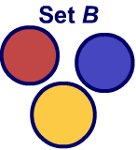
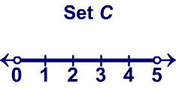
Examples
A = {1, 2, 3, 4, 5, 6, 7, 8, 9} is a set of single digit positive numbers.
B = {red, yellow, blue} is the set of primary colors
C = {x|0 < x < 5} is the set of numbers between 0 and 5

Slide 11
Subset
In mathematics, a set A is a subset of a set B if all elements of A are also elements of B; B is then a superset of A.
It is possible for A and B to be equal; if they are unequal, then A is a proper subset of B. The relationship of one set being a subset of another is called inclusion.
Example: If set A has {X, Y} and set B has {X, Y, Z}, then A is a subset of B because elements of A are also present in set B.

Slide 12
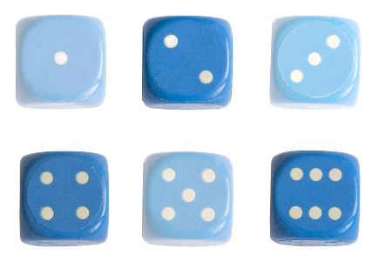
Subsets
What is the set of possible outcomes from rolling a die?
Subsets
A = {1, 2, 3, 4, 5, 6}
What is the set of possible even outcomes?
A_{e} = {2, 4, 6}
The universal set is the largest possible set for a given scenario. For this example, A is the universal set.
A_{e} is a subset of all the possible outcomes, A, because is contains some of the elements of A. The null set is a subset of every set.
Subsets are denoted using the ⊆ symbol.
A_{e} ⊆ A

Slide 13
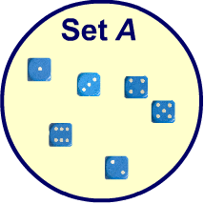
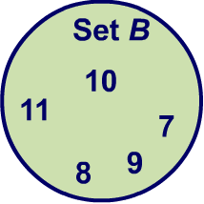

Unions
The union of two or more sets contains all the elements in all the sets.
The union of sets A and B is the elements in either set A or B or both.
Unions of sets are denoted by the symbol ∪.
What is the union of set A, the outcomes of rolling a dice, and set B, all positive integers between 7 and 11?
set A = {1, 2, 3, 4, 5, 6}
set B = {7, 8, 9, 10, 11}
A ∪ B = {1, 2, 3, 4, 5, 6, 7, 8, 9, 10, 11}

Slide 14
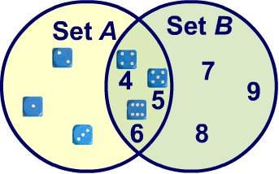
Intersections
The intersection of two or more sets contains all the elements that are in all sets.
For example, all the elements in set A and B.
Intersections of sets are denoted by the symbol ∩.
What is the intersection of set A, the outcomes of rolling a dice, and set B, all positive integers between and inclusive of 4 and 9?
set A = {1, 2, 3, 4, 5, 6}
set B = {4, 5, 6, 7, 8, 9}
A ∩ B = {4, 5, 6,}

Slide 15
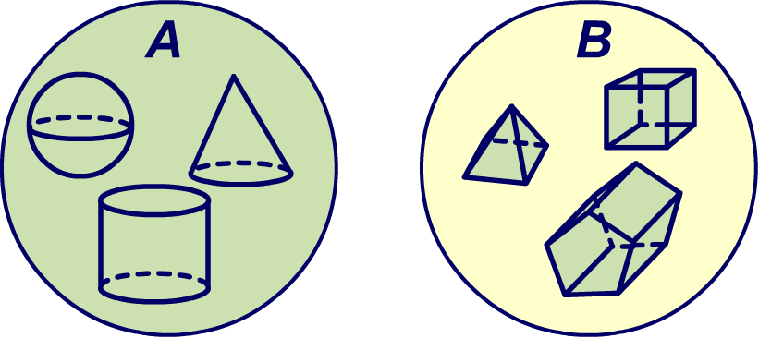
Disjoint Sets
Disjoint sets are two or more sets that have no elements in common, therefore the intersection is an empty set.
For example: a set of all 3D shapes with a curved surfaces, and B, a set of all polyhedrons, are disjoint sets.
The intersection of disjoints sets is the empty set:
A ∩ B = ∅

Slide 16

Set Difference
The Venn diagram for the set difference of sets A and B is shown below where the shaded region represents A – B.
For sets A, B, the difference of A and B, written A−B, is the set of all elements that are in A but not B.
The Venn diagram for the set difference of sets A and B is shown below where the shaded region represents
A – B.

Slide 17
Examples-Set difference
Example: Let A = {a, b, c, d} and B = {b, d, e}.
Then A – B = {a, c}
and B – A = {e}.
Example: Let G = {t, a, n} and
H = {n, a, t}.
Then G – H = ∅.

Slide 18
Random Experiment
A Random Experiment is an experiment, trial, or observation that can be repeated numerous times under the same conditions. The outcome of an individual random experiment must be independent and identically distributed.
It must in no way be affected by any previous outcome and can not be predicted with certainty

Slide 19
Random Experiment
Rolling an ordinary six-sided die is a familiar example of a random experiment, an action for which all possible outcomes can be listed, but for which the actual outcome on any given trial of the experiment can not be predicted with certainty.

Slide 20
Sample Space
The sample space of a random experiment is the collection of all possible outcomes. An event associated with a random experiment is a subset of the sample space.
The probability of any outcome is a number between 0 and 1. The probabilities of all the outcomes add up to 1.

Slide 21
Example 1
Construct a sample space for the experiment that consists of tossing a single coin.
Solution:
The outcomes could be labeled h for heads and t for tails.
Then the sample space is the set S={h,t}.

Slide 22
Example 2
Construct a sample space for the experiment that consists of rolling a single die. Find the events that correspond to the phrases “an even number is rolled” and “a number greater than two is rolled.”

Slide 23
Example 2 -Solution
The outcomes could be labeled according to the number of dots on the top face of the die. Then the sample space is the set S={1,2,3,4,5,6}.
The outcomes that are even are 2, 4, and 6, so the event that corresponds to the phrase “an even number is rolled” is the set {2,4,6}, which it is natural to denote by the letter E. We write E={2,4,6}.

Slide 24
Example 2 -Solution
Similarly the event that corresponds to the phrase “a number greater than two is rolled” is the set T={3,4,5,6}T={3,4,5,6}, which we have denoted T.

Slide 25
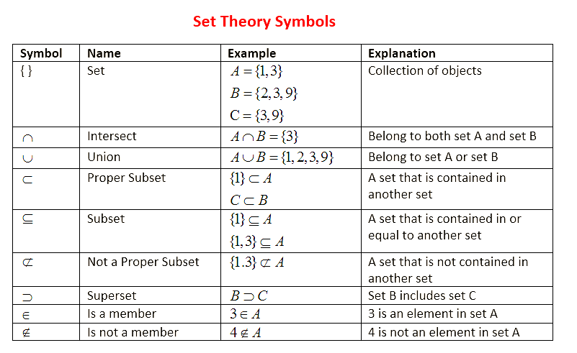
Summary of sets

