Slide 2
Understand concept of Bayes theorem.
Solve examples of Bayes theorem.
Understand applications of Bayes theorem.

Slide 3


Probability
Probability is the measure of the likelihood that an event will occur. Probability is quantified as a number between 0 and 1 (where 0 indicates impossibility and 1 indicates certainty).

Slide 4


Example
A simple example is the toss of a fair (unbiased) coin. Since the two outcomes are equally probable, the probability of "heads" equals the probability of "tails", so the probability is 1/2 (or 50%) chance of either "heads" or "tails".

Slide 5
Conditional Probability
A conditional probability measures the probability of an event given that (by assumption, presumption, assertion or evidence) another event has occurred. If the event of interest is A and the event B is known or assumed to have occurred, "the conditional probability of A given B", or "the probability of A under the condition B", is usually written as P(A|B)

Slide 6
Conditional Probability
Let's think of cases where this happens:
Drawing a second ace from a deck given we got the first ace
Finding the probability of having a disease given you were tested positive
Finding the probability of liking Harry Potter given we know the person likes fiction

Slide 7
What Is Bayes Theorem?
The Bayes Theorem is a mathematic model, based on statistics and probability, that aims to calculate the probability of one scenario based on its relationship with another scenario.

Slide 8
What Is Bayes Theorem?
Largely defined, conditional probability is the likelihood of an event transpiring, due to its association with another scenario. For instance, your likelihood of playing a round of golf within four hours depends on the time of previous rounds played, the time of day, the course you're playing, how many other people you're golfing with, and where and how often you hit your golf ball.

Slide 9
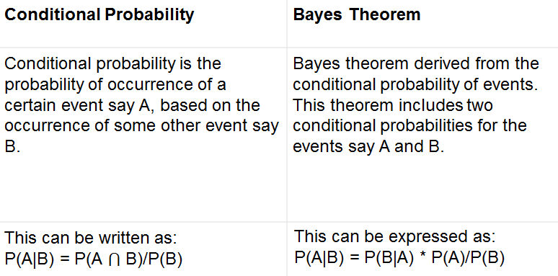
What is the difference between Bayes theorem and conditional probability?

Slide 10
Bayes Theorem: Historical Application
The theorem was used to crack the infamous Nazi Enigma code in World War II. Alan Turing, a British mathematician, used the Bayes Theorem to assess the translations culled from the Enigma encryption machine used to crack the German messaging code. Applying probability models, Turing and his staff were able to break down the almost infinite number of possible translations based on the messages that were most likely to be translatable, and ultimately crack the German Enigma code.

Slide 11
How to Use Bayes Theorem for Business and Finance
In evaluating interest rates. Companies rely on interest rates for multiple reasons - borrowing money, investing in the fixed income market, and trading in currencies overseas. Any unexpected shifts in interest rate values can hit a company hard in the pocketbook, and can negatively impact profits and revenues. With the Bayes Theorem and estimated probabilities, companies can better evaluate systematic changes in interest rates, and steer their financial resources to take maximum advantage.

Slide 12
Applications-For extending credit
Under the Bayes Theorem conditional probability model, financial companies can make better decisions and better evaluate the risk of lending cash to unfamiliar or even existing borrowers. For example, an existing client may have had a good previous track record of repaying loans, but lately, the client has been slow in playing This additional information, based on probability theory, could lead the company to treat the slow payment history as a red flag, and either hike interest rates on the loan or reject it altogether.

Slide 13
When to Apply Bayes' Theorem
You should consider Bayes' theorem when the following conditions exist.
Within the sample space, there exists an event B, for which P(B) > 0.

Slide 14
When to Apply Bayes' Theorem
In statistics and probability theory, the Bayes’ theorem (also known as the Bayes’ rule) is a mathematical formula used to determine the conditional probability of events. Essentially, Bayes’ theorem describes the probability of an event based on prior knowledge of the conditions that might be relevant to the event.

Slide 15
Bayes Rule
The Bayes Theorem was developed and named for Thomas Bayes(1702-1761)
Show the relation between one conditional probability and its inverse.
Provide a mathematical rule for revising an estimate or forecast in light of experience and observation

Slide 16
Bayes Rule
In the 18th Century , Thomas Bayes,
Ponder this question:
“Does God really exist?”

Slide 17
Bayes Rule
In the 18th Century , Thomas Bayes,
Being interested in mathematics, he attempted to develop a formula to arrive at the probability that God does exist based on the evidence that was available to him on earth.
Later, Laplace refined Bayes’ work and gave it the name “Bayes’ Theorem”.

Slide 18
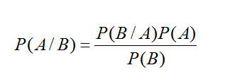
Definition
In probability theory and statistics, Bayes' theorem (alternatively Bayes' law or Bayes' rule) describes the probability of an event, based on conditions that might be related to the event.

Slide 19
Explanation
Where A and B are events:
P(A) and P(B) are the probabilities of A and B without regard to each other.
P(A | B), a conditional probability, is the probability of observing event A given that B is true.
P(B | A) is the probability of observing event B given that A is true.

Slide 20
Bayesian inference
Bayesian inference is a method of statistical inference in which Bayes' theorem is used to update the probability for a hypothesis as evidence. It Involves:
Prior Probability:
The initial probability is based on the present level of information.
Posterior Probability:
A revised probability is based on additional information.

Slide 21
Example of Bayes Rule
Marie is getting married tomorrow, at an outdoor ceremony in the desert. In recent years, it has rained only 5 days each year. Unfortunately, the weatherman has predicted rain for tomorrow. When it actually rains, the weatherman correctly forecasts rain 90% of the time. When it doesn't rain, he incorrectly forecasts rain 10% of the time. What is the probability that it will rain on the day of Marie's wedding?

Slide 22
Solution
The sample space is defined by two mutually-exclusive events - it rains or it does not rain. Additionally, a third event occurs when the weatherman predicts rain. Notations for these events appear below.
Event A₁. It rains on Marie's wedding.
Event A₂. It does not rain on Marie's wedding.
Event B. The weatherman predicts rain.

Slide 23
Solution
We want to know P( A₁ | B ), the probability it will rain on the day of Marie's wedding, given a forecast for rain by the weatherman. The answer can be determined from Bayes' theorem, as shown below.

Slide 24
Solution
In terms of probabilities, we know the following:
P( A₁ ) = 5/365 =0.0136985 =1/73[It rains 5 days out of the year.]
P( A₂ ) = 360/365 = 0.9863014 =72/73[It does not rain 360 days out of the year.]
P( B | A₁ ) = 0.9 [When it rains, the weatherman predicts rain 90% of the time.]
P( B | A₂ ) = 0.1 [When it does not rain, the weatherman predicts rain 10% of the time.]

Slide 25
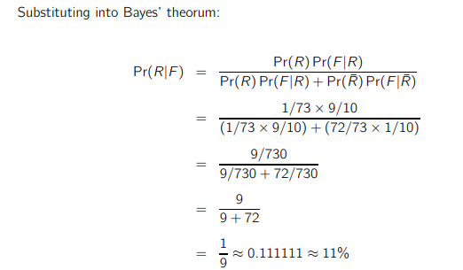
Solution

Slide 26
Example
Imagine you are a financial analyst at an investment bank. According to your research of publicly traded companies, 60% of the companies that increased their share price by more than 5% in the last three years replaced their CEOs during that period.

Slide 27
Solution
At the same time, only 35% of the companies that did not increase their share price by more than 5% in the same period replaced their CEOs. Knowing that the probability that the stock prices grow by more than 5% is 4%.
These types of problems can be solved with Bayes theorem .

