Slide 2
understand JavaScript Development Environment
understand basics of javascript.

Slide 3
What is Javascript?
A lightweight programming language ("scripting language")
used to make web pages interactive
insert dynamic text into HTML (ex: user name)
react to events (ex: page load user click)

Slide 4
What is Javascript?
A lightweight programming language ("scripting language")
get information about a user's computer (ex: browser type)
perform calculations on user's computer (ex: form validation)

Slide 5
Why to Learn Javascript
Javascript is everywhere, it comes installed on every modern web browser and so to learn Javascript you really do not need any special environment setup.
For example Chrome, Mozilla Firefox , Safari and every browser you know as of today, supports Javascript.

Slide 6
Advantages of JavaScript
Speed. Client-side JavaScript is very fast because it can be run immediately within the client-side browser. Unless outside resources are required, JavaScript is unhindered by network calls to a backend server.
Simplicity. JavaScript is relatively simple to learn and implement.
Popularity. JavaScript is used everywhere on the web.

Slide 7
Advantages of JavaScript
Interoperability. JavaScript plays nicely with other languages and can be used in a huge variety of applications.
Server Load. Being client-side reduces the demand on the website server.
Gives the ability to create rich interfaces.

Slide 8
Setup JavaScript Development Environment
To use JavaScript in developing a web application you must have at least two things,
a browser, and
an editor to write the JavaScript code.

Slide 9
Browser
You can also install the following browser as per your preference:
Microsoft Edge
Google Chrome
Mozilla FireFox
Safari
Opera

Slide 10

IDEs for JavaScript Application Development
You can write JavaScript code using a simple editor like Notepad. However, you can install any open-sourced or licensed IDE (Integrated Development Environment) to get the advantage of IntelliSense support for JavaScript and syntax error/warning highlighter for rapid development.

Slide 11
JavaScript Editors:
The followings are some of the well-known JavaScript editors:
Visual Studio Code (Free, cross-platform)
Eclipse (Free, cross-platform)
Atom (Free, cross-platform)
Notepad++ (Free, Windows)
Code Lobster (Free, cross-platform)
WebStorm (Paid, cross-platform)

Slide 12
Where can I download JavaScript?
You don't have to get or download JavaScript.
JavaScript is already running in your browser on your computer, on your tablet, and on your smart-phone.
JavaScript is free to use for everyone.

Slide 13
JavaScript importance
JavaScript is one of the 3 languages all web developers must learn:
HTML to define the content of web pages
CSS to specify the layout of web pages
JavaScript to program the behavior of web pages

Slide 14
JavaScript Can Change HTML Content
One of many JavaScript HTML methods is getElementById().
The example below "finds" an HTML element (with id="demo"), and changes the element content (innerHTML) to "Hello JavaScript":
Example
document.getElementById("demo").innerHTML = "Hello JavaScript";

Slide 15
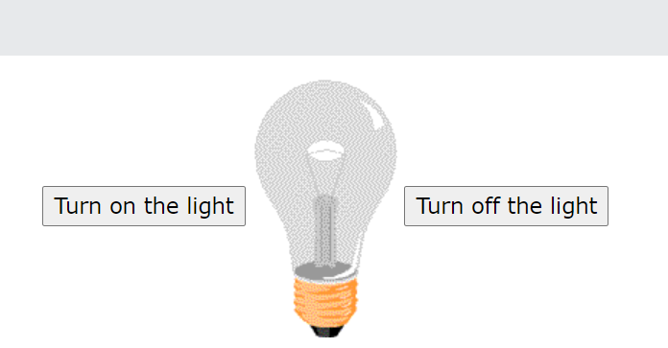
JavaScript Can Change HTML Attribute Values
JavaScript changes the value of the src (source) attribute of an <img> tag

Slide 16
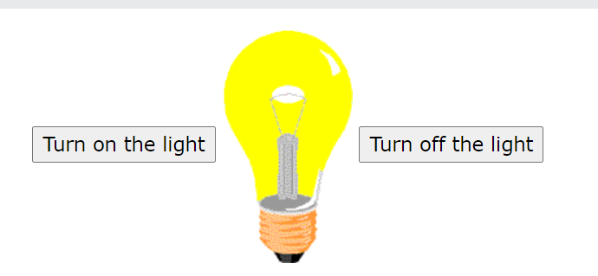
JavaScript Can Change HTML Attribute Values
JavaScript changes the value of the src (source) attribute of an <img> tag

Slide 17
JavaScript Can Change HTML Styles (CSS)
Changing the style of an HTML element, is a variant of changing an HTML attribute:
Example
document.getElementById("demo").style.fontSize = "35px";

Slide 18
JavaScript Can Hide HTML Elements
Hiding HTML elements can be done by changing the display style:
Example
document.getElementById("demo").style.display = "none";

Slide 19

Practical

