Slide 2
Learning Outcomes
understand the minimal spanning tree
understand the Prim’s and Kruskal’s algorithms

Slide 3
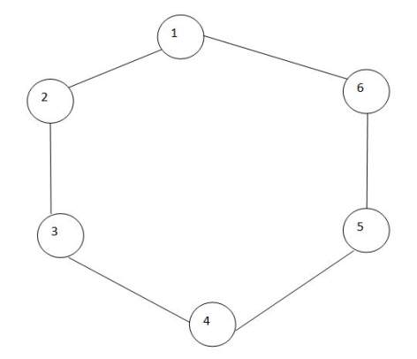
Graph

Slide 4
Components of a graph
G=(V,E)
V={1,2,3,4,5,6}
E={(1,2),(2,3),(3,4),(4,5),(5,6),(6,1)}

Slide 5
Spanning tree
A spanning tree is a subset of Graph G, which has all the vertices covered with minimum possible number of edges.
Hence, a spanning tree does not have cycles and it cannot be disconnected.
By this definition, we can draw a conclusion that every connected and undirected Graph G has at least one spanning tree.

Slide 6
Spanning tree
A spanning tree is sub-graph of a graph which has all the vertices; the number of edges will be less one than the number of vertices.

Slide 7
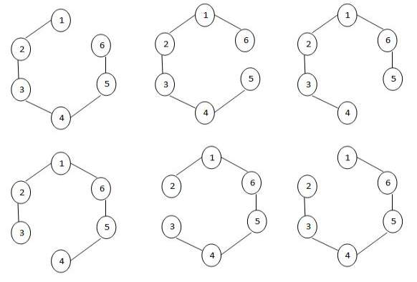
Possible spanning trees

Slide 8
Spanning tree
S ⊆ G
S=(V’,E’)
V’=V
E’= |V|-1

Slide 9
Number of spanning trees possible?
Total number of edges in the tree, |E| = 6.
Total number of edges in spanning tree = 5.
⁶C₅ = 6.

Slide 10
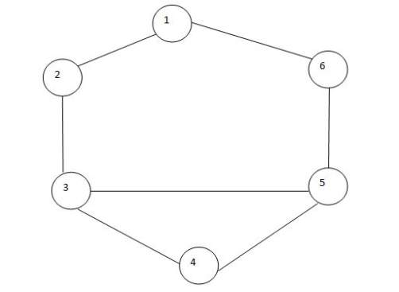
Tree

Slide 11
Spanning tree
So, the number of possible spanning trees = ⁷C₅
Number of cycles formed = 2

Slide 12
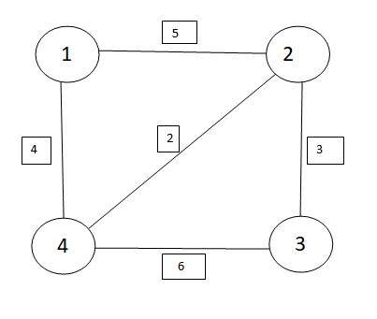
Weighted graph

Slide 13
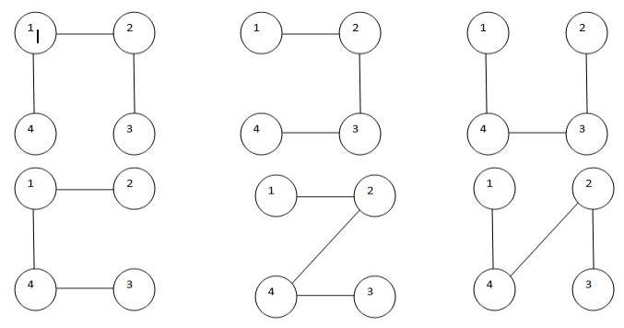
Some of possible spanning tree

Slide 14
Minimal spanning tree
There are greedy methods for finding the minimal cost spanning trees:
Prim’s Algorithm
Kruskal’s Algorithm

Slide 15
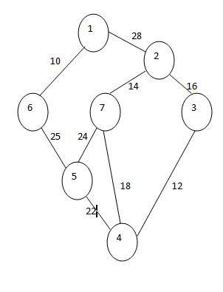
Prim’s Algorithm

Slide 16
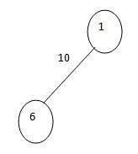
Prim’s Algorithm

Slide 17
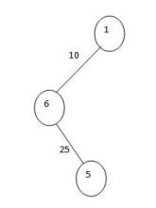
Prim’s Algorithm

Slide 18
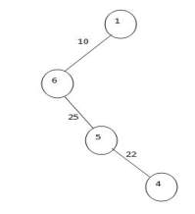
Prim’s Algorithm

Slide 19
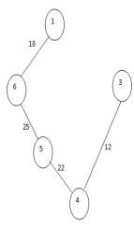
Prim’s Algorithm

Slide 20
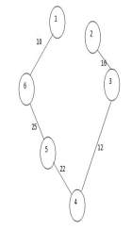
Prim’s Algorithm

Slide 21
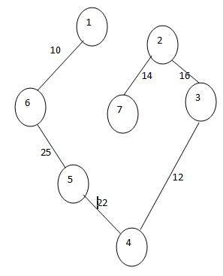
Prim’s Algorithm

Slide 22
Prim’s Algorithm

Slide 23
Prim’s Algorithm
COST = 10 +25 +22 +12 +16 +14
= 99

Slide 24
Prim’s Algorithm
Select the minimum cost edge.
Select the next connected minimum cost edge (it should not form a cycle).
Form a spanning graph.
Calculate the total cost.

Slide 25
Algorithm
1) Initialize a tree with a single vertex, chosen arbitrarily from the graph.
2) Grow the tree by one edge: of the edges that connect the tree to vertices not yet in the tree, find the minimum-weight edge, and transfer it to the tree.
3) Repeat step 2 (until all vertices are in the tree).

Slide 26
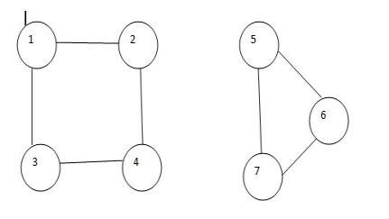
Case of non-connected graph
In case of non-connected graph, we can’t find the spanning tree.

Slide 27
Kruskal’s Algorithm
Follows the greedy approach.
Kruskal’s algorithm says that always select a minimum cost edge (but is should not form a cycle).

Slide 28
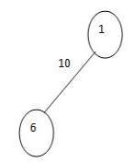
Kruskal’s Algorithm

Slide 29
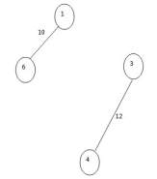
Kruskal’s Algorithm

Slide 30
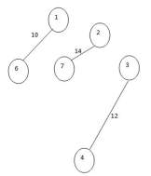
Kruskal’s Algorithm

Slide 31
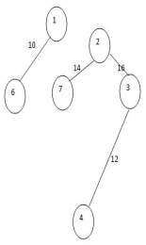
Kruskal’s Algorithm

Slide 32
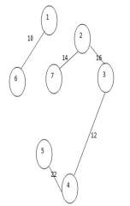
Kruskal’s Algorithm

Slide 33
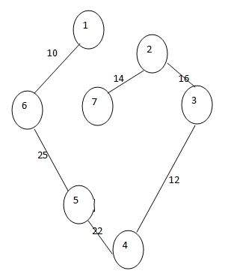
Kruskal’s Algorithm

Slide 34
Kruskal’s Algorithm

Slide 35
Kruskal’s Algorithm
COST = 10+25+22+12+14+16
= 99

Slide 36
Time Complexity
Θ (|V| |E|) = Θ (n.e) = Θ(n²)
The Time taken by Kruskal’s algorithm can be improved by taking Min Heap.
A min-heap is a binary tree such that - the data contained in each node is less than (or equal to) the data in that node's children.

Slide 37
Time Complexity
When you use a Min heap, you need not to search. It will give the minimum value.
The time taken for finding a minimum cost edge= Log n.
The number of times, the procedure is repeated = n.
So, the time complexity is Θ (nlog n).

Slide 38
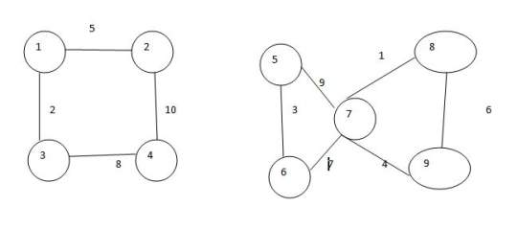
Case of non-connected graph
It may find the spanning graph for different components, but it is not able to find the spanning graph for the complete one.

Slide 39
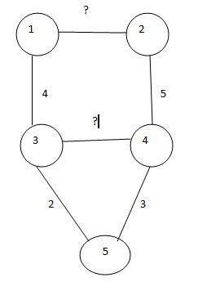
How to find the minimum weight of an edge?

Slide 40
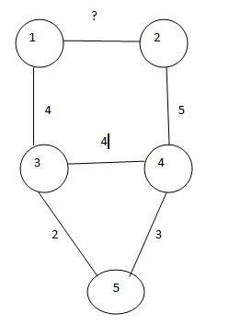
How to find the minimum weight of an edge?

Slide 41
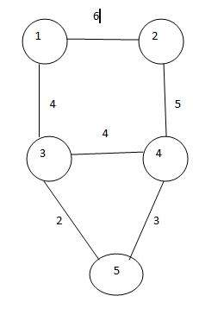
How to find the minimum weight of an edge?

Slide 42


