Slide 2
Learning Outcomes
understand the single source shortest algorithm

Slide 3
Single source shortest path
Finding the shortest path from the starting vertex to all the other vertices (May be a direct path or via other vertices).
Any vertex can be selected as a source vertex.

Slide 4
Single source shortest path
Applied to optimization problem.
So, greedy algorithm can be applied.
It can be solved in stages (take only one input at a time).

Slide 5
Single source shortest path
Dijkstra algorithm is used for this.
This algorithm can work on directed as well as non-directed graph.

Slide 6

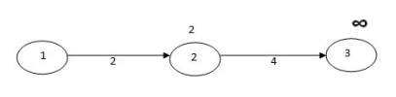
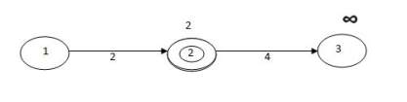
Relaxation

Slide 7
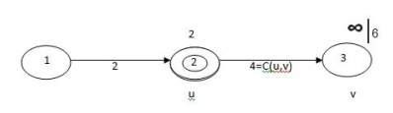
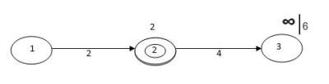
Relaxation

Slide 8
Working of Dijkstra algorithm
Dijkstra’s algorithm always searches for the shortest path. So, it selects a vertex with the shortest path and then find the shortest path to the vertices.

Slide 9
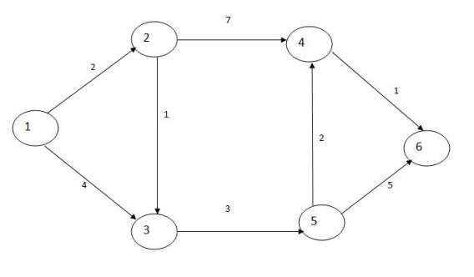
Procedure of Dijkstra algorithm
Starting vertex = 1

Slide 10
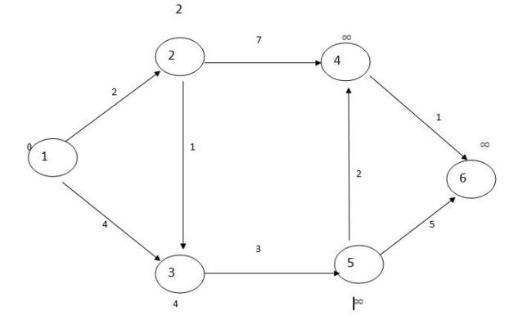
Procedure of Dijkstra algorithm

Slide 11
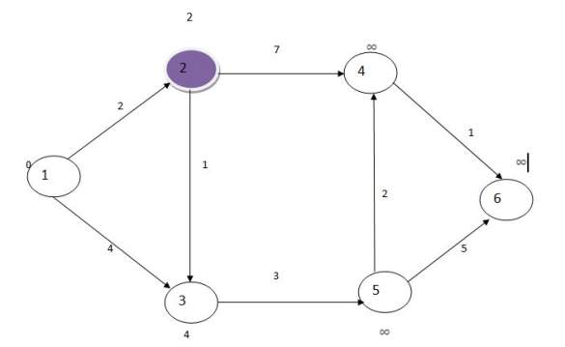
Procedure of Dijkstra algorithm
Vertices 3 and 4 are connected.

Slide 12
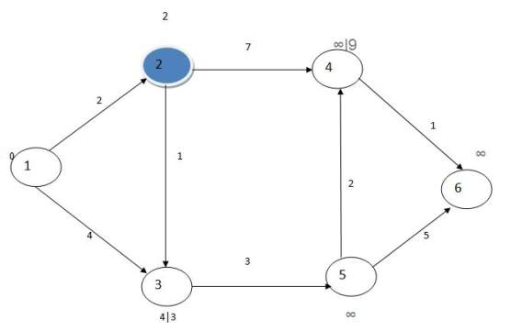
Procedure of Dijkstra algorithm

Slide 13
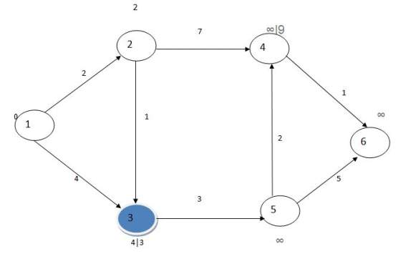
Procedure of Dijkstra algorithm

Slide 14
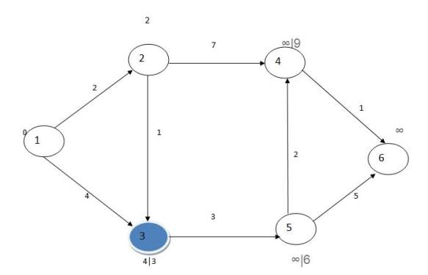
Procedure of Dijkstra algorithm

Slide 15
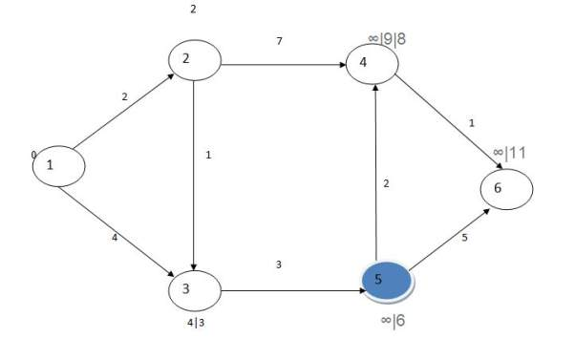
Procedure of Dijkstra algorithm

Slide 16
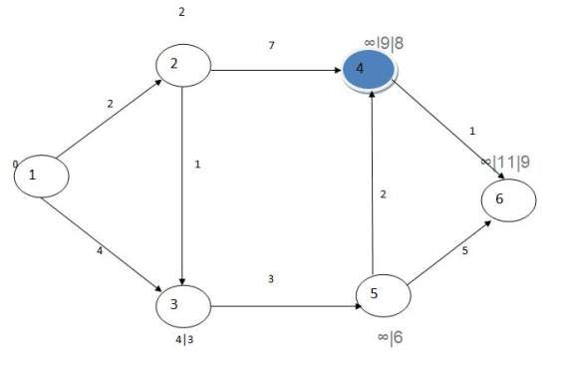
Procedure of Dijkstra algorithm

Slide 17
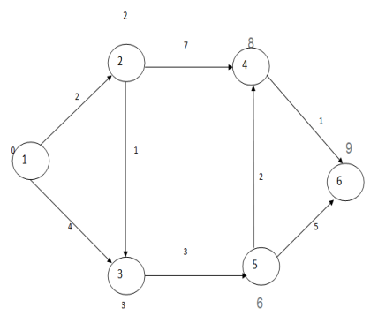
Procedure of Dijkstra algorithm
vertices | distances
2 | 2
3 | 3
4 | 8
5 | 6
6 | 9

Slide 18
Time complexity
Number of vertices , |V| = n
It is relaxing = Atmost n vertices
Time taken = n*n = n²
Worst case time = Θ(n²)

Slide 19
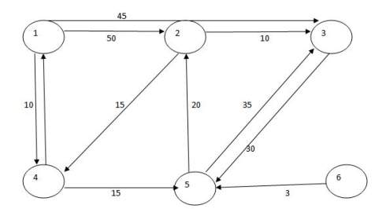
Procedure of Dijkstra algorithm
Starting vertex is 1

Slide 20
Procedure of Dijkstra algorithm
Selected Vertex | 2 | 3 | 4 | 5 | 6
4 | 50 | 45 | 10 | ∞ | ∞
5 | 50 | 45 | 10 | 25 | ∞
2 | 45 | 45 | 10 | 25 | ∞
3 | 45 | 45 | 10 | 25 | ∞
6 | 45 | 45 | 10 | 25 | ∞

Slide 21
Non directed graph
A graph containing non-directed edges can be converted to directed edges by adding parallel edges.
So, the Dijkstra algorithm can work on directed as well as non-directed graphs.

Slide 22
Algorithm of Dijkstra algorithm
Mark all nodes unvisited. Create a set of all the unvisited nodes called the unvisited set.
Assign to every node a tentative distance value: set it to zero for our initial node and to infinity for all other nodes. Set the initial node as current.

Slide 23
Algorithm of Dijkstra algorithm
Mark all nodes unvisited. Create a set of all the unvisited nodes called the unvisited set.
Assign to every node a tentative distance value: set it to zero for our initial node and to infinity for all other nodes. Set the initial node as current.

Slide 24
Algorithm of Dijkstra algorithm
3) For the current node, consider all of its unvisited neighbors and calculate their tentative distances through the current node. Compare the newly calculated tentative distance to the current assigned value and assign the smaller one. For example, if the current node A is marked with a distance of 6, and the edge connecting it with a neighbor B has length 2, then the distance to B through A will be 6 + 2 = 8. If B was previously marked with a distance greater than 8 then change it to 8. Otherwise, the current value will be kept.

Slide 25
Algorithm of Dijkstra algorithm
4) When we are done considering all of the unvisited neighbors of the current node, mark the current node as visited and remove it from the unvisited set. A visited node will never be checked again.

Slide 26
Algorithm of Dijkstra algorithm
5) If the destination node has been marked visited (when planning a route between two specific nodes) or if the smallest tentative distance among the nodes in the unvisited set is infinity (when planning a complete traversal; occurs when there is no connection between the initial node and remaining unvisited nodes), then stop. The algorithm has finished.

Slide 27
Algorithm of Dijkstra algorithm
6) Otherwise, select the unvisited node that is marked with the smallest tentative distance, set it as the new "current node", and go back to step 3.

Slide 28
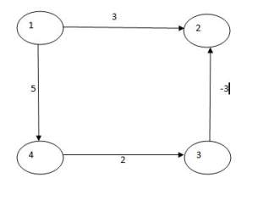
Drawback of Dijkstra algorithm

Slide 29
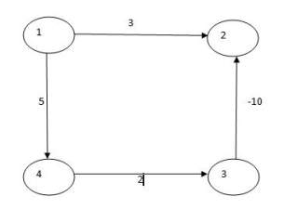
Drawback of Dijkstra algorithm

Slide 30
Conclusion
Dijkstra algorithm may or may not work on negative edges.
It is not trying all the possibilities. It is just seeing the minimum one and selecting it. So, it is a greedy approach. So, greedy approach is failed here when we have the negative edges.

